Slide 1

MLOps with Azure Machine Learning
Rachael Phillips

Slide 2
Table of Contents
Machine Learning Development Flow
Challenges of ML Model Management
DevOps and What it Provides
Bringing Machine Learning and DevOps Together (MLOps)
Resources

Slide 3
Machine Learning Development Flow

Slide 4
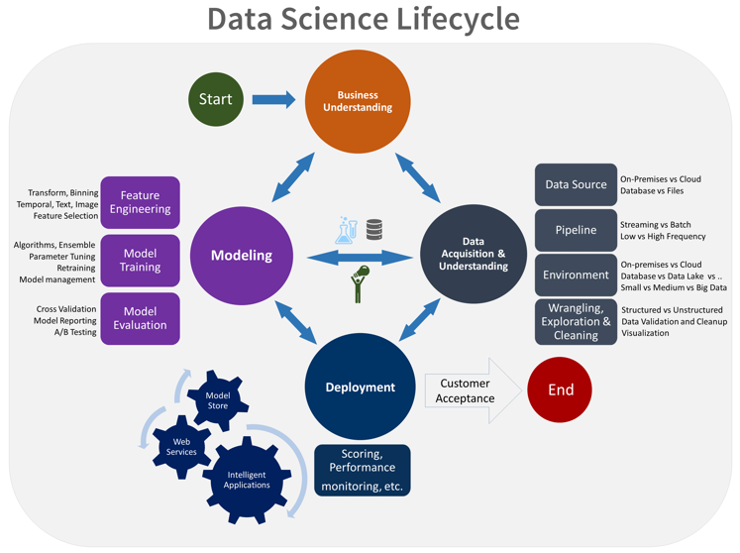
Microsoft Team Data Science Process
Notes:
\

Slide 5
Build Business Understanding
Begin with the exploration of a problem
“We spend a lot of money to acquire and retain customers. Turning over a customer, or reacquiring them is also expensive.”
Define business goals with “sharp” questions that can be answered by Data Science:
How much or how many? (regression)
Which category? (classification)
Which group? (clustering)
Is this weird? (anomaly detection)
Which option should be taken? (recommendation)
Arrive at an analytical question that addresses the problem
“It would be great if we could predict whether a customer is likely to leave us next month and target them for retention.”
Understand the data required to address the problem
“We have historical data representing customer acquisition and turnover for the past n years, including all customer interactions.”
How will people or systems use these conclusions, on which devices. How will they want to consume the analytic output and what will they do with it?
Define the consumption experience

Slide 6
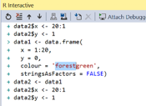
Data Prep and Modeling
Acquire data sets
Plan and locate potential sets of data. Gather data from internal and external sources
Experimentation may cause re-visitation of data understanding or even the business problem
Data prep tasks can be repeated multiple times
Rigorous model evaluation
Explore and transform the data
Using data transformation tools and engineering techniques, mine, extract, clean, mark up, label, transform, enrich and stage data
Begin the modelling experimentation
Feature engineering, model fitting, model evaluation on “unseen” data

Slide 7
Deploy and Monitor Performance
Model deployment/ operationalization
Systematic integration into dashboards, systems, applications including continued data ingestion and training
Move beyond “experimentation” into production
Integrate into dashboards, apps and acquire new data sets
Monitor performance accuracy
Revisit the modelling stage to refine the model as needed
Continuous monitoring of model performance, refine model based on field feedback, retrain model on new data
Monitor performance

Slide 8
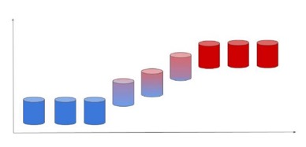
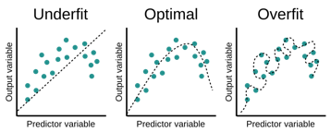
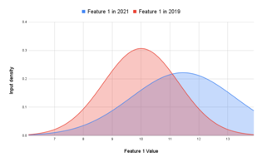
Model Monitoring
Real testing of a model happens in a live environment. There are 3 reasons for which a model may shows unexpected behavior once deployed to production. This challenge can only be solved with data feedback loop to the ML team.
Model Bias
Data Drift
Concept Drift
The model was wrongly trained because the model’s prediction differs from the target value, compared to the training data.
The features created to train the model on have statistically changed over time.
The features are the same, but the value of the target variable has changed.
Example:
The company has gained a new and younger customer base with different characteristics (less experience, lower budget, …) that model did not see before.
Examples:
company launching a new product to the same customer base.
Change in interest rates, salaries, etc which cause attraction/churn of clients

Slide 9
Success Ingredients for a Data Science Project
Know your problem
Is there a clear business need?
Is the outcome measurable?
Is there data to support the business scenario? What are the caveats? Data exploration and validation are essential.
Know your data
Which types of models can answer the business question? Is it a regression, classification, anomaly detection, clustering, recommendation, or other problem?
Build relevant models
Integrate with business
Trust building through testing and validation, then deploy

Slide 10
General Roles in a Data Science Project
2. Data Scientist
Understand and help refine/shape the analytical question to answer
Craft approaches for new analytic technical foundations (i.e., Statistical Testing, Machine Learning, Data Lakes, etc.)
Conduct analytical modeling, testing, evaluation and interpretation
Assist in monitoring and adjusting for model performance over time
1. Data Architect
Architect the whole data platform
Design the data governance strategy
Ensure data security and privacy
3. Data Engineer
4. Machine Learning Engineer
Acquire, transform and stage/store data sources
Orchestrate data acquisition and flow through to organizational data stores
Create ,schedule and provision foundational orchestration services
Implement the MLOps pipeline
Deploy machine learning solution into production
Optimize solutions for performance and scalability

Slide 11
Challenges of ML Model Management

Slide 12

Traditional DS Delivery
I have a model for you…
How do I deploy, manage, monitor…
Wall
Of
Confusion
Data Drift
Model Decay
Stale Models
Concept Drift
Data Science
Ops

Slide 13
Key Challenges
Reproducibility / Auditability:
What data the model was trained on?
Which version of source code was run?
What kind of hyper-parameters the model used?
What was the performance metric?
Validation / Packaging
How to validate the quality of code?
How to make sure the best model is selected?
Automation / Observability
How to make sure the right model is being deployed?
How to monitor the live performance of the model?
When to retrain the model?

Slide 14
DevOps and What it Provides

Slide 15



MLOps Business Value
Continuous Delivery
Build in automation to enable a continuous delivery and continuous integration pipeline
Reduced Downtime
Ensure ML models have required governance and operational discipline related to data quality, security and compliance, and access.
Predictable Performance
Enable monitoring & performance data collection across the build and inference pipeline, enabling a predictable ML operating environment.

Slide 16
What is DevOps?
DevOps is the union of people, process, and products to enable continuous delivery of value.
“
Build& Test
Deploy
Continuous Delivery
”
Develop
Operate
People
Collaborate early and often
Cross-disciplinary teams
Share common goals and metrics
Shared responsibility
Plan & Track
Monitor & Learn
Process
Agile Principles
Streamline feedback
Delivering value faster
Products
Enhance productivity
Improve collaboration
Facilitate experimentation and measurement
Automate processes
Notes:
Plan smarter, collaborate better, and ship faster with a set of modern dev services.

Slide 17

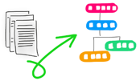
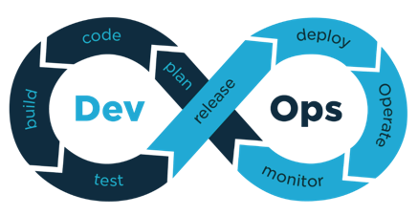
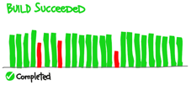
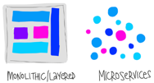
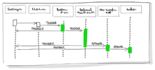
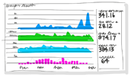
DevOps practices
Version Control
Infrastructure as Code
Continuous Integration
Microservices
Continuous Delivery
Monitoring and logging

Slide 18
Bringing Machine Learning and DevOps Together (MLOps)

Slide 19
MLOps = ML + DEV + OPS
CREATE
PLAN
RELEASE
CONFIGURE
ML
DEV
OPS
VERIFY
PACKAGE
MONITOR
Experiment
Business Understanding
Data Acquisition
Exploratory data analysis
Modeling
Develop
Code Refactoring
Versioning
Testing & Validation
Operate
Model Deployment
CI/CD pipeline
Monitoring & Triggering

Slide 20






MLOps Workflow
Prepare
Experiment(build)
Deploy
Prepare Data
Build Model
Train & Test Model
Register and Manage Model
Build Image
Deploy Service
Monitor Model
Orchestrate
Boards
(Azure DevOps)
Repos
(Azure DevOps)
Pipelines & Test Plans
(Azure DevOps)
Artifacts & Pipelines
(Azure DevOps)
Model monitoring
(Azure Machine
Learning Service)
Application
Insights

Slide 21






Continuous Integration in MLOps
Training Pipeline
ML/DevOps Team
Create Scoring Docker Image Or Deploy model
Tests
Launch training
Evaluate models
Register model
Experiment
Packaged model
Model packaging documentation
Data Scientist Team
Notes:
CI pipeline captures:
Create sandbox
Run unit tests and code quality checks
Attach to compute
Run training pipeline
Evaluate model
Register model
Package model into container image

Slide 22




Continuous Deployment in MLOps
Based on Azure Architecture Recommendation: Organize and set up Azure Machine Learning environments - Cloud Adoption Framework | Microsoft Docs
CD Pipeline
Deploy model in DEV
Deploy model in PROD
Tests
. . .
Approval (manual or automatic)
Webservice
(development environment)
Webservice
(production environment)
ML/DevOps Team
Prod Team
Notes:
CD pipeline captures:
Validate and profile model
Deploy model to DevTest (ACI)
If all is well, proceed to rollout to AKS or any other service in prod
Everything is done via the CLI

Slide 23
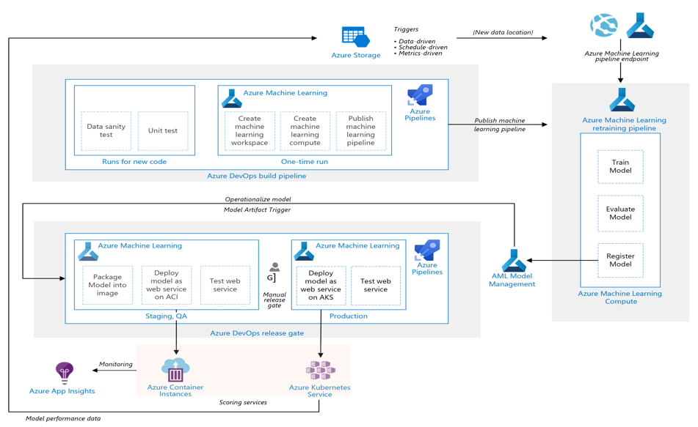
MLOps Reference Architecture

Slide 24
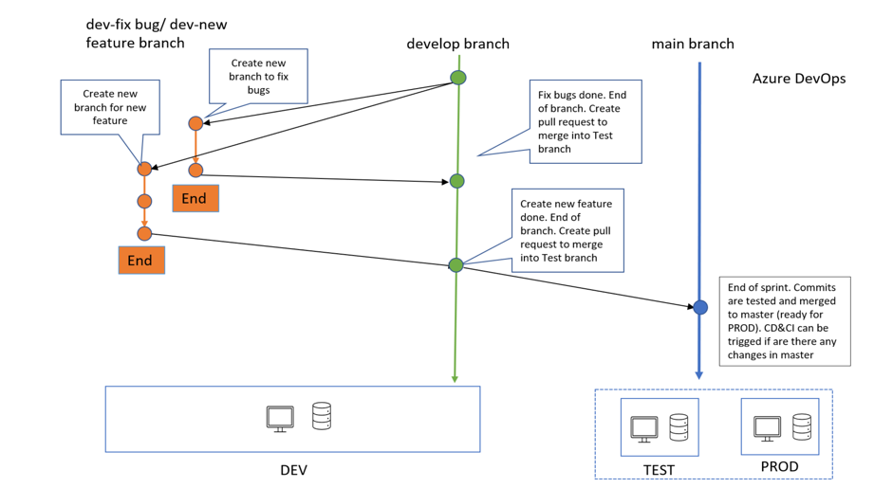
Branching Strategy for MLOps

Slide 25
Resources
Azure Machine Learning Training: Build and operate machine learning solutions with Azure Machine Learning - Learn | Microsoft Docs
Cloud Framework Best Practices: Organize and set up Azure Machine Learning environments - Cloud Adoption Framework | Microsoft Docs​
Industry Data Strategy: Microsoft Industry Solutions - Data Strategy - Home (sharepoint.com)
MLOps Maturity Assessment: Machine Learning Operations maturity model - Azure Architecture Center | Microsoft Docs
MLOps principles: https://ml-ops.org/content/mlops-principles#iterative-incremental-process-in-mlops

