Slide 1
Time Series Forecasting with Tree-Based Ensemble Methods: Part II
April 15, 2022

Slide 2

About the Presenter
Brett Efaw
Data Scientist at Idaho Power Company
BEfaw@idahopower.com or brettefaw@gmail.com
Work with various business groups to implement Data Science solutions
Decision support
Predictive modeling
Forecasting
BI and DS reporting/analysis applications

Slide 3
Overview
Part I (DS Seminar 2022-02-25):
data_science_seminar/2022_1 at master · lselector/data_science_seminar · GitHub
Time series forecasting approaches
Compare XGBoost to Auto-ARIMA on a simple simulated data set
Part II (DS Seminar 2022-04-15):
Use a more complex simulated data set
Real world data set (from Kaggle)
Auto-ARIMA with exogenous regressors
Simulated time series data set
Multiple cyclic patterns/seasonality
Non-linear trend
Modeling/forecasting process
Extract the “trend” from the time series
Model 1: Fit and forecast the trend component
Model 2: Use XGBoost (or similar tree-based algo) to model remainder
Forecast = combination of model 1 + model 2 predictions

Slide 4
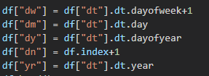
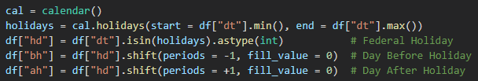
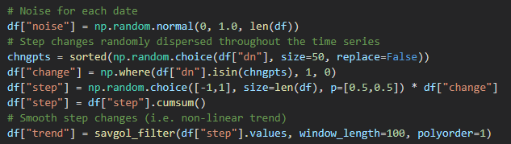
(A More Interesting) Simulated Data Set
Cyclic pattern features:
Day of week
Day of month
Day of year
Sequence features:
Day number
Year
Holiday effects:
Holiday
Day before/after holiday
More realistic trend:
Non-linear
Randomly-spaced up/down steps
numpy.random.choice()
Smoothed out across time
savgol_filter()

Slide 5
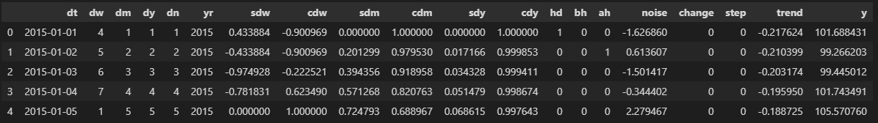
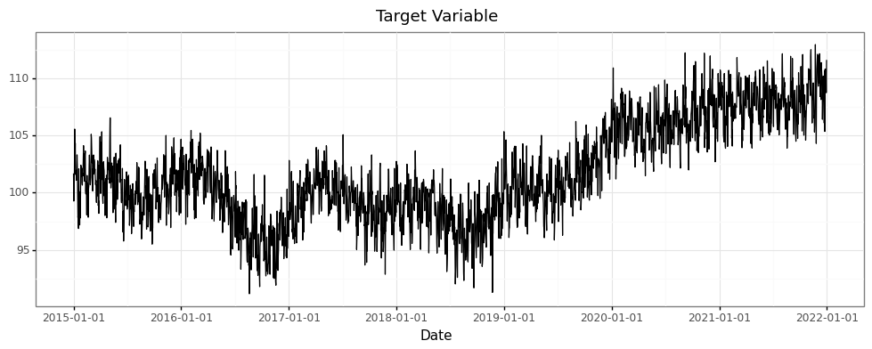

Slide 6
Model 1: Fit and Forecast Trend
M1-a. Extract the trend
Use statsmodels.tsa.seasonal.STL() to decompose the time series (i.e. extract the trend)
Trend = the number of time steps to include in the decomposition
larger values = smoother trend (favors long-term)
smaller values = wigglier trend (favors short-term)
M1-b. Model the trend
Use statsmodels.tsa.ar_model.AutoReg() to model (and forecast) the trend
Lags = the number of time steps prior to consider as lagged inputs in regression model
M1-c. Detrend the past (need these for Model 2)
M1-d. Forecast the trend using model in M1-b
Other parameters
Period = the frequency of the time series (daily = 7, monthly = 12, quarterly = 4, etc.)
Number of splits = the number of train/test splits for back-casting / model evaluation
Test size = the number of time steps in the forecast horizon

Slide 7
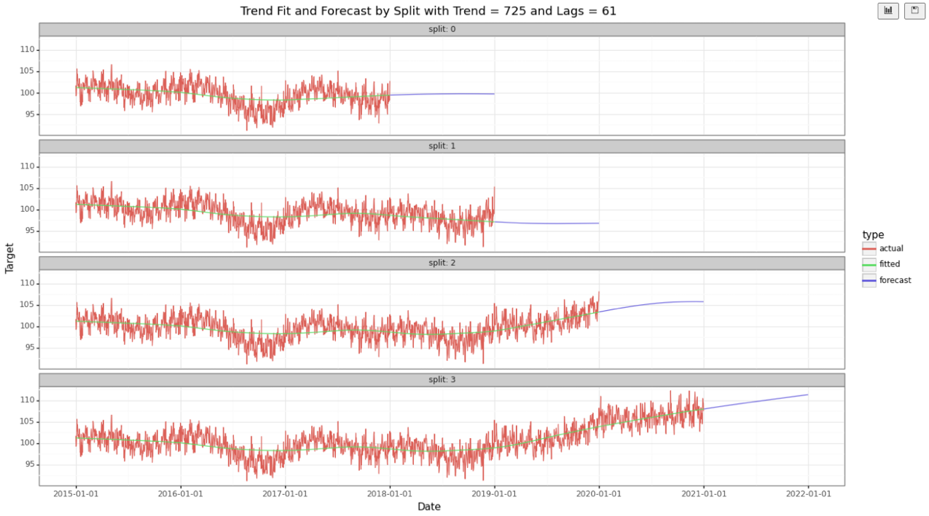

Slide 8
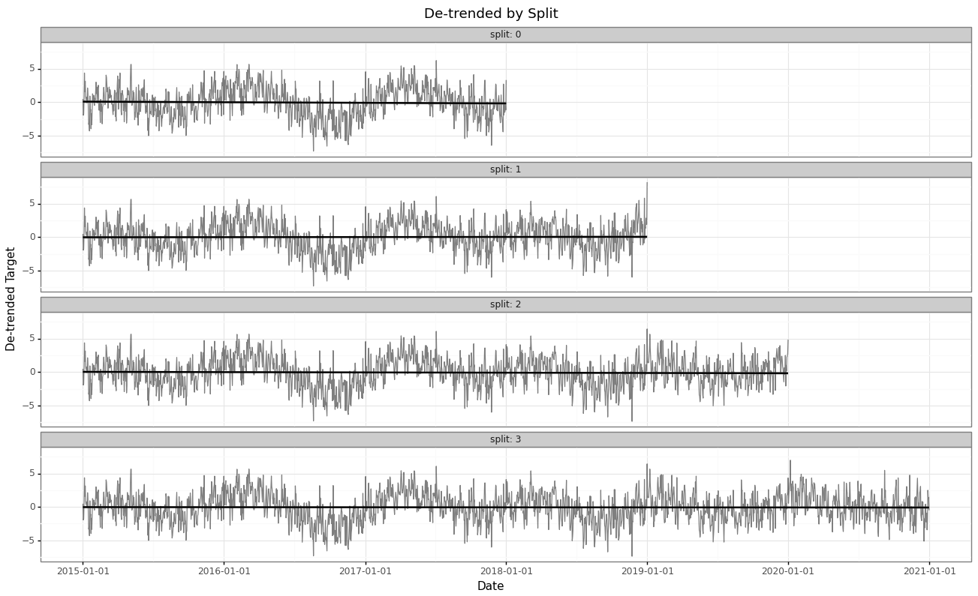

Slide 9
Model 2: Tree-Based Ensemble
Use tree-based ensemble to model de-trended time series
De-trending ensures the tree-based model can safely predict within the range of training examples.
Features are calendar-based:
Day-of-week
Day-of-month
Day-of-year
Holidays (adjacent)
Month-of-year
Etc.
HistGradientBoostingRegressor() parameters
Max iterations = 300
Max tree depth = 30
Learning rate = 0.1
L2 regularization = 0.1
Forecast = trend forecast + tree-based prediction

Slide 10
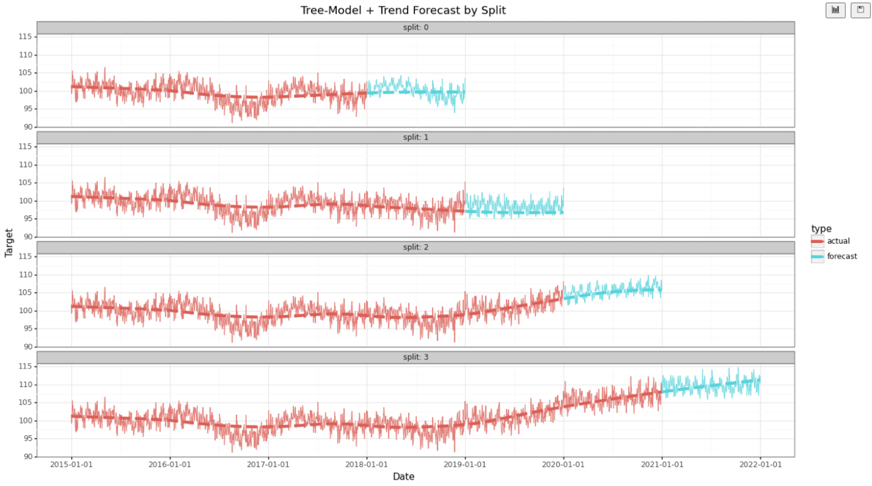

Slide 11
Auto-ARIMA Procedure
Compare trend + tree-based model to auto-ARIMA procedure
Implemented in Python via the pmdarima library
based on auto.arima() function from R forecast package
SARIMAX = Seasonal Auto-Regressive Integrated Moving-Average with eXogenous
ARIMA, plus:
Enable seasonality parameter
Include exogenous regressors (calendar features)
Parameters
D = 1 (difference at lag-1)
Period = 7 (daily frequency)
Seasonal = True
Stepwise = True
Exogenous = matrix of external regressors (calendar features)
Max iterations = 10 (default = 50)
Note: For real-world data sets, try adding Fourier transforms instead of calendar features as exogenous regressors

Slide 12
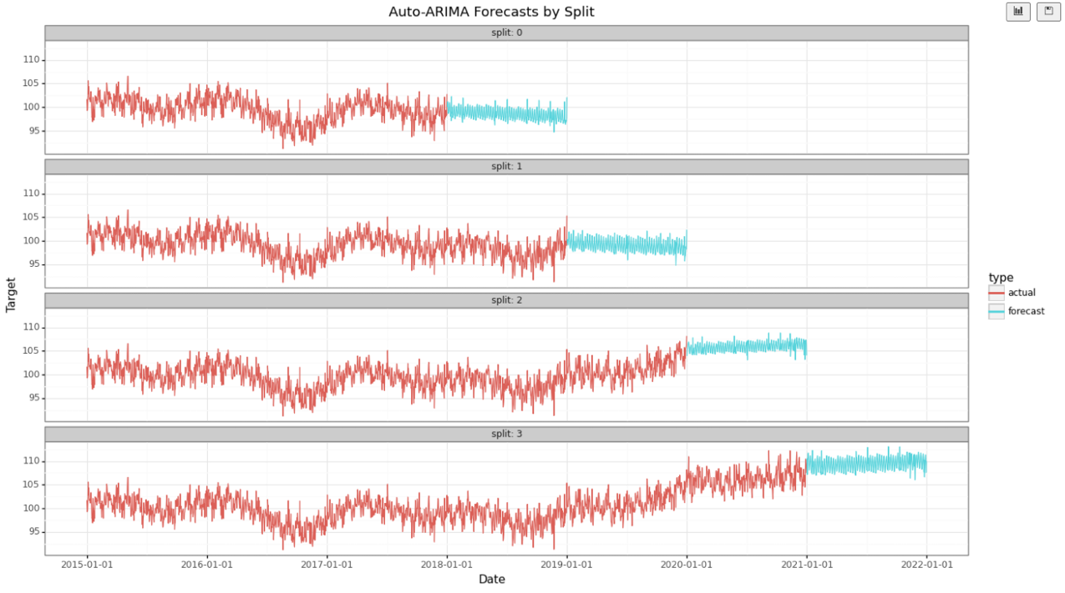

Slide 13
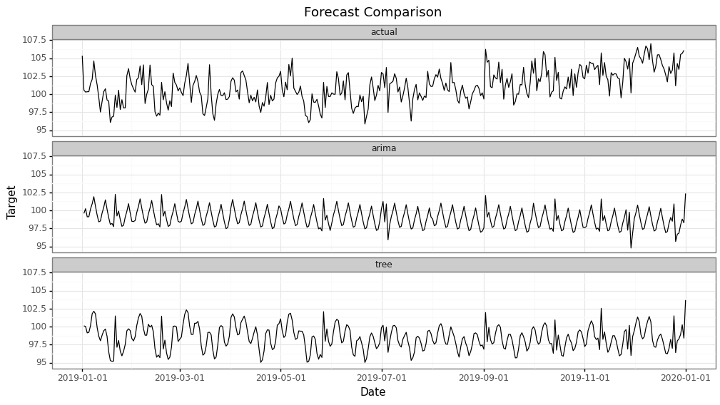
Trend increased 2nd half of this year
Both models stayed relatively flat

Slide 14
Comparison Between Models on Simulated Data Set
STL/AutoReg Trend + XGBoost
Train Time*:
Trend: from 0:00:0.49 to 0:00:0.87
De-Trending: 0:00:0.01
XGBoost: from 0:00:1.26 to 0:00:1.36
Total: ~2-3 seconds per split
Accuracy:
from 1.3% to 3.2%
Avg across splits: 2.3%
Auto-ARIMA
Train Time*:
from 1min 16sec to 3min 28sec
Accuracy:
from 1.4% to 3.1%
Avg across splits: 2.1%
*4 splits with 365 test size each

Slide 15
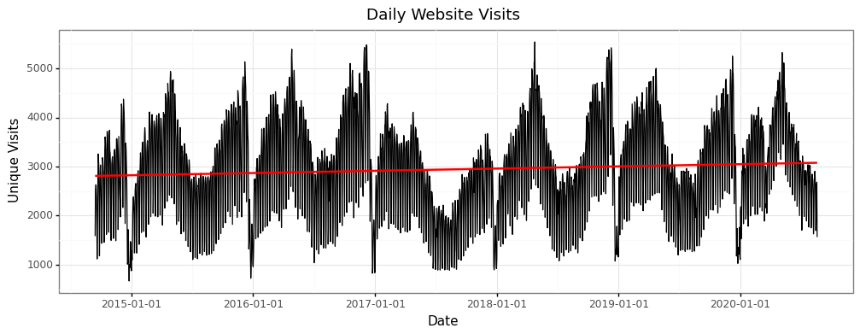
Real-World Data Set
Data Set on Kaggle: Daily website visitors (time series regression) | Kaggle
This file contains 5 years of daily time series data for several measures of traffic on a statistical forecasting teaching notes website whose alias is statforecasting.com. The variables have complex seasonality that is keyed to the day of the week and to the academic calendar. The patterns you see here are similar in principle to what you would see in other daily data with day-of-week and time-of-year effects.

Slide 16
Trend + Tree-Based Modeling Procedure
Extract trend
(STL)
Color Legend
Training Split i.e. Historical
Model trend
(AutoReg)
De-trend
Trend model residuals
Testing Split i.e. Future
Model residuals (XGBoost)
Forecast trend
Predict tree model
Combined forecast

Slide 17
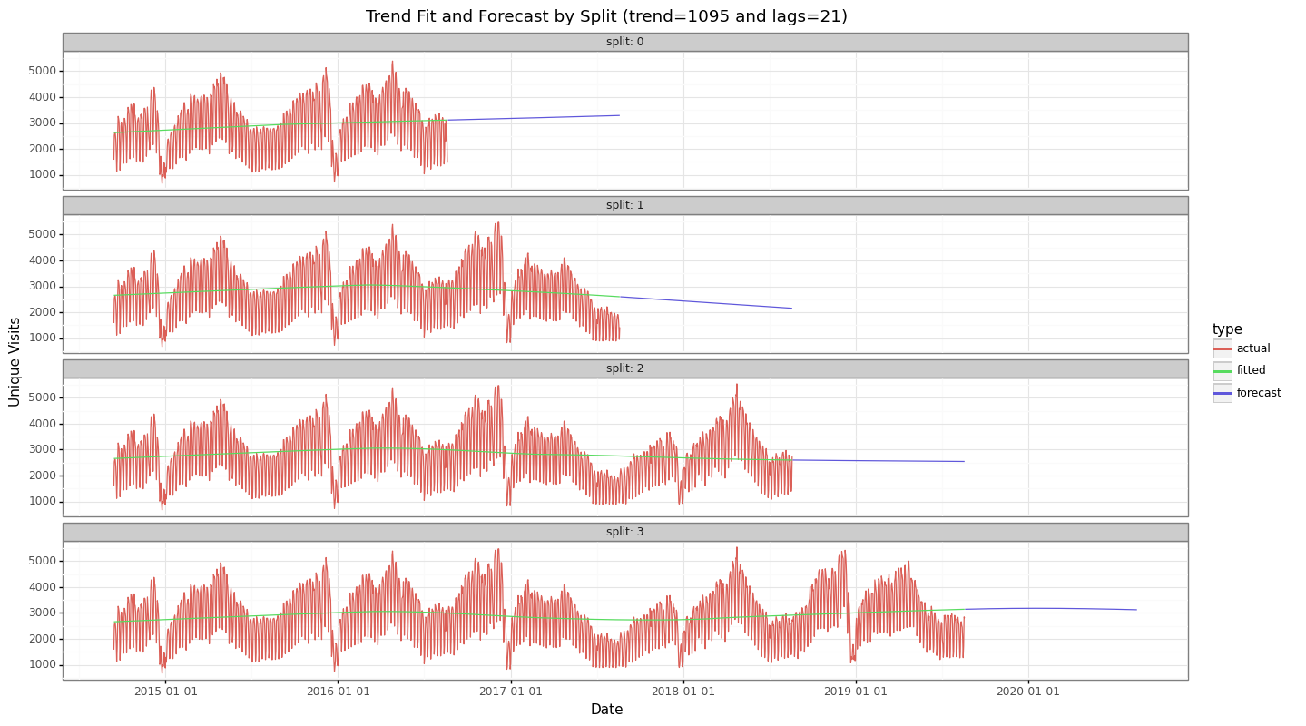

Slide 18
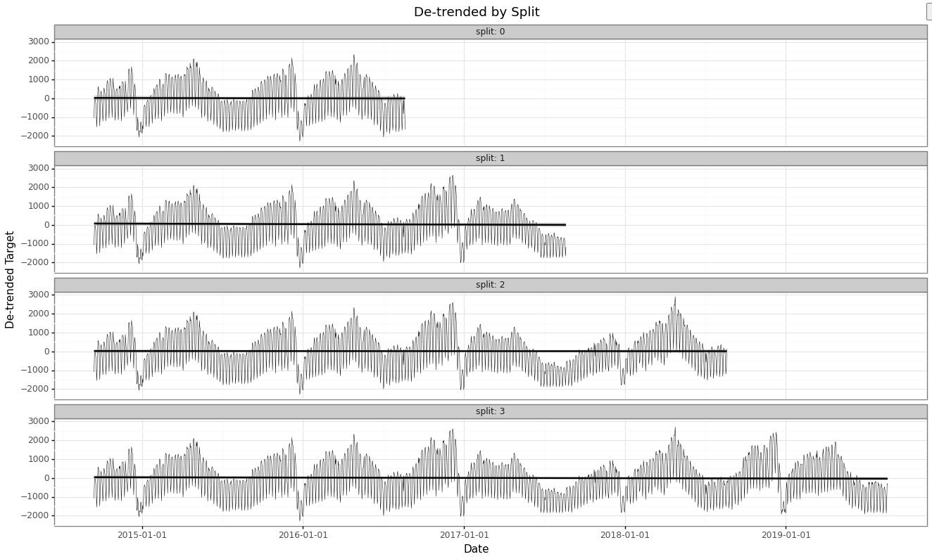

Slide 19
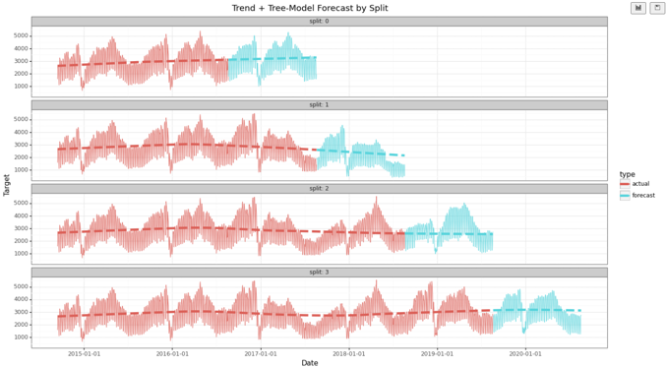
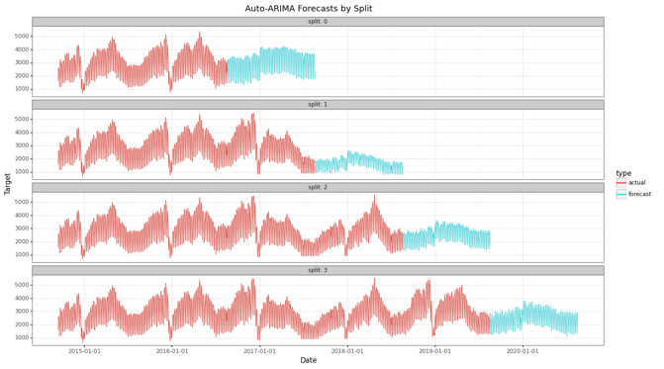
Conclusion
Method | Avg Error (across 4 splits) | Avg Train Time (across 4 splits)
Trend + Tree-Model | 14.6% | ~2sec
Auto-ARIMA (SARIMAX) | 21.6% | ~2min

Slide 20
The End
Some other forecasting tools worth checking out:
Azure AutoML
Python SDK: Set up AutoML for time-series forecasting - Azure Machine Learning | Microsoft Docs
No Code: Tutorial: Demand forecasting & AutoML - Azure Machine Learning | Microsoft Docs
Modeltime (Business-Science)
R: https://business-science.github.io/modeltime/
Prophet
Github: https://github.com/facebook/prophet
Python: https://pypi.org/project/prophet/
R: https://cran.r-project.org/web/packages/prophet/index.html
Neural Prophet
https://pytorch.org/
Much faster than Prophet, uses PyTorch
Uses AR-Net for modeling autocorrelation
Python notebooks and PPT will be available on Lev’s repo

Slide 21
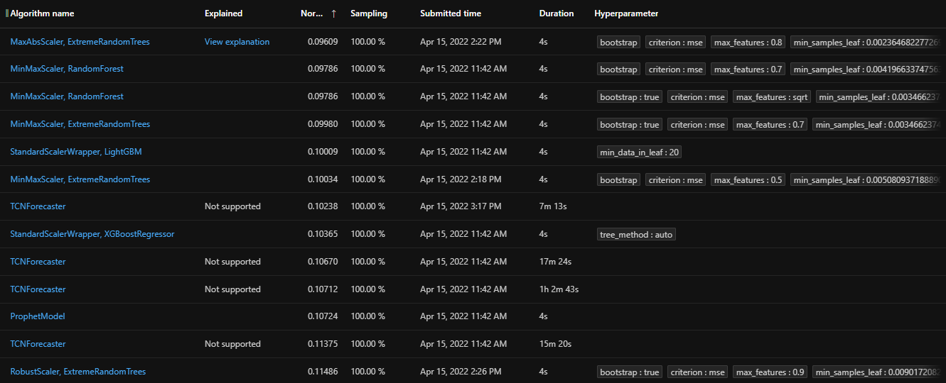
Bonus: Azure AutoML Experiment: Daily Website Data Set

Slide 22
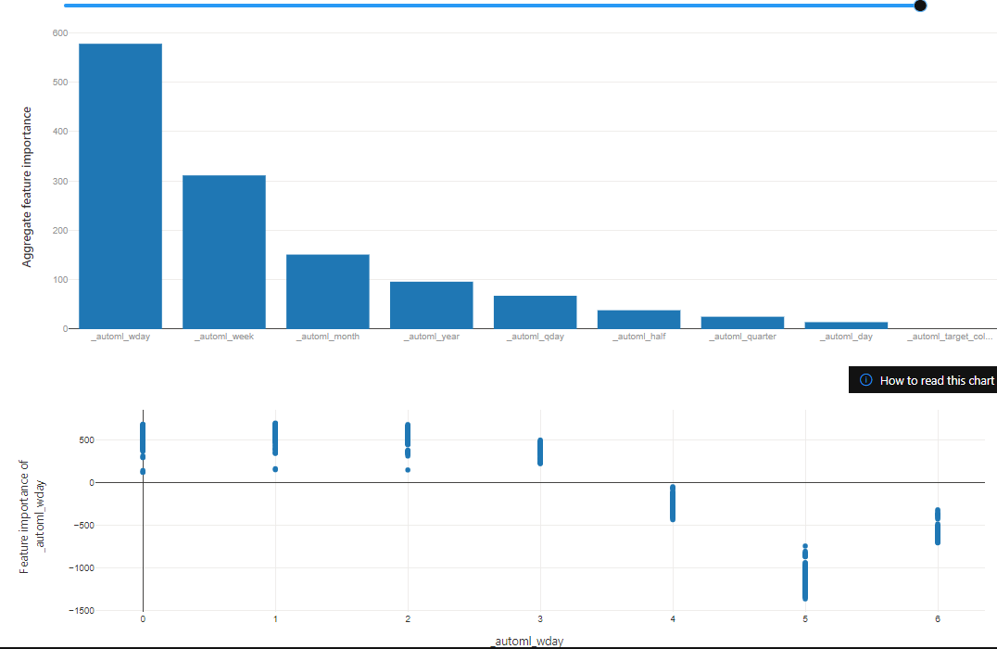
AutoML Explanations: MaxAbsScaler, ExtremeRandomTrees

Slide 23
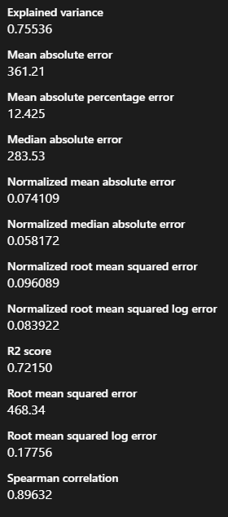
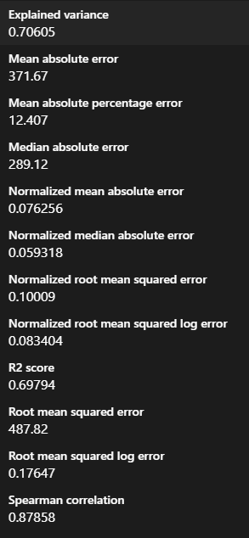
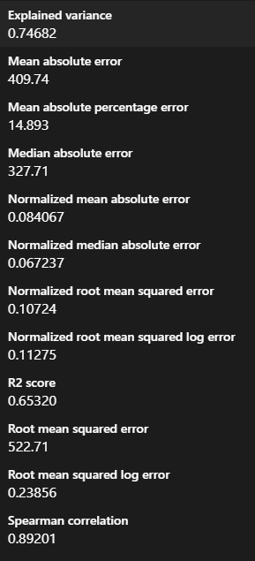
MaxAbsScaler, ExtremeRandomTrees
StandardScalerWrapper, LightGBM
ProphetModel

Slide 24
Bonus: Comparing Different Ensemble Methods
# from sklearn.ensemble:
GradientBoostingRegressor
HistGradientBoostingRegressor # (best, inspired by LightGBM)
RandomForestRegressor
ExtraTreesRegressor
# from xgboost !pip install xgboost
XGBRegressor
XGBRFRegressor
All regressors had similar speed and accuracy.
But the best was HistGradientBoostingRegressor - the histogram-based gradient boosting.
https://scikit-learn.org/stable/modules/generated/sklearn.ensemble.HistGradientBoostingRegressor.html
https://machinelearningmastery.com/histogram-based-gradient-boosting-ensembles/
https://inria.github.io/scikit-learn-mooc/python_scripts/ensemble_hist_gradient_boosting.html
Why the "histogram-based" approach is faster and better?
The bottleneck in training any boosted trees algorithm is the time for finding the best split between values when building the trees
This time can be significantly reduced if we pre-process the data for a given tree – aggregate them into "bins"
So, we convert the continuous float numbers into limited number of discrete integer values
This "histogram binning" reduces the number of tests needed to find best split
This makes finding the split much faster - but reduces the accuracy
To increase accuracy, we can simply increase the number of trees

