Slide 1

Python Plotly
https://plotly.com

Slide 2
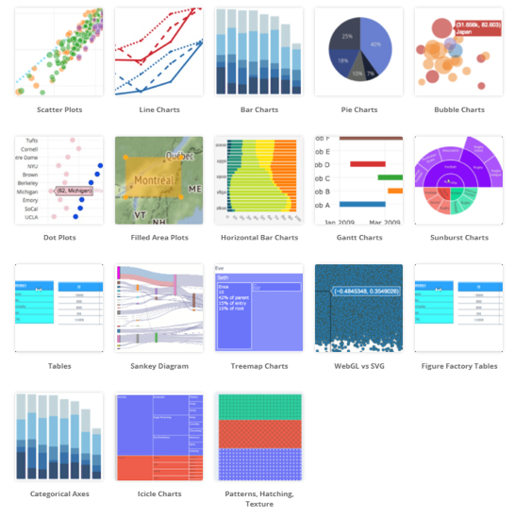
About Plotly:
Plotly is a Montreal based technical computing company
Plotly products: tools for data visualization such as Plotly, Dash and Chart Studio (web service).
Plotly is an open-source Javascript library allowing creation of ineractive graphs in browser windows
Plotly API exist for different programming languages (Python, R, Julia, MATLAB, .NET, C#, etc.)
Plotly Javascript receives plot data and configuration in JSON format
Graphs can also be exported in various raster formats as well as vector image formats
Most commonly Plotly is used in Jupyter notebooks or web pages.

Slide 3
Installation of Python package
https://plotly.com/python/getting-started/
pip install plotly
# or
conda install -c plotly plotly
There are three main sub-modules in Plotly:
plotly.plotly – communication with server
plotly.graph_objects – definitions of graph objects that make up the plots (Figure, Data, Layout, Scatter, Box, Histogram etc., 3D plots, etc. ). All graph objects are dictionary- and list-like objects used to generate and/or modify Plotly plots.
plotly.tools

Slide 4
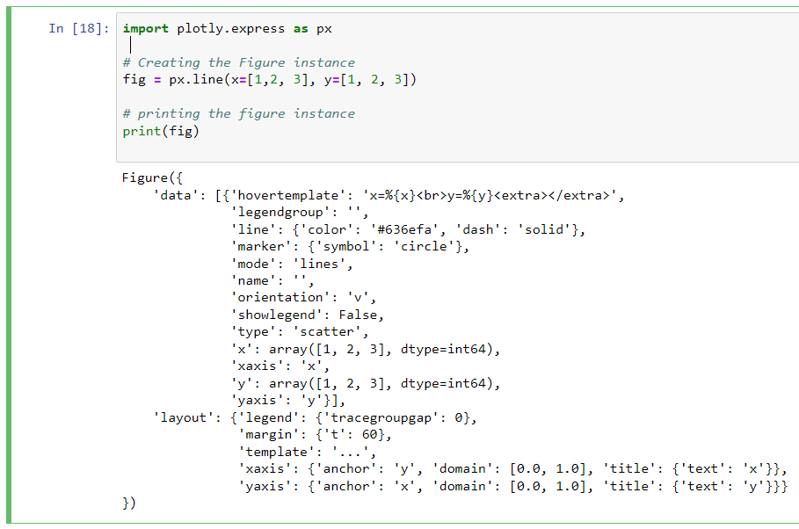
The plotly.tools module:
.. functions for subplot generation
.. embedding plots in IPython notebooks
.. saving and retrieving your credentials
A plot is represented by Figure object
as defined in plotly.graph_objs module
Figure is serialized as JSON before it gets passed to plotly.js
Example of JSON representation of a Figure object:
Note:
plotly.express sub-module can create the entire Figure in few lines of code. It uses the graph_objects internally.

Slide 5
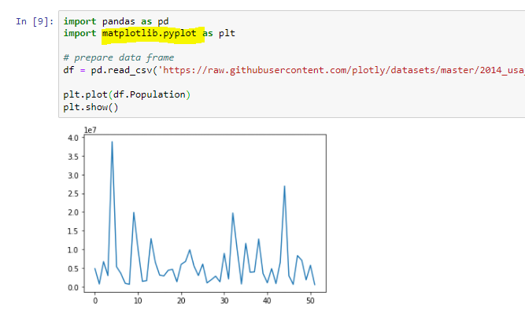
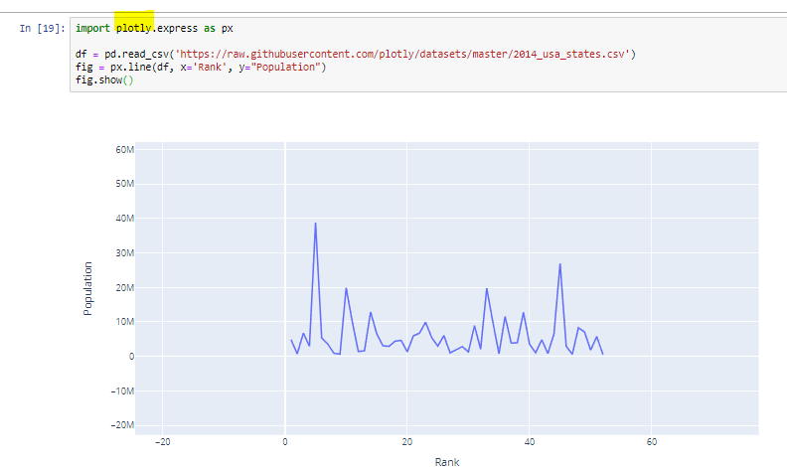
Compare static Matplotlib plot with Interactive Plotly
Static
Interactive and modern presentation

Slide 6
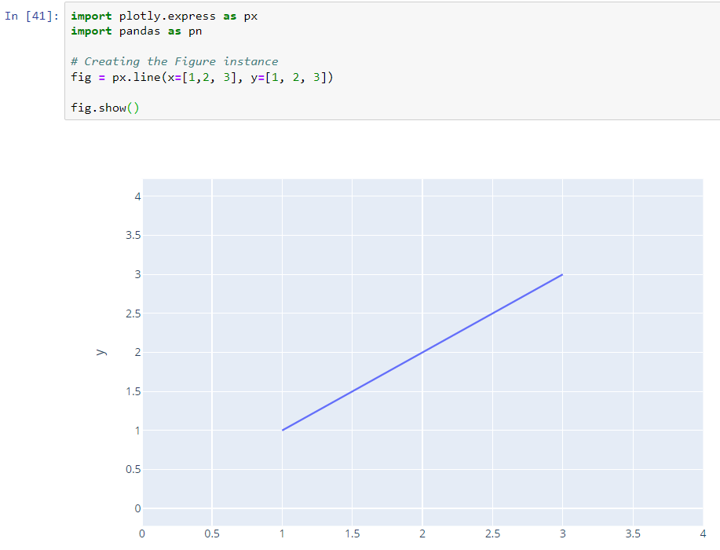
Plotly.express examples (quick way to create power graphs with just a few attributes ) - start
Show graph from Jupyter code + image
Dash

Slide 7
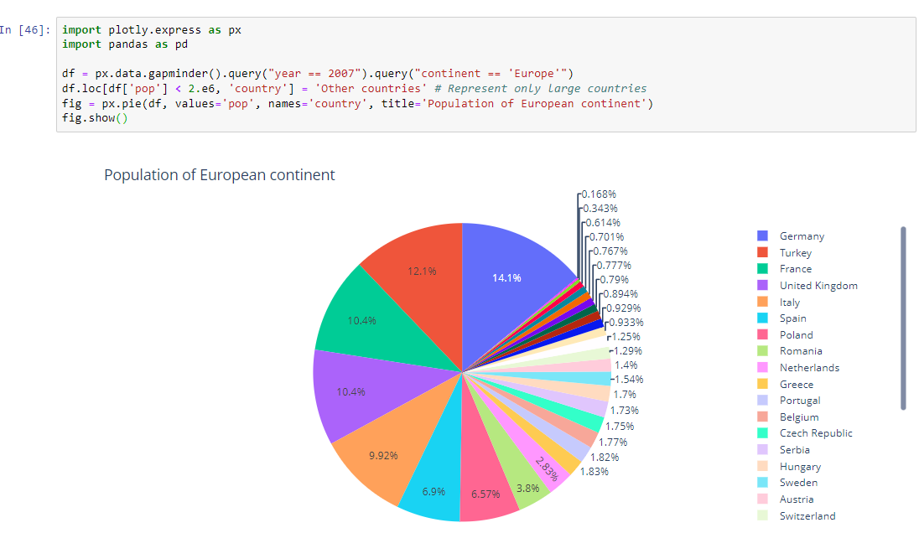
Plotly Pie

Slide 8
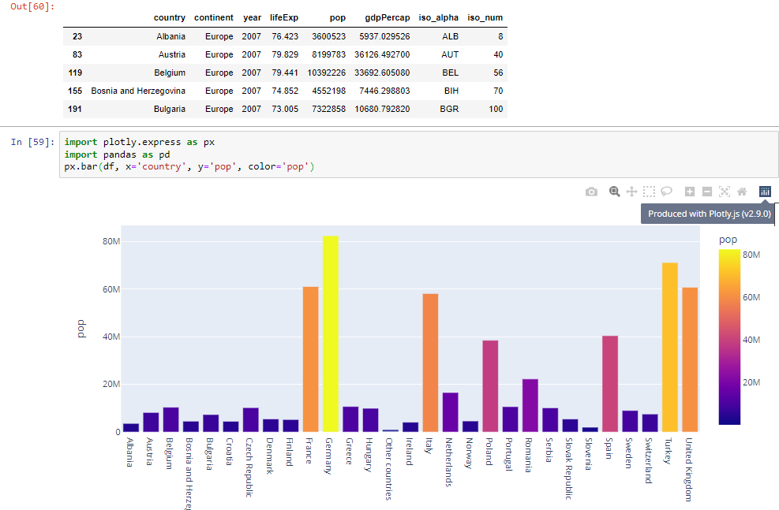
Plotly Bar

Slide 9
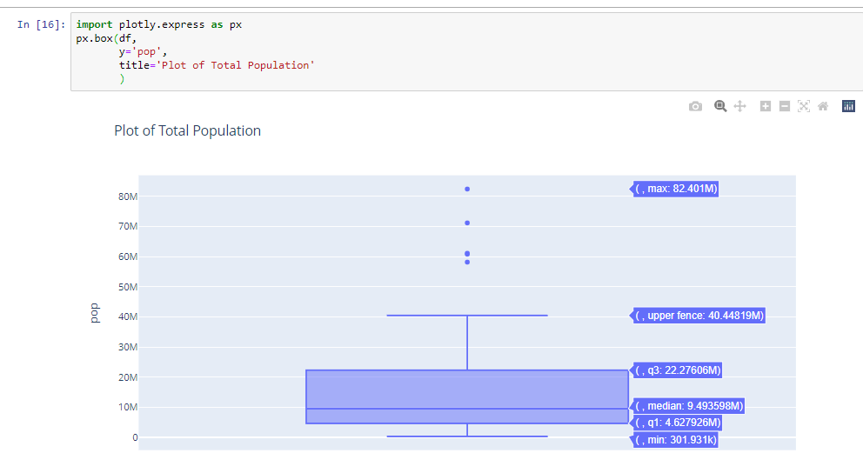
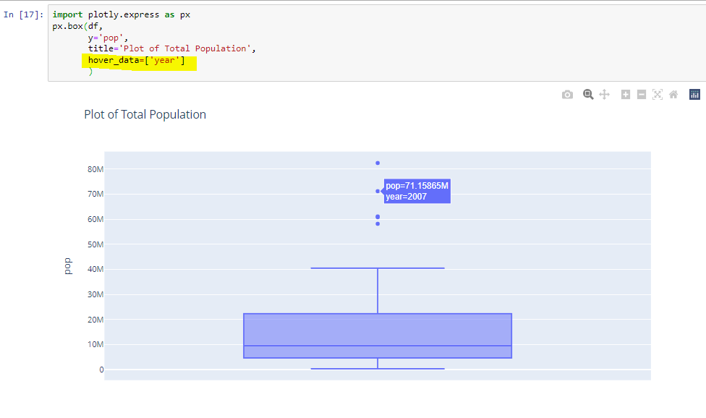
Plotly Box with hover

Slide 10
Plotly Express vs Plotly Graph Objects
plotly.express it's a quick way to create power graphs with just a few attributes. For more advanced graphs with Plotly Express High-level Interface see documentation https://plotly.com/python-api-reference/plotly.express.html)
plotly.graph_objects you have to build everything from the bottom up and define attributes: data, layout, frame , etc.
For customization use Plotly Graph_Objects documentation for figure updates:
https://plotly.com/python/reference/index/
Layout - represents the chart (frames, title, color, tick, hover, legend)
Traces - represent the data (inside the layout)

Slide 11
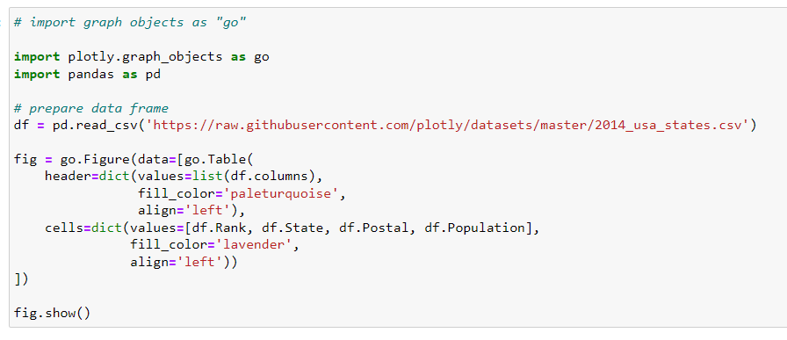
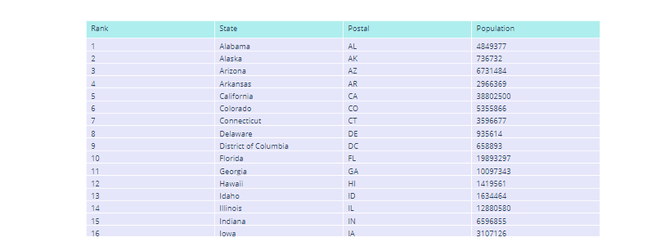
Plotly Table

Slide 12
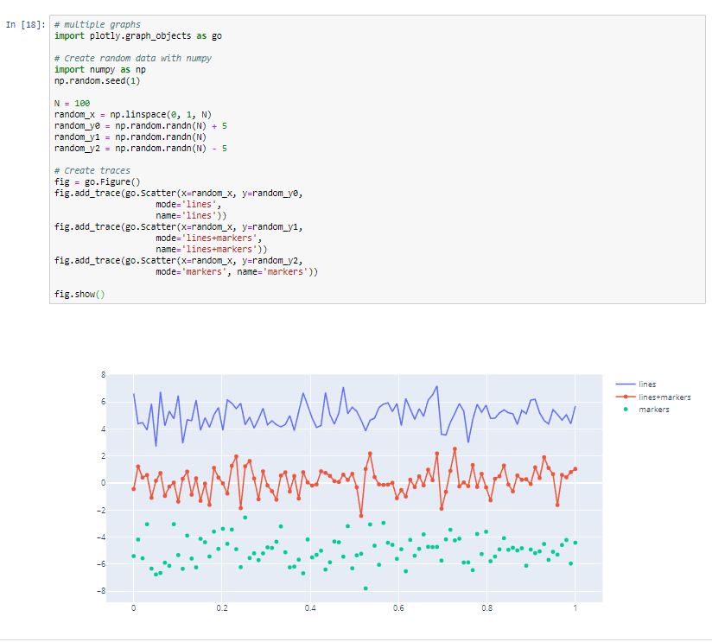
Multiple graphs on the same Chart with plotly.graph.objects

Slide 13
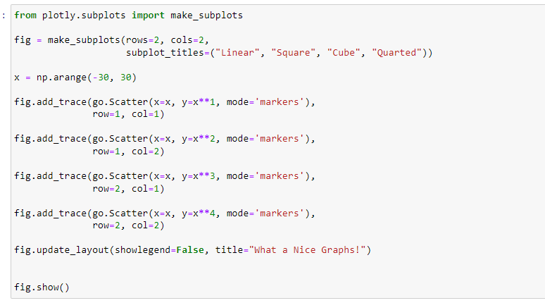
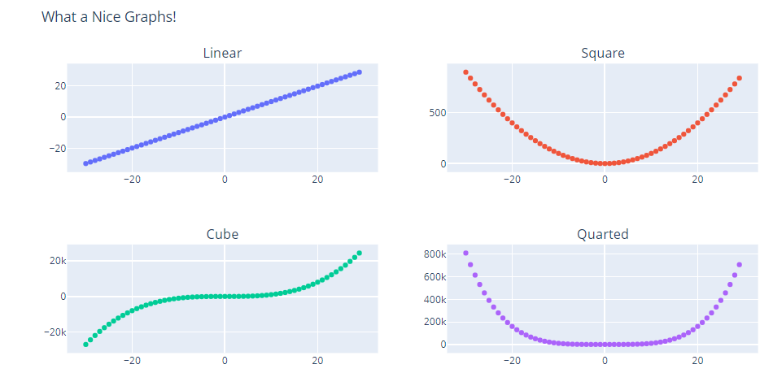
Plotly Subplots

Slide 14
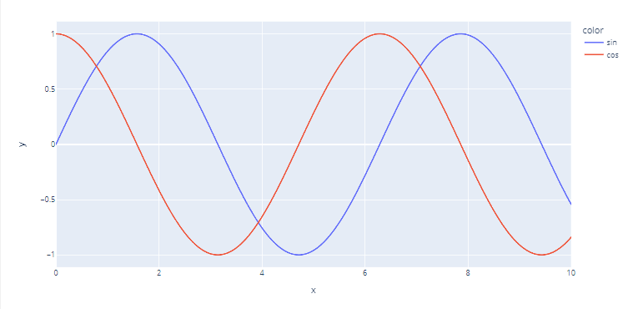
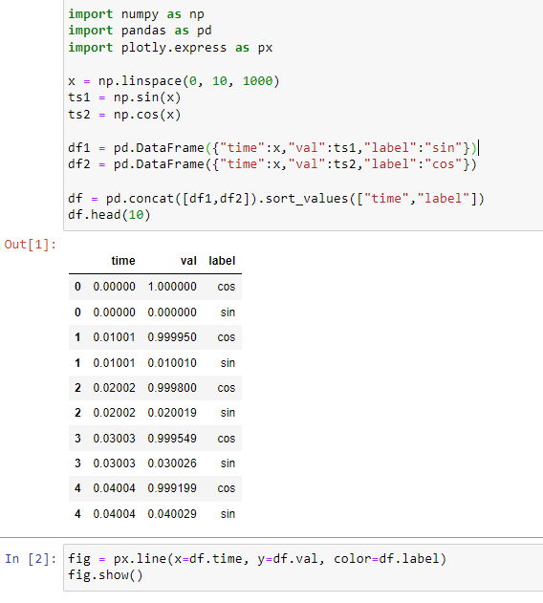
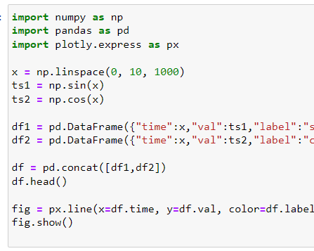
Plotly and Multiple Time Series
Plotly can split one column into two lines
using another column (label) as criteria
https://plotly.com/python/time-series/
https://stackoverflow.com/questions/64158858/plotly-how-to-create-a-line-plot-of-a-time-series-variable-that-has-a-multiple

Slide 15
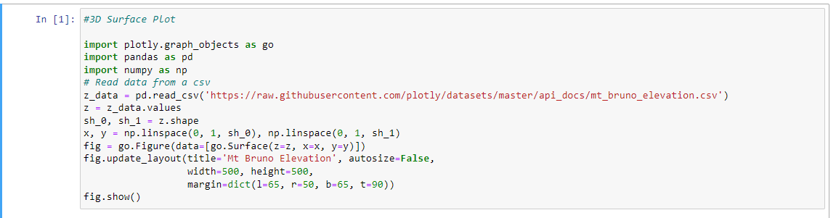
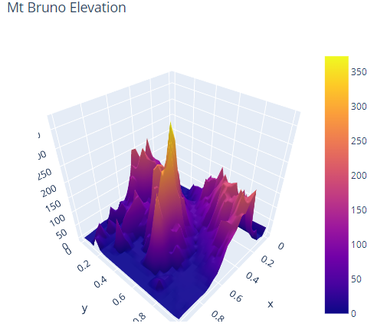
Plotly 3D Charts
https://plotly.com/python/3d-surface-plots/#topographical-3d-surface-plot

Slide 16
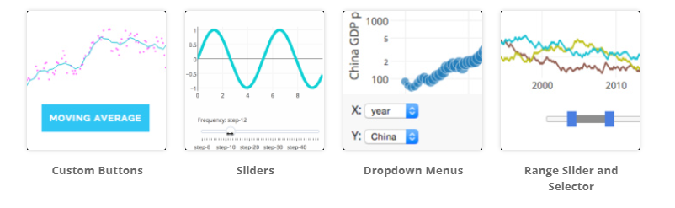
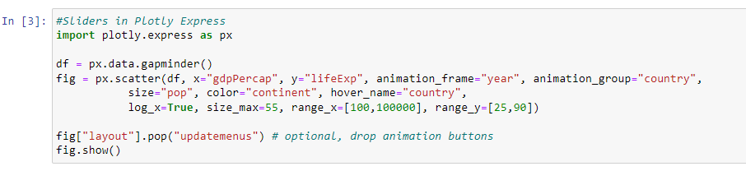
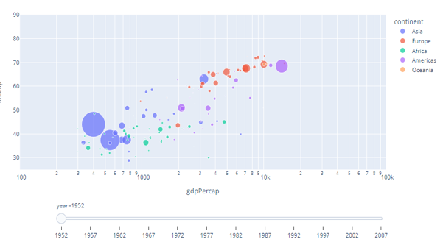
Plotly and Custom Controls
Reference
https://plotly.com/python/#controls
https://plotly.com/python/reference/layout/updatemenus/

Slide 17
Dash - Plotly Charts in Web Pages
Dash is a way to use Plotly in web pages.
You can create Graphs in python on server side using the same syntax as in Jupyter.
Dash app gallery: https://dash.gallery/Portal/
Installation instructions: https://dash.plot.ly/installation.
pip install dash
Dash components
Dash Core Components (buttons, sliders, dropdown, etc.)
https://dash.plotly.com/dash-core-components
Plotly Python Open Source Graphing Library (Plotly Graphs )
https://plotly.com/python/
Dash Callbacks
https://dash.plotly.com/basic-callbacks

Slide 18
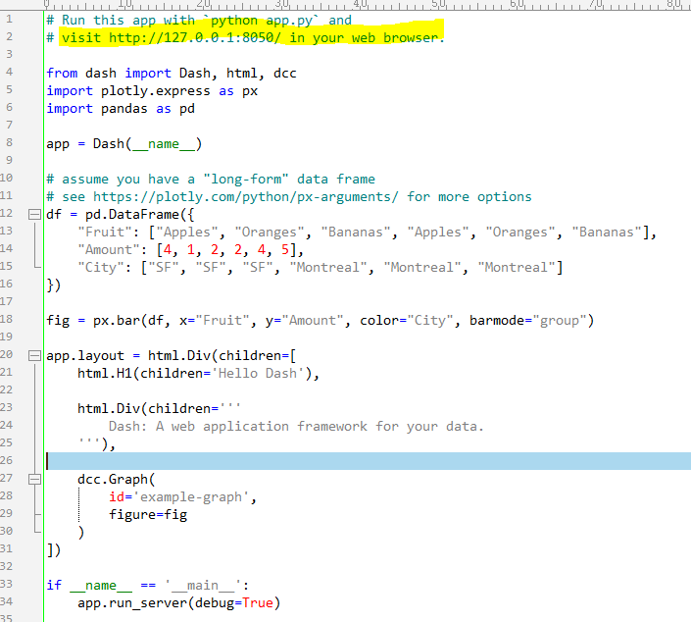
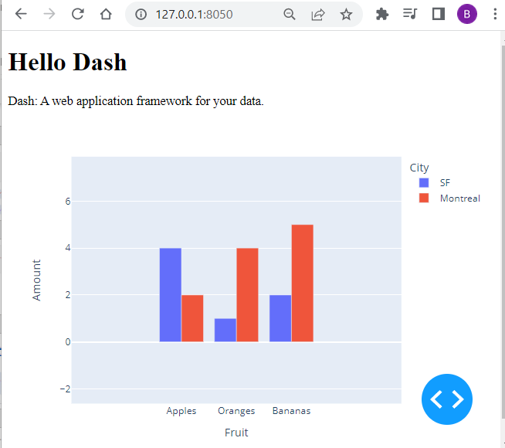
Dash is running on http://127.0.0.1:8050/ (Press CTRL+C to quit)

Slide 19
References:
Plotly library - to be used from Jupyter:
https://plotly.com
Gallery and getting started - https://plotly.com/python/
Plotly Express: https://plotly.com/python-api-reference/plotly.express.html
Python API reference for plotly: https://plotly.com/python-api-reference/
Dash - same library to be used in a web site:
https://plotly.com/dash/
https://dash.gallery/Portal/
https://dash.plotly.com/
Dash App Gallery: https://dash-gallery.plotly.host/Portal/
Dash Components: https://dash.plotly.com/dash-core-components
The Callback: https://dash.plotly.com/basic-callbacks
Dash Plotly Community Forum: https://community.plotly.com/c/dash/16
Comparisons of different libraries:
https://pythonplot.com – very good comparison
https://ritza.co/articles/matplotlib-vs-seaborn-vs-plotly-vs-MATLAB-vs-ggplot2-vs-pandas/
https://www.justintodata.com/python-data-visualization-libraries/
https://www.projectpro.io/article/python-data-visualization-libraries/543
https://geo-python-site.readthedocs.io/en/stable/lessons/L7/python-plotting.html

