Slide 1

Bitcoin price analysis by Tweets
Dequan Er, Ph.D.
https://www.linkedin.com/in/dequan-er-69518643/

Slide 2
Contents
Intro
What’s NN and RNN
Why LSTM
Results
Summary

Slide 3
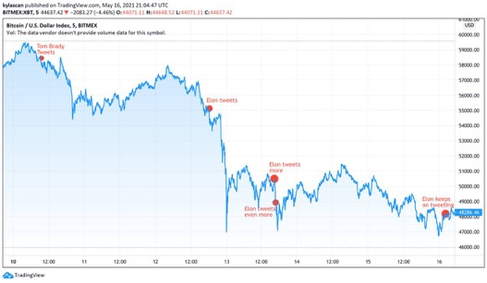

Intro
Bitcoin is an innovative payment network and a new kind of crypto currency.
Bitcoin was the first crypto currency published in 2008 by Satoshi Nakmoto.
Bitcoin is highly volatile
Machine learning can capture the past fluctuations in prices.
Information from the market is an important factor in determining the Bitcoin price.
Tweets is part of the information.

Slide 4
Goal
Sentiment analysis of Tweets
Build model that predict positive/neutral/negative signals of bitcoin price
Label future tweets data
Approach
NLP and sentiment analysis of Tweets
Bi-directional LSTM model

Slide 5
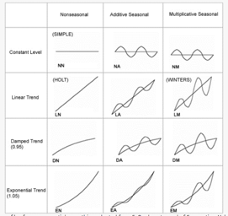
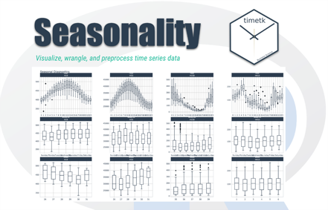
How to present time series data
a sequence of data points collected over time intervals, giving us the ability to track changes over time.
Event
Trend
Seasonality
Autocorrelation

Slide 6
Data Flow
Tweets
Tokenizing
Sentiment Analysis
Features
Model
Bitcoin Price

Slide 7
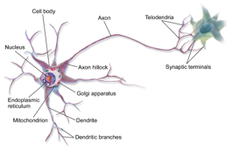
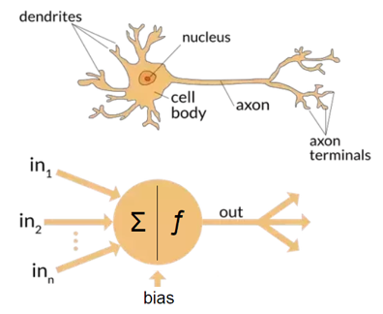
Neural Net
https://en.wikipedia.org/wiki/Artificial_neural_network
NN is an unidirectional, only moves through hidden layers.
No memory. Simply they cannot remember the past inputs.
Not enough to capture NLP

Slide 8
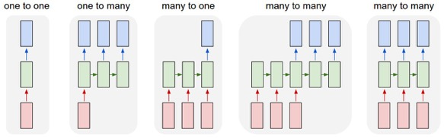
RNN
Recurrent Neural Network (RNN) is advanced artificial NN in which direct cycles in memory are involved.
RNN can build networks with fixed sized input and output layers.
RNN considers the current input and also the previously received inputs
RNN many formats

Slide 9
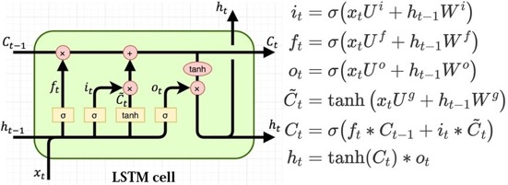
LSTM
Drawbacks of RNN
Long Term dependencies
LSTM
Long Short Term Memory
input gate, output gate, forget gate
Remembers arbitrary time intervals and the three gates regulate the flow of information in and out of the cell.
Example: Mandy and Monica walk into the room together, later Richard walks into the room. Mandy said “Hi” to ___ ??

Slide 10
Model Summary
Predict the bitcoin price movement by tweets sentiment analysis
Data: BTC price, Tweets
Sample the data randomly and normalize data, find the derivative of BTC price.
Define a classification problem that predict the movement as positive, neutral, negative.

Slide 11
Demo
https://www.kaggle.com/code/erdeq1024/bitcoin-price-analysis-by-tweets
Libraries imported:
VADER (Valence Aware Dictionary and sEntiment Reasoner) is a lexicon and rule-based sentiment analysis tool that is specifically attuned to sentiments expressed in social media.
Sklearn
Textblob

Slide 12
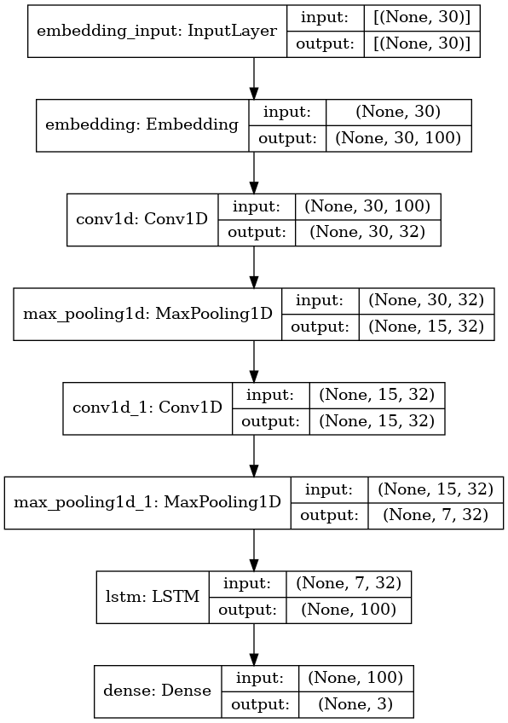
Demo
Model: "sequential"
_________________________________________________________________
Layer (type) Output Shape Param #
=================================================================
embedding (Embedding) (None, 30, 100) 2000000
_________________________________________________________________
conv1d (Conv1D) (None, 30, 32) 9632
_________________________________________________________________
max_pooling1d (MaxPooling1D) (None, 15, 32) 0
_________________________________________________________________
conv1d_1 (Conv1D) (None, 15, 32) 3104
_________________________________________________________________
max_pooling1d_1 (MaxPooling1 (None, 7, 32) 0
_________________________________________________________________
lstm (LSTM) (None, 100) 53200
_________________________________________________________________
dense (Dense) (None, 3) 303
=================================================================
Total params: 2,066,239
Trainable params: 2,066,239
Non-trainable params: 0
_________________________________________________________________
Model 1

Slide 13
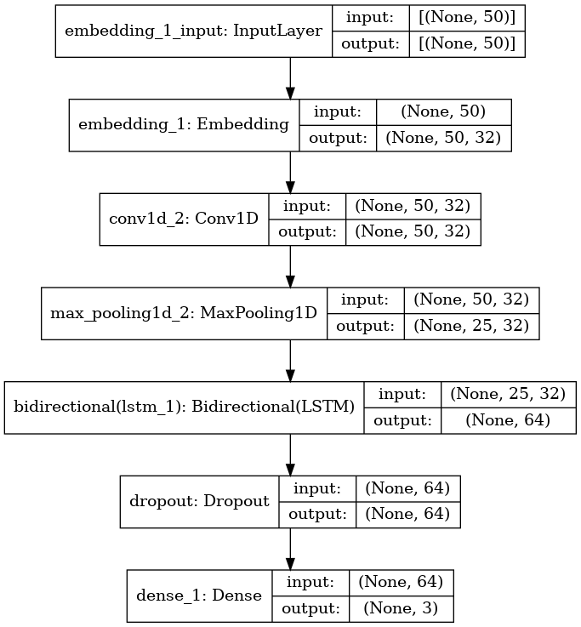
Demo
Model 2

Slide 14
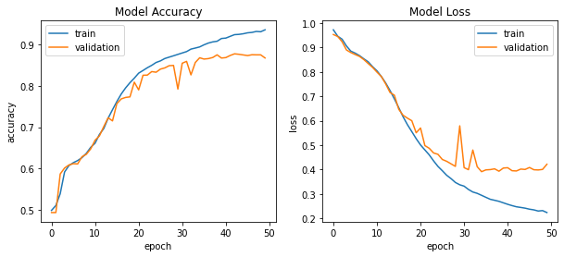
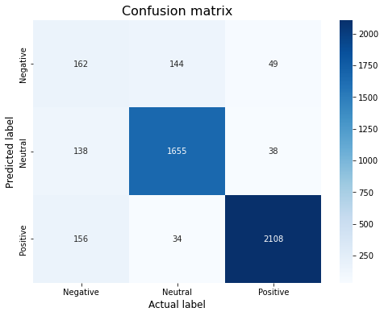
Results
Model converge at a descent level. Acc: 0.936, val_acc: 0.868
Confusion matrix shows model can understand most positive and neutral sentiments of BTC price signals.
This model enables use to label tweets based on the BTC price trend.

Slide 15
Summary
Key Takeaways:
Tweets data can be analyzed using NLP method with sentiment analysis
The trend can be marked as positive, neutral, and negative.
The model of LSTM can reach a fair accuracy on both training and testing dataset.

