Slide 1
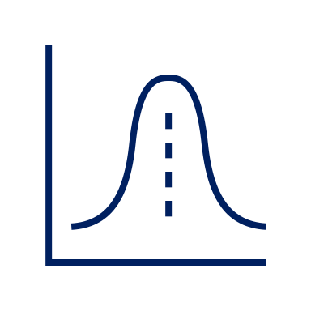
Karyna Pryiomka, MPhil
Quantitative Reasoning with Descriptive Statistics
You Are Here
Awesome

Slide 2
A few words about me
Karyna Pryiomka
Doctoral Candidate in Social/Personality Psychology at the Graduate Center, CUNY
Lecturer (Psychology Department) at Lehman College, CUNY

Slide 3
Two Categories of Statistics
Descriptive Statistics—tools and procedures used to summarize, organize, and simplify data
Inferential Statistics—tools and procedures used to study samples to make generalization about populations

Slide 4
Types of Descriptive Statistics
Frequency Distributions
Tables and Graphs
Measures of Central Tendency
Mean
Median
Mode
Measures of Variability
Range
Variance
Standard Deviation

Slide 5
What is a frequency distribution?
A frequency distribution is an organized tabulation showing the number of individuals located in each category on the scale of measurement.
In other words, it is a summary of how many people fall into each category of the variable that you are measuring.
Frequency distributions can take a form of a table or a graph.

Slide 6
How many siblings do you have?
# of siblings (X) | f | p | %
9 | 1 | 0.0588 | 5.88
8 | 1 | 0.0588 | 5.88
7 | 1 | 0.0588 | 5.88
6 | 0 | 0.0000 | 0.00
5 | 2 | 0.1176 | 11.76
4 | 2 | 0.1176 | 11.76
3 | 1 | 0.0588 | 5.88
2 | 3 | 0.1765 | 17.65
1 | 4 | 0.2353 | 23.53
0 | 2 | 0.1176 | 11.76

Slide 7
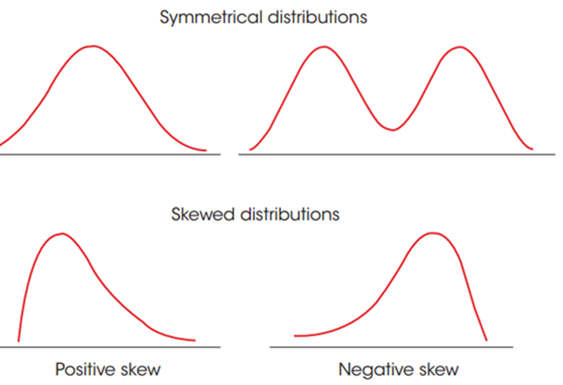
Distribution Shape

Slide 8
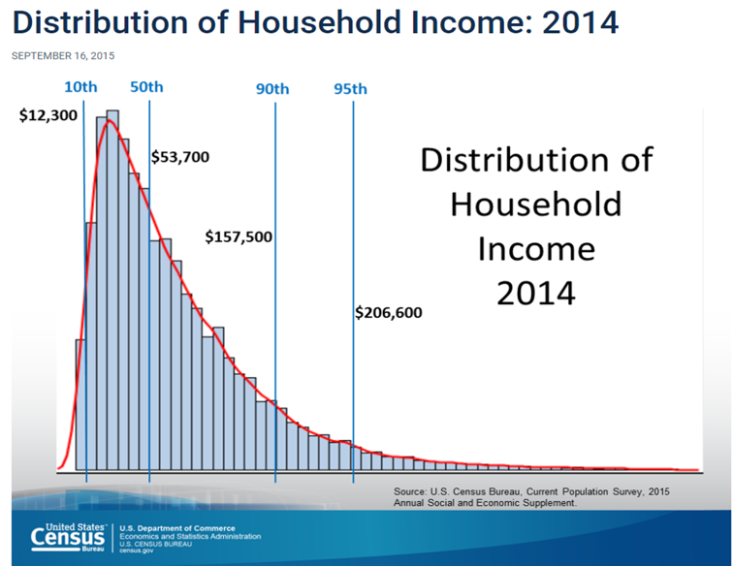
https://www.census.gov/library/visualizations/2015/demo/distribution-of-household-income--2014.html

Slide 9
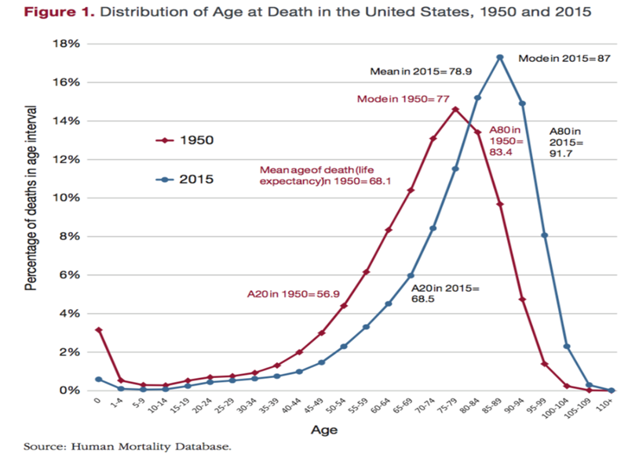

Slide 10
Measures of Central Tendency Example Dataset: 1, 1, 1, 2, 2, 2, 3, 3, 3, 3, 4, 4, 4, 4, 4, 4, 4, 4, 5
Mean is the sum of all the scores divided by the number of scores in the data
Mean = (1+ 1 + 1 + 2 + 2 + 2 + 3 + 3 + 3 + 3 + 4 + 4 + 4 + 4 + 4 + 4 + 4 + 4 + 5)/19 = 3.05
Median is the midpoint of the scores in a distribution when they are listed in order from smallest to largest
Median = 1, 1, 1, 2, 2, 2, 3, 3, 3, 3, 4, 4, 4, 4, 4, 4, 4, 4, 5
Mode is the score or category that has the greatest frequency of any score in the frequency distribution.
Mode = 4

Slide 11
Which measure of central tendency should I use?

Slide 12
Step 1: Consider scales of measurement
Nominal – named-based categories only (ex: eye color, academic major)
Mode only
Ordinal – ranked categories (ex: shirt size S, M, L)
Mode and Median
Interval/Ratio – numeric categories (ex: temperature, weight, height, income in $).
Mean and Median is preferred

Slide 13
Not your average American
“MALONE: My issue is with this thing that people talk about, the average American. And, like, yeah, there's something sort of silly about the average American 'cause it's like a melting pot. Who is average, really? But my quibble is more pedantic than that because I think people don't mean average American. I think what they actually mean is, who is the person - if I walk outside into America, who is the person I'm most likely to run into?”
-Mode is typically the most useful statistic when we are trying to identify a typical person, customer, client.
The Modal American by NPR Planet Money (https://www.npr.org/2019/08/28/755191639/episode-936-the-modal-American)

Slide 14
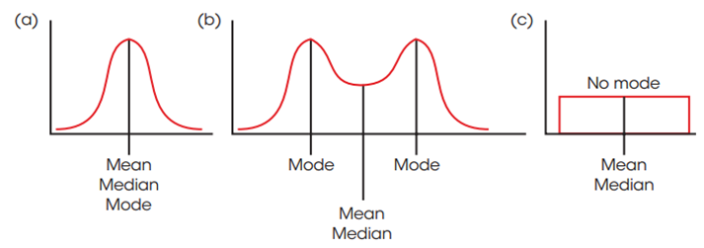
Step 2: Consider distribution shape
Symmetrical Distributions

Slide 15


Slide 16

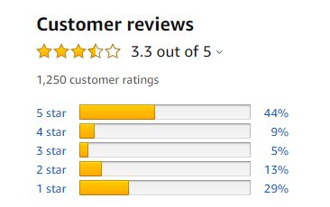

Slide 17

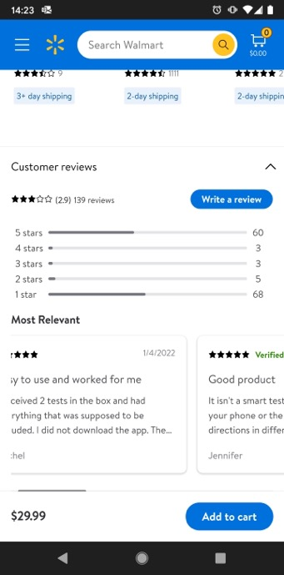
Always look at the distribution shape!

Slide 18
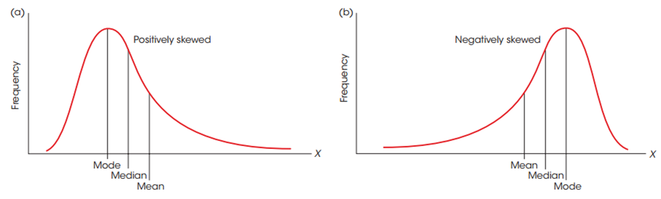
Skewed Distributions and Measures of Central Tendency

Slide 19
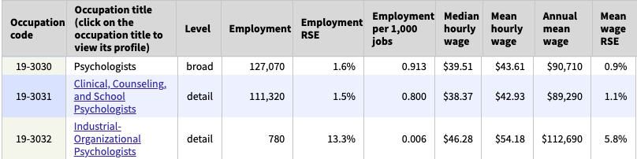
Consider Salary Distributions (Psychologists)
https://www.bls.gov/oes/current/oes_nat.htm#19-0000

Slide 20
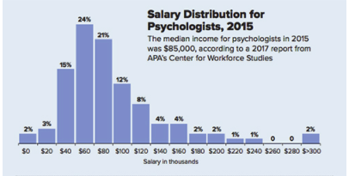
Consider Salary Distributions (Psychologists)
https://www.apa.org/monitor/2017/09/psychologists-earn

Slide 21
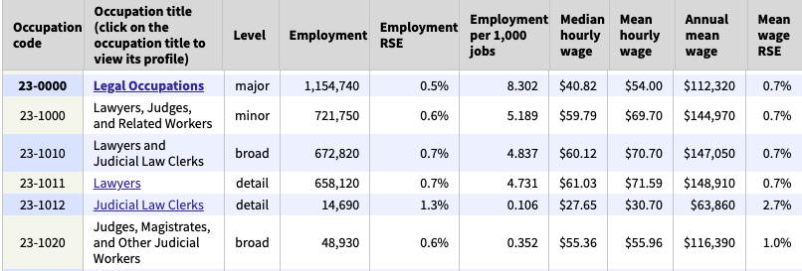
Consider Salary Distributions (Legal Professions)
https://www.bls.gov/oes/current/oes_nat.htm#19-0000

Slide 22
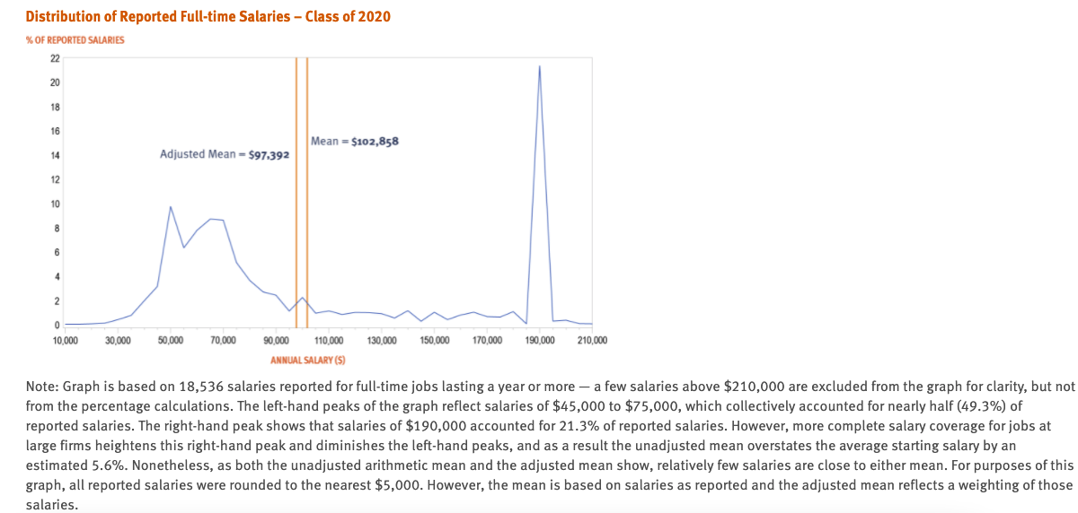
Consider Salary Distributions (Legal Professions)
https://www.nalp.org/salarydistrib#2020

Slide 23
Step 3: Consider underlying data
Extreme values/outliers
1, 1, 1, 2, 2, 2, 3, 3, 3, 3, 4, 4, 4, 100
Undetermined values
How many hours a week do you study?
4-5, 6-7, about 15.
Open-ended distributions
X | f
4 and over | 4
3 | 5
2 | 0
1 | 7

Slide 24
Selecting a Measure of Central Tendency
Measure of Central Tendency | Appropriate to choose if … | Could be misleading if…
Mean | You can calculate ∑X You know the value of every score | Extreme scores Skewed distribution Undetermined values Open-ended distribution Ordinal scale Nominal scale
Median | Extreme scores Skewed distribution Undetermined values Open-ended distribution Ordinal scale | Nominal scale
Mode | Nominal scales Discrete variables Describing shape | Interval or ratio data, except to accompany mean or median
Essentials of Statistics for the Behavioral Sciences, 9th edition, Authors: Gravetter & Wallnau.

Slide 25
A few words about data variability

Slide 26
Josh wants to know if playing music during quizzes affects students’ performance. Josh teaches three sections of the same class, so he decides to play classical music in one class, light instrumental rock in another, and no music in his third class. Below are his results. Does it look like music had an effect on quiz scores in Josh’s classes?
M_{music_class} = 5
M_{music_rock} = 5
M_{no_music} = 5

Slide 27
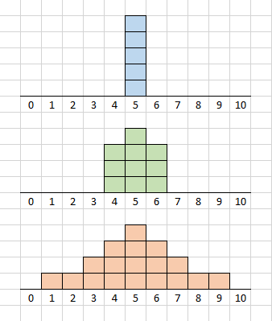
Be Careful
A.
B.
C.
Identical mean scores do not always indicate identical distributions.
Which class would you rather be in?

Slide 28
Consider your goals
A.
B.
C.
Assuming that 5 or higher is a passing score,
which class would you rather be in?

Slide 29
If the scores are very spread out (high variability), each individual score provides a poor representation of the entire distribution.

Slide 30
Summary
Descriptive statistics play a vital role in our ability to accurately draw conclusions from data.
When analyzing data, make sure to explore key descriptive statistics for each variable or combinations of variables.
Do NOT skip the graphs
When consuming data-based information, look for missing details. Use your knowledge of descriptive statistics to ask critical questions. Demand to see the graph☺

Slide 31
Thank You!

