Slide 1
Cracking the Coding Interview
Alex Ni - July 22nd, 2022

Slide 2
Alex Ni
Senior consultant at Redapt, Advanced Analytics
4+ years of experience in ETL, BI, data warehouse
Familiar with data science and full cycle machine learning pipeline
Certified in Azure data and AI scientist and GCP data engineer and cloud architect
Connect on LinkedIn:
https://www.linkedin.com/in/haowen-ni-860612117

Slide 3
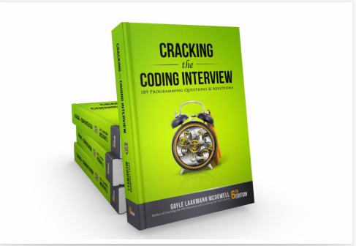
Agenda
What to expect in a coding interview
How to prepare for coding interview
Demo: Two Sum
CRACKING the CODING INTERVIEW - Home (crackingthecodinginterview.com)

Slide 4
What is the coding interview?
A 45 minutes, problem-oriented session used to assess potentially employees on:
Analytical skills
Coding Skills
Technical/CS knowledge and fundamentals
Communication skills
Technical phone interviews
Technical challenges using web-based code editor like Coderpad and HackerRank
Onsite interviews
3 to 5 rounds technical interviews
Coding on a whiteboard
Online assessment/Take home
For example, Amazon OA

Slide 5
Research on what questions each company will ask me
IMPORTANT: Figure out in advance what common question are asked for the company you’re interviewing with
Generally, you can find this information in a few places:
Job description: to gauge the focus of the questions
Coding interview prep websites: for example, Leetcode has collections of top interview questions for each big tech company
Current/former employees: online forums, blogs, places where they discuss about their interview process
Recruiter: ask them directly for topics that may appear
Eliminate the guesswork from coding interviews:
https://www.codinginterview.com

Slide 6
How to prepare for coding interview?

Slide 7
Tip1: DON’T jump into coding questions directly
Foundations in coding
The knowledge you will learn from CS101: variables, data type, functions, parameters, for/while loops, if/else, recursion, and etc.,
Data structures and algorithms
Arrays, Linked Lists, Hash Tables, Stacks and Queues, Trees, Graphs, ...
Binary search, Sorting, Breadth First Search, Depth First Search, …
Complexity Analysis, Big O notation
Time Complexity: how fast an algorithm runs, expressed using
Space Complexity: how much memory an algorithm takes up

Slide 8
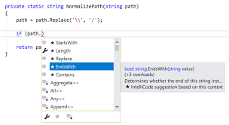

Tip 2: Pick the programming language most comfortable with you
You need to be extremely familiar with the syntax so that you can better focus on the logic of solution
No intellisense such as code completion and syntax checking
Coding style

Slide 9

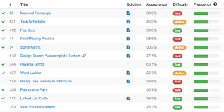
Tip 3: MOST IMPORTANT: Practice, practice, and practice
Make a continuous plan for your preparation
Study for the basic knowledge
Begin with easier questions to brush up what you just learned about data structures and algorithms knowledge
Start to timing yourself, think out loud, consider time and memory complexity
Practice more complex coding problems
Practice on LeetCode
If you practice enough LeetCode questions, there is a good chance that you will either see or complete one of your actual interview questions (or some variant of it)

Slide 10
Demo: Two Sum

Slide 11
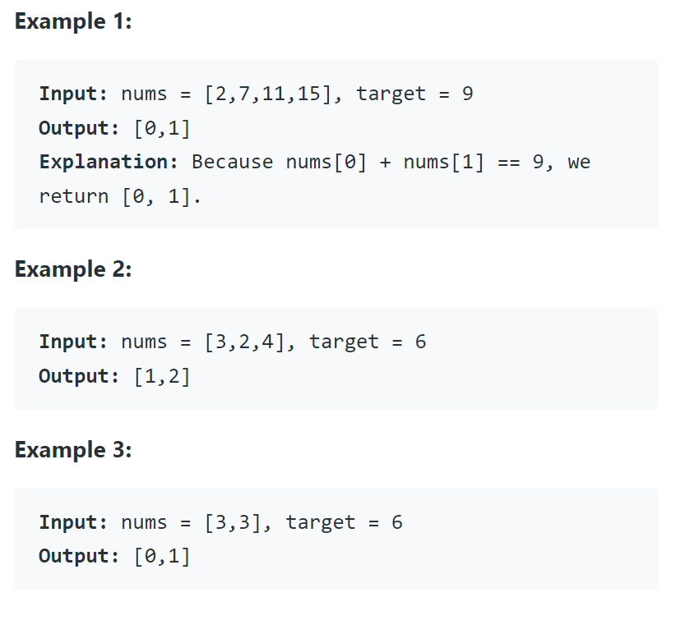
Two Sum - Description
LeetCode #1
Given an array of integers numbers and an integer target, return indices of the two numbers such that they add up to target.
You may assume that each input would have exactly one solution, and you may not use the same element twice.
You can return the answer in any order.

Slide 12

Two Sum - Hints
Hint 1
A really brute force way would be to search for all possible pairs of numbers but that would be too slow. Again, it's best to try out brute force solutions for just for completeness. It is from these brute force solutions that you can come up with optimizations.

Slide 13
Approach 1: Brute Force
class Solution:
def twoSum(self, nums: List[int], target: int) -> List[int]:
for i in range(len(nums)):
for j in range(i + 1, len(nums)):
if nums[j] == target - nums[i]:
return [i, j]
Algorithm
The brute force approach is simple. Loop through each element x and find if there is another value that equals to target - x.
Time complexity:
O(n^2). For each element, we try to find its complement by looping through the rest of the array which takes O(n) time. Therefore, the time complexity is O(n^2).
Space complexity:
O(1). The space required does not depend on the size of the input array, so only constant space is used.

Slide 14
Two Sum - Hints
Hint 2
So, if we fix one of the numbers, say x
We have to scan the entire array to find the next number y, which is value - x where value is the input parameter.
Can we change our method somehow so that this search becomes faster?

Slide 15
Two Sum - Hints
Hint 3
The second train of thought is, without changing the array, can we use additional space somehow? Like maybe a hash map to speed up the search?

Slide 16
Approach 2: Two-pass Hash Table
class Solution:
def twoSum(self, nums: List[int], target: int) -> List[int]:
hashmap = {}
for i in range(len(nums)):
hashmap[nums[i]] = i
for i in range(len(nums)):
complement = target - nums[i]
if complement in hashmap and hashmap[complement] != i:
return [i, hashmap[complement]]
Algorithm
A simple implementation uses two iterations. In the first iteration, we add each element's value as a key and its index as a value to the hash table. Then, in the second iteration, we check if each element's complement (target - nums[i]) exists in the hash table. If it does exist, we return current element's index and its complement's index. Beware that the complement must not be nums[i] itself!

Slide 17
Approach 2: Two-pass Hash Table
class Solution:
def twoSum(self, nums: List[int], target: int) -> List[int]:
hashmap = {}
for i in range(len(nums)):
hashmap[nums[i]] = i
for i in range(len(nums)):
complement = target - nums[i]
if complement in hashmap and hashmap[complement] != i:
return [i, hashmap[complement]]
Time complexity:
O(n). We traverse the list containing nn elements exactly twice. Since the hash table reduces the lookup time to O(1), the overall time complexity is O(n).
Space complexity:
O(n). The extra space required depends on the number of items stored in the hash table, which stores exactly n elements.

Slide 18
Approach 3: One-pass Hash Table
class Solution:
def twoSum(self, nums: List[int], target: int) -> List[int]:
hashmap = {}
for i in range(len(nums)):
complement = target - nums[i]
if complement in hashmap:
return [i, hashmap[complement]]
hashmap[nums[i]] = i
Algorithm
It turns out we can do it in one-pass. While we are iterating and inserting elements into the hash table, we also look back to check if current element's complement already exists in the hash table. If it exists, we have found a solution and return the indices immediately.
Time complexity:
O(n). We traverse the list containing nn elements only once. Each lookup in the table costs only O(1) time.
Space complexity:
O(n). The extra space required depends on the number of items stored in the hash table, which stores at most n elements.

Slide 19
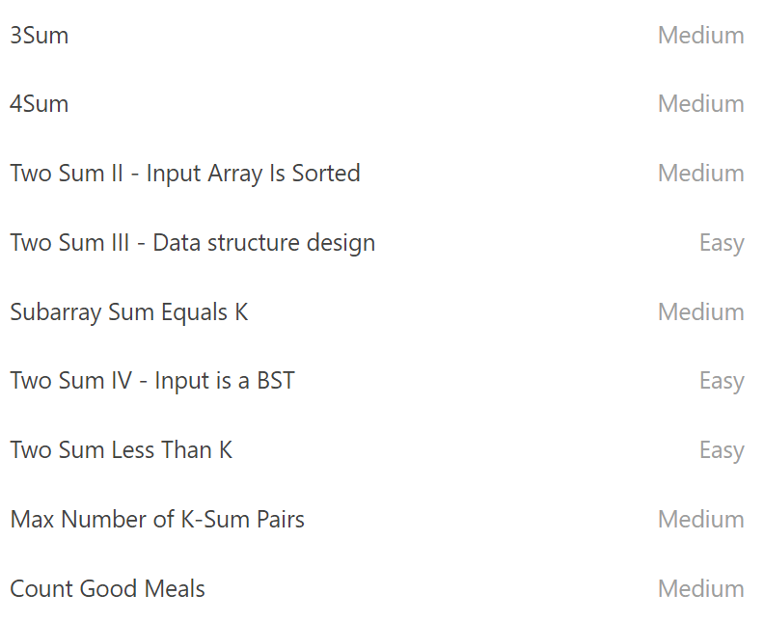
Two Sum - Similar Questions
LeetCode #15 - 3 Sum
Given an integer array nums, return all the triplets [nums[i], nums[j], nums[k]] such that i != j, i != k, and j != k, and nums[i] + nums[j] + nums[k] == 0.
Notice that the solution set must not contain duplicate triplets.

Slide 20
Summary
For preparing coding interviews, remember:
Start with the foundational knowledges, especially data structures and algorithms
Pick the programming language most comfortable with you
Start with the easy questions, build a long term motivation and keep practicing

Slide 21
Thank you!

Slide 22
Reference
Cracking the coding interview
https://www.crackingthecodinginterview.com/
LeetCode - The World's Leading Online Programming Learning Platform
https://leetcode.com/
Coding Interview Preparation | Codinginterview
https://www.codinginterview.com/

