Slide 1
Window Functions in T-SQL
by Malte Thesenvitz
July 29th 2022

Slide 2
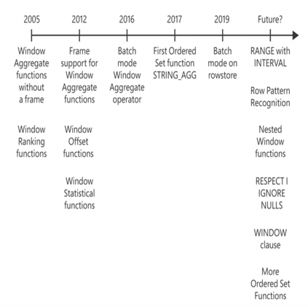


Background of Window Functions
Source and Author: Ben Itzik-Gan

Slide 3
1. The Island Problem:
Query a table holding a sequence of values in some column and identifying the consecutive ranges of existing values.
Col1
2
3
11
12
13
27
33
34
35
43
Output
Start range | End range
2 | 3
11 | 13
27 | 27
33 | 35
43 | 43

Slide 4
The 4 Main Types of Window Functions
Aggregates | Ranking | Statistical | Offset
AVG() | ROW_NUMBER() | PERCENT_RANK() | LAG()
COUNT() | NTILE() | CUME_DIST() | LEAD()
MIN() | RANK() | PERCENTILE_CONT() | FIRST_VALUE()
MAX() | DENSE_RANK() | PERCENTILE_DISC() | LAST_VALUE()
SUM()

Slide 5
Elements of Window Functions
Partitioning | Ordering | Framing
Optional | Defines order within partition | Further restrict the window partition
SUM(profit) OVER(PARTITION BY country) AS country_sum | SUM(profit) OVER(PARTITION BY country ORDER BY ordermonth) AS ordered_country_sum | SUM(profit) OVER(PARTITION BY country ORDER BY ordermonth ROWS BETWEEN UNBOUNDED PRECEDING AND CURRENT ROW) AS dynamic_country_sum
Supported by all window functions & Restricts window to only certain values => Think of it as grouping | Often used as tiebreaker to ensure determinism | Works with aggregate & selected offset functions
Only work in SELECT and ORDER BY clauses due to logical query ordering

Slide 6
Examples with SQL Server

Slide 7
Nested Window Functions

Slide 8
Nested Group Functions Within Window Functions

Slide 9
Set Based Window Functions

