Slide 1
Coding Interview
Code Examples - Session 2
2sum & 3sum
Towers of Hanoi
Histogram Rectangle
Reverse Linked List
Binary Heap
Contiguous Array
Longest Consecutive Sequence
Max Subarray
Concatenate Words
Jumping Kangaroos
Tax Brakets

Slide 2
1
2sum problem
3sum problem
Given an array of integers, find two numbers such
that they add up to a specific target number.
Function twoSum() should return indices i1 & i2
of two such numbers (i1 < i2, indexes NOT zero based).
Assume that each input have exactly one solution.
Example:
Input : numbers={2, 7, 11, 15}, target=9
Output : index1=1, index2=2
Time/Space complexity O(N)
3sum problem - return triplets summing to zero
An easy solution has complexity O(N*N)
.. https://en.wikipedia.org/wiki/3SUM
import itertools
stuff = [-1, 0, 1, 2, -1, -4]
# [-1, 0, 1] and [0, 1, -1] are the same
# sort the list to avoid double-counting:
stuff.sort()
ls = []
for subset in itertools.combinations(stuff, 3):
if sum(list(subset))==0:
if list(subset) not in ls:
ls.append(list(subset))
print(ls)
# Out: [[-1, -1, 2], [-1, 0, 1]]
def twosum(nums, target):
seen = {} # num : pos
for ii, num in enumerate(nums):
pos = ii+1 # use 1-based indexing
if target - num in seen:
return seen[target-num], pos
seen[num] = pos
return -1,-1

Slide 3
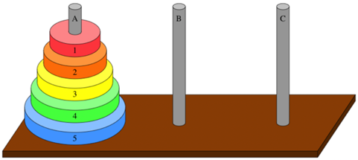
2
Towers of Hanoi
counter = 0
# --------------------------------------------------------------
def hanoi(n, source, helper, target):
global counter
if n <= 0:
return
counter += 1
print(counter)
# move tower of size n - 1 from source to helper:
hanoi(n - 1, source, target, helper)
# move disk from source peg to target peg
if source:
target.append(source.pop())
# move tower of size n-1 from helper to target
hanoi(n - 1, helper, source, target)
# --------------------------------------------------------------
def print_state(label, source, helper, target):
print(label, ": ", source, helper, target)
# --------------------------------------------------------------
print()
source = [4,3,2,1]
target = []
helper = []
print_state("Initial state",source, helper, target)
hanoi(len(source),source,helper,target)
print_state("Final state",source, helper, target)
print()
The game "Towers of Hanoi" uses three rods and a set of disks stacked on the first rod from largest disk on bottom to smallest on top – thus forming a conical tower.
The aim of the game is to move the tower of disks from one rod to another.
Only one disk can be moved at a time
We can only take the top-most disk (can not take disk from the middle)
The disk can NOT be placed on top of a smaller disk
https://en.wikipedia.org/wiki/Tower_of_Hanoi

Slide 4
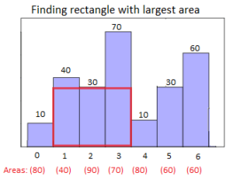
3
Histogram Rectangle
def calc_max_area(hist):
print(hist)
if len(hist) == 0:
return 0
if len(hist) == 1:
return hist[0]
hist.append(0) # trick to handle the end of histogram
stack = list()
max_area = 0
ii = 0
while ii < len(hist):
if (not stack) or (hist[stack[-1]] <= hist[ii]):
stack.append(ii)
print(f"appended: {stack}")
ii += 1
else:
ts = stack.pop() # top of stack
print(f" popped {ts}")
di = ii
if stack:
di = (ii - stack[-1] - 1)
area = hist[ts] * di
print(f" area = {area}")
if area > max_area:
max_area = area
print(f" max_area = {max_area}")
return max_area
Largest area of a rectangle in histogram
https://www.geeksforgeeks.org/largest-rectangle-under-histogram/
Create an empty stack.
Then for every bar hist[i] ( 'i' changes from 0 to n-1) do the following:
(a) Zero, same, or going up:
If stack is empty or hist[i] is same or higher than the bar at top of stack, then push index 'i' to stack.
b) Going down:
If this bar hist[i] is smaller than the top of stack hist[ts], then keep removing the top of stack while top of the stack is greater. While doing this we will try rectangels as following:
Let the removed bar be hist[ts]. Calculate area of rectangle with hist[ts] as
smallest bar. For hist[tp], the 'left index' is previous to ts item in stack,
and 'right index' is 'i' (current index).
In the end if the stack is not empty, then one by one remove all bars from stack and do step 'b' above for every removed bar. This actually can be acheved by a simple trick - appending value [-1] to the histogram at the very beginning.

Slide 5
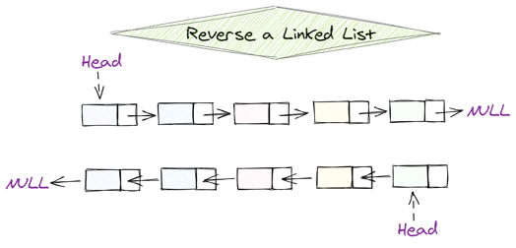
4
Reverse Linked List
# Definition for singly-linked list.
class ListNode:
def __init__(self, x):
self.val = x
self.next = None
def reverseList(self, head: ListNode) -> ListNode:
"""
# this function reverses the list "in place"
"""
prev = None
while head:
curr = head
head = head.next
curr.next = prev
prev = curr
return prev
def reverseList(head: ListNode) -> ListNode:
"""
# this function creates separate inverted list
# (it doesn't change the original list)
"""
if (head == None) or (head.next == None):
return head
l1p = head
l2n = ListNode()
l2n.val = head.val
# l1p --> l1p.next
# l2n <-- l2p
while l1p.next != None:
l2p = ListNode()
l2p.val = l1p.next.val
l2p.next = l2n
l1p = l1p.next
l2n = l2p
return l2p

Slide 6
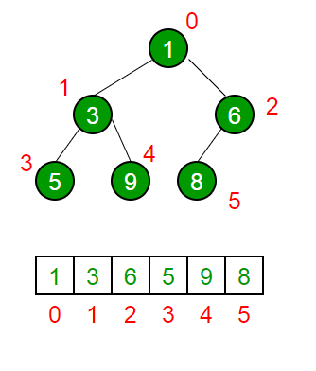
5
Binary Heap
def heapify(arr, n, i):
"""
# heapify subtree from index "i" down (recursively)
# by swapping elements as needed
# arr - list to change in place, n – length of arr
"""
largest = i; # Initialize largest as root
idxl = 2*i + 1;
idxr = 2*i + 2;
# find if one of children is larger than root
if (idxl < n) and (arr[idxl] > arr[largest]):
largest = idxl;
if (idxr < n) and (arr[idxr] > arr[largest]):
largest = idxr;
# swap large child with root and fix subtree
if largest != i:
arr[i], arr[largest] = arr[largest], arr[i]
heapify(arr, n, largest) # recursively fix sub-tree
# ---------------------------------------------------------
def build_max_heap(arr):
""" build a Max-Heap from list "arr" in-place """
n = len(arr)
if n <= 1:
return
start_idx = n // 2 - 1; # index of last non-leaf node
# heapify each "parent" node (from last to first)
for i in range(start_idx, -1, -1):
heapify(arr, n, i);
# ---------------------------------------------------------
arr = [ 1, 3, 5, 4, 6, 13, 10, 9, 8, 15, 17 ];
build_max_heap(arr);
print(arr)
Binary heap (max-heap or min-heap)
is a data structure which looks like binary tree, where each parent is
larger than values of children for max-heap,
or smaller for min-heap.
Binary heaps are a common way of implementing priority queues.
Heap is usually stored in an array
idx = 0 - root (top element)
idx - 1,2 - next layer
idx = 3,4,5,6 - text layer
etc.
last parent's idx = floor(N/2) - 1
Given an array we can "heapify" it in place
by simply swapping its elements.
Time complexity:
building heap - O(N)
push (add at bottom and adjust) - O(lg(N))
pop (take from top and adjust) - O(lg(N))
heap sort - O(N*log(N))
min-heap

Slide 7
6
Contiguous Array
Given an array having only ones and zeros (up to 50,000 elements),
find max length of a contiguous subarray with equal number of 0s and 1s.
Example:
Input: [0,1,0]
Output: 2 ( [0, 1] or [1, 0] )
Idea: Change all Os to -1s. Then we go through the array and calculate the running sum() – and store it in hash:
key = sum,
value = first index when we got this sum value
If we hit the same value again (if it is already in the hash),
this means that we had equal number of 1 and -1 between these points.
So we can calculate the length - and update the max_length as needed.
Complexity O(N) for time and space
def findMaxLength(nums: List[int]) -> int:
mysum = 0
myhash = {0: -1} # key - mysum value
# value - leftmost index for this mysum value
max_length = 0
for idx, num in enumerate(nums):
mysum = (mysum + 1) if num else (mysum - 1) # go up or down
if mysum in myhash: # good subarray
max_length = max(max_length, (idx - myhash[mysum]))
else: # 1st time on this height/depth - update myhash
myhash[ mysum ] = idx
return max_length

Slide 8
7
Longest Consecutive Sequence
Given an unsorted array of integers,
find the length of the longest consecutive elements sequence.
Your algorithm should run in O(n) complexity.
Example:
Input: [100, 4, 200, 1, 3, 2]
Output: 4 (for sequence [1, 2, 3, 4])
Idea: Make a set of all values
If value x is in the set, but value (x-1) is not,
then x is a beginning of of a sequence.
Then follow it (check if x+1 is in set, etc.)
def longestConsecutive(nums: List[int]) -> int:
myset = set(nums)
mymax = 0
for x in myset:
if x - 1 not in myset: # beginning
y = x + 1
while y in myset: # follow the sequence forward
y += 1
mymax = max(mymax, y - x)
return mymax

Slide 9
8
Max Subarray
Given array of numbers, find the contiguous subarray with the largest sum – and return the value of this sum.
.. https://en.wikipedia.org/wiki/Maximum_subarray_problem
Explanation of this algorithm:
For a list of numbers [a0, a1, a2, a3, ... aN], for each index "i" we can look at all possible series
(starting with 0,1,... i-1 and ending with "i"), and select the biggest sum() among them.
Let's call it "si" (sum-ending-at-i).
We will calculate those numbers for all "i"-s, and select the maximum among them.
This will be the answer.
So how can we calculate those largest sums? It turned out to be a simple process.
i=0: There is only one series - [a₀], so s₀ = a₀
i=1: There are two series: [a₀,a₁],[a₁]. So s₁ = max(a₀+a₁, a₁)=max(s₀+a₁, a₁)
i=2: There are 3 series (sums). But we can simplify two 2.
We need to find s₂ = max (a₀+a₁+a₂, a₁+a₂, a₂)
Look at max of first two elements:
max(a₀+a₁+a₂, a₁+a₂) = max(a₀+a₁, a₁) + a₂ = s₁+a₂
so we simplify to max of 2 elements: s₂ = max(s₁+a₂, a₂)
We can use same logic going forward – and remember max value among the results.
s₀ = a₀
s₁ = max(s₀ + a₁, a₁)
s₂ = max(s₁ + a₂, a₂)
s₃ = max(s₂ + a₃, a₃)
...
s_{N} = max(s_{N-1} + a_{N}, a_{N})
# complexity O(N)
arr = [2,3,-10,4,5,6,-2]
N = len(arr)
ss = arr[0] # maximum left subarray so far
output = ss
for ii in range(1,N):
sn = max(ss+arr[ii], arr[ii])
output = max(ss,sn)
ss = sn
output = max(output, 0)
print(output)

Slide 10
9
Concatenate Words
# --------------------------------------------
def mytest(word, words_set, mydict):
if word in mydict:
return mydict[word]
for i in range(1, len(word)):
p = word[:i] # prefix, should be a word
if p not in words_set:
continue
s = word[i:] # suffix, may be composite
if (s in words_set) or (s in mydict and mydict[s]==True):
return True
elif mytest(s, words_set, mydict):
mydict[s]=True
return True
else:
mydict[s]=False
continue
return False
# --------------------------------------------
def find_concatenated(words):
words_set = set(words) # words
mydict = dict() # cache
res = [] # output list
for word in words:
if mytest(word, words_set, mydict):
res.append(word)
return res
# --------------------------------------------
input = ['catmancatsdog', 'cat', 'cats',
'dog', 'man', 'woman', 'catsdog']
print(find_concatenated(input)) # ['catcatsdog', 'catsdog']
Given a list of words (without duplicates),
return all words which are concatenations of
shorter words in the same list
Tme complexity O(N * L²),
where N - number of words, L - length of words

Slide 11
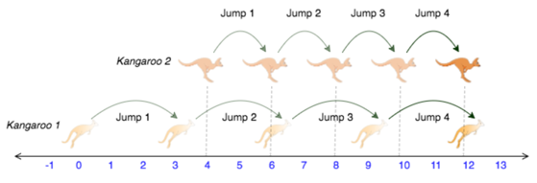
10
Jumping Kangaroos
Two kangaroos start jumping from positions x1 & x2.
They jump syncronously and in the same direction,
but the lengths of jumps may differ: v1 & v2
Question - will they meet at the same location?
def check_jumps(x1,v1,x2,v2):
dx = x2-x1
dv = v2-v1
if ((dv == 0) and (dx != 0)) or ((dv != 0) and (dx == 0)):
return False
elif (dv == 0) and (dx == 0):
return True
elif (dv*dx > 0):
return False
# if we are here, we move in the same direction and can divide.
steps = float(dx)/float(dv)
r_steps = int(steps + 0.5) # rounding
if abs(steps-r_steps) < 1e-6 :
return True
else:
return False

Slide 12
11
Tax Brakets
We have incremental income tax-brackets.
Calculate total tax for a given income
tax_brakets = [
[10, 0.1], # 0 .. 10K
[20, 0.2], # 10 .. 30K
[10, 0.3], # 30 .. 40K
[None, 0.4]] # 40 ..
def calc_tax(income, tax_brakets):
tax = 0.0
mylist = []
level1 = 0
for incr, tax_rate in tax_brakets:
if incr == None:
level2 = math.inf
else:
level2 = level1 + incr
tax_add = 0.0
if (income >level2):
tax_add = tax_rate*(level2-level1)
elif income >=level1:
tax_add = tax_rate*(income-level1)
mylist += [tax_add]
tax += tax_add
level1 = level2
return tax, mylist

