Slide 1
Coding Interview
Code Examples - Session 4
Find K-th largest number in the array
Substring Search Algorithms: Brute Force, KMP, Z
Substring Search Algorithms: Rabin Karp, Boyer-Moore, Aho-Corasick
Thompson NFA (Non-Deterministic Finite Automata)
Longest Palindromic Substring
Longest Palindromic String from Characters
Shortest Palindrome
Find depth of a binary tree
Invert Binary Tree
Binary Search Tree Checker
Suggest Word Completion Using Trie Structure
Wordle Game
Cycle in Linked List?
Find The Rotation Point In An Array
Single Riffle Shuffle

Slide 2
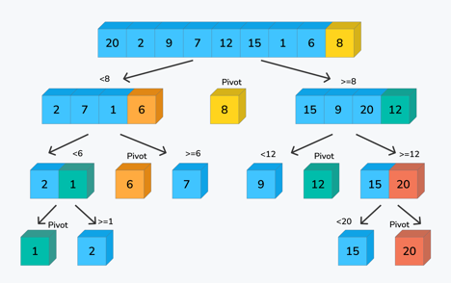
1
Find K-th largest number in the array
Different solutions: Time complexity
1. Go through array K times. O(K*N)
2. Sort array – and return arr[N-K] O(N*lg(N))
3. build a max-heap - and do K pop-s O(N) + O(K*lg(N))
4. use partitioning method (see below) O(2N)
similar to quicksort / binary search
def _partition(arr, low, high):
pivot = arr[high]
index = low
for j in range(low, high):
if arr[j] <= pivot:
arr[index], arr[j] = arr[j], arr[index]
index += 1
arr[index], arr[high] = arr[high], arr[index]
return index
def findKthLargest(arr, k):
left = 0
right = len(arr) - 1
while left <= right:
pivotIndex = _partition(arr, left, right)
if pivotIndex == (len(arr) - k) :
return arr[pivotIndex]
elif pivotIndex > (len(arr) - k) :
right = pivotIndex - 1
else:
left = pivotIndex + 1
return -1
Quick sort is a recursive sorting algorithm.
We randomly select a pivot point (8), and then keep swapping left and right elements so that:
.. all elements to the left of pivot are smaller than it
.. all elements to the right are larger than the pivot point.
Once we done, the pivot point is at its right place in the array.
Then we can select pivot points in left and right portions, do the same swapping, and continue recursively until the whole array is sorted.
To find K-th largest element we follow the quick-sort partitionning-pivoting, but only concentrate on the right potion(s) – because we only need to sort the top K elements. Complexity: N + N/2 + N/4 + ... = O(2N)
- https://www.youtube.com/watch?v=QGVCnjXmrNg
- https://github.com/techleadhd/three-coding-problems/blob/master/largest.py
- https://www.youtube.com/watch?v=XE4VP_8Y0BU

Slide 3
2
Substring Search Algorithms – Brute Force, KMP, Z
1) Brute Force Search
Time complexity O(m*n)
where:
m = length of text
n = length of pattern
3) Z algorithm
Time complexity O(m+n)
Z-array for a string is an array of integers showing
the maximum length of a prefix starting at this position.
The first entry of Z array is meaningless because the
complete string is always its own prefix.
Examples:
str: aabcaabxaaaz
Z : x10031002210
str: aaaaaa
Z : x54321
str: aabaacd
Z : x102100
str: abababab
Z : x0604020
https://www.youtube.com/watch?v=CpZh4eF8QBw
https://github.com/mission-peace/interview/blob/master/src/com/interview/string/ZAlgorithm.java
http://www.geeksforgeeks.org/z-algorithm-linear-time-pattern-searching-algorithm/
http://www.utdallas.edu/~besp/demo/John2010/z-algorithm.htm
2) KMP Substring Search algorithm (Knuth-Morris-Pratt)
Time complexity O(m+n)
Example:
in string: abcxabcdabxabcdabcdabcy
pattern: abcdabcy
algorithm:
1. we try to match.
2. if fail, we see if the end of the partial match can be a beginning of another match - and shift to that point. (look for suffix that can be a prefix)
In actual implementation we first go through the pattern and populate a temporary array of the same length showing where there are potential starting of match points.
For example, for "abcdabcy":
"00001230"
.. https://www.youtube.com/watch?v=GTJr8OvyEVQ
.. https://github.com/mission-peace/interview/blob/master/src/com/interview/string/SubstringSearch.java

Slide 4
3
Substring Search Algorithm – Rabin Karp, Boyer-Moore, Aho-Corasick, ...
4) Rabin Karp (compare rolling hash to pattern hash)
Time complexity O(m+n)..O(m*n)
Good use: detecting plagiarism. Given source material, the algorithm can rapidly search through a text for instances of sentences from the source material.
6) Aho-Corasick algorithm (1975)
Time complexity O(TextLength + Words_Length + N_matches)
A dictionary-matching algorithm.
Was used in original unix fgrep.
Algorithm constructs a finite-state machine that resembles
a trie with additional links between the various internal nodes (to jump fast between failed string matches).
5) Boyer-Moore 1977 (compare ends of strings)
Time complexity O(m+n) or better
This algorithm is used in GNU grep.
It is also provided in C++ Boost, search.go, etc.
It is a standard modern benchmark
.. https://en.wikipedia.org/wiki/Boyer%E2%80%93Moore_string-search_algorithm
Construct "Bad Match Table"
Compare pattern to the text starting from the rightmost character in pattern.
When the mismatch occurs - shift the pattern to the right
corresponding to the value in "Bad Match Table"
str: welcometoteammast # string we searching in
pat: teammast # pattern we searching for
01234567 # 8 - length of pattern
bad: teams* # bad-match table
862318 #
.. https://www.youtube.com/watch?v=G-h1Dph9IOE
Length-Index-1,
fill from left to right, overwriting duplicates
7) Finate state automation
Thompson NFA, awk, grep, Google re2
see on next sldies

Slide 5
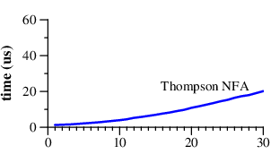
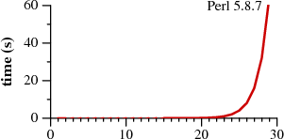
4
Regular Expressions:
"Regular Expression Matching Can Be Simple And Fast
(but is slow in Java, Perl, PHP, Python, Ruby, ...)"
by Russ Cox (2007) - https://swtch.com/~rsc/regexp/regexp1.html
also
- https://swtch.com/~rsc/regexp/regexp2.html
- https://swtch.com/~rsc/regexp/regexp3.html
- https://swtch.com/~rsc/regexp/regexp4.html
Two classes of RegEx engines:
not using backtracking (Thompson NFA, awk, grep, Google re2) NFA (NFDA) = Non-Deterministic Finite Automata
those using backtracking PCRE = Perl Compatible Regular Expressions
Notice (on the graphs) that Perl requires over 60 seconds to match a 29-character string.
Thompson NFA algorithm requires only 20 microseconds to match the same string.
That's not a typo. It is million times faster.
And the trend continues!
For a 100-character string:
Thompson NFA - under 200 microseconds
Perl would require over 10¹⁵ years
Python, PHP, Ruby algorithms are similar to Perl.
micro-seconds
seconds
Graphs of the time to match a?^{n}a^{n} against a^{n}

Slide 6

4
Ken Thompson (the creator of Unix OS) has created his regular expression algorithm in 1968:
"Regular expression search algorithm" http://doi.acm.org/10.1145/363347.363387
Thompson NFA
The machine uses multi-state approach moving forward over all possible paths in parallel.
This results in (at worst) a constant amount of work growing in linear time with the length.
This is a dramatic improvement over the exponential time required by the backtracking approach.
In an NFA with n nodes, there can only be n reachable states at any step, but there might be 2^{n} paths!
"... each character in the text to be searched is examined in sequence against a list of all possible current characters. During this examination a new list of all possible next characters is built. When the end of the current list is reached, the new list becomes the current list, the next character is obtained, and the process continues."

Slide 7
5
Longest Palindromic Substring
Palindrome = symmetric string which reads the same backward as forward, for example: civic, radar, level, rotor, etc.
If you go through a given string and test each character as possible center of a Palindrome, we can easily derive a solution with complexity O(N²). But Manacher has invented a linear time algoriithm in 1975. Time complexity O(N)
Below is a pseudocode.
https://en.wikipedia.org/wiki/Longest_palindromic_substring
https://pipiwiki.com/wiki/Longest_palindromic_substring
Example 1:
Input: "babad"
Output: "bab"
Note: "aba" is also a valid answer.
Example 2:
Input: "cbbd"
Output: "bb"
-- given string S
-- generate S' by inserting a bogus character ('|')
between each character in S (including outer boundaries)
-- Create array P to store the lengths of the palindrome
for each center point in S (initially all 0s)
(S'.length = P.length = 2 × S.length + 1)
-- track the following pointers
(referencing indices in P and S'):
R -> the next element to be examined (initially 0)
C -> the largest/left-most palindrome whose
right boundary is R-1 (initially 0)
i -> the next palindrome to be calculated
(initially 1)
L -> character candidate for comparing with R.
Computed implicitly as: L = i - (R - i)
i' -> the palindrome mirroring i from C.
Computed implicitly as: i' = C - (i - C)
-- while R < P.length:
If i is within the palindrome at C (Cases 1 and 2):
Set P[i] = P[i'] (else P[i] is set to 0)
Expand the palindrome at i (primarily Cases 2 and 3; can be skipped in Case 1, though we have already shown that S'[R] S'[L] because otherwise the palindrome at i' would have extended at least to the left edge of the palindrome at C):
while S'[R] == S'[L]:
increment P[i]
increment R
If the palindrome at i extends past
the palindrome at C:
Update C = i
increment i
return max(P)

Slide 8
6
Longest Palindromic String from Characters
Given a string s which consists of lowercase or uppercase letters,
return the length of the longest palindrome that can be built with those letters.
Letters are case sensitive, for example, "Aa" is not considered a palindrome here.
def longestPalindrome(s):
hash = set()
for c in s:
if c not in hash:
hash.add(c)
else:
hash.remove(c)
# len(hash) is the number of the odd letters
if len(hash) > 0:
return len(s) - len(hash) + 1
else:
return len(s)

Slide 9
7
Shortest Palindrome
Given a string s, you are allowed to convert it to a palindrome by adding characters in front of it. Find and return the shortest palindrome you can find by performing this transformation.
Example 1:
Input: "aacecaaa"
Output: "aaacecaaa"
Example 2:
Input: "abcd"
Output: "dcbabcd"
On the right there are several solutions.
It may be useful to explore other solutions
using algorithms like KMP, Z, Rabin Karp,
Boyer-Moore, Manachers, etc.
# ----------------------------------------------------
# Runtime: 60 ms, brute force using builtin "s.startswith()"
def shortestPalindrome(s):
r = s[::-1]
for i in range(len(s) + 1):
if s.startswith(r[i:]):
return r[:i] + s
# ----------------------------------------------------
# Runtime: 412 ms
def shortestPalindrome(s):
for i in range(len(s), -1, -1):
if s[:i] == s[:i][::-1]:
return s[i:][::-1] + s
# ----------------------------------------------------
# Runtime: 396 ms
def isPalin(s):
return s==s[::-1]
def shortestPalindrome(s):
if isPalin(s):
return s
add = ''
while not isPalin(s):
add += s[-1]
s = s[:-1]
return add + s + add[::-1]

Slide 10
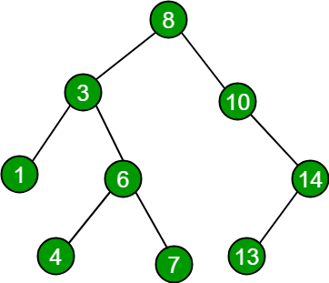
8
Find depth of a binary tree
# ---------------------------
# class TreeNode:
# def __init__(self, x):
# self.val = x
# self.left = None
# self.right = None
# -------------------------------------------------------
# Recursive solution:
def maxDepth(root):
if root == None:
return 0
return max(maxDepth(root.left), maxDepth(root.right)) + 1
# -------------------------------------------------------
# Iterative solution:
def maxDepth(root):
if root == None:
return 0
nodeStack = [root];
depthStack = [1];
maxDepth = 0;
while len(nodeStack)>0:
node = nodeStack.pop();
depth = depthStack.pop();
maxDepth = max(maxDepth, depth)
if node.left != None:
nodeStack.append(node.left)
depthStack.append(depth+1)
if node.right != None:
nodeStack.append(node.right)
depthStack.append(depth+1)
return maxDepth

Slide 11
9
Invert Binary Tree
4 4
/ \ / \
2 7 ==> 7 2
/ \ / \ / \ / \
1 3 6 9 9 6 3 1
class TreeNode():
def __init__(self, x):
self.key = x
self.left = None
self.right = None
def inv_tree_recurs(tmp):
if tmp:
tmp.left, tmp.right = (
inv_tree_recurs(tmp.right),
inv_tree_recurs(tmp.left)
)
return tmp

Slide 12
10
Binary Search Tree Checker
INT_MAX = int(4e9)
INT_MIN = -int(4e9)
# -----------------------------------------------------
class Node:
def __init__(self, data):
self.data = data
self.left = None
self.right = None
# -----------------------------------------------------
def check_bst_valid(node, mini, maxi):
if node is None: # empty is True
return True
if node.data < mini or node.data > maxi:
return False
return (
check_bst_valid(node.left, mini, node.data -1)
and
check_bst_valid(node.right, node.data+1, maxi) )
# -----------------------------------------------------
root = Node(4)
root.left = Node(2)
root.right = Node(5)
root.left.left = Node(1)
root.left.right = Node(3)
if (check_bst_valid(root, INT_MIN, INT_MAX)):
print("Is BST")
else:
print("Not a BST")
Write a function to check that a binary tree of integer numbers is a valid binary search tree.
Careful: checking a node against its parent isn't sufficient to prove...

Slide 13
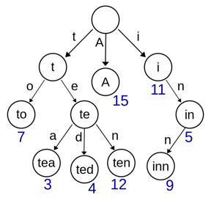
11
Suggest Word Completion Using Trie Structure
from techlead - interview problems
.. https://www.youtube.com/watch?v=QGVCnjXmrNg
.. https://github.com/techleadhd/three-coding-problems/blob/master/autocomplete.py
class Solution:
def __init__(self):
self.trie = None
def build(self, words):
self.trie = Node({}, False)
for word in words:
current = self.trie
for char in word:
if not char in current.children:
current.children[char] = Node({}, False)
current = current.children[char]
current.isWord = True
def autocomplete(self, prefix):
current = self.trie
for char in prefix:
if not char in current.children:
return []
current = current.children[char]
return self._findWordsFromNode(current, prefix)
def _findWordsFromNode(self, node, prefix):
words = []
if node.isWord:
words += [prefix]
for char in node.children:
words += self._findWordsFromNode(
node.children[char],
prefix + char)
return words
class Node:
def __init__(self, children, isWord):
self.children = children
self.isWord = isWord
s = Solution()
s.build(['dog','dark', 'cat', 'door', 'dodge'])
print(s.autocomplete('do')) # ['dog', 'door', 'dodge']

Slide 14
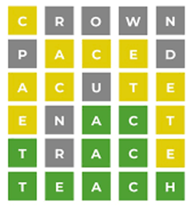
12
Wordle
Wordle is a web-based word game created and developed by Welsh software engineer Josh Wardle, and owned and published by The New York Times Company since 2022
You’re asked to guess the word of the day, which is a five-letter word in English.
If you guess wrong, you’re given a few hints:
a letter in the word is green if your guess for that letter in that position is right;
a yellow letter if that letter is present in the word, but not that position;
and gray, if the letter is not in the word at all.
3Blue1Brown on YouTube
Solving Wordle using information theory
https://www.youtube.com/watch?v=v68zYyaEmEA
Oh, wait, actually the best Wordle opener is not “crane”
https://www.youtube.com/watch?v=fRed0Xmc2Wg
Solver tries to rank possible guesses, and propose the best guess on every step. We have dictionary of words.
We also know frequency distribution of words and characters.
When we select a word, we want to get two things:
maximum information gain
minimum remaining uncertanity
We want to calculate several (at least two) steps ahead.
Some top initial guesses:
slane
slate
salet – winner after multiple simulations
trace
crate
reast
carle
roast
torse
carse
carte
toile
...

Slide 15
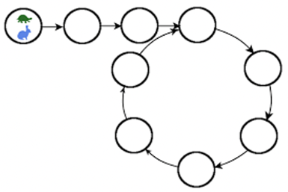
13
Cycle in Linked List ?
class Node:
def __init__(self, data, next):
self.data = data
self.next = next
class LinkedList:
def __init__(self):
self.head = Node(None, None) # sentinel node!
self.head.next = self.head # link it to itself
def add(self, data):
self.head.next = Node(data, self.head.next)
def check_cycle(head):
slowPointer = aa.head
fastPointer = aa.head.next
while fastPointer != None and fastPointer.next != None:
fastPointer = fastPointer.next.next
slowPointer = slowPointer.next
print(id(fastPointer),id(slowPointer))
if fastPointer == slowPointer:
return True
return False
aa = LinkedList()
for ii in range(10): aa.add(ii)
bb = aa.head.next
while bb.data:
print(bb.data)
bb = bb.next
check_cycle(aa.head)
Idea: Rabbit & Turtle.
Let's make two variables, slow_runner and fast_runner.
The slow_runner advances one node, while fast_runner advances two nodes.
If there is no cycle, rabit will finish ahead of turtle.
If there is a cycle, both will go in circles, rabit gaining 1 step at a time - and eventually catch up with turtle.
Complexity : O(n) time and O(1) space

Slide 16
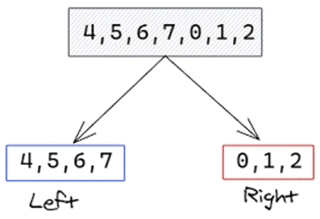
14
Find The Rotation Point In An Array
Given rotated array of words, find rotation point
(in this case it is index of "aa"):
arr = [mm nn oo pp qq aa bb cc dd]
Solution - use binary search comparing with arr[0].
Complexity - O(lg(n))
def find_rotation_point(words):
first_word = words[0]
floor_index = 0
ceiling_index = len(words) - 1
while floor_index < ceiling_index:
# Guess a point halfway between floor and ceiling
guess_index = floor_index + ((ceiling_index - floor_index) / 2)
# If guess comes after first word or is the first word
if words[guess_index] >= first_word:
# Go right
floor_index = guess_index
else:
# Go left
ceiling_index = guess_index
# If floor and ceiling have converged
if floor_index + 1 == ceiling_index:
# Between floor and ceiling is where we flipped to the beginning
# so ceiling is alphabetically first
return ceiling_index

Slide 17

15
Single Riffle Shuffle
Write a function to tell us if a deck of cards is a single riffle of two other halves half1 and half2.
def is_single_riffle(half1, half2, shuffled_deck):
half1_index = 0
half2_index = 0
half1_max_index = len(half1) - 1
half2_max_index = len(half2) - 1
for card in shuffled_deck:
# if we still have cards in half1
# and the "top" card in half1 is the same
# as the top card in shuffled_deck
if half1_index <= half1_max_index and \
card == half1[half1_index]:
half1_index += 1
# if we still have cards in half2
# and the "top" card in half2 is the same
# as the top card in shuffled_deck
elif half2_index <= half2_max_index and \
card == half2[half2_index]:
half2_index += 1
# if the top card in shuffled_deck doesn't match the top
# card in half1 or half2, this isn't a single riffle.
else:
return False
# all cards in shuffled_deck have been "accounted for"
# so this is a single riffle!
return True

