Slide 1
DOC Generation with Python
(Skip MS office SUITE and become the master of your own files)

Slide 2

Irina Dimitrov
Health Care Management
Data Science and Data Analysis
FP&A (Financial Planning & Analysis)
Live in Chicago (US)

Slide 3
Table of contents:
Generate Word doc with text, image and table
Generate Excel file with cells, content and image/graph
Generate pdf file with text, image/logo, and various other sections
Generate a powerpoint file with 2 slides which include text and image

Slide 4
Generate Your own docs with Python
Why:
Automate
1. Document generation
2. Reporting
3. Invoicing
Avoid constant updates of MS Office
Use consistent templates across departments (content, logos, pricing, etc)
Avoid duplicative work

Slide 5
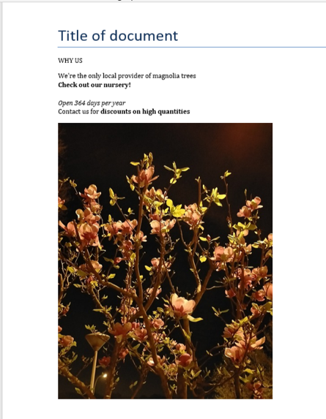
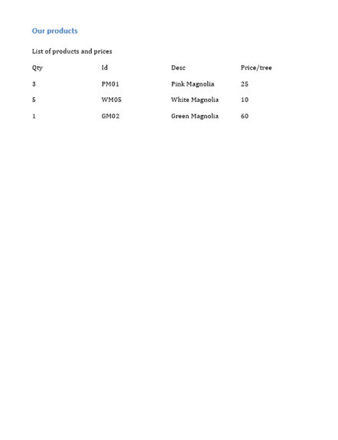
Create a Word doc

Slide 6

Create a Word doc
Use python-docx library
pip install python-docx
from docx import Document
#if you want to add pics
from docx.shared import Inches
doc = Document()
#create title
doc.add_heading('Title of document', 0)
doc_para = doc.add_paragraph("We're the only local provider of magnolia trees")
# add a run i.e, style like
# bold, italic, underline, etc.
doc_para.add_run('\nCheck out our nursery!').bold = True
doc_para.add_run('\n')
doc_para.add_run('\nOpen 364 days per year').italic = True

Slide 7
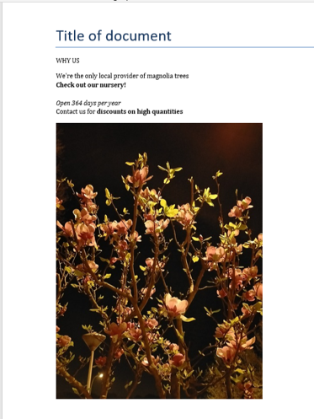
Create a Word doc_continued
#if you want to add another paragraph before any other created previously
first_para = doc_para.insert_paragraph_before('WHY US’)
# optional: doc.add_picture('path_to_picture')
#or
# doc.add_picture('image-filename.png', width=Inches(1.0))
doc.add_picture('C:/temp/magnolia_at_night.jpg', width=Inches(4.75))
https://python-docx.readthedocs.io/en/latest/user/quickstart.html#adding-a-picture

Slide 8
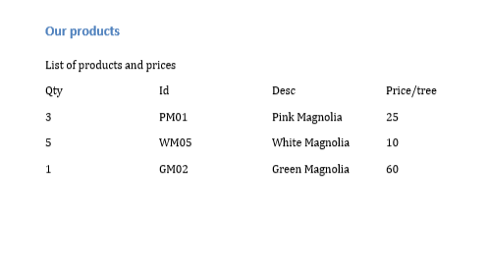
Create a Word doc_continued
doc.add_page_break()
doc.add_heading('Our products', 2)
doc_para2 = doc.add_paragraph('\nList of products and prices ')
https://python-docx.readthedocs.io/en/latest/user/quickstart.html

Slide 9
Create a Word doc_continued
# optional: create table; start with variable for list of flowers
records = (
(3, 'PM01', 'Pink Magnolia', 25),
(5, 'WM05', 'White Magnolia', 10),
(1, 'GM02', 'Green Magnolia', 60)
)
table = doc.add_table(rows=1, cols=4)
hdr_cells = table.rows[0].cells
hdr_cells[0].text = 'Qty'
hdr_cells[1].text = 'Id'
hdr_cells[2].text = 'Desc'
hdr_cells[3].text = 'Price/tree'
for qty, id, desc, price in records:
row_cells = table.add_row().cells
row_cells[0].text = str(qty)
row_cells[1].text = id
row_cells[2].text = desc
row_cells[3].text = str(price)
https://www.codetd.com/en/article/7092452

Slide 10
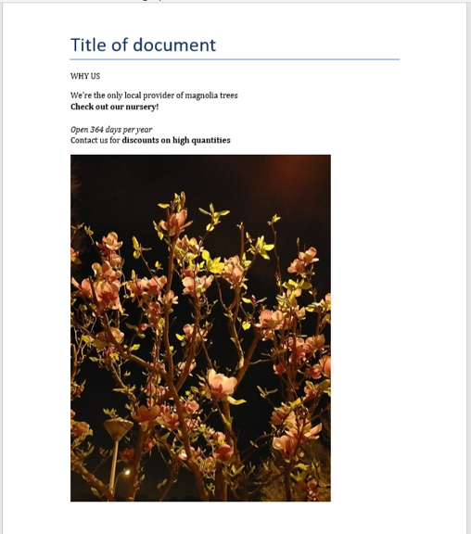
Create a Word doc_continued
https://python-docx.readthedocs.io/en/latest/user/quickstart.html

Slide 11
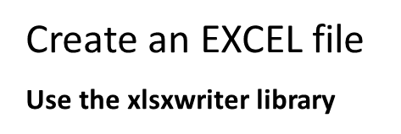
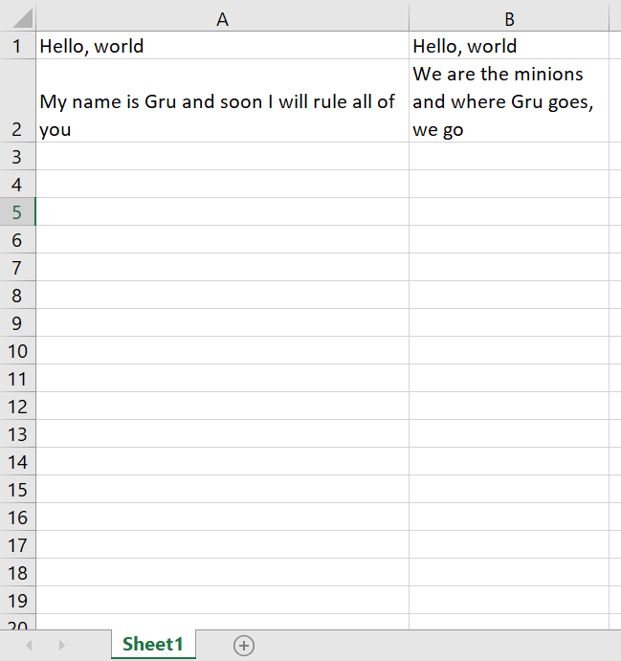

import xlsxwriter
#define workbook object with output file location
workbook = xlsxwriter.Workbook('hello.xlsx')
#create worksheet in the workbook
worksheet = workbook.add_worksheet()
#add text to cell
worksheet.write('A1', 'Hello, world')
worksheet.write('A2', 'My name is Gru and soon I will rule all of you')
worksheet.write('B1', 'Hello, world')
worksheet.write('B2', 'We are the minions and where Gru goes, we go')
workbook.close()
Tutorial 2: Adding formatting to the XLSX File — XlsxWriter Documentation

Slide 12
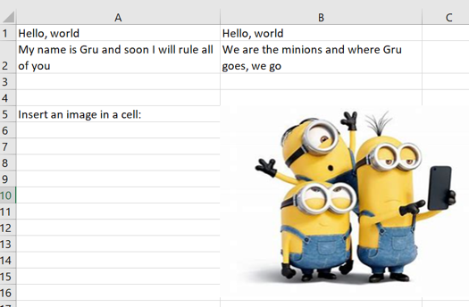
Create an EXCEL file_continued
Use the xlsxwriter library
# widen the target column to make the text clearer.
worksheet.set_column('A:A', 30)
# Insert an image.
worksheet.write('A5', 'Insert an image in a cell:')
worksheet.insert_image('B5', 'C:/Users/Irina/Desktop/Minions_pic.png’)
https://xlsxwriter.readthedocs.io/example_images.html

Slide 13
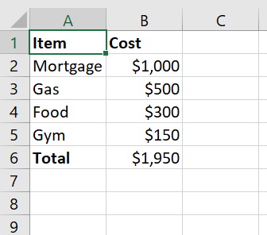
Create an EXCEL file _ continued
# Create a workbook and add a worksheet.
workbook = xlsxwriter.Workbook('Expenses02.xlsx')
worksheet = workbook.add_worksheet()
# Add a bold format to use to highlight cells.
bold = workbook.add_format({'bold': True})
# Add a number format for cells with money.
money = workbook.add_format({'num_format': '$#,##0'})
# Write some data headers.
worksheet.write('A1', 'Item', bold)
worksheet.write('B1', 'Cost', bold)

Slide 14
Create an EXCEL file _ continued
expenses = (
['Mortgage', 1000],
['Gas', 500],
['Food', 300],
['Gym', 150],
)
# Start from the first cell below the headers.
row = 1
col = 0
# Iterate over the data and write it out row by row.
for item, cost in (expenses):
worksheet.write(row, col, item)
worksheet.write(row, col + 1, cost, money)
row += 1
https://xlsxwriter.readthedocs.io/tutorial02.html

Slide 15
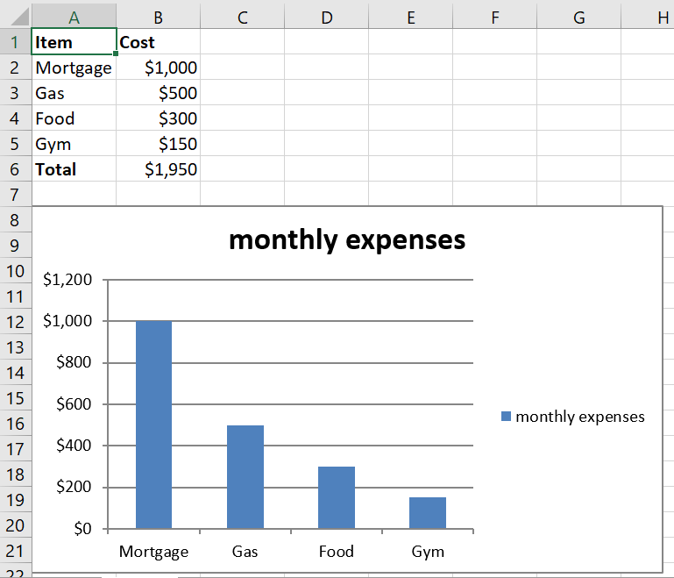
Create an EXCEL file _ continued
# Write a total using a formula.
worksheet.write(row, 0, 'Total', bold)
worksheet.write(row, 1, '=SUM(B2:B5)', money)
#to add a chart, use the chart class and add_chart method
chart = workbook.add_chart({‘type’: ‘column’})
# Configure the chart with one or more data series.
chart.add_series({'name': 'monthly expenses','categories': '=Sheet1!$A$2:$A$5', 'values': '=Sheet1!$B$2:$B$5'})
#insert chart class as an embedded chart
worksheet.insert_chart(‘A8’, chart)
workbook.close()
https://www.tutorialspoint.com/python_xlsxwriter/python_xlsxwriter_quick_guide.htm

Slide 16
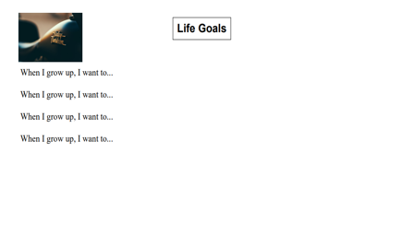
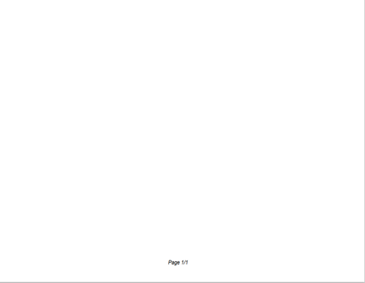
CREATE a PDF file - Use fpdf library
Pip install fpdf in your jupyter notebook or Powershell
from fpdf import FPDF
def header(self):
# Logo
self.image('C:/Users/Irina/Desktop/Motorcycle.jpg', 10, 8, 33)
# Arial bold 15
self.set_font('Arial', 'B', 15)
# Move to the right
self.cell(80)
# Title
self.cell(30, 10, 'Life Goals', 1, 0, 'C')
# Line break
self.ln(20)
https://pyfpdf.readthedocs.io/en/latest/Tutorial/index.html

Slide 17
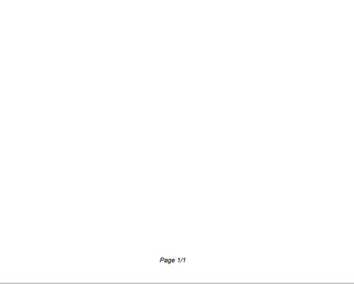
Create a PDF file_continued
# Page footer
def footer(self):
# Position at 1.5 cm from bottom
self.set_y(-15)
# Arial italic 8
self.set_font('Arial', 'I', 8)
# Page number
self.cell(0, 10, 'Page ' + str(self.page_no()) + '/{nb}', 0, 0, 'C')

Slide 18
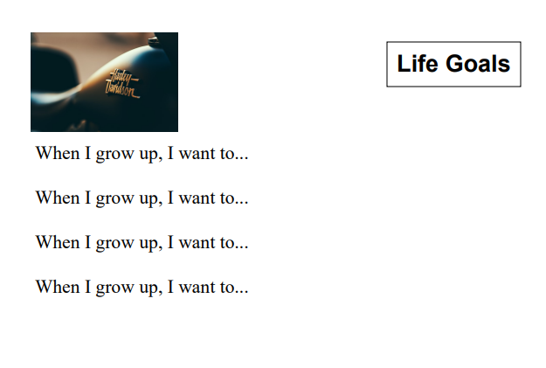
Create a PDF file_continued
# Create an instance of the PDF class
pdf = PDF()
#call the alias_nb_pages method to define the total number of pages (set to default nb)
pdf.alias_nb_pages()
pdf.add_page()
pdf.set_font('Times', '', 12)
#print cell with w, h, text, border and line/position
for i in range(1, 5):
pdf.cell(0, 10, 'When I grow up, I want to... ', 0, 1)
pdf.output('Test1.pdf', 'F')
https://pyfpdf.readthedocs.io/en/latest/index.html

Slide 19
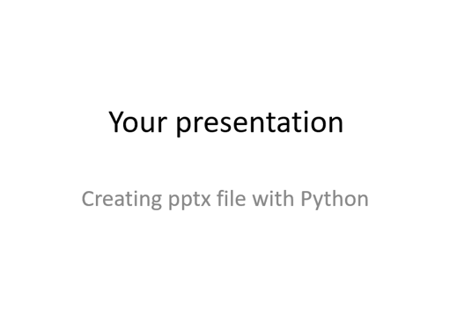
Create a Powerpoint presentation with the pptx library
from pptx import Presentation
#create presentation object
root = Presentation()
#create slide layout
first_slide_layout = root.slide_layouts[0]
#create slide object
slide = root.slides.add_slide(first_slide_layout)
slide.shapes.title.text = " Your presentation"
#add a placeholder with index of 1; you can change the index for a different design
slide.placeholders[1].text = " Creating pptx file with Python“
root.save("Output1.pptx")
https://python-pptx.readthedocs.io/en/latest/user/quickstart.html

Slide 20
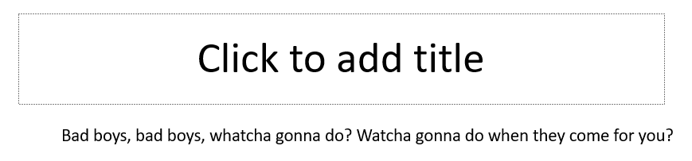
create a powerpoint presentation_continued
#add second slide
second_layout = root.slide_layouts[5]
second_slide = root.slides.add_slide(second_layout)
#comes with default textbox for title but you can create it as shown in previous slide
#add textbox and text
textbox = second_slide.shapes.add_textbox(inches(1), inches(1.5),inches(3), inches(3))
textframe = textbox.text_frame
paragraph = textframe.add_paragraph()
paragraph.text = “Bad boys, bad boys, whatcha gonna do? watcha gonna do when they come for you?"

Slide 21
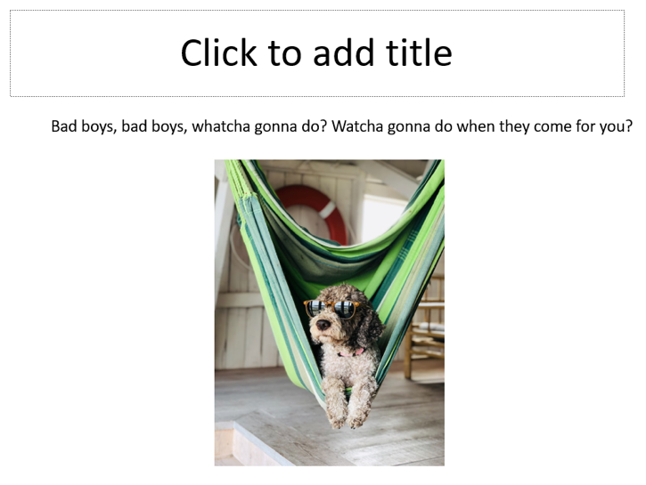
create a powerpoint presentation_continued
#add image to second slide
img_path = 'C:/Users/Irina/Downloads/Dog_sunglasses.jpg’
#positioning
left = Inches(3.5)
top = Inches(2.5)
#picture size
height = Inches(4.5)
pic = second_slide.shapes.add_picture(img_path, left, top, height=height)
root.save(‘Output1.pptx')
https://python-pptx.readthedocs.io/en/latest/user/quickstart.html

Slide 22
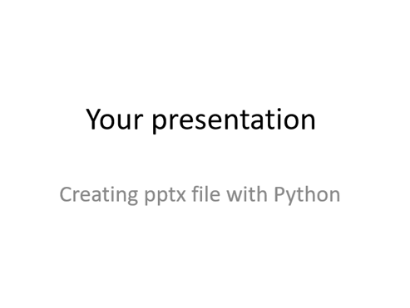

Create a powerpoint presentation_continued
https://python-pptx.readthedocs.io/en/latest/user/quickstart.html

Slide 23
Summary
Generated word doc with text, image and table
Generated excel file with cells, content and image/graph
Generated pdf file with text, image/logo, and various other sections
Generated a powerpoint file with 2 slides which include text and image
For any questions, contact Irina at fcr_irina@yahoo.com

