Slide 1

Data Analytics in Baseball & Effectiveness of Shifting in Major League Baseball
Mark Kaplan
Notes:
Modern Baseball strategy is increasingly using “The Shift” (moving infielders to a particular side of the field based on the hitting tendencies of a particular batter) placing fielders in optimal positions to prevent hits.
We look to assess the effect on this shift on Batting Average on Balls in Play (BABIP) over time, as well as on individual offensive stats during the 2017 season.
Our study does so with several methods, including visual graphs, statistical comparisons, and machine learning methods.
We conclude that while the shift is effective in preventing ground ball hits, it may have several unintended consequences that could negatively affect the defensive team.
We find that The Shift effectively has reduced opposing BABIP over time, and in 2017 negatively impacted a batter's strikeout rate, BABIP, batting average and isolated power, but also led to increases in walks, strikeouts-minus-walks and weighted On-Base-Average.

Slide 2
Statistics in Baseball
In 2021, the combined revenue of all Major League Baseball teams was 9.56 billion U.S. dollars, with each team looking for as many competitive advantages as possible
Modern baseball strategy is largely data-driven, and tactics are employed based on statistical analysis, as opposed to relying on “tradition” or “feel.”
The move from “tradition/feel” based tactics occurred in the late 1990’s in what is known as the Sabermetric or Moneyball revolution

Slide 3




Key Figures in Statistical Revolution
Billy Beane
Bill James

Slide 4
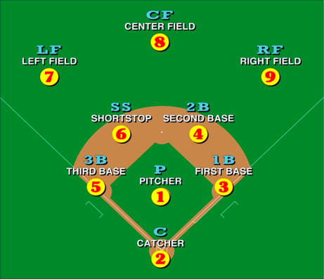
Background on my research
Throughout the past decades, baseball teams generally have positioned their defensive players in an alignment known as “straight-up,” as shown in this picture.
With the advent of modern-tracking technology (radar & video), and the baseball data-driven revolution, teams are moving away from traditional defensive positioning and are starting to employ more granular positioning based on the offensive profile of each batter. These positionings are collectively known as “the shift.”
Notes:
Throughout the past decades, baseball teams generally have positioned their defensive players in an alignment known as “straight-up,” as shown in the following picture.

Slide 5
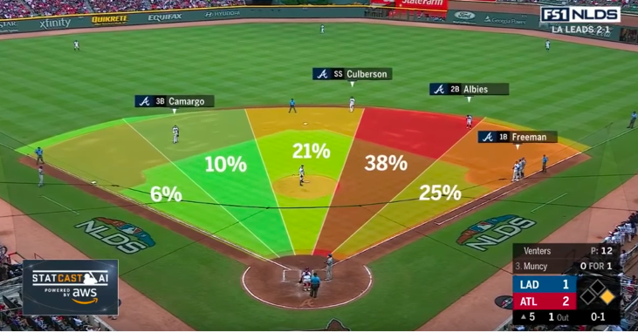
The following image is another example of a shift against a batter, with an overlay of the distribution of the batters’ balls in play. As one can see, this lefty batter clearly prefers one particular side, and the defense is accordingly positioned
Notes:
The following image is another example of a shift against a lefty, with an overlay of the distribution of the batters’ balls in play. As one can see, this lefty batter clearly prefers his pull side, and the defense is accordingly positioned.
Right-handed batters, who stand in the batter’s box on the left side of the field, are “shifted on” at much lower rates. This is due to several different reasons, the discussion of which is outside the scope of this proposal.

Slide 6
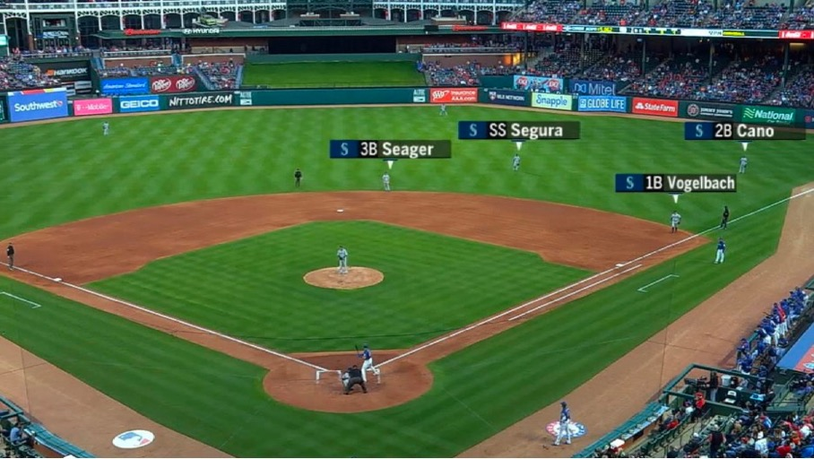
Notes:
The most common shift seen in baseball is employed when left-handed batters are at bat.
Left-handed batters stand in the batter’s box on the right side of the field and are generally assumed to favor hitting the ball towards the right side of the field, called the “lefty pull side,” as opposed to the left side of the field which is called “the lefty opposite side.”
The following image portrays a left handed batter and the shift employed against him.

Slide 7
Research Goal
Effectiveness of Shift in preventing offensive production
Effect on BABIP as shift increases over time period 2016 - 2019
Effect on other defensive statistics within a single season

Slide 8
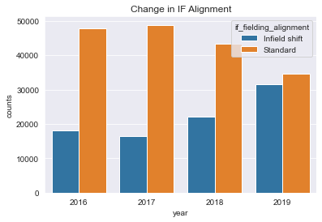
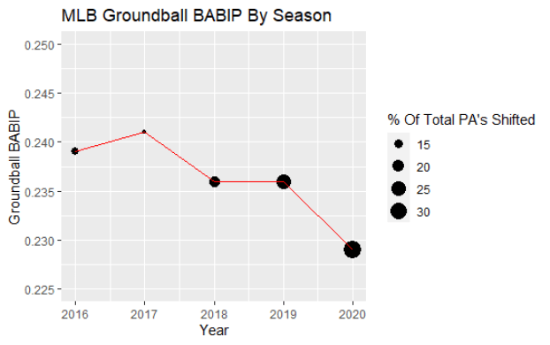
The effect of Shift on BABIP
Notes:
As shown, with Shift Percentage increasing year over year, the groundball BABIP decreases, thus showing that the shift is effective in decreasing ground ball hits.

Slide 9
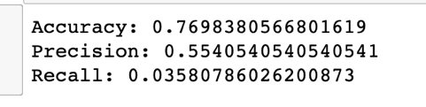
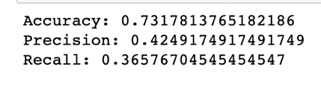
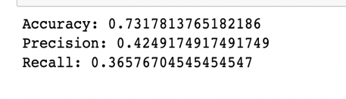
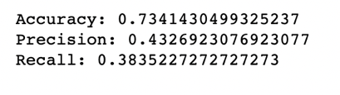
Does infield alignment affect hit probability?
Linear Regression, no shift data vs shift data
Decision Tree

Slide 10
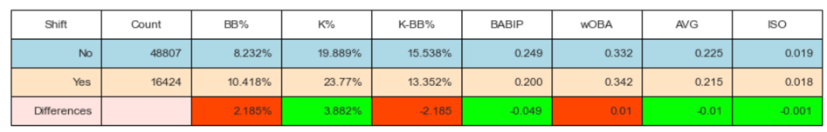
2017 Offensive Stats
The second analysis we perform is the effect of shifting on offensive stats.
We looked at strikeout and walk rate, BABIP, Batting Average, weighted On Base Average and Isolated Power

Slide 11
Conclusion
We found that there is strong correlational relationship between a defensive shift against left-handed batters and a decreased BABIP for the opposing batter, but came short of a statistically significant causation. We also found that there were statistical changes to offensive hitters when faced with a shift. We successfully answered our original research question of determining if a shift in defensive formation affects BABIP.
We found that as shifted defenses increased, ground ball BABIP decreased, demonstrating that the strategy is effective at combating lefty hitters.
We found that a switch to shift coverage against left handed hitters in the 2017 season negatively impacted a batter's strikeout rate, BABIP, batting average and isolated power, but also led to increases in walks, strike-outs-minus-walks and wOBA. We found much smaller changes in other indivigual offensive statistics such as hit direction (Pull, Cent, Oppo) and exit velocity (HARD), concluding that in our analysis we could not find significant changes in the ways that hitters approach at-bats.

Slide 12
Additional Questions and Further Research
The question of defensive infielding shifts against lefty batters is a constantly debated, scrutinized and researched question in professional baseball.
In the future, work could be done on how pitch count affects the the shifted infields effectiveness. Perhaps it is more effective with a full count than on the first pitch. Another question could be how do infielding shifts affect right handed batters. Finally, work could be done on
Ultimately, we demonstrated the effect of the defensive shift against left handed batters on BABIP and other offensive measures, and believe that there is a multitude of interesting research yet to be done on the subject.

