Slide 1

Generating Diagrams with Code
Graphviz and dot

Slide 2

Why create diagrams?
Collaboration
Defining a clear vision
Identify short comings
Communicating
Documentation

Slide 3
Types of tech diagrams
Database ERD
UML
Flowcharts
Wireframes
Dataflow
Architecture

Slide 4
Diagramming Solutions
Microsoft Visio
LucidChart
Draw.io
Miro
Others

Slide 5
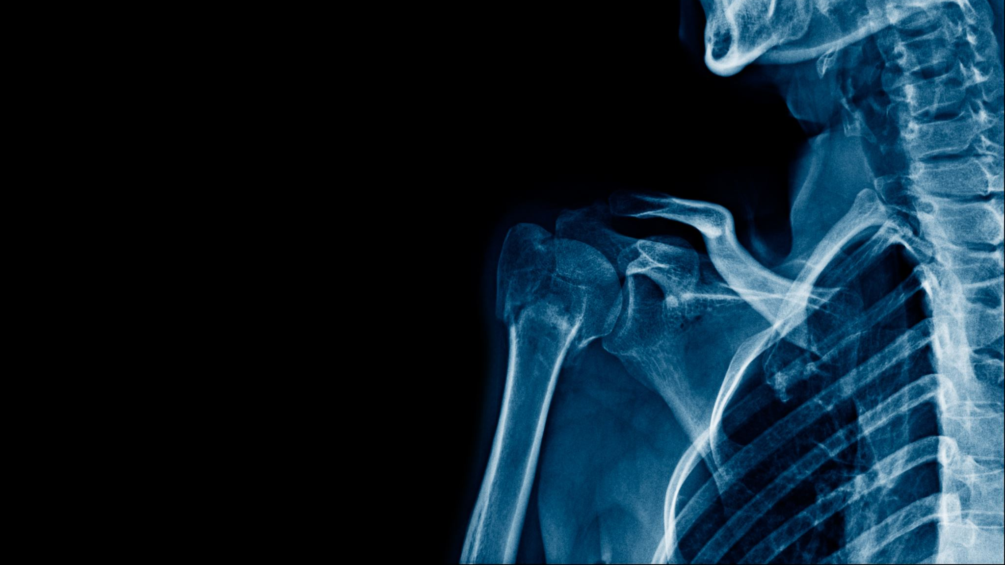
Pain in the neck
Drag, click, type

Slide 6

Is there another way?
Diagrams as code
Notes:
Why diagram with code?
- Version control
Ease

Slide 7
Introducing dot and Graphviz
- Another Bell Labs project

Slide 8

Why diagram with code?
Simple
Version Control
Efficiency

Slide 9
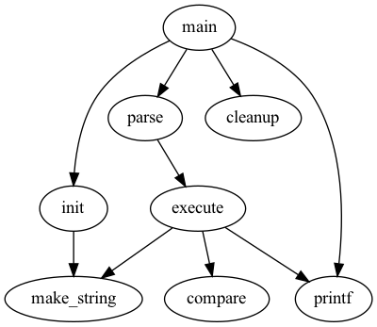
Simple code generates diagrams
digraph G {
main -> parse -> execute;
main -> init;
main -> cleanup;
execute -> make_string;
execute -> printf;
init -> make_string;
main -> printf;
execute -> compare;
}

Slide 10
Core concepts
Nodes
Edges
Graphs/Subgraphs
Attributes

Slide 11
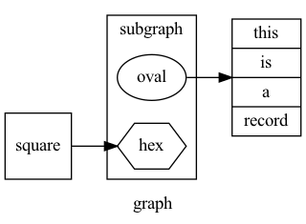
Graphs/Subgraphs
digraph
Edges have direction
Coded “->”
graph
Edges may be be ‘directionless’
subgraph
Rank all contained nodes together
cluster
Subgraph bounded by line

Slide 12

Graphs/Subgraphs
digraph test_graph{
label=Example
}

Slide 13

Nodes
Basic objects
Three main types:
Shapes
Record-based
User defined
Ports
Compass directions

Slide 14
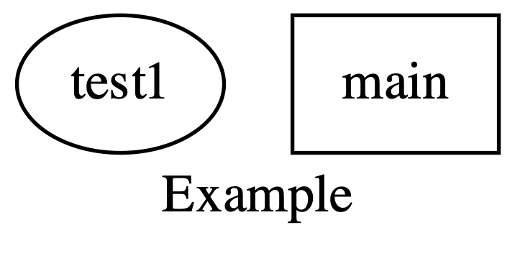
Nodes
digraph test_graph{
label=example
test [ label="test1” ]
main [shape=box];
}

Slide 15
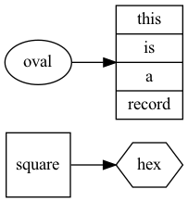
Edges
Connect objects
Parts:
Head
Tail
Label
Shape

Slide 16
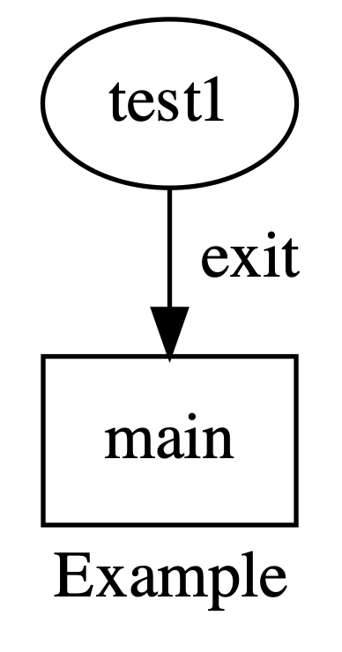
Edges
digraph test_graph{
label=Example
test [
label="test1"
]
main [shape=box];
test -> main [headlabel="exit”
labeldistance=2.7 labelangle=-40]
}

Slide 17
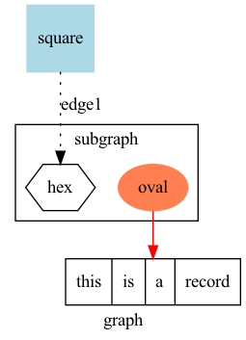
Attributes
For object enhancement
Apply to graphs, nodes, edges
Examples:
Shape
Style
Color
Label
More

Slide 18
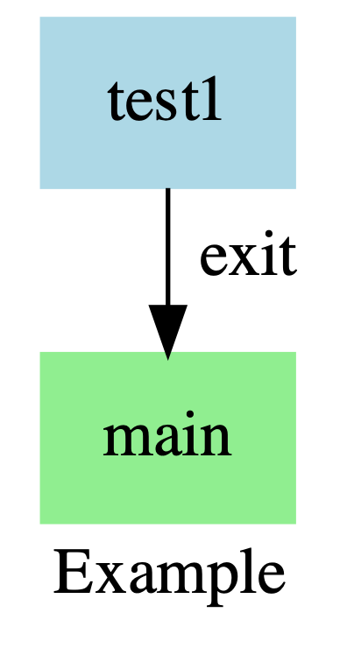
Attributes
digraph test_graph{
label=Example
node [ shape="rectangle"
color="lightblue"
style="filled"]
test [ label="test1"; ]
main [ shape=box; color=lightgreen];
test -> main [headlabel="exit”
labeldistance=2.7 labelangle=-40]
}

Slide 19
Demonstration

Slide 20
Resources
Graphviz.org
Drawing graphs with Dot
Gallery

Slide 21

Chris von Rabenau
LinkedIn: https://www.linkedin.com/in/cvr/
Email: cgappperi@me.com

