Slide 1

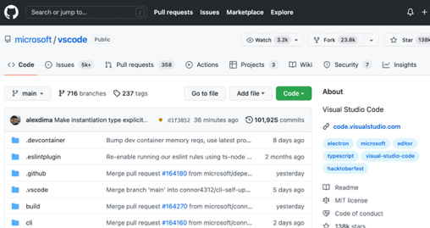
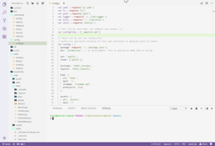
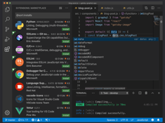
Microsoft Visual Studio Code
Code on GitHub
Editor - Free, open source, on GitHub, since 2015: .. https://github.com/microsoft/vscode .. https://code.visualstudio.com .. https://code.visualstudio.com/docs
Unix-like modular architecture: More than 1,700 contributors !! More than 30,000 extensions on VS Code Market Place .. https://marketplace.visualstudio.com/vscode
More than 70% of Software Developers are currently using it
IntelliSense (code completion, quick info, ...)
Run & Debug, Remote SSH, SQL, Python, ... .. https://code.visualstudio.com/docs/python/jupyter-support-py .. https://learn.microsoft.com/en-us/azure/azure-sql/database/connect-query-vscode
Git built in
Very customizable
Written in Javascript, runs using Electron platform .. https://www.electronjs.org
There are many good tutorials, for example: .. https://www.youtube.com/watch?v=VqCgcpAypFQ
Open Source Development
Linux | VS Code
Kernel Gnu Core Utilities Everything else | Editor Extensions
Light Theme
Dark Theme

Slide 2
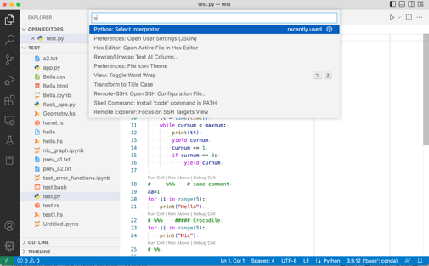
Keyboard Shortcuts
Some shortcuts for MacOS:
cmd-shift-P – find and execute command
cmd-K cmd-R - show keyboard shortcuts
cmd-N – new file
cmd-O - open (folder, file)
cmd-shift-N – new window
cmd-K O – open active file in new window
cmd-B – toggle expansion of the (left) side bar
cmd-J – toggle bottom (terminal) panel
ctrl-shift-` - new terminal
cmd-/ - toggle comments (in python)
cmd-D – select word at the cursor
cmd-P - navigate between files
ctrl-R - switch between projects
cmd-shift-Option + arrows - to select (columnar) blocks of text
cmd-shift-ctrl + arrows - to select content between HTML tags (also expand selection to outer tags)
Option-Q - rewrap the paragrapg or selected text
Option-Z - toggle auto-wrap
cmd-D repeatedly – to select same words – and then change them at once
cmd+arrow – fast movement (top/bottom of file, begin/end of line)
cmd+arrow+shift – fast move + select
option + arrows – move lines up/down
option-shift + arrow – copy the line
option-cmd-[ or ] – fold/unfold block of code
cmd-K cmd-0 – fold everything
cmd-K cmd-J – unfold everything
cmd + arrow right/left – change indentation
Key Bindings: .. https://code.visualstudio.com/docs/getstarted/keybindings
VSCode Shortcuts Tips and Tricks (video): .. https://www.youtube.com/watch?v=jsZoR1kkq6s
Mastering code selection and editing: .. https://www.youtube.com/watch?v=Zgf2vXl5Gkk
menu Help > keyboard shortcuts
menu File > Preferences > Keyboard Shortcuts (on Windows)
menu Code > Preferences > Keyboard Shortcuts (on macOS)
cmd-shift-P – find and execute command

Slide 3



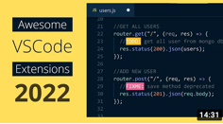
Extensions – more than 30,000
https://code.visualstudio.com/docs/editor/extension-marketplace#
I use the following extensions:
Better Line Select
Python IntelliSense (Pylance), Linting, Debugging (multi-threaded, remote), Jupyter Noteb...
Jupyter (Microsoft)
Jupyter Keymap (Microsoft)
Jupyter Notebook Renderers
Hex Editor (Microsoft)
Remote - SSH (Microsoft)
Save as Root in Remote SSH (yy0931)
Rewrap (stkb)
Render Line Endings (Josip Medved)
Material Icon Theme
Pylance (Microsoft)
IntelliCode (Microsoft)
R Extension ... (REditorSupport)
Prettify JSON
MySQL (DB client by Weijan Chen, supports MySQL/MariaDB, PostgreSQL, SQLite, Redis and ElasticSearch)
Many YouTube Recommendation Videos
Extensions get installed under your home directory
On Mac or Linux. : $HOME/.vscode/extensions/
On Windows : %USERPROFILE%\.vscode\extensions
To list your extensions:
code --list-extensions
code --list-extensions --show-versions

Slide 4
More Extensions
Live Share Extension Pack - live collaboration
Code Snap - make a png image of part of your code
Better Comments - make comments bright
Turbo Console Log - to show/print values
TabNine - AI auto-completion
Prettier - code auto-formatting (on save)
Auto Rename Tag - rename multiple tags at once
Color Brackets - color brackets with different colors
Import Cost - shows the size of package
Git history - ("View History" command) - convenient
GitHub Pull Requests and Issues - by GitHub
ms-azuretools.vscode-docker - Docker
ms-vscode-remote.remote-containers - Dev Containers
ms-vscode.azure-account - Azure Sign In and Subscription
mshdinsight.azure-hdinsight - Spark & Hive Tools
mtxr.sqltools - by Matheus Teixeira - SQL DB management (supports AWS Redshift, CockroachDB, MariaDB, MSSQL, MySQL, PostgreSQL, SQLite, ClickHouse, Google Cloud Spanner, InterSystems IRIS, SAP HANA, Snowflake, Teradata, Trino)
vscodevim.vim - Vim emulation
Auto Close Tag
Liveserver (live node.js server)
ESLint
Snippet
Code Spell Checker
Path Intellisense
Beautify
vscode-icon
REST Client
Material Theme
Todo Highlight
Marquee
Code time
ES7 Snippets
SVG Previewer
Better Line Select
markdown-mermaid - by Matt Bierner – diagram/flowchart for markdown
gera2ld.markmap-vscode - by Gerald Liu – markdown viewer
JSON Viewer - by Mr.Che - see JSON as collapsible tree
JSON Tree View - by chaunceykiwi - Generate a tree view from JSON file
mohsen1.prettify-json -
joaompinto.vscode-graphviz - by João Pinto - GraphViz (dot) language support
efanzh.graphviz-preview - by efanzh - Preview Graphviz (dot) files
geeklearningio.graphviz-markdown-preview - by Geek Learning - Graphviz support to VSCode's builtin markdown preview
stephanvs.dot - by Stephanvs - Graphviz (dot) language support
hediet.vscode-drawio - by Henning Dieterichs - integrates draw.io
jakeboone02.cypher-query-language - by Jake Boone - Syntax highlighting for Neo4j's Cypher Query Language
jebbs.plantuml - by jebbs - UML diagrams (Rich PlantUML support)

Slide 5
Python: Select Interpreter
cmd-shift-P
python interpreter
Python: Select Interpreter

Slide 6
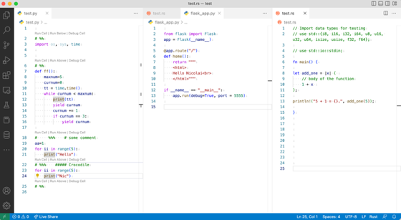
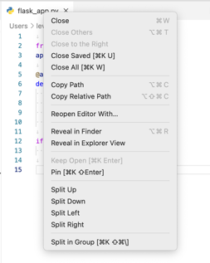
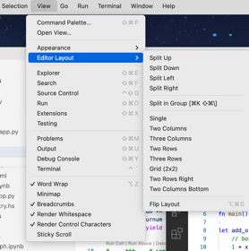

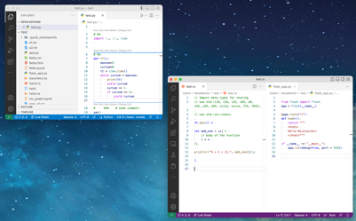
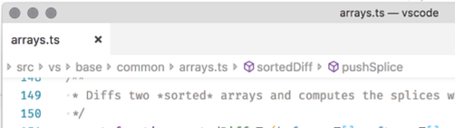
Side-by-side editing
You can drag tabs to split or combine the editing panes
https://code.visualstudio.com/docs/getstarted/userinterface
Split/modify layout cmd-\
Breadcrumbs – clickable path to the file above content
cmd-K O - open active file in a new window
cmd-shift-N - open new window. Then you can drag any tabs into this window

Slide 7
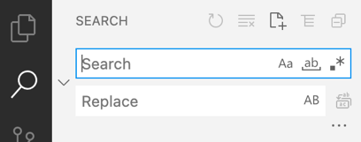
Find / Replace
https://code.visualstudio.com/docs/getstarted/userinterface
Click on search lense on the left
or use cmd-F
Can use case-sensitive, case-insensitive, or regex search

Slide 8
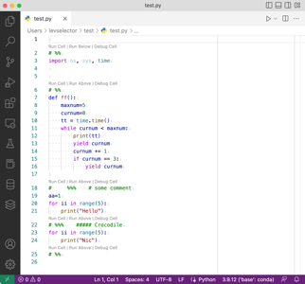
Window Bottom Right Bar
Which Python interpreter I am using
Encoding
Type Checking
Switch Line Endings between Unix or Windows
Syntax Highlighting

Slide 9
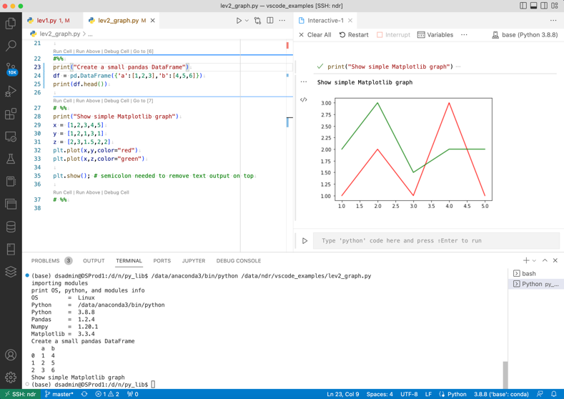
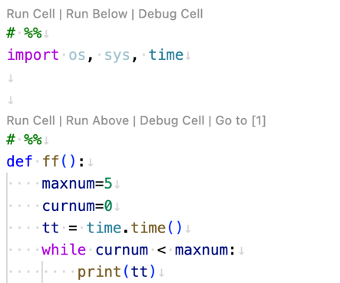
Run Python as Jupyter Cells Using Syntax # %%
In Python you can add special comments # %% to split your code into cells
These cells can be executed separately in any order as in Jupyter notebook
The output will show in a separate tab on the right (which you can save as a jupyter notebook)
You can also run the whole script – and see the output in the terminal at the bottom of the screen
You can use Matplotlib and other graph libraries, and see the graphs right in the VS Code screen
You can associate py and ipynb file extensions with VS Code to use it as default viewer or IDE

Slide 10

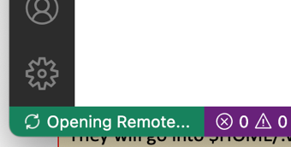
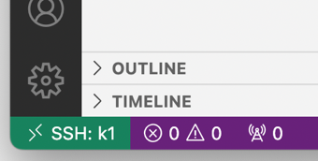
Remote SSH
Edit $HOME/.ssh/config file
For each entry provide something like this:
Host myhost
User myuser
HostName 123.123.123.123 (or abcdef.com)
IdentityFile /Users/levselector/.ssh/myhost/my-ssh-key.pem
Host *
AddKeysToAgent yes
Then from unix prompt you can do commands like these:
ssh myhost
scp test.py myhost:/data/somedir/
scp myhost:/data/somedir/test.py ./
Remote Explorer Icon
Once you install extension "Remote - SSH", you will see a new icon (remote explorer) at the left bar (called activity bar).
When you click on it - it will read SSH config file and show you all your remote hosts. You can then click on the right of them and open SSH connections in separate windows.
Once you connected - there will be a green indicator at the left-bottom
Then you can install Python and other extensions on remote machine.
They will go into $HOME/.vscode-server/ directory on the remote server.
And then you can enjoy working on remote machine
connected to server "k1"

Slide 11
Remote SSH – Edit "root owned" Files
Remote SSH – Bugs – Stale Processes
Install Extension "Save as Root in Remote SSH" (by yy0931)
This Extension adds a command "Save as Root" in the command palette
(F1 or Ctrl+Shift+P or Cmd+Shift+P).
This allows you to edit configuration files with root privileges
while editing files remotely using the Remote - SSH extension.
This extension needs to be enabled on the remote server.
As of this writing (October 2022) using Jupyter or R via Remote SSH can result in stale processes left behind on the server.
I googled this problem - and found multiple discussions of similar problems over the last 3 years, for example: .. https://github.com/microsoft/vscode-jupyter/issues/1626 It looks like VS Code developers have fixed some of the problems, but not all of them - so we should expect to see these problems.
I wrote a script to clean out these processes:
kill_stale_ssh_remote_processes.py
and put it on my github:
github.com/lselector/code_samples/

Slide 12
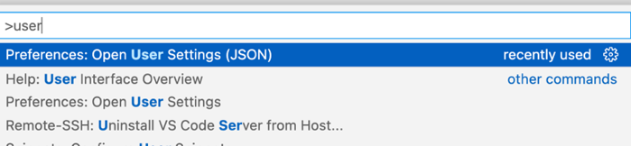
Custom settings
Press cmd-shift-P,
search for settings,
You can select settings via UI or Open User Settings (JSON)
Here are my current Settings (JSON):
{
"editor.minimap.enabled": false,
"security.workspace.trust.untrustedFiles": "open",
"python.defaultInterpreterPath": "/Users/levselector/miniconda3/bin/python",
"terminal.integrated.inheritEnv": false,
"workbench.editor.untitled.hint": "hidden",
"editor.renderWhitespace": "all",
"workbench.colorTheme": "Default Light+",
"workbench.startupEditor": "newUntitledFile",
"editor.rulers": [55,80],
"editor.wordWrap": "on",
"editor.detectIndentation": false,
"editor.insertSpaces": true,
"editor.tabSize": 4,
"workbench.iconTheme": "material-icon-theme",
"[plaintext]": {
"editor.unicodeHighlight.ambiguousCharacters": true,
"editor.unicodeHighlight.invisibleCharacters": true
},
"[markdown]": {
"editor.unicodeHighlight.ambiguousCharacters": true,
"editor.unicodeHighlight.invisibleCharacters": true
},
"editor.bracketPairColorization.enabled": true,
"editor.guides.bracketPairs": "active",
"editor.accessibilitySupport": "off",
"editor.unicodeHighlight.ambiguousCharacters": false,
}

Slide 13


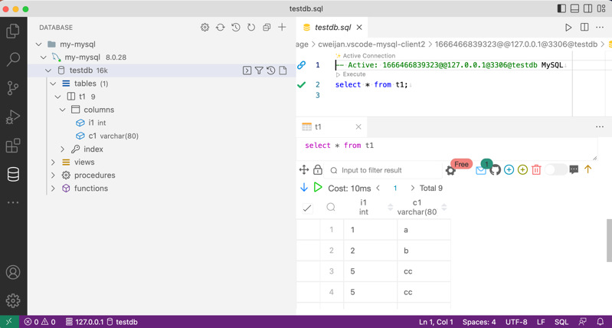
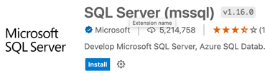
SQL
There are several good SQL extensions
I like MySQL extension by Weijan Chen (it is FREE, but also has some extra features for $20/year)
You can also use SQLTools by Matheus Teixeira
Or for Microsoft SQL Server you can use extension SQL Server (mssql)

Slide 14

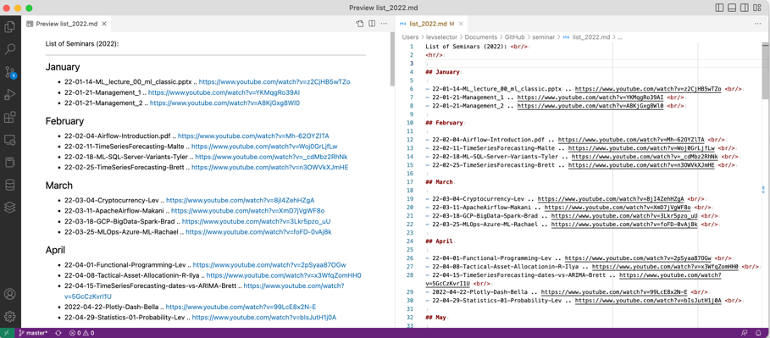
Markdown
https://en.wikipedia.org/wiki/Markdown
https://www.markdownguide.org
https://github.com/adam-p/markdown-here/wiki/Markdown-Cheatsheet
Edit Markdown file
Press Cmd-Shift-V to open Preview
Then drag it to the left to get side-by-side layout
Live Preview
Original Markdown

Slide 15
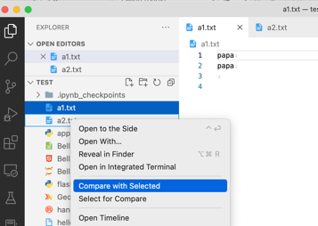
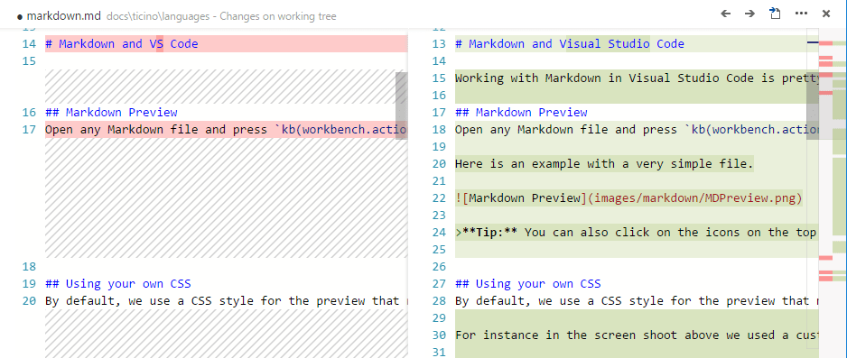
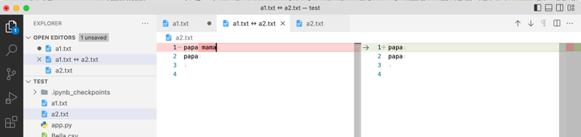
Diff Files – Compare files side-by-side
Git Diff
https://dailydotnettips.com/how-to-compare-files-in-visual-studio-code/
Open both the files in VS Code.
From the left Explorer panel:
.. right-click 1st file and choose Select for Compare
.. right-click 2nd file and choose Compare with Selected
Both files will be opened side-by-side in a new tab
git diff
click on the Git icon on the left bar
double-click on one of the files under Changes

Slide 16
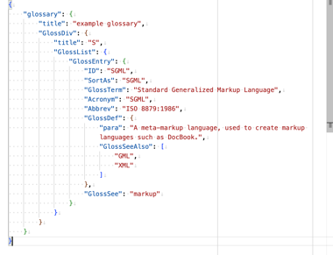
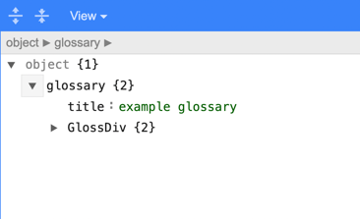
JSON Prettyfier
Wrapping
Auto-Wrapping:
I set wrapping on - it wraps on the right screen Endings
I can toggle this auto wrapping on/off by pressing Option-Z
=======================
Hard wrapping (using extension Rewrap)
Put cursor on line (inside paragraph)
and press Option-Q
Note: if wrapping doesn't work, it maybe because the
module tries to be smart about not-wrapping whole strings.
(depending on language settings).
A simple method to overcome this problem is to tell
the editor that your file type is Plain Text.
To do this click in the bottom-right of the window,
where you can select the file type.
=======================
JSON Interactive Viewer

Slide 17

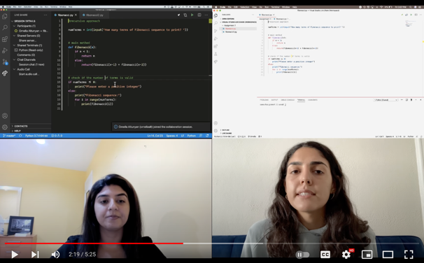
Live Share Extension Pack
https://code.visualstudio.com/learn/collaboration/live-share
Collaboratively edit and debug in real time
Including integrated audio and text chat
Pair programming, remote code reviews, interactive lectures, etc.
Open project, click the Live Share button in your status bar
Enter your GitHub or Microsoft login info
Open the Live Share Sessions Details view – and click the Start audio call ...
A new Live Share Chat will open on the side
You can send the VS Live Share link to another developer – to join
Use "Recent contacts" list in the Live Share Contacts (status, messages, ...)

