Slide 1
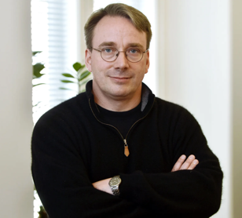
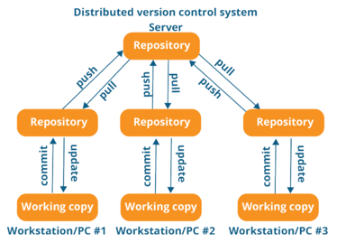




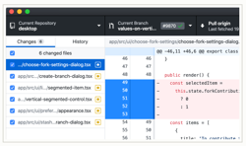
Git
Linus Torvalds has developed Git in 2005
to use in Linux development community.
(before Git they used BitKeeper).
Some of the goals of the new system were:
Speed
Simple design
Strong support for non-linear development (thousands of parallel branches)
Fully distributed
Able to handle large projects like the Linux kernel efficiently (speed and data size)
Linus Torvalds
Linux - https://www.linux.org
Git - https://git-scm.com - https://github.com
GitHub - founded in 2008
Microsoft acquired GitHub for $7.5B in 2018
In 2020:
- 40 Million users
- 190 Million repositories
- 2.5 Thousand employees
GutHub
Desktop
GutHub
Linux
Git

Slide 2
Git – continued …
.gitconfig. (example)
Git is a source control system
- http://git-scm.com
- https://git-scm.com/doc
git config --global user.name "Last, First"
git config --global user.email FLast@example.com
Some files to know:
~/.git-completion.bash
~/.gitconfig
~/.gitexcludes
mkdir ~/workdir
cd ~/workdir
git clone git@github.com:myuser/repo1.git
git clone git@github.com:myuser/repo2.git
cd repo1
edit .gitignore
git add .
git commit -m'soem comment'
git remote add origin git@github.com:myuser/repo1.git
git push -u origin master
git fetch
git pull
git log
...
Check your remote:
git remote -v (base)
origin git@github.com:lselector/ml_ai_doc.git (fetch)
origin git@github.com:lselector/ml_ai_doc.git (push)
(base)
[filter "lfs"]
process = git-lfs filter-process
required = true
clean = git-lfs clean -- %f
smudge = git-lfs smudge -- %f
[user]
name = Lev Selector
email = lev.selector@gmail.com
[credential]
username = lselector
[color]
ui = auto
[alias]
st = status
ci = commit
co = checkout
staged = diff --cached
unstage = reset HEAD --
amend = commit --amend
unci = reset --soft HEAD^
oneline = log --oneline
unstaged = diff
both = diff HEAD
lg = log --graph --pretty=oneline --abbrev-commit --decorate
wdiff = diff --word-diff
[log]
decorate = short
[push]
default = tracking
[branch]
autosetuprebase = always

