Slide 1
2022 Review
Bad Things
Good Things, Abundance, Exponential Growth
AI is the New Electricity
Noble Prize 2022 - Quantum Entanglement
Nuclear Fusion, December 2022
Hubble Telescope – Black Hole Ignites Stars
James Webb Space Telescope
2,4 km Stable Transmission via Laser
Human Genome Gapless Sequence - over 3 Bln base pairs
AlphaFold – shapes of 200 million proteins from 1 million species
Pig-to-Human Heart Transplantation
People of the Year
The Brookings Institution
China has overtaken the US as the world's leader in Science
ChatGPT (AI answers questions)
Our Weekly Seminar in 2022
Next game

Slide 2
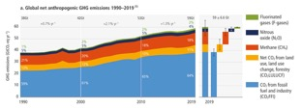
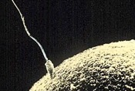
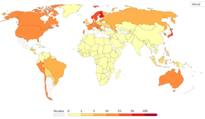
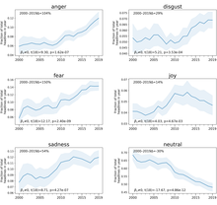
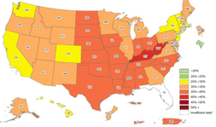

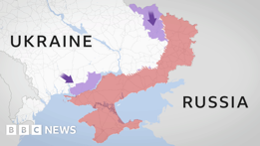
Bad Things Happening in 2022
UN climate report: It’s ‘now or never’ to limit global warming to 1.5 degrees
A 62% decline in sperm counts is found to have occurred since the early 1970s. Causes may include stress, smoking, exposure to plastic and chemicals, lack of physical activity, ultra-processed foods.
https://www.cnn.com/2022/11/18/health/sperm-counts-decline-debate
COVID Deaths
https://ourworldindata.org/grapher/biweekly-covid-deaths-per-million-people
Media becomes more "negative"
Substantial increase of sentiment negativity and decrease of emotional neutrality in headlines across written popular news media since 2000 is reported.
Obesity rates in US are 25-50% across all the States (no "green" States left).
World Hunger is on the rise, affecting nearly 10% of people globally. From 2019 to 2022 the number of undernourished people grew by 150 M (due to conflicts, climate change, COVID)
War in Ukraine – massive deaths and destruction

Slide 3
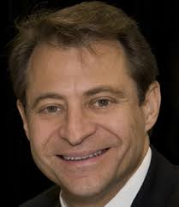

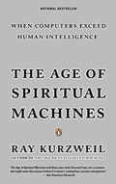
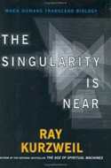
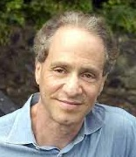
Good Things are Happening Too
Some recent changes in our lives:
Smartphones
Social media
GPS Navigation
Video/Audio Streaming
E-Readers
Human Genome Map
Cryptocurrency
AI
Top Discoveries of the decade: https://www.newscientist.com/article/mg24432613-200-new-scientist-ranks-the-top-10-discoveries-of-the-decade/
Top Inventions that shape our day-to-day world: https://thebossmagazine.com/21st-century-inventions/
Science in 2022
https://en.wikipedia.org/wiki/2022_in_science
Exponential Growth in Technologies (Moore's law – double every 1-2 years)
leads to abundance. Example – cost of solar power may become very cheap.
Steps of Exponential Growth:
Digitization (can be easily accessed and distributed)
Deception (slow initial growth of exponent)
Disruption (new technologies kill old ones)
Demonetization (prices go down)
Dematerialization (oil refineries will start to vanish, etc.)
Democratization (anybody can have it because the price is low)
This sequence applies to all "grand challenges": Food, Water, Shelter, Energy, Communication, Education, Healthcare, Freedom
Peter H. Diamandis
https://www.xprize.org
https://www.diamandis.com
https://abundance.su.org
https://www.diamandis.com/podcast
"The Age of Spiritual Machines: When Computers Exceed Human Intelligence"
by Ray Kurzweil, 2000
"Singularity is Near: When Humans Transcend Biology"
by Ray Kurzweil, 2006
"Abundance: The Future Is Better Than You Think"
by Peter Diamandis, Steven Kotler, 2014
Ray Kurzweil
https://en.wikipedia.org/wiki/Ray_Kurzweil

Slide 4

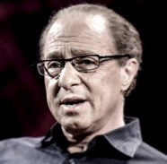
Andrew Ng
Ray Kurzweil
“AI is the New Electricity”
Electricity came into our life ~120 years ago: lamps and motors, telegraph, telephone, radio, TV, Internet, computers, IT, Machine Learning, AI, finance, trading, science, education, medical diagnostics, automation, robotics, etc.
AI, like electricity, will also change our lives in many ways which is difficult to predict
"AI Could Empower Any Business"
https://www.youtube.com/watch?v=reUZRyXxUs4
AI was so far mostly used by large tech companies because it is expensive to build and often needs highly skilled engineers to maintain.
But what if your local pizza shop could use AI to predict which flavor would sell best each day of the week? It is possible as AI becomes more accessible and less expensive. Any business will be able to make better decisions, thus increasing profit and productivity.
Ray Kurzweil, chief engineer for Google and famous futurist stated that
"... ultimately, AI will benefit us in the same way that previous technologies have.
... My view is not that AI is going to displace us, ... (but) ... It’s going to enhance us. It does already.”

Slide 5
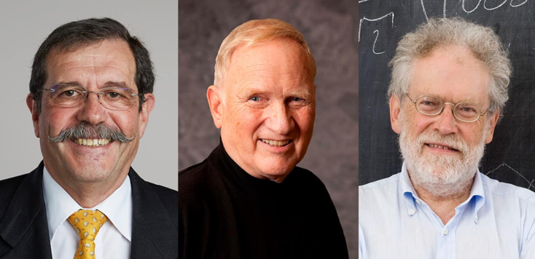
Nobel Prize in Physics 2022
“for experiments with entangled photons,
establishing the violation of Bell inequalities
and pioneering quantum information science”
Alain Aspect
John F. Clauser
Anton Zeilinger
https://physicsworld.com/a/alain-aspect-john-clauser-and-anton-zeilinger-win-the-2022-nobel-prize-for-physics/
Alain Aspect John F Clauser Anton Zeilinger
https://physicsworld.com/a/alain-aspect-john-clauser-and-anton-zeilinger-win-the-2022-nobel-prize-for-physics/
The three laureates worked independently. All three of the experiments measured violations of Bell’s inequality, which places a limit on the correlations that can be observed in a classical system.
1972 - University of California at Berkeley, by John Clauser - measured the correlations between the polarizations of pairs of photons that were created in an atomic transition.
1982 - Alain Aspect and colleagues at the Université Paris-Sud in Orsay, France, improved on Clauser’s experiment by using a two-channel detection scheme
1998 - Anton Zeilinger and colleagues at the University of Innsbruck in Austria used two fully independent quantum random-number generators to set the directions of the photon measurements.

Slide 6
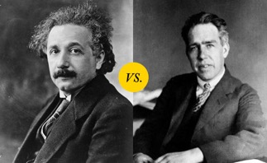
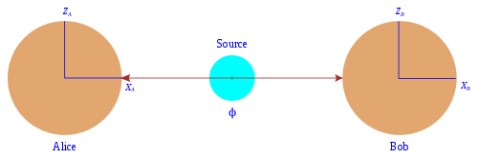
Quantum Entanglement
Quantum entanglement occurs when a group of particles are generated in a way such that the quantum state of each particle of the group cannot be described independently of the state of the others
.. https://en.wikipedia.org/wiki/Quantum_entanglement
EPR paradox (Einstein–Podolsky–Rosen, 1935)
.. https://en.wikipedia.org/wiki/EPR_paradox
EPR paradox is a simple thought experiment in which a pair of particles are created in "entangled state" – moving in opposite directions, same mass, same speed, opposite spins.
If the position of particle A were measured, we thus can predict the position of B. This action taken on A particle could not instantaneously affect the B, since this would involve information being transmitted faster than light.
If we also measure the momentum of "B", then we know both position and momentum of B. This contradicts the Heisenberg uncertainty principle, according to which the position and the velocity of an object cannot both be measured exactly, at the same time, even in theory.
Einstein vs. Bohr
Bohr's interpretation was that the particles can not be considered independent. They constitute a system described by one wave function.

Slide 7
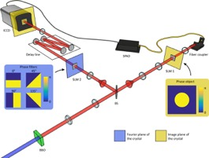
Quantum Entanglement – Experimental Proof
Quantum entanglement has been demonstrated experimentally with photons, neutrinos, electrons, molecules as large as buckyballs, and even small diamonds. The utilization of entanglement in communication, computation and quantum radar is a very active area of research and development.
1964 – Bell's paper on possibility of experimental testing of EPR paradox .. https://en.wikipedia.org/wiki/Bell%27s_theorem
1982 - good test
2000 - improved test
2002 - testing the inequality was feasible in undergraduate laboratory courses.
Quantum secure direct communication (QSDC) – research into methods of sending un-hackable messages.
Error rates and limited distances have prevented its practical application.
Most recent demo - 63.5 miles via optical fiber.
https://www.iflscience.com/secure-quantum-communications-over-100-kilometers-breaks-records-for-accuracy-and-distance-63360

Slide 8
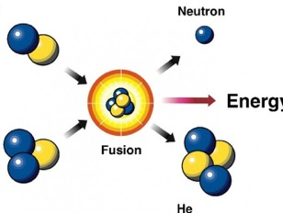
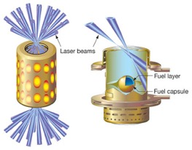
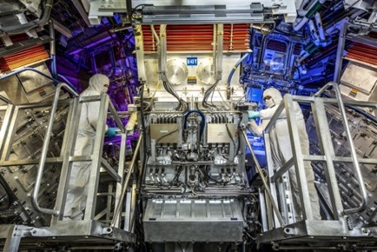
Nuclear Fusion 2022
December 13, 2022
Net energy gain in fusion power is reported at the National Ignition Facility at Lawrence Livermore National Laboratory in California.
.. https://www.nature.com/articles/d41586-022-04440-7
Scientists at the world’s largest nuclear-fusion facility have for the first time achieved the phenomenon known as ignition — creating a nuclear reaction that generates more energy than it consumes.
It’s an incredible accomplishment.
But ... there is still a lot of work to do before this will become practical.
The NIF fusion power still consumes 130 times more energy than it creates
.. https://bigthink.com/the-future/fusion-power-nif-hype-lose-energy/
Nuclear fusion: smashing two atoms together at incredibly high speeds and transforming elements from that reaction into electricity that people can use.
192 giant lasers blasted a small (~3mm) frozen pellet that contained a mix of deuterium and tritium, two heavier isotopes of hydrogen.
This fuel pellet was placed in a small (gold) cylinder about the size of a pencil eraser.
The laser beams entered at the top and bottom of the cylinder, vaporizing it.
That generated an inward onslaught of X-rays that compresses a fuel pellet and causes the reaction.
Time (in ns = nanoseconds)
Time of the blast: 10 light feet = 10 ns
Time of energy release: 1 light inch < 0.1 ns

Slide 9
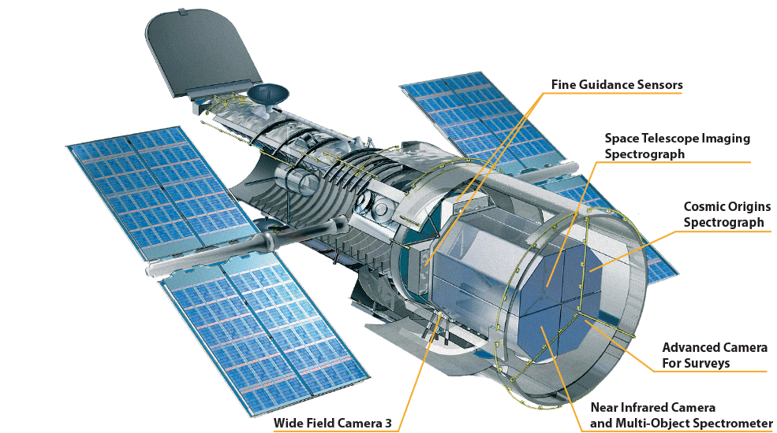
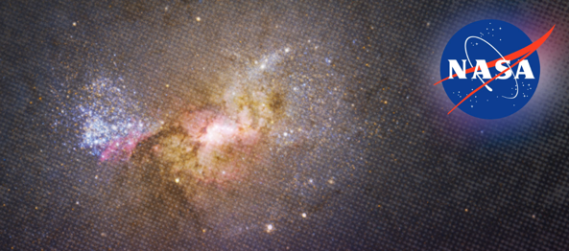
Hubble Telescope - Finds A Black Hole Igniting Star Formation
https://nasa.gov/hubble
https://svs.gsfc.nasa.gov/14076
Black holes are often described as the monsters of the universe—tearing apart stars, consuming anything that comes too close, and holding light captive.
Detailed evidence from NASA's Hubble Space Telescope, however, shows a black hole in a new light: fostering, rather than suppressing, star formation.
Hubble imaging and spectroscopy of the dwarf starburst galaxy Henize 2-10 clearly show a gas outflow stretching from the black hole to a bright star birth region like an umbilical cord, triggering the already dense cloud into forming clusters of stars.

Slide 10
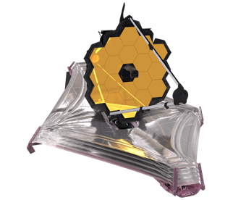

The James Webb Space Telescope
https://webb.nasa.gov
The James Webb Space Telescope is the world's premier space science observatory
Webb will solve mysteries in our solar system, look beyond to distant worlds around other stars, and probe the mysterious structures and origins of our universe and our place in it
Webb is an international program led by NASA with its partners, ESA (European Space Agency) and CSA (Canadian Space Agency)
James Webb is ~ 100 times more powerful than its predecessor and much larger –the diameter is 6.5 meters.
The project started in 1990s, official launch was in the end of 2021

Slide 11
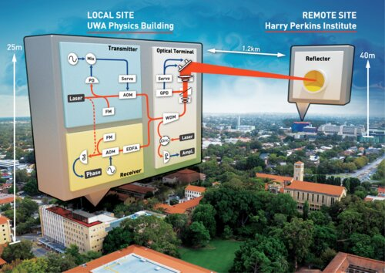
Record-breaking laser link
https://phys.org/news/2021-01-record-breaking-laser-link-einstein-theory.html
Scientists from the International Centre for Radio Astronomy Research (ICRAR) and the University of Western Australia (UWA) have set a world record for the most stable transmission of a laser signal through the atmosphere. Distance – 2.4 km
Scientists expect them to be used to communicate between ground stations and satellites or orbiting craft.
They also would like to use them to connect atomic clocks. Connecting one clock on the surface of the Earth to one aboard a spacecraft would allow for testing Einstein's general theory of relativity—the clock in space should run slightly faster than the one on the ground.

Slide 12
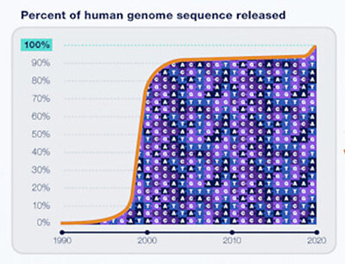
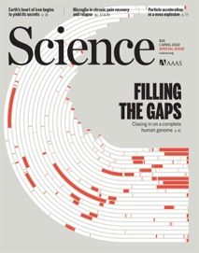
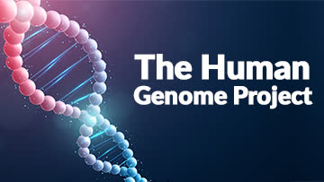
Human Genome is now complete
https://www.genome.gov/about-nhgri/Director/genomics-landscape/april-7-2022-the-human-genome-sequence-is-now-complete
In 2003, the Human Genome Project achieved estimated 92% sequencing of the human genome.
In 2022 the Telomere-to-Telomere (T2T) consortium published a collection of papers that report the first truly complete sequence of the human genome. The sequence — over 3 billion base pairs long across 23 chromosomes — is entirely gapless.
January 2022
A team reports the fastest ever sequencing of a human genome, accomplished in just five hours and two minutes

Slide 13
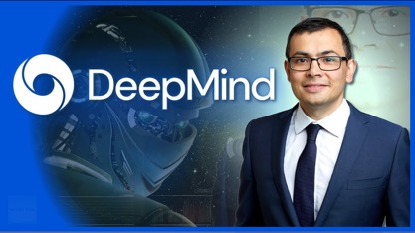
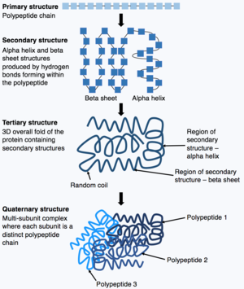
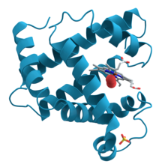
AlphaFold
AI Google company DeepMind reports that its AlphaFold program has determined the likely structure of nearly every protein known to science.
https://en.wikipedia.org/wiki/AlphaFold
AlphaFold 1 (2018)
AlphaFold 2 (2020)
The AlphaFold Protein Structure Database was launched on July 22, 2021
On July 28, 2022, the team uploaded to the database the structures of around
200 million proteins
from 1 million species,
covering nearly every known protein on the planet

Slide 14
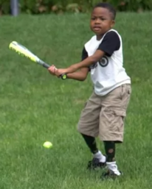
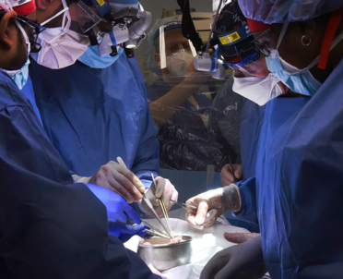
Pig-to-Human Heart Transplantation
January 2022 - Doctors transplanted a genetically modified pig heart into a human. University of Maryland Medical Center, USA The patient, David Bennett, 57, has died two months later.
Zion Harvey - both hands were transplanted (2015)
Hand Transplantation Program at The Children’s Hospital of Philadelphia, USA

Slide 15
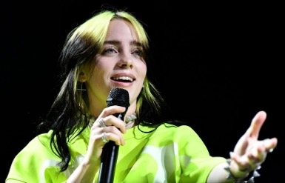
People of the Year
100 Most Influential People of 2022
.. https://time.com/collection/100-most-influential-people-2022/
BBC – 100 women of 2022
.. https://www.bbc.co.uk/news/resources/idt-75af095e-21f7-41b0-9c5f-a96a5e0615c1
Billie Eilish – the only one born in 21st Sentury
Grammy Award-winning and record-breaking superstar
.. https://www.britannica.com/biography/Billie-Eilish

Slide 16
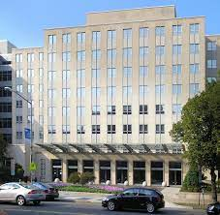
The Brookings Institution – the most influential Research Institution in social sciences (economics, politics)
The Brookings Institution, often stylized as simply Brookings, is an American research group founded in 1916.
Located on Think Tank Row in Washington, D.C.
Conducts research and education in the social sciences, primarily in economics (and tax policy), metropolitan policy, governance, foreign policy, global economy, and economic development
Its stated mission is to "provide innovative and practical recommendations that advance three broad goals: strengthen American democracy; foster the economic and social welfare, security and opportunity of all Americans; and secure a more open, safe, prosperous, and cooperative international system."
Brookings has five research programs at its Washington campus: Economic Studies, Foreign Policy, Governance Studies, Global Economy and Development, and Metropolitan Policy.
It also established and operated three international centers in Doha, Qatar (Brookings Doha Center); Beijing, China (Brookings-Tsinghua Center for Public Policy); and New Delhi, India (Brookings India).
The University of Pennsylvania's Global Go To Think Tank Index Report has named Brookings "Think Tank of the Year" and "Top Think Tank in the World" every year since 2008
The Economist describes Brookings as "perhaps America’s most prestigious think-tank."
Brookings states that its staff "represent diverse points of view" and describes itself as nonpartisan, and various media outlets have alternately described Brookings as centrist, center-left, liberal, or right-wing.
An academic analysis of congressional records from 1993 to 2002 found that Brookings was cited by conservative politicians almost as often as by liberal politicians, earning a score of 53 on a 1–100 scale, 100 representing the most liberal score. The same study found Brookings to be the most frequently cited think tank by U.S. media and politicians.
https://en.wikipedia.org/wiki/Brookings_Institution

Slide 17
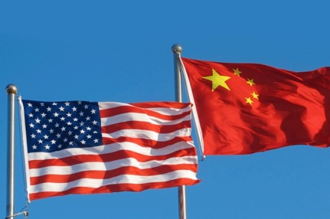
China has overtaken the US
as the world's leader in Science
A new data-rich report by the National Science Foundation (NSF)
confirms China has overtaken the United States
as the world's leader in several key scientific metrics,
including the overall number of papers published
and patents awarded.
https://www.science.org/content/article/u-s-science-no-longer-leads-world-here-s-how-top-advisers-say-nation-should-respond#
5 big science countries:
US
China
Germany
UK
Japan
https://www.natureindex.com/supplements/nature-index-2022-big-5

Slide 18
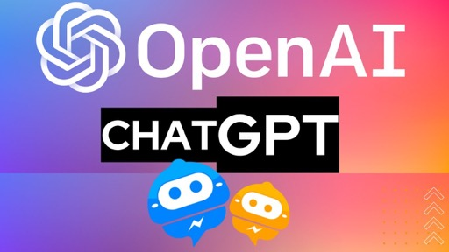
ChatGPT
ChatGPT is everywhere.
It is a new Chatbot from OpenAI.
It can talk to you, answer questions.
For many questions it is better than Google Search.
It is based on OpenAI.
https://en.wikipedia.org/wiki/ChatGPT
It is based on OpneAI language model GPT-3
(Generative Pre-trained Transformer 3)
https://en.wikipedia.org/wiki/GPT-3
Why OpenAI's new ChatGPT will change the future of every industry
https://youtu.be/XuHfzVkZGBU

Slide 19
Our Weekly Seminar in 2022
2022-01-14-ML_lecture_00_ml_classic.pptx
2022-01-21-45-Management.pptx
2022-02-11-TimeSeries-Forecasting.pptx
2022-02-18-Comparison-of-SQL-Server-Variants.pptx
2022-02-25-TimeSeries-Forecast-EnsembleModel.pptx
2022-03-04-Cryptocurrency.pptx
2022-03-11-ds51-Astronomer.pptx
2022-03-25-MLOps-Azure-ML.pptx
2022-04-01-Functional-Programming.pptx
2022-04-15-Time-Series-Forecasting-EnsembleModel-Part-II.pptx
2022-04-22-Plotly-Dash.pptx
2022-05-27-Bitcoin-price-analysis-by-tweets.pptx
2022-06-24-Quant-Reason-Descriptive-Stats.pptx
2022-07-22-Cracking-the-Coding-Interview.pptx
2022-07-29-T-SQL-Window-Functions.pptx
2022-08-12-code0_algorithms_review.pptx
2022-08-19-code1_code_examples.pptx
2022-08-19-code1_knapsack.pptx
2022-08-26-code2_code_examples.pptx
2022-09-02-code3_code_examples.pptx
2022-09-09-code4_code_examples.pptx
2022-09-16-code5_code_examples.pptx
2022-10-07-Python_generate_docs.pptx
2022-10-14-Baseball-Mark.pptx
2022-10-21-CodeDiagrams-Chris.pptx
2022-10-28-VSCode.pptx
2022-11-18-OLAP-Cubes-Makani.pptx
2022-12-09-Git-Chris.pptx
2022-12-16-Transformer-Review-Dequan.pptx
2022-12-16-Transformer-Review-Lev.pptx
22-12-23-year-review-2022-Lev.pptx

Slide 20
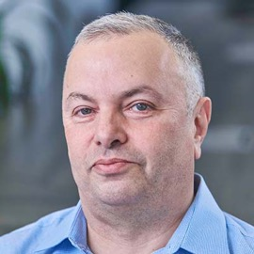
Games I played in Life
My first game was being a scientist. I have played this game for ~15 years
My second game was being a high-paid Software Engineer Consultant I was doing this for 19 years
My third game was being a Team Lead Data Scientist (5 years). I started the YouTube channel too.
My current game is being a founder and CTO of a startup company. It is completely different game with different "book of rules".
It is not difficult to change your game.
It is fun.
It feels really great to learn new games and to build something of value.
Me – Lev Selector
As I am working on the startup, I don't have time for this seminar.
So I will slow down.
If someone wants to make a presentation – please contact me.

