Slide 1
Generating Documents
from Python
MS Word Doc
MS Excel
MS PowerPoint
PDF
Automate generating documents, reports, invoices
Use consistent templates
Avoid duplicative work

Slide 2
1
MS Word Doc
# pip install python-docx
from docx import Document
from docx.shared import Inches
doc = Document()
doc.add_heading("My Title", 0)
doc_para = doc.add_paragraph("Test1 test1")
doc_para.add_run('\nSome text').bold = True
doc_para.add_run('\n')
doc_para.add_run('\nmore text').italic = True
first_para = doc_para.insert_paragraph_before('more text2')
_ = doc.add_picture('path/to/pict.jpg',
width=Inches(4.75))
doc.add_page_break()
doc.add_heading("Heading 2", 2)
doc_para2 = doc.add_paragraph("Test2 test2")
doc_para2.add_run('\nContact us ')
doc_para2.add_run('for ')
doc_para2.add_run('discounts').bold = True
# add a table
table = doc.add_table(rows=1, cols=4)
hdr_cells = table.rows[0].cells
hdr_cells[0].text = 'Qty'
hdr_cells[1].text = 'Id'
hdr_cells[2].text = 'Desc'
hdr_cells[3].text = 'Price'
# records is a list of tuples
for qty, id, desc, price in records:
row_cells = table.add_row().cells
row_cells[0].text = str(qty)
row_cells[1].text = id
row_cells[2].text = desc
row_cells[3].text = str(price)
doc.save('test.docx')

Slide 3
2
MS Excel
"""
# test_excel_1_simple.py
# writes into files/simple.xlsx
# using pandas.ExcelWriter()
# puts data and a chart
"""
import os, sys
import pandas as pd
import xlsxwriter
df = pd.DataFrame([10, 20, 30, 20, 15, 30, 45])
fname = "files/simple.xlsx"
writer = pd.ExcelWriter(fname, engine='xlsxwriter')
mysheet = 'test1'
df.to_excel(writer, sheet_name=mysheet)
workbook = writer.book
worksheet = writer.sheets[mysheet]
chart = workbook.add_chart({'type': 'column'})
chart.add_series({'values': '='+mysheet+'!$B$2:$B$8'})
worksheet.insert_chart('D2', chart)
writer.save()

Slide 4
3
MS PowerPoint
# pip install python-pptx
from pptx import Presentation
root = Presentation()
first_slide_layout = root.slide_layouts[0]
slide = root.slides.add_slide(first_slide_layout)
slide.shapes.title.text = "Your Presentation"
slide.placeholders[1].text = "Creating pptx file"
root.save("output.pptx")

Slide 5

4
PDF
https://pyfpdf.readthedocs.io/en/latest/index.html
# pip install fpdf
from fpdf import FPDF
pdf = FPDF()
pdf.add_page()
pdf.set_font('Arial', 'B', 16)
pdf.cell(40, 10, 'Hello World!')
pdf.output('files/junk1.pdf', 'F')

Slide 6
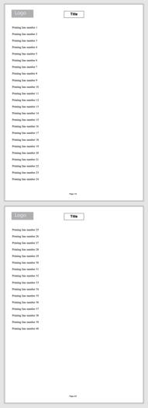
4
PDF - Header, footer, page break and image
https://pyfpdf.readthedocs.io/en/latest/index.html
from fpdf import FPDF
# --------------------------------------------------------------
class PDF(FPDF):
def header(self):
self.image('files/mylogo.png', 10, 8, 33) # Logo
self.set_font('Arial', 'B', 15) # Arial bold 15
self.cell(80) # Move to the right
self.cell(30, 10, 'Title', 1, 0, 'C') # Title
self.ln(20) # Line break
def footer(self):
self.set_y(-15) # Position at 1.5 cm from bottom
self.set_font('Arial', 'I', 8) # Arial italic 8
# Page number
self.cell(0, 10, 'Page ' + str(self.page_no()) + '/{nb}', 0, 0, 'C')
# --------------------------------------------------------------
pdf = PDF()
pdf.alias_nb_pages()
pdf.add_page()
pdf.set_font('Times', '', 12)
for i in range(1, 41):
pdf.cell(0, 10, 'Printing line number ' + str(i), 0, 1)
pdf.output('files/junk2.pdf', 'F')

Slide 7
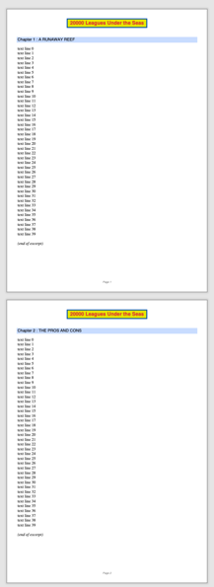
4
PDF - Line breaks and colors
https://pyfpdf.readthedocs.io/en/latest/index.html
from fpdf import FPDF
title = '20000 Leagues Under the Seas'
class PDF(FPDF):
def header(self):
self.set_font('Arial', 'B', 15)
w = self.get_string_width(title) + 6
self.set_x((210 - w) / 2)
self.set_draw_color(0, 80, 180)
self.set_fill_color(230, 230, 0)
self.set_text_color(220, 50, 50)
self.set_line_width(1)
self.cell(w, 9, title, 1, 1, 'C', 1)
self.ln(10) # line break
def footer(self):
self.set_y(-15) # Position at 1.5 cm from bottom
self.set_font('Arial', 'I', 8)
self.set_text_color(128)
self.cell(0, 10, 'Page ' + str(self.page_no()), 0, 0, 'C')
def chapter_title(self, num, label):
self.set_font('Arial', '', 12)
self.set_fill_color(200, 220, 255)
self.cell(0, 6, 'Chapter %d : %s' % (num, label), 0, 1, 'L', 1)
self.ln(4) # Line break
def chapter_body(self):
txt = ""
for ii in range(40):
txt += f"text line {ii}\n"
self.set_font('Times', '', 12)
self.multi_cell(0, 5, txt) # Read text file
self.ln() # Line break
self.set_font('', 'I')
self.cell(0, 5, '(end of excerpt)')
def print_chapter(self, num, title):
self.add_page()
self.chapter_title(num, title)
self.chapter_body()
pdf = PDF()
pdf.set_title(title)
pdf.set_author('Jules Verne')
pdf.print_chapter(1, 'A RUNAWAY REEF')
pdf.print_chapter(2, 'THE PROS AND CONS')
pdf.output('files/junk3.pdf', 'F')

Slide 8
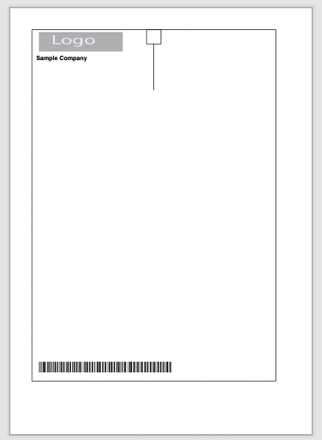
4
PDF - Templates
https://pyfpdf.readthedocs.io/en/latest/Templates/index.html
from fpdf import Template
# define the elements that will compose the template
elements = [
{'name': 'company_logo', 'type': 'I', 'x1': 20.0, 'y1': 17.0, 'x2': 78.0, 'y2': 30.0,
'font': None, 'size': 0.0, 'bold': 0, 'italic': 0, 'underline': 0, 'foreground': 0,
'background': 0, 'align': 'I', 'text': 'logo', 'priority': 2, },
{'name': 'company_name', 'type': 'T', 'x1': 17.0, 'y1': 32.5, 'x2': 115.0, 'y2': 37.5,
'font': 'Arial', 'size': 12.0, 'bold': 1, 'italic': 0, 'underline': 0, 'foreground': 0,
'background': 0, 'align': 'I', 'text': '', 'priority': 2, },
{'name': 'box', 'type': 'B', 'x1': 15.0, 'y1': 15.0, 'x2': 185.0, 'y2': 260.0,
'font': 'Arial', 'size': 0.0, 'bold': 0, 'italic': 0, 'underline': 0, 'foreground': 0,
'background': 0, 'align': 'I', 'text': None, 'priority': 0, },
{'name': 'box_x', 'type': 'B', 'x1': 95.0, 'y1': 15.0, 'x2': 105.0, 'y2': 25.0,
'font': 'Arial', 'size': 0.0, 'bold': 1, 'italic': 0, 'underline': 0, 'foreground': 0,
'background': 0, 'align': 'I', 'text': None, 'priority': 2, },
{'name': 'line1', 'type': 'L', 'x1': 100.0, 'y1': 25.0, 'x2': 100.0, 'y2': 57.0,
'font': 'Arial', 'size': 0, 'bold': 0, 'italic': 0, 'underline': 0, 'foreground': 0,
'background': 0, 'align': 'I', 'text': None, 'priority': 3, },
{'name': 'barcode', 'type': 'BC', 'x1': 20.0, 'y1': 246.5, 'x2': 140.0, 'y2': 254.0,
'font': 'Interleaved 2of5 NT', 'size': 0.75, 'bold': 0, 'italic': 0, 'underline': 0,
'foreground': 0, 'background': 0, 'align': 'I',
'text': '200000000001000159053338016581200810081', 'priority': 3, },
]
# instantiate the template and define the HEADER
f = Template(format="A4", elements=elements, title="Sample Invoice")
f.add_page()
# fill some of the fields of the template with the information we want
# note: we access the elements treating the template instance as a "dict"
f["company_name"] = "Sample Company"
f["company_logo"] = "files/mylogo.png"
# and now we render the page
f.render("files/junbk4.pdf")

