Slide 1

Introduction to Azure Data Factory
Andy Leonard
Enterprise Data & Analytics
Notes:
Start the recording

Slide 2
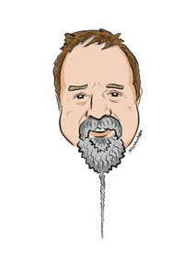
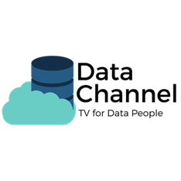
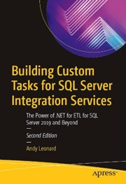
Andy Leonard
Chief Data Engineer Enterprise Data & Analytics entdna.com
Data Philosopher Data Integration Lifecycle Management Suite DILMSuite.com
Husband, Dad, Grandpa
Engineer
Media-caster
Writer
Farmer
andy.leonard@entdna.com
andyleonard.blog @AndyLeonard
Notes:
Don’t dawdle!

Slide 3
Agenda
A Brief History of ETL, ETL Tools / Vendors, and Data Engineering
Provision Azure Data Factory
A Brief Tour
Build a Pipeline

Slide 4
Some ETL Tools & Vendors (other than SSIS & ADF) [credit: Lev Selector]
AWS Glue
Ab Initio
Actian DataConnect
Adeptia Integration Server
Airbyte (open source)
Alooma
Apache Airflow (open Source, python)
Astronomer (based on Apache Airflow)
Apache Camel (open source)
Apache Kafka (open source)
Apache NiFi
Apatar (Deprecated)
ApatarForge (open source)
Atom (from ironSource)
BODS (Business Objects Data Services) from SAP
BiG EVAL
Blendo
Bubbles (open source)
CDAP
CData Sync
Centerprise Data Integrator
CloverDX Data Integration Software
CloverETL (open source)
Cognos Data Manager
DBConvert Studio By SLOTIX s.r.o.
DBSoftlab
Dataddo
Dell Boomi
Elixir Repertoire for Data ETL
Etleap
Fivetran
FlyData
Heka (Deprecated)
Hevo Data
IBI Data Migrator
IBM Cognos Data Manager (Formerly known as Cognos Decision Stream)
IBM Infosphere Information Server
IBM Websphere DataStage (Formerly known as Ascential DataStage)
IBM Datastage = IBM Information Server
IBM Infosphere Information Server
IBM Infosphere Warehouse Edition
IRI Voracity
Informatica Power Center
Jaspersoft ETL
Logstash (open source)
Matillion
Microsoft Azure Data Factory (same as Azure Synapse Integration)
Microsoft SQL Server Integration Services (SSIS)
N8n
Nexla
OWB and ODI from Oracle
Open Text Integration Center
Open source Clover ETL
Oracle − Data Integrator ODI (Formerly known as Sunopsis Data Conductor)
Oracle − Warehouse Builder
Oracle Data Integrator (ODI)
Oracle Warehouse Builder (OWB)
PDI (Pentaho Data Integration) from Pentaho (now Hitachi Data Systems)
Panoply
Pentaho Data Integration (Kettle) (open source)
Pentaho Data Integration (PDI)
Petl (open source)
Pygrametl (open source)
QlikView Expressor
QuerySurge
Relational Junction
SAP − Business Objects Data Services BODS
SAP – BusinessObjects Data Integrator
SAP Data Services
SAS − Data Integration Studio
SAS Data Integration Studio from SaS
SAS Data Management
Sagent Data Flow
Scriptella (open source, Deprecated)
Segment
Singer (open source)
Skyvia
Stitch
StreamSets
Striim
Sybase ETL
Syncsort DMX
Talend Open Studio & Integration Suite
Talend Open Studio (open source)
Vendia
Web Data Extraction & Aggregation Services
Xplenty
Xtract.io

Slide 5
ETL – Extract Transform Load [credit: Lev Selector]
Good ETL Architecture with one central Layer
Extract data from one system (database?)
Transform to different formats (filter, clean, join, etc.)
Load into another system (database)
A
B
files
ETL
Layer
files
C
B
Good Practices
C
D
- Try to separate process into 3 distinct steps: Extract, Transform, Load.
- Avoid chaining. Embrace parallel processing. Use FedEx architecture – use central "Airport" to get all data into one processing center at the same time, process fully in one place, and only then deliver to targets at the same time.
- All individual steps should be re-runnable.
- Think about moving data as a big set of distributed transactions. Expect that individual steps will often fail. All steps should be logged. Logs allow to design system to do self-recovery.
- All rows of data should be tagged with individual unique row_id, individual unique load_id, timestamp, user, and other metadata to allow cleaning and rerunning.
- Use bulk loaders/unloaders whenever possible. Bulk operations are much faster than querying or inserting one row at a time.
- Split huge chunks of data into reasonably sized pieces. In case of failure, smaller pieces allow to rerun only failed pieces – not the whole thing.
- Do all processing externally in ETL layer. This includes validation, joining, key-generation, etc. Try to avoid post-processing in the target.
- When loading into databases – disable triggers, drop indices, etc.
- Monitor memory usage to avoid crashes.
E
T
L
Bad Architectures – chaining or multiple mutual inter-connections
A
B
C
D
E

Slide 6
A Brief History of Data Engineering [partial credit: Lev Selector]
In the beginning there was SneakerNet™, where people wrote data to media on one computer and physically carried the media to a different computer, where the media was then read. </joke></kinda>
SSIS – Microsoft SQL Server Integration Services an XML-based Microsoft ETL tool. Microsoft SSIS was introduced with SQL Server 2005 as a replacement for an earlier integration tool called Data Transformation Services (DTS).

Slide 7
A Brief History of Data Engineering [partial credit: Lev Selector]
ADF (Azure Data Factory) – a more recent Microsoft ETL tool on Azure cloud. Azure Data Factory v1 went into public preview on 28th Oct 2014 and then released for general available on 6th Aug 2015.
ADF v2 is current, and includes an ever-growing collection of connection options, activities, and data flows.

Slide 8

Demos!
Provision Azure Data Factory
A Brief Tour
Build a Pipeline

Slide 9


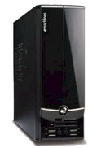
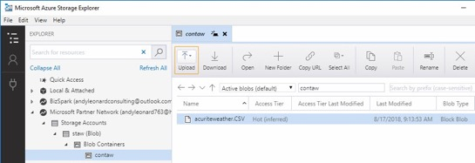
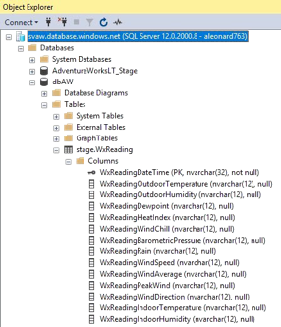
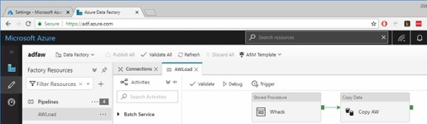
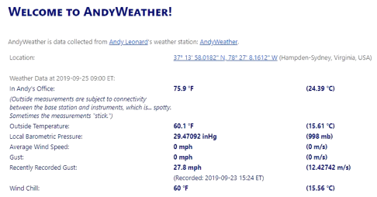
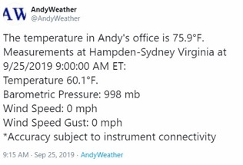
AndyWeather
andyweather.com
@AndyWeather
Blog Post: AndyWeather Internet of Things (IoT)

Slide 10
Questions?

Slide 11
andyleonard.blog/learn-more
Notes:
To learn more, go here…

Slide 12
andy.leonard@EntDNA.com
Notes:
And for help, contact me…

