Slide 1
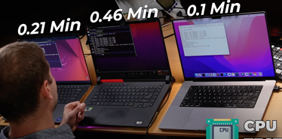
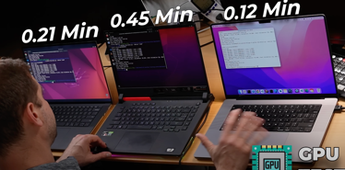
ML on Mac M1/M2 Silicone
is MUCH faster than NVIDIA CUDA
When M1 destroys Nvidia
https://www.youtube.com/watch?v=u9ECps9b664
DELL XPS 15
Intel Core i9 12 Gen
32 GB ram
RTX 3050 ti
4 GB video memory
ASUS ROG STRIX
AMD Ryzen 5900HX
RTX 3070 Mobile
6 GB video memory
Macbook Pro M1 Max
64 GB RAM
64 GB shared memory
CPU Test: Mac is x2-x5 times faster
GPU Test: Mac is x2-x4 times faster
How to Install Keras GPU for Mac M1/M2 with Conda
.. https://www.youtube.com/watch?v=o4-bI_iZKPA
How to Install PyTorch GPU for Mac M1/M2 with Conda
.. https://www.youtube.com/watch?v=VEDy-c5Sk8Y

