Slide 1

Effective & Agile Analytics Teams
Kyle Clubb
Practice Director & Chief Value Engineer
Advanced Analytics
kclubb@redapt.com

Slide 2
Jimi Hendrix
“When the Power of Love overcomes the Love of Power,
The world will know peace”

Slide 3
How truth comes to us
Academic logic rules
Prescriptive
Experiential

Slide 4
Why?
“Research shows that every time the size of a city doubles, innovation or productivity per resident increases by 15 percent.
But when companies get bigger, innovation or productivity per employee generally goes down.”

Slide 5
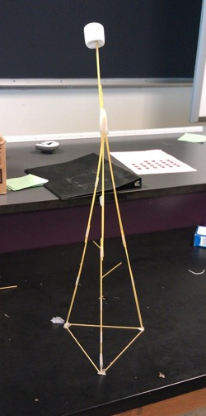
Spaghetti and Marshmallow Tower Lab
Lab materials:
20 pieces of spaghetti per group
20 small marshmallows per group
1 large marshmallow per group
1 foot of tape per group
1 piece of paper

Slide 6

What is analytics?
Analytics is the scientific execution of leveraging repeatable processes to solve a business problem using data and analysis to drive impact.
Data + Intuition = Powerful Insights
Achievements:
Effective Decisions
AND
Problem Solved

Slide 7
Problems framed
 | Cause | Effect
Past | Corrective | Adaptive
Future | Preventative | Contingent
Past
Future

Slide 8

Problems only exist when …
Deviation
Unknown cause
You care
Further simplification:
Problem exist only because something
has changed.

Slide 9
Decision
Objectives
Alternatives
Risks

Slide 10

Cohesive Achievement Matrix
Happiness Artifact Created
(Quality, Quantity, Cost)
X
Y
Event Created (Quality, Quantity, Cost)
Logistical (Supplies Schedules)
Z
Happier Child
(Quality, Quantity, Cost)
Culture/Policy Levels
Strategic (Role/Job)
Tactical (Tasks)
Quality
Accuracy
Class
Novel
Quantity
Rate
Timeliness
Volume
Cost
Labor
Material
Management
unregretted attrition rate

Slide 11
Metric Creation
A – Accomplishment
Performance Aid – “Does it persist when they leave the building”
C – Control
Performance Aid – “Does they have complete control of it”
O - Only Objective
Performance Aid – “If perfectly achieved would performance be perfect? Would any more be desired?”
R – Reconciliation –
Performance Aid – “If the mission is perfectly executed, will it be possible to execute all other missions perfectly?”
N – Number - Is it measurable

Slide 12
Behavioral Model
Information
Instrumentation
Motivation
Data
Resources
Incentives
ENVIRONMENT
1. Relevant and frequent feedback about the adequacy of performance
2. Descriptions of what is expected of performance 3. Clear and relevant guides to adequate performance
1. Tools, resources, time and materials of work designed to match performance needs
1. Adequate financial incentives made contingent upon performance 2. Non-monetary incentives made available 3. Career-development opportunities 4. Clear consequences for poor performance
INDIVIDUAL
Knowledge
Capacity
Motives
1. Systematically designed training that matches the requirements of exemplary performance 2. Placement
1. Flexible scheduling of performance to match peak capacity 2. Prosthesis or visual aids 3. Physical shaping 4. Adaptation 5. Selection
1. Assessment of people’s motives to work 2. Recruitment of people to match the realities of situation
12

Slide 13


Behavioral Model Anti-Pattern
Data
Instrumentation
Incentives
• Don’t tell people how well they are doing
• Provide misleading info on how they are doing
• Hide what is expected • Don’t guide performance
• Design tools without consulting the users
• Keep developers or engineers away from users
• Pay poor performers the same as good performers • Punish good performers in some way • Don’t use non-monetary incentives
Knowledge
Capacity
Motives
• Leaving training to chance • Let unskilled supervisor’s train • Make training irrelevant to the job • Make training difficult to get
• Schedule work times for when people are not at their sharpest • Select the wrong people for the job • Don’t provide job aids
• Design futureless jobs • Arrange unpleasant work conditions • Give pep talks instead of incentives
Notes:
•

Slide 14

80/20 Rule
Business analytics: The use of simpler analytics methodologies on past data.
Advanced analytics: Everything else, including predictive analytics.

Slide 15
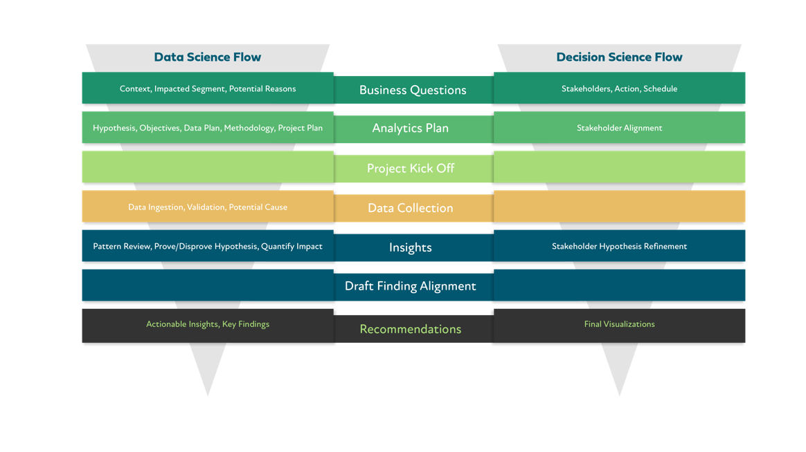

Slide 16

Agile Data Warehouse & KPI design
Agile DW Development Timeline
Stakeholder Interaction
JDUF
Agile
Dimension Modeling
ETL TDD
BI
Prototyping
Review
Release
This Year
Next Year
Iteration 1
Iteration 2
ADM ETL BI REV
Iteration…
Iteration n
Value
Value
Value
Value
Value
Data

Slide 17






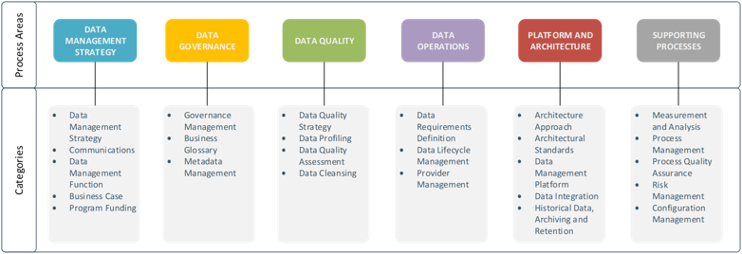
Agile Culture & Organization
Agile Reality Modeling
Technology
Analytical cross functional teams and roles with no parent-child relationships
Business Event and Analytics Modeling integrated into agile DevOps process
Not the biggest challenge
Treat tensions and the fuel for innovation and positive change
Buy where appropriate and build for strategic advantages
Data literacy training for all. 80% of business questions can be answered with no machine learning
Most important function of analytics

Slide 18

True agile analytics struggle in typical parent child corporate relationships—meaning a shift in power and in doing so empowering employees.
CORPORATE STRUCTURE
AGILE STRUCTURE
CEO
EMPLOYEES EMPLOYEES
VICE PRESIDENT
EMPLOYEES EMPLOYEES EMPLOYEES
MANAGEMENT
EMPLOYEES
EMPLOYEES EMPLOYEES

Slide 19

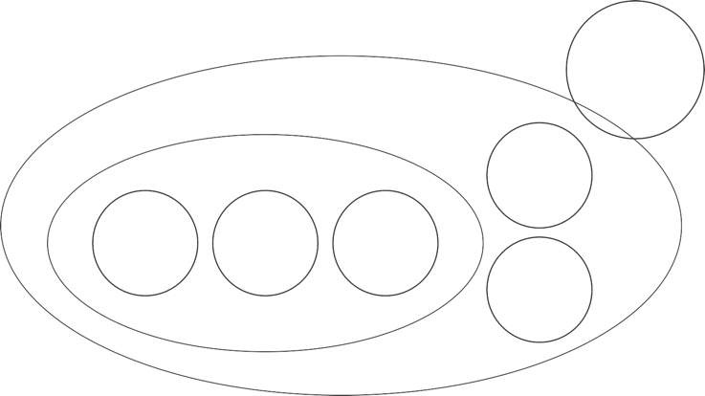
It’s all about working in circles
The new org-chart looks like this:
Board Circle
General Company Circle
Analytics
Sales Circle
Team Circle
Team Circle
Team Circle
Operations Circle

Slide 20
Compare
 | Hierarchy | Agile
Leadership | Power, Position | Servant, Personality
Decision-making | Top | Case by case
Relationship | Levels | Flat
Information | Controlled | Open
Roles | Descripted | Flexible
Management | Command, Control | Self-management
Rewards | Money, Fame | Satisfaction, Happiness
Thinking | Analysis | Synthesis

Slide 21
Compare
Business as usual
Painful metings with little or no structure
Led by the boss; vaguely actionable outputs
Rigid organizational structure
Encourages fiefdoms and silo mentality
Organizational design centralized in the CEO
Structure doesn’t reflect actual work patterns
Managers are decision-making bottlenecks
Energy wasted on defining the work and dealing w/ politics
With agile circles
Focused and coherent meetings Structured facilitaion; clearly actionable outputs
Evolving organizational structure Continually updated via dynamic governance process
Local and distributed organizational design
Agile structure locally updated based on real-time data
Clear structure for distributed decision-making
Authority distributed to clearly defined roles

Slide 22

Roles Re-Imagined
Shifting from people to roles
A role should not be a person’s singular job. Rather, one person should hold many roles.

Slide 23




A new approach …
… to organizational structure, meetings, autonomy and decision making.
A role should not be a person’s singular job. Rather, one person should hold many roles.
Agile Organization Structures
Flexible organizational structure
New meeting format
More autonomy with teams and individuals
Unique
decision-making process
Topic should be geared toward action and eliminat ing over-analysis
With clear roles and accountabilities
For individuals to solve issues themselves and cut through bureaucracy
To continuously evolve the organization’s structure.

Slide 24


What’s a role?
Two examples
A “Role” is an organizational construct with a descriptive name and one or more of the following:
(a) A “Purpose,” which is a capacity, potential, or unrealizable goal that the role will pursue or express on behalf of the organization.
(b) One or more “Domains,” which are things the role may exclusively control and regulate as its property, on behalf of the organization.
(c) One or more “Accountabilities,” which are ongoing activities of the organization that the role will enact.
Sample Role
Brand Strategy
Website Developer
Purpose:
Provide an exceptional experience for website visitors
Purpose:
Strategic expressions of our identity that resonate with those we can serve best
Domains:
ExternalWebsites.xyz, InternalWebsite.xyz
Role Accountabilities
Distilling and capturing cohesive strategic guidance for the expression and conveyance of the Holacracy brand by relevant roles, and integrating Objections from all General Company Circle roles before enacting major proposed changes to this guidance
Evaluating organizations, upon request of Licensing Design, to assess their capacity to effectively represent and promote using the Holacracy brand as part of the Holacracy licensed ecosystem
Maintaining and evolving a set of usage and messaging standards around the Holacracy brand
Accountabilities:
Gathering and updating all websites content. Delveloping new services by working stakeholders. Maintaing the security and stability of website.

Slide 25

Tension is really the difference between the ideal state and the current state.
IS
COULD BE

Slide 26
How it works
Different meetings for different purposes.
Sensing “Tensions”
as challenges or opportunities
Stuff Comes in
Doing Work
in clear roles
Tactical Meetings
to sync and triage next action
Governance Meetings to clarify and improve role structure

Slide 27
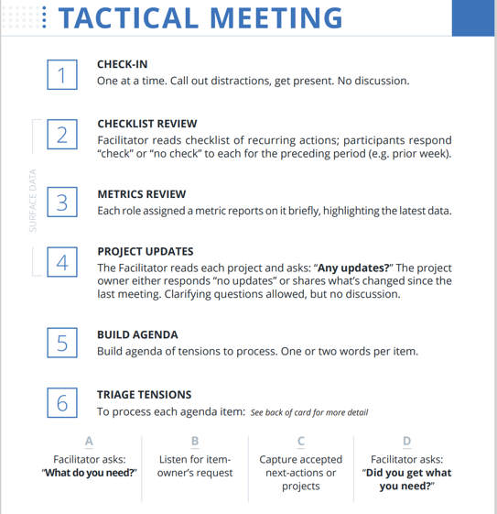
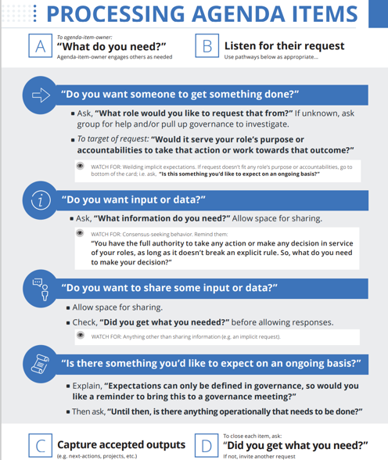

Slide 28
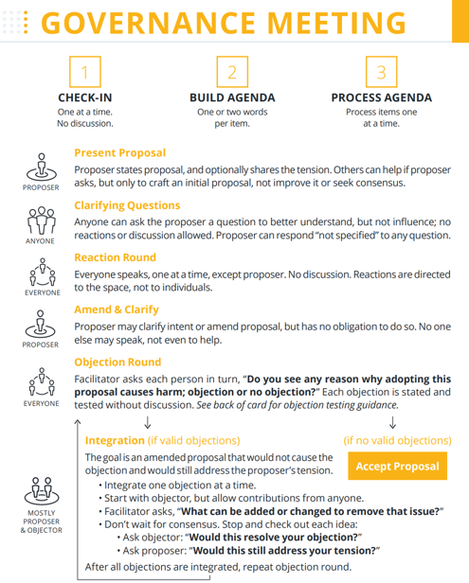
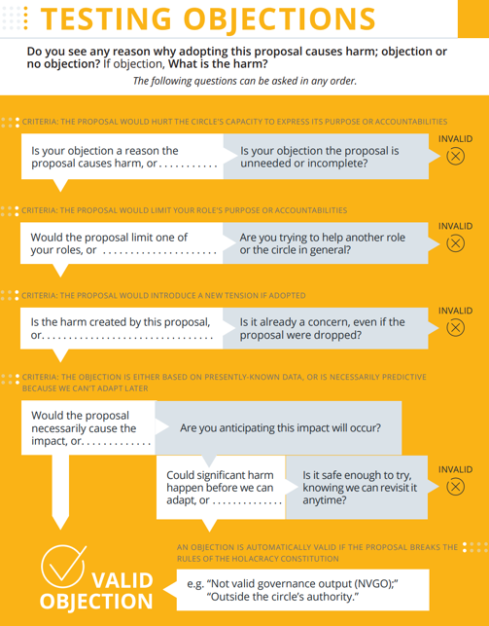

Slide 29





Companies Using / Implementing
A few of many …

Slide 30
Thank You
Kyle Clubb
Practice Director & Chief Value Engineer
Advanced Analytics
kclubb@redapt.com

