Slide 1
Bagging and Boosting
Topics
Bagging and Boosting concepts
Decision Trees → Ensemble Learning
(Regression) Implementations in Python
Mitigations for model prediction “errors”
Brett Efaw
February 10, 2023

Slide 2
Idea:
make a reliable system from unreliable blocks using single-shot democratic voting
Idea:
get to correct answer by making multiple corrective steps
Power of the majority
committee, senate, congress, council, board of directors, ...
1st approximation
Power of validation
science, open source community, ...
Computer 1
correction
Data
Computer 2
Majority voting
system
Weighted
voting
system
correction
Computer 3
...
correction
Bagging
Wrong bias is not removed,
it is simply averaged
Wrong bias is removed
using correction and validation
Boosting
Notes:
Can be used to improve predictive performance of “weak” learners like decision trees

Slide 3
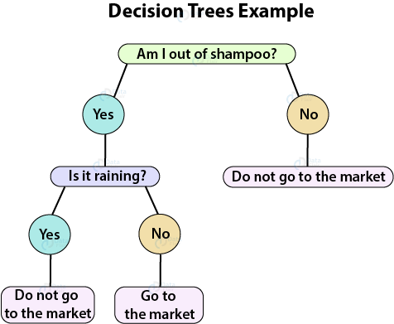
Decision Tree (DT)
DT goes from observations about an item (represented in the branches) to conclusions about the item's target value (represented in the leaves).
DT can do classification or regression.
DTs are intuitive and easily interpretable.
Algorithms for constructing DTs usually work top-down, by choosing and splitting on a variable at each step that most informative for the target label (produces the purest daughter nodes).
Splits can result in more than two branches.
Decision Tree Algorithms
ID3 (Iterative Dichotomiser 3) – uses smallest Entropy metrics
C4.5 – successor of ID3 (since 1993), uses Entropy metrics
CART (Classification And Regression Tree) – (since 1984), uses Gini metrics
CHAID (CHi-squared Automatic Interaction Detector). Performs multi-level splits when computing classification trees.
MARS: extends decision trees to handle numerical data better.
Conditional Inference Trees. Statistics-based approach that uses non-parametric tests as splitting criteria, corrected for multiple testing to avoid overfitting. This approach results in unbiased predictor selection and does not require pruning.
Trees:
Greedy splitting (top->down)
Greedy pruning (to prevent over-fitting)
Fast and easy to build
Surprisingly good
Explainable

Slide 4

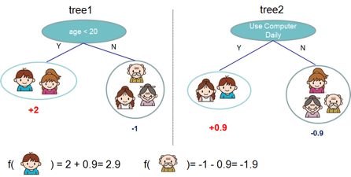
Ensemble Learning
Idea - train several models to do predictions.
Then combine predictions of these models to get a better predictor.
It is possible to combine any types of models into one predictor.
But commonly people combine variations of similar models, like decision trees models.
Two most famous approaches are:
- "Random Forest"
- "Gradient Boosted Trees"
Under the hood these models combine 100 ... 200+ similar trees.
The differences between algorithms:
how you select the data to train those trees
how you combine the predictions of these trees
Notes:
Ensembles of decision trees can learn non-linear relationships in the data

Slide 5
Ensemble Learning with Decision Trees
A group of “weak learners” come together to form a “strong learner”
Bagging
reduces variance (averages)
does NOT reduce bias error
Boosting
reduces bias error
by sequential corrective learning
Stacking
improves predictive force (combines "skills" of different models)
Random Forest – parallel independent learners, democratic equal-weight voting.
Note - Random Forest is a specific case of Bagging = Bootstrap Aggregating
Bootstrap = data sampling with replacement
Aggregating = voting
Each learner gets a random subset of data (rows) and a random subset of features (columns).
Each tree is trained independently.
Each tree then can make its prediction.
Then overall decision is made by averaging decisions of individual trees.
Boosted Trees – trees trained sequentially.
Train 1st tree
Train 2nd tree concentrating on fixing errors left after 1st tree, combine trees (weighted voting)
Train 3rd tree concentrating on fixing errors left after 1st and 2nd trees, etc.
Continue boosting accuracy by adding trees.
Stacking (Meta-learner) - train several different models, and then train model on top of their outputs
- https://www.kdnuggets.com/2017/02/stacking-models-imropved-predictions.html

Slide 6
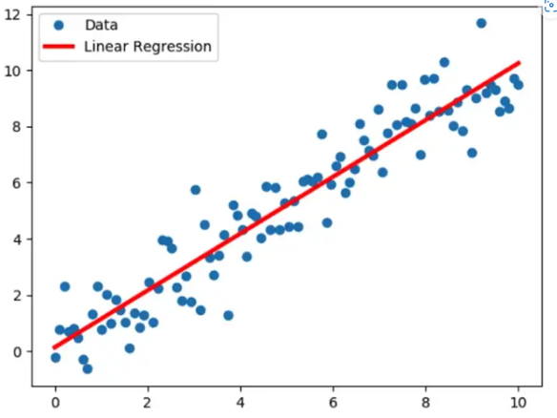
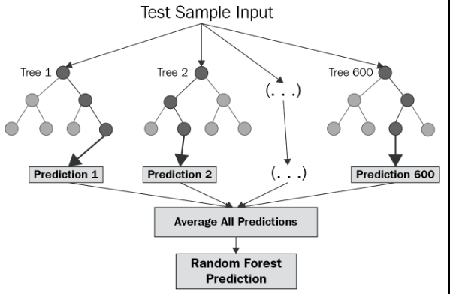
Model Explain-ability vs Performance

Slide 7
Bagging and Boosting Regressors in Python
# from sklearn.ensemble:
GradientBoostingRegressor
HistGradientBoostingRegressor # (best, inspired by LightGBM)
RandomForestRegressor
# from xgboost !pip install xgboost
XGBRegressor
XGBRFRegressor
Rob Mulla Time Series Forecasting w/ XGBoost
https://youtu.be/z3ZnOW-S550
https://youtu.be/vV12dGe_Fho
All regressors have similar speed and accuracy.
But the best is HistGradientBoostingRegressor - histogram-based gradient boosting.
https://scikit-learn.org/stable/modules/generated/sklearn.ensemble.HistGradientBoostingRegressor.html
https://machinelearningmastery.com/histogram-based-gradient-boosting-ensembles/
https://inria.github.io/scikit-learn-mooc/python_scripts/ensemble_hist_gradient_boosting.html
Why the "histogram-based" approach is faster and better?
The bottleneck in training any boosted trees algorithm is the time
needed for finding the best split between values when building the trees.
This time can be significantly reduced if we pre-process the data for a given tree – aggregate them into "bins".
We convert the continuous float numbers into limited number of discrete integer values.
This "histogram binning" reduces the number of splits we need to try to find the best split.
This makes finding the split much faster, but reduces the accuracy.
To increase the accuracy we can simply increase the number of trees.

Slide 8
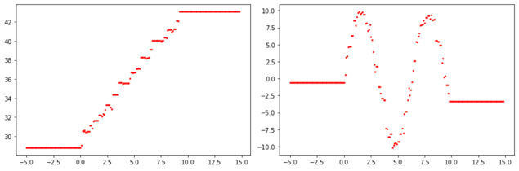
Extrapolation
Random Forest can not extrapolate
Why does XGBoost regression predict completely unseen values
RF does interpolation for values inside the range of values.
But it can not go outside.
- https://neptune.ai/blog/random-forest-regression-when-does-it-fail-and-why
Random Forest Regressor works by finding closest matches in given range.
We take random subset of data (columns, rows), and build a tree splitting by "x".
Each leave has "x" and "y".
We build hundred trees like this.
For inference, given value "x" we traverse all 100 trees (by "x") and find 100 values of "y".
Then we average them to get the desired prediction.
The result is always within the range of "y" values. It can not extrapolate.
Note: Boosting algorithms with default RMSE loss function can have 1-2 % of predictions going outside of the range. For example, we were getting negative duration (in days) although the training data has contained only positive number of days. We solved this problem by switching loss function to "count poison".
The Gradient Boosting Regressor (assuming a squared error loss function) successively fits regression trees to the residuals of the previous stage. Now if the tree in stage "i" predicts a value larger than the target variable for a particular training example, the residual of stage "i" for that example is going to be negative, and so the regression tree at stage "i+1" will face negative target values (which are the residuals from stage "i"). The boosting algorithm adds up all these trees to make the final prediction – thus you may end up with some negative values (especially when you increase number of trees and use some categorical features)
https://datascience.stackexchange.com/questions/565/why-does-gradient-boosting-regression-predict-negative-values-when-there-are-no
https://github.com/dmlc/xgboost/issues/1581
https://datascience.stackexchange.com/questions/77234/can-boosted-trees-predict-below-the-minimum-value-of-the-training-label/77272

Slide 9
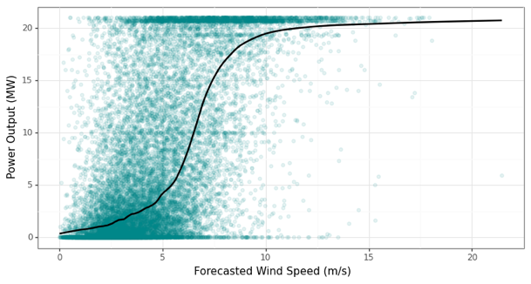
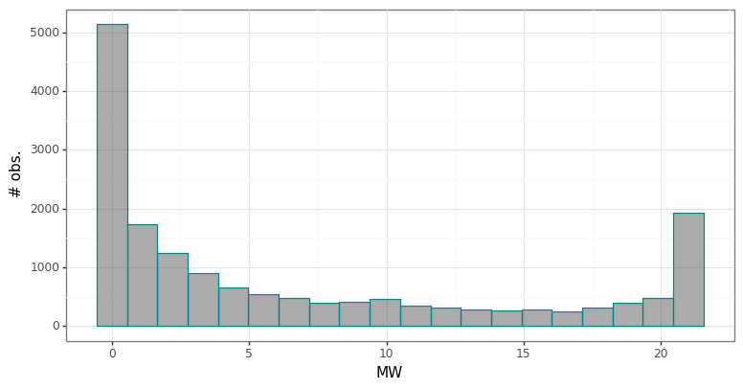
Example Regression Problem
Continuous target variable constrained by floor (min) and ceiling (max) values
Edge cases (near floor and ceiling) are prevalent
Non-linear relationship with (forecasted) wind speed
Target variable is u-shaped with prevalence near min and max

Slide 10
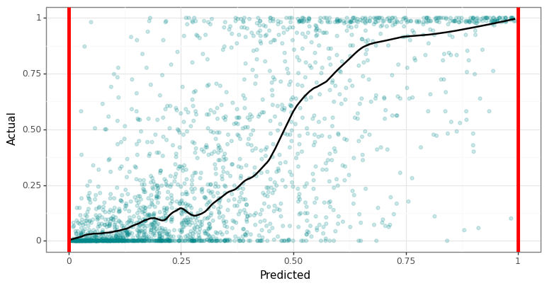
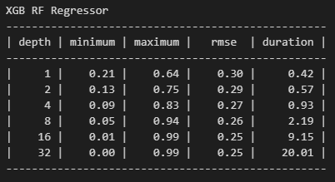
Random Forest w/ 500 trees and squared error objective
max_depth = 32

Slide 11
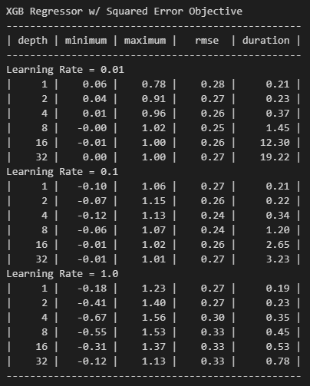
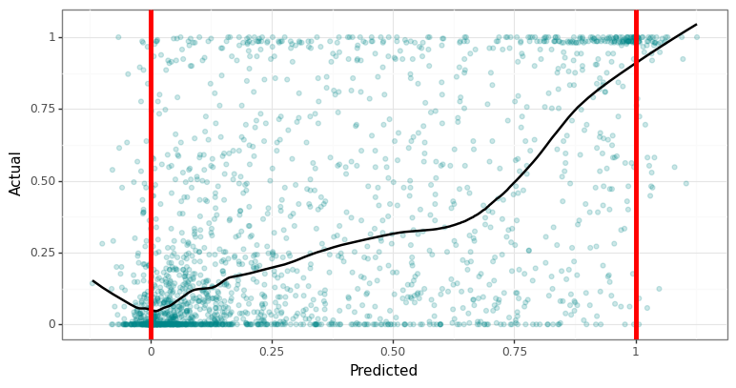
XGBoost w/ hist method, 500 iterations, reg:squarederror
max_depth = 32 and learning_rate = 1.0

Slide 12
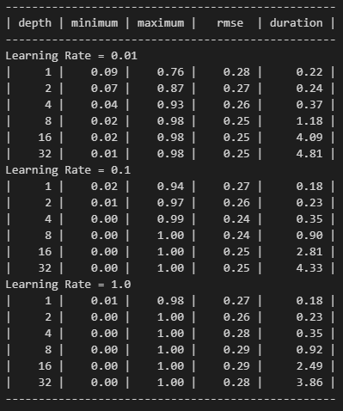
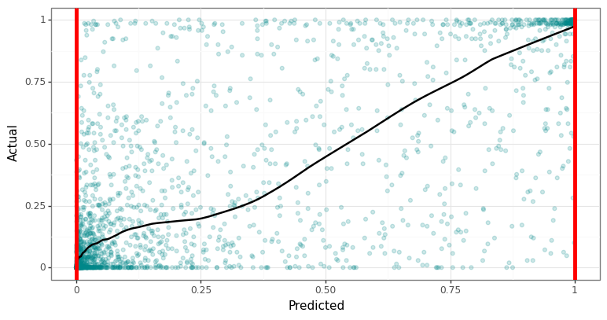
XGBoost w/ hist method, 500 iterations, reg:logistic
max_depth = 32 and learning_rate = 1.0

Slide 13
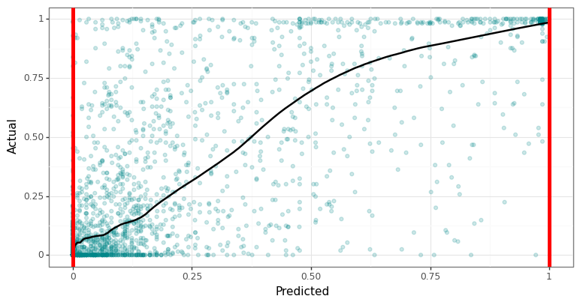
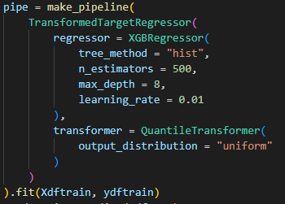
Pipeline w/ Transformed Target Regressor
Use .get_params() method to see what the parameters got renamed to

Slide 14
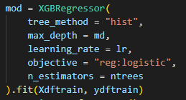
Mitigation Options for Boosting Model Prediction “Errors”
A. Try smaller learning rate (default = 0.1, try values closer to 0.01)
B. Manually apply transformation
Logarithm on positive data (w/ offset)
Logit on bounded data (0 min, 1 max)
C. Change objective in regressor
Poisson is an option in HistGBR() and XGBRegressor()
Logistic is an option in XGBRegressor()
D. Sci-Kit Learn Transformed Target Regressor
Part of a model pipeline
E. Post-process (i.e. clip) the predictions

Slide 15
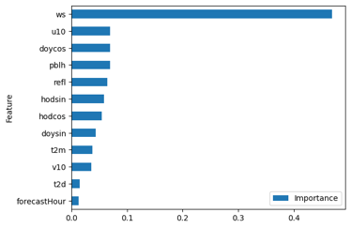
Conclusion
Bagging and Boosting are ensemble methods
Improve predictive ability of weak learners (i.e. DT)
Random Forests = Bagging (bootstrap aggregating)
Boosting = Light GBM, Ada Boost, Cat Boost, etc.
Pros
Relatively fast
Flexible (non-linear)
Accurate
Feature importance
Missing values support (XGB)
Cons
Not designed to extrapolate
Boosting model prediction “errors”

