Slide 1
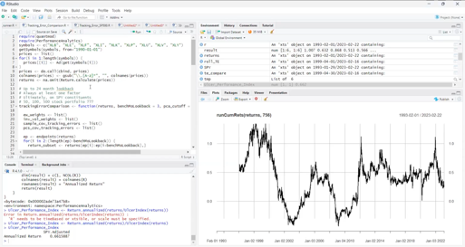
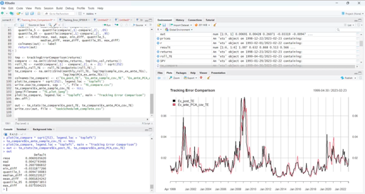
Calculating Tracking Error
For Direct Indexing
by Ilya Kipnis

Slide 2
Notes:
x'Sx
x' = 1xn,
S = nxn covariance matrix,
x = nx1 = 1x1 ex-ante estimation of volatility
(x-.002)'S(x-.002)
rolling_standard_deviation (portfolio_returns - index_returns, 21)

