Slide 1
Job Searching
Leader vs Follower

Slide 2

Technical Worker vs Leader/Visionary
Compare two accountants
Follower
Leader
Senior accountant
low salary
high competition
VP of Tech (moving accounting into Cloud and AI)
high salary
in high demand

Slide 3
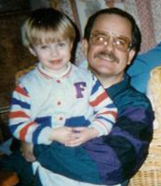

Interview is the transfer of energy
Interview is the transfer of energy.
You must have energy, excitement.
Your top-paying skills are NOT your technical skills, but your enthusiasm.
I have learned this lesson almost 20 years ago from Charly McAliley
He was making $300/hour when I was making $115/hour.
He has explained to me why he was paid much more.
It was quite eye opening.
Same idea is explained very well in this famous book:
"How I Raised Myself from Failure to Success in Selling"
by Frank Bettger
.. https://www.amazon.com/Raised-Myself-Failure-Success-Selling/dp/067179437X
Charly McAliley
- https://www.legacy.com/us/obituaries/atlanta/name/charles-mcaliley-obituary?n=charles-mcaliley&pid=86229824
During the face-to-face interview you can do the following:
smile, be positive, feel good
be attentive and supporting listener
be a cheerleader for the other person
be happy and relaxed
radiate bubbling positive energy
build trust, be authentic
be excited and curious about the person, technology, project, company

