Slide 1
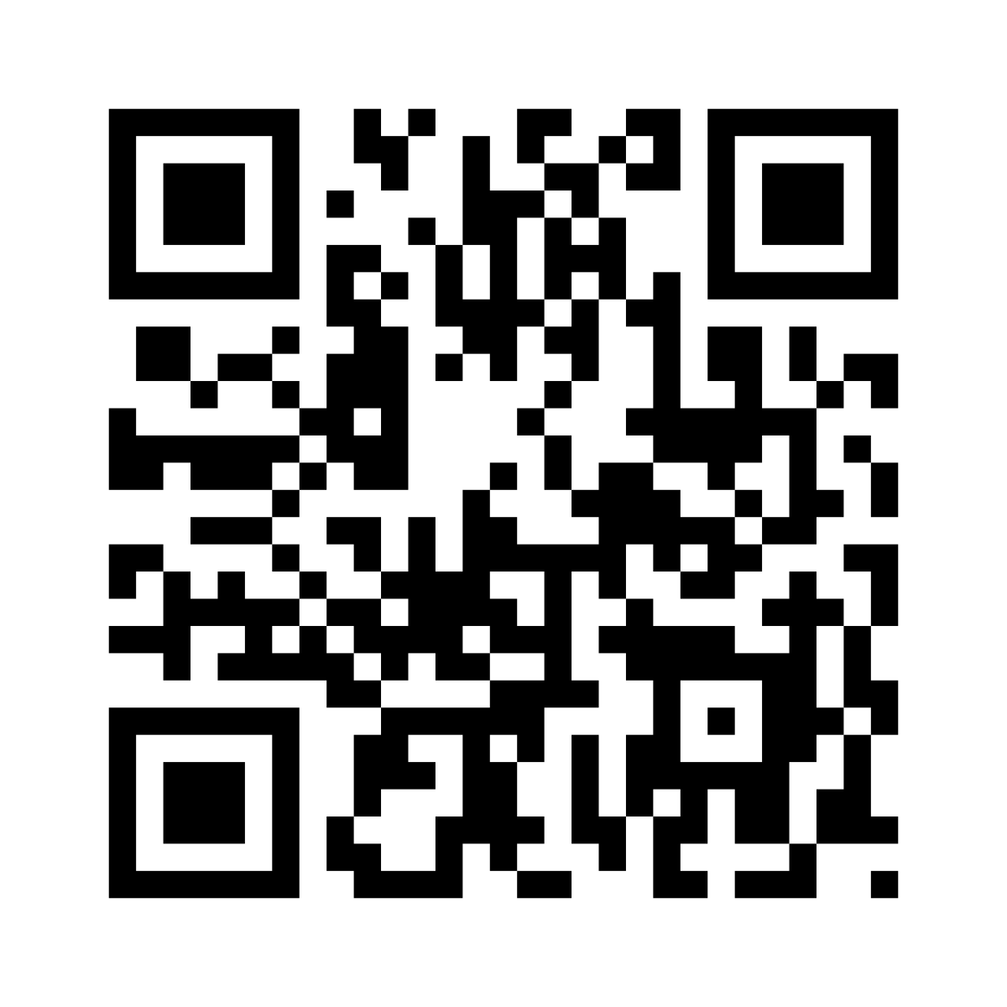
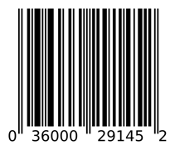
QR Code
Barcode
A QR code (Quick Response Code) is a type of matrix barcode (or two-dimensional barcode) invented in 1994 by Japanese company Denso Wave. Can encode a string which may contain a number, web link, contact details, WiFi password, or any other text.
.. https://en.wikipedia.org/wiki/QR_code
A barcode is a machine-readable optical label

Slide 2
Creating QR Code is easy with Python
https://pypi.org/project/qrcode/
https://github.com/lincolnloop/python-qrcode
pip install qrcode # installs command "qr"
qr "Some text" > test.png
Decoding QR Code into string using Python requires additional libraries/modules:
https://stackoverflow.com/questions/27233351/how-to-decode-a-qr-code-image-in-preferably-pure-python
https://github.com/mchehab/zbar
I found that on Mac it is easier to simply use an App "QR Capture" from Apple App Store.
# pip install pyqrcode
# pip install pypng
import pyqrcode
import png
from pyqrcode import QRCode
ss = "https://www.MyCompany.com/MyForm.html"
url = pyqrcode.create(ss)
url.svg("myqr.svg", scale = 8)
url.png('myqr.png', scale = 6)
Javascript
It is also easy to generate QR codes in Javascript
https://github.com/davidshimjs/qrcodejs
https://github.com/bitjson/qr-code
https://www.geeksforgeeks.org/python-generate-qr-code-using-pyqrcode-module/
https://www.geeksforgeeks.org/generate-qr-code-using-qrcode-in-python/
scanova – custom QR code https://scanova.io/blog/how-to-make-a-custom-qr-code/

Slide 3
vCard
Example of a simple vCard text:
Example of MeCard text (for QR Code):
BEGIN:VCARD
VERSION:4.0
FN:Simon Perreault
N:Perreault;Simon;;;ing. jr,M.Sc.
BDAY:--0203
GENDER:M
EMAIL;TYPE=work:simon.perreault@viagenie.ca
END:VCARD
MECARD:N:Doe,John;TEL:13035551212;EMAIL:john.doe@example.com;;
https://en.wikipedia.org/wiki/MeCard_(QR_code)
MeCard is simpler and shorter, optimized for using in QR Codes.
But you can also use a longer vCard in QR Code as well:
pip install qrcode
bash
qr "MECARD:N:Smith,John;
TEL:1 (212) 123-4567 ;
EMAIL:John.Smith@gmail.com ;
URL:https://www.linkedin.com/in/johnsmith;;" > ~/Desktop/john_smith.png
https://en.wikipedia.org/wiki/VCard
https://github.com/zxing/zxing
https://github.com/zxing/zxing/wiki/Barcode-Contents
vCard (a.k.a. VCF = Virtual Card Format) is a simple text file format standard for electronic business cards. Usual file extension: .vcf or .vcard
The file structure:
BEGIN:VCARD
VERSION: ...
...
...
END:VCARD
VERSION should be on the 2nd line, other properties may go in any order.
Here is a list of properties that can be used (VCF version dependent):
ADR, AGENT, ANNIVERSARY, BDAY, BEGIN, CALADRURI, CALURI, CATEGORIES, CLASS, CLIENTPIDMAP, EMAIL, END, FBURL, FN, GENDER, GEO, IMPP, KEY, KIND, LABEL, LANG, LOGO, MAILER, MEMBER, N, NAME, NICKNAME, NOTE, ORG, PHOTO, PRODID, PROFILE, RELATED, REV, ROLE, SORT-STRING, SOUND, SOURCE, TEL, TITLE, TZ, UID, URL, VERSION, XML
You can create two contacts for yourself in your phone:
One using your portrait, and another using QR Code instead of portrait.
You can use the second contact as your business card. People can scan it to import your contact info into their phone.

Slide 4
WiFi
You can make a QR code for your WiFi So that visitors don't have to type in the password – they can scan the QR Code instead.
Example of WiFi QR Code string:
WIFI:S:MySSID;T:WPA;P:MyPassW0rd;;
where:
MySSID – name of the network
WPA – encryption type
MyPassW0rd – your WiFi password
You can also use "H" to specify if the network is hidden or not
Common format:
WIFI:S:<SSID>;T:<WEP|WPA|blank>;P:<PASSWORD>;H:<true|false|blank>;;
Modern phones may give you this WiFi QR Code – so that you don't have to generate it.
For example, on my Samsung Android phone:
click on Settings > Connections > WiFi
click on the gear icon next to my network,
click on "QR Code"
click on "Save as image"

Slide 5

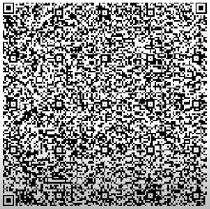
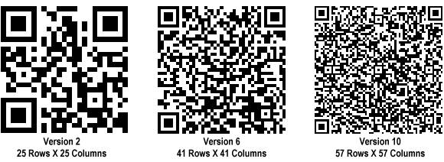
More about QR Codes
https://www.youtube.com/watch?v=KMsvtqQqz5g – very good 16 min video
QR Code sizes / versions:
Micro QR 11x11
V1 21x21 (17 + 4*1) = (17 + 4 * Version)
V2 25x25 (17 + 4*2)
V6 41x41 (17 + 4*6)
. . .
V40 177x177 (17 + 4*40) - 31,329 squares, can encode up to 4296 alphanumeric chars
https://blog.beaconstac.com/2021/11/how-to-perfectly-size-your-qr-codes/
Micro QR 11x11 squares
4296 alphanumeric code

