Slide 1
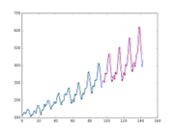
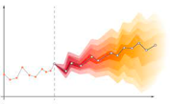
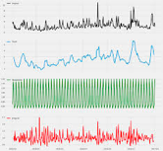
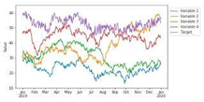
Time Series
with Machine Learning: Problems and Frameworks
by Yuri Shlyakhter

Slide 2

About the Speaker
Yuri Shlyakhter
Data Scientist and AI Practitioner
Former Physicist and former defense software & systems engineer
Recently has been working with Climate and Agricultural data
Yield Predictions - time series (TS) regression
Predicting stable features - TS forecasting
Land Suitability and Similarity - TS similarity and distance
Crop Masking and Field Boundary delineation - TS classification with spatial component
Investigated learning Ag time features - TS annotation and curve fitting/smoothing
Now working on motion classification - TS classification
Looking for more work - also worked on NLP, optimizations, demand prediction, satellite data, building models with climate change projections

Slide 3
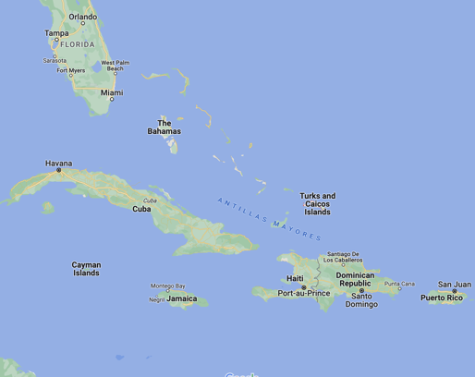

Just Arrived Here

Slide 4
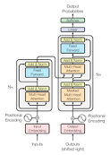
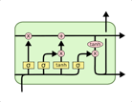
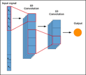

Why this talk
To me TS Forecasting is the least interesting task but it gets most attention (could get lucky and predict stock prices)
Switching to time series classification/clustering tasks, need to pick fast, deployable and performant methods and frameworks
Recently a lot of frameworks were developed to combine traditional and deep learning methods and provide sklearn-like interfaces and pipelines, want to compare
Want to understand when to use and when not to use XGBoost, LSTM, 1-dim CNN, or Transformer-based methods

Slide 5
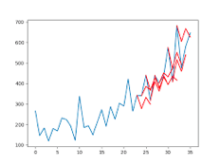
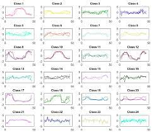
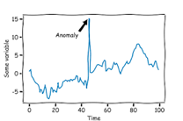

TS Problems - worth defining them explicitly
Forecasting (Given X (t_0 to t) predict t+1, t+2, etc)
Single and Multi variables, with or without exogenous variables)
Imputation - can be a simple preprocessing step or a goal of forecasting
Annotation (find max, min, pattern)
May require smoothing (smoothing less ambiguous word than filtering)
TS Regression - like forecasting but target is a single variable, not a time series
TS Classification - classifying time series data
TS Clustering
Calculate Distance (or similarity measure) between time series
Anomaly detection
TS Similarity/Distances

Slide 6
Time Series ML Task Peculiarities
Specific Time Series data from different domain is very different, methods were developed separately for each field
TS tasks can be solved by normal ML methods
Need time aware train/test split and avoid other data leakage pitfalls
TS specific methods
Traditional (in many fields) and recent ML and DL
Usually implemented in papers, no common library/package
Hence looking at the frameworks that implement or interface with SOTA methods
TS methods can be used on more than one task

Slide 7




Frameworks
sktime - http://www.sktime.net strong classification methods, pipeline with sklearn
DARTS - https://unit8co.github.io/darts/ mostly forecasting, a lot of new Deep Learning Methods
Nixtla - https://www.nixtla.io for large throughput. range of implementation, their own methods (like N-HiTS based on N-Beats)
HCTSA - https://github.com/benfulcher/hctsa in Matlab (10,000 feature generation methods, started from EKG data)

Slide 8
Not Frameworks
XGBoost and other ML methods for time series problems follow techniques to apply ML methods to time series
If not too many time updates, can treat each feature_at_time_i as a separate feature (works for weeks in the agricultural growing season, 20-some weeks for seasonal crops)
Methods described for forecasting, can be applied to other problems Feature Engineering for Time Series Forecasting - by Kishan Manani .. https://www.youtube.com/watch?v=2vMNiSeNUjI .. https://www.udemy.com/user/kishan-manani/ Most of those techniques are incorporated into the framework
Remove time component at all - worked for multivariate time series with correlated behavior (weather and soil moisture data)
New methods which are not in the frameworks yet (Transformers, ViT for TS, 1D CNN for feature extractions)

Slide 9

SKTime
https://github.com/sktime/sktime
Framework compatible with sklearn .. Fit/predict interfaces, features are time series .. Can use sklearn when TS specific estimators not used .. Uses sklearn pipeline (can train estimators togher)
Good balance of functionality, .. super strong on time classification "classical" and DL, .. support forecasting and regression
Added (or will be adding): .. Anomaly Detection, .. Clustering, .. latest algorithms implementations or integrations
https://scikit-learn.org

Slide 10
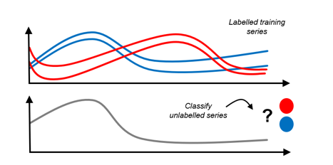
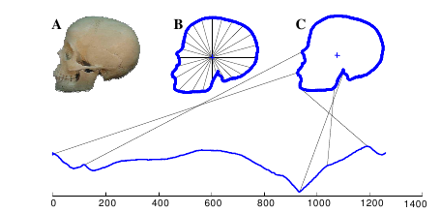
Time Series Classification
From sktime presentations
TS Classification problem
Can convert image classification problem to sequence (Time Series) classification

Slide 11
Approaches to TS Classification problem
Remove time, change to problem solvable by sklearn:
Treat each time update as a separate feature. "tabularize" in sktime terms
Apply feature generator to time series (tsfresh, domain specific feature generators)
Remove time component, switch to point distribution problem (works for multivariate TS). Example - 6 dimensional trajectory with position and velocity data.
Use Time Series classifiers. There are many classifiers: .. Rocket - https://pub.towardsai.net/rocket-fast-and-accurate-time-series-classification-f54923ad0ac9 .. HC2 - https://arxiv.org/abs/2104.07551 .. DTW - https://en.wikipedia.org/wiki/Dynamic_time_warping

Slide 12
Motion classification as a case of TS Classification
Time Series data generated by observing moving objects or part of objects
Gait classification, missile vs drone vs air balloon
Change in the next data point determines by laws of physics (cannot turn or accelerate randomly) easier to forecast and easier to generate features
Traditionally not using TS methods for motion data, could be a good way of building more generalizable solution.

Slide 13



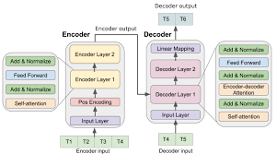

Resources
Data Skeptic Time Series Season .. https://dataskeptic.com/episodes/timeseries
SKTime Related Products .. https://www.sktime.net/en/latest/related_software.html
M3/M4/M5 Forecasting competition .. https://en.wikipedia.org/wiki/Makridakis_Competitions
TS Classification Repository .. http://timeseriesclassification.com
TS Forecasting with Transformers .. https://towardsdatascience.com/multivariate-time-series-forecasting-with-transformers-384dc6ce989b

Slide 14
Conclusion
Useful to work with the framework .. implements range of methods that can be tried, .. includes many recent SOTA papers, .. makes one think of the constraints of the problem
A lot of methods available within Frameworks and outside, still need to learn which methods applicable to each domain
Transformers are coming to Time Series domain as well

Slide 15
Backup

Slide 16
Collection of things to cover
How to approach TS Regression or TS classification problem - this is a problem of Regression and classification where some Xs are TS and Y is not
Time Series methods (Many implemented in frameworks like Time Intervals)
Remove time component by one of two methods (borrowing from SKTime)
Treat each update as independent column. They call it "Tabularize" - go from the whole time series being in the column (Panel Data) to each update in its own column
Create features - TSFresh (ave, std, min/max, lags, fourie, etc), hctsa, create averages and lagged features or do other transformations from knowing of the physics of the problem (Growing Degree Days for agricultural yield models, max turn rate for kinematics)
You can do 2 and still keep time component - as average or lagging features or split time series into Intervals or Serments
You can remove time component by just keeping point distribution - works for multivariate time series like weather or trajectory - two examples

Slide 17
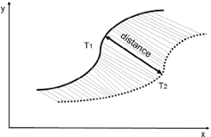
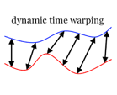
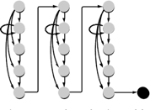
TS Distances
Frechet Distance .. https://en.wikipedia.org/wiki/Fr%C3%A9chet_distance
Dynamic Time Warping .. https://en.wikipedia.org/wiki/Dynamic_time_warping
Distance between HMM models (Hidden Markov Models) .. https://towardsdatascience.com/interpretable-time-series-similarity-with-hidden-markov-models-88fdf7ee4962

