Slide 1




Atlassian Software:
JIRA (tasks, project management)
Confluence (documentation) Bitbucket (Git-based repository)

Slide 2

About the Speaker
Izabella Rakhman
Lead Software Architect & Scrum Master
Corsearch, Inc https://www.linkedin.com/in/izabella-rakhman-a5875b7/

Slide 3


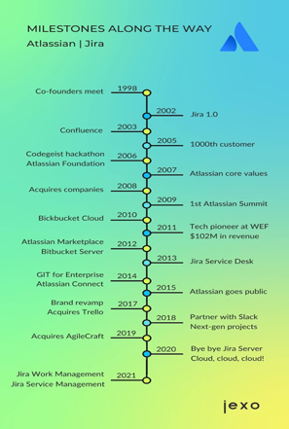
Atlas
2002 - Mike Cannon-Brookes and Scott Farquhar have founded Atlassian. The pair has met while studying at the University of New South Wales in Sydney, Australia
The name Atlassian is a derivation from the titan Atlas in Greek mythology who had been punished to hold up the Heavens after the Greek gods had overthrown the Titans
Atlassian started as a tech support service for software companies
2002 - Atlassian released its flagship product, Jira - a project and issue tracker (named after “Gojira,” which means Godzilla in Japanese.
2004 - Atlassian released Confluence, a team collaboration platform (similar to Wiki) - share documents and other media assets
2010 - Atlassian acquired Bitbucket - a Git-based repository
2022 - ~ 9,000 employees

Slide 4

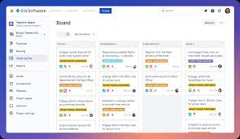
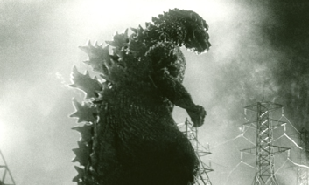
Atlassian JIRA
Since 2002
GOJIRA, 1954

Slide 5


Jira -> tasks
Confluence -> Documentation
Bitbucket -> Git repository

Slide 6

Key JIRA concepts
Jira is the world's most highly recommended Agile project management tool
Jira has the most features out of the box
Jira has an insane plugin library, and it’s all about automating workflows
JIRA allows teams to track issues, manage projects, and automate workflows
JIRA provides powerful reporting capabilities
JIRA integrates with other tools, such as Confluence and Bitbucket
Jira is based on four key concepts: issue, project, workflow, and board

Slide 7
Issues the tasks/tickets you need to finish in order to complete a project.
Projects groups of issues. You can have separate project for each product you are developing. You can configure visibility and workflows per project.
Workflows the paths that issues take as they progress from creation to completion. Each issue starts in the backlog of "To Do" items, then progresses to "In Progress" and "Done" status. You can configure different statuses and trigger actions that occur when an issue moves into a status.
Boards visual representations of your team’s workflow within a project. You can use different types of boards for flexible ways to view, manage, and report on work in progress on the same project. If you use an agile approach, you may find it helpful to use a Kanban Board view to track backlog items as they refine and a Sprint Board to show the Sprint Backlog for your current sprint.

Slide 8
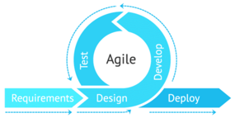
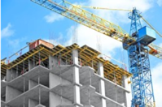
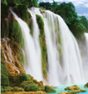

From Waterfall to Agile
Agile (2001)
(Software Development - Iterative)
The Waterfall methodology (1976) (manufacturing & construction)
Analysis
Requirements
Design
Development
Testing & Integration
Deployment
Maintenance
In 2001, a team of 17 visionary software developers held a meeting in Utah to discuss industry problems and possible solutions.
They later created what is known throughout the industry as the Agile Manifesto.

Slide 9
Workflow Management
Agile workflows and processes
Scrum (uses Sprints)
uses regular sprints
allows to deliver results fast (much faster than waterfall)
uses "continuous delivery"
focus on transparency, keeping track of work in real time
reflecting on successes and failures
Kanban (no sprints)
issues are generally thrown straight into the active queue, without the need for planning or time estimates
Focus on Customer’s Needs and Expectations
Change Manage the Work, Not the Workers
Regularly Review the Network of Services
For larger projects, that can be tackled as an iterative series of releases (like creating a piece of software or designing a product), Scrum is likely to be better suited.
For simple projects and processes that will run for the medium to long term (such as customer support), Kanban is a great fit.

Slide 10
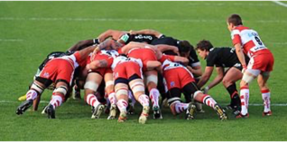
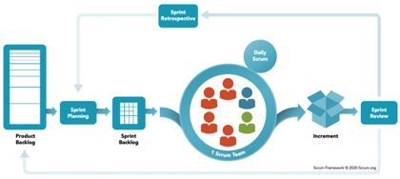
Scrum
Scrum is a simple framework for developing, delivering, and sustaining products
Important components are:
product backlog
planning sprints (sprint backlog)
daily scrum meetings
sprint review and retrospective
A scrum (short for scrummage) is a method of restarting play in rugby football that involves players packing closely together with their heads down and attempting to gain possession of the ball.

Slide 11

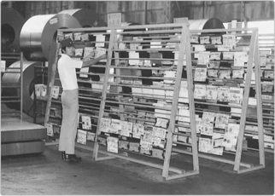
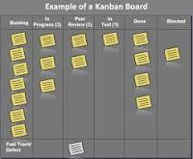
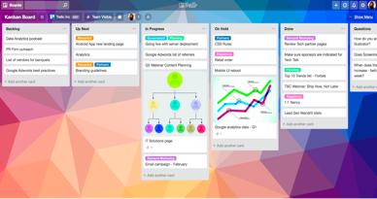
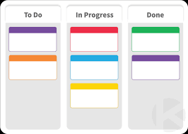
Kanban Board
Kanban - a Japanese system (introduced by Taiichi Ohno from Toyota) in which the manufacturing process is tracked and regulated through the use of an instruction cards.
A kanban board is an Agile-based project management tool that visualizes a project’s progress

Slide 12
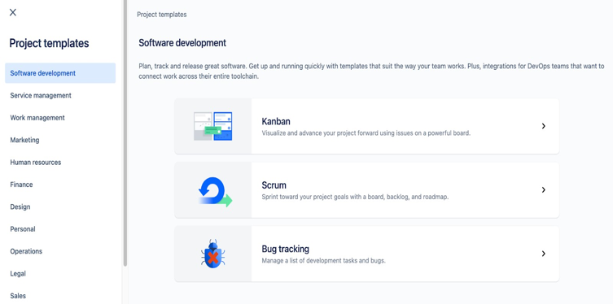
Project Templates

Slide 13
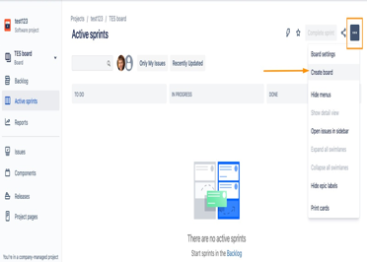
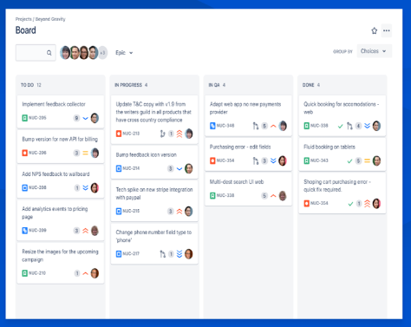
Agile Board in JIRA

Slide 14
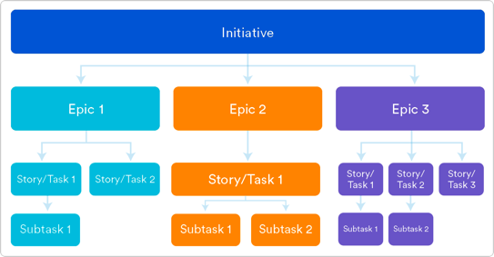
Jira Issue Types: Epic vs. Story vs. Task
https://community.atlassian.com/t5/Jira-articles/Difference-and-use-cases-of-Jira-issue-types-Epic-vs-Story-vs/ba-p/1655157

Slide 15
Setting Up a JIRA Project is Easy
First, you need to create a project and define the scope of the project.
Analyze the project in detail and split it into stories and to-do lists inside them
Analyze each item in those stories
Do the estimation of time and resources needed for each item
Add users to the project and assign tasks to each user
Set up the project's workflow and configure the project's settings
Start 1st Sprint
Do daily short 15 min scrum meetings to track the progress

Slide 16
How to Set Up a JIRA Project
JIRA also provides powerful reporting capabilities that make it easy to track progress and identify areas of improvement.
It also integrates with other tools, such as Confluence and Bitbucket, making it easy to share information and collaborate with other teams.

Slide 17
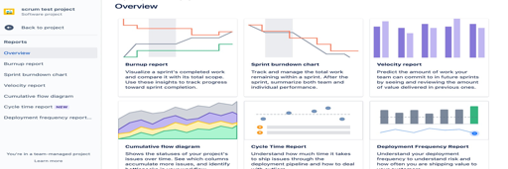
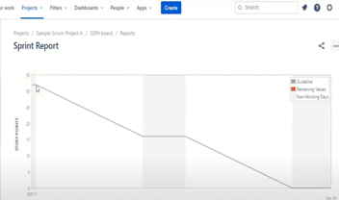
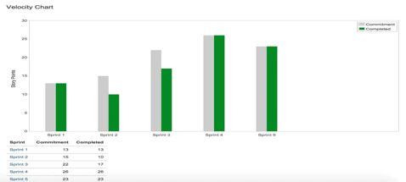
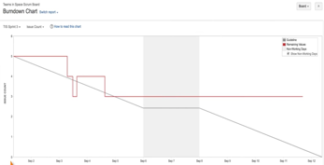
Sprints and Agile Reporting for Scrum in Jira

Slide 18
Summary: Benefits of Using Atlassian JIRA
JIRA provides a comprehensive set of features that make it easy to manage projects and tasks
It allows teams to easily track progress, prioritize tasks, and keep everyone up-to-date
It also provides powerful reporting capabilities and integrates with other tools, such as Confluence and Bitbucket
JIRA also provides an intuitive user interface that makes it easy to use
It is highly customizable and allows teams to tailor the software to their specific needs
It is also highly scalable and can be used for both small and large projects.

Slide 19
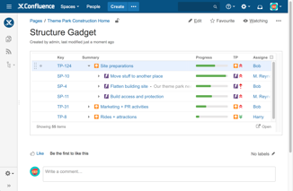
Atlassian Confluence
Since 2004

Slide 20
Key Confluence Concepts
Confluence - creating documentation.
Confluence is basically a wiki for your team.
You can create, collaborate, and organize all your work in one place using dynamic wiki-style pages
Spaces help your team structure, organize, and share work, so every team member has visibility into institutional knowledge and access to the information they need to do their best work
Confluence is for teams of any size and type, from those with mission-critical, high-stakes projects that need rigor behind their practices, to those that are looking for a space to build team culture and engage with one another in a more open and authentic way.

Slide 21
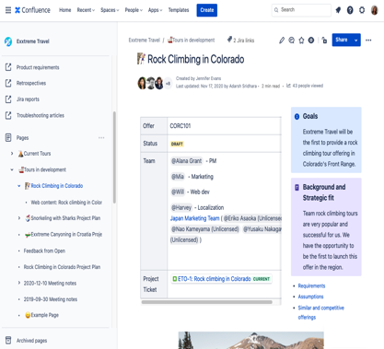
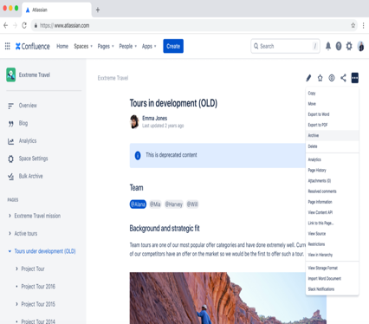
Teams’ “Spaces” in Confluence

Slide 22
Confluence is designed to improve:
team productivity
centralized knowledge base
collaboration in real-time
commenting, sharing
document creation (such as templates and macros)
version control
Confluence is often used with other Attlassian products like JIRA and Bitbucket

Slide 23

Atlassian BitBucket
https://en.wikipedia.org/wiki/Bitbucket
Since 2008
Bitbucket is a Git version control repository hosting service
Was created in 2008 (Git was released in 2005)
Owned by Atlassian since 2010
Written in Python using Django web framework
Integrates well with other Atlassian products (Jira, wiki, ...)
Offers free and paid plans, very comparable to GitHub

Slide 24
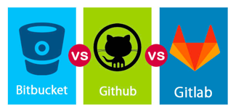
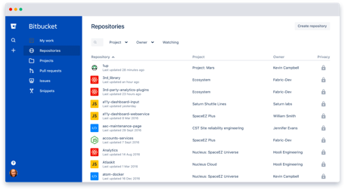
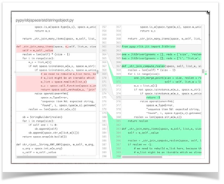
Bitbucket vs GitHub vs GitLab
Bitbucket Interface
Bitbucket diffs view

Slide 25



Links
https://www.atlassian.com
https://www.atlassian.com/software/jira
https://www.atlassian.com/software/confluence
https://www.atlassian.com/software/bitbucket
JIRA for Beginners- by Stewart Gauld - https://www.youtube.com/watch?v=GWxMTvRGIpc -
Getting Started in Confluence - https://www.youtube.com/watch?v=kaNPNbAT-as - https://www.youtube.com/watch?v=5p3QzaS33GA
Bitbucket tutorial - https://www.youtube.com/watch?v=M44nEyd_5To

Slide 26
Backup (Extra Slides)

Slide 27

Working with Kanban Boards
CONWIP - Constant Work In Progress
“Stop starting and start finishing”
Better approach - limit the total number of tasks in the Kanban board instead of just limiting tasks per column.
CONWIP – use "tickets".
Each key account manager gets two "Todo tickets" to use on the Kanban board. Once placed on the board, the ticket would then be stuck to the task, until it had travelled all the way to the Done column. Only then would it be released back to the owner.
2017 by Thorbjørn Sigberg
https://www.miles.no/case-study-the-pursuit-of-flow-part-1/
https://www.miles.no/case-study-the-pursuit-of-flow-part-2/
https://kanbanize.com/blog/patrick-steyaert-customer-kanban/
The goal – to improve throughput and quality of the team efforts by limiting
the number of tasks on the Kanban board.
First improvement – set smaller WIP (Work In Progress) limits on columns.
The new board had up to 40 tasks in the following columns:
Backlog (invisible) | Todo(10) | In progress(20) | Acceptance(10) | Done
We reduced 12 (!) different classes of service down to the following four:
Normal, Fixed deadline, Urgent, Critical
New tasks were selected based on priority, capacity and competence
Focus on unblocking and finishing existing tasks before starting new ones
Do not start new task without enough information/resources to complete it
Completed tasks are moved to “Acceptance”. It is not moved to “Done” until the customer accepted it.
In addition, each of 7 account managers would get an extra (3rd) ticket for small, urgent tasks. So we had 14-21 tickets on the board. Also bugs/problems would not require a ticket, to ensure priority.
For faster rotation of tickets, account managers started to slice their tasks into smaller chunks. They were also more eager to help out with blocked tasks and helping to get customer's acceptance.
The effect was dramatic – more done in less time:
cycle time reduced from 10 to 4 days
lead time reduced from 4 weeks to 1 week
much less stress, less tasks in progress at any given time

Slide 28
Many PM Tools
Jira - https://www.atlassian.com/software/jira
SmartSheet - https://www.smartsheet.com
Asana - https://asana.com
Trac - https://en.wikipedia.org/wiki/Trac
ProjectLocker - https://www.projectlocker.com (managed trac)
More Similar to JIRA:
ClickUp
Binfire
Basecamp
Pivotal Tracker
Clubhouse
Trello - https://trello.com
ProofHub
Kanbanize
Notion
Wrike
Bitrix24
Azure DevOps
See long ( ~40 ) list of DevOps & bug-tracking tools here:
.. https://en.wikipedia.org/wiki/Comparison_of_issue-tracking_systems
Note that for small scale projects people successfully
use Google Docs/Sheets:
.. https://moz.com/blog/visualising-time-using-google-sheets

Slide 29
ChatGPT, give me five best short jokes about agile project management
Why did the Scrum Master go to the bank? To make a withdrawal from the Sprint.
Why did the Agile coach refuse to come to the meeting? Because they were already fully booked for the next 2 weeks.
What do you call an Agile project manager who doesn't use Post-It notes? UnScrumptious.
What do you get when you cross Agile with Waterfall? A project that's constantly falling, but also always trying to get back up.
How many Agile coaches does it take to change a light bulb? None, they'll just facilitate a retrospective to figure out why the bulb went out in the first place.
ChatGPT, give me five most famous short jokes about agile development process
Why did the Agile developer refuse to go on a coffee break? Because they were already in a stand-up.
What's the difference between Waterfall and Agile? In Waterfall, you drown. In Agile, you sprint.
Why do Agile teams prefer to work in small iterations? So they can avoid committing large sins.
How many Agile developers does it take to change a light bulb? None, they just refactor the darkness.
Why do Agile developers prefer to work in pairs? Because two heads are better than one, and three is considered a crowd.

