Slide 1
Comparing IT Project Management Tools
Asana
Jira
Bugzilla
trac

Slide 2

About the Speaker
Inna Botchkina
Software Engineer
Project Manager
Former Research Scientist (UCSF)
New York / San Francisco

Slide 3
Many IT Project Management Tools
More Similar to JIRA:
ClickUp
Binfire
Basecamp
Pivotal Tracker
Clubhouse
Trello - https://trello.com
ProofHub
Kanbanize
Notion
Wrike
Bitrix24
Azure DevOps
Jira - https://www.atlassian.com/software/jira
SmartSheet - https://www.smartsheet.com
Asana - https://asana.com
Bugzilla - https://www.bugzilla.org
Trac - https://en.wikipedia.org/wiki/Trac
ProjectLocker - https://www.projectlocker.com (managed trac)
See long ( ~40 ) list of DevOps & bug-tracking tools here:
.. https://en.wikipedia.org/wiki/Comparison_of_issue-tracking_systems
Note that for small projects people successfully use Google Docs/Sheets:
.. https://moz.com/blog/visualising-time-using-google-sheets
Forbes Advisor: Best Software for Project Management of 2023
Monday.com: Best For Startups On A Tight Budget
Airtable: Best For Data-Driven Companies
ClickUp: Best For Agile Development Teams
Notion: Best For Content Creators
Confluence: Best For Virtual Teams
Teamwork: Best For Client-Facing Service Providers
Note that there are many separate dedicated tools for other areas:
ITSM = IT Service Management (Zendesk, etc.)
Devops (automation of dev, test, & release procedures)
Managing sales (Salesforce, etc.)
Agile Enterprise Management (Planview, Digital.ai, etc.)

Slide 4




Traditional Ways of Managing Projects
Cinderella
Tom Sawyer

Slide 5

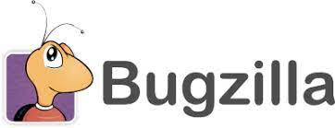
Bugzilla
https://www.bugzilla.org
https://en.wikipedia.org/wiki/Bugzilla
https://www.linkedin.com/in/terryweissman/
https://www.bugzilla.org/about/developers/terry/
Terry Weissman
1998 - Terry Weissman created Bugzilla for Mozilla.org project
Bugzilla was originally written in Tcl, then ported to Perl
Bugzilla is a web-based bug tracking system and testing tool
Bugzilla is open source
Bugzilla is used by:
Mozilla Foundation
WebKit
Linux kernel
FreeBSD
KDE
Apache
Eclipse
LibreOffice
Red Hat (gradually migrating to Jira)

Slide 6


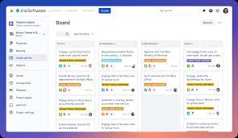


JIRA
2002 - Mike Cannon-Brookes and Scott Farquhar have founded Atlassian. The pair has met while studying at the University of New South Wales in Sydney, Australia
The name Atlassian is a derivation from the titan Atlas in Greek mythology who had been punished to hold up the Heavens after the Greek gods had overthrown the Titans
Atlassian started as a tech support service for software companies
2002 - Atlassian released its flagship product, Jira - a project and issue tracker (named after “Gojira,” which means Godzilla in Japanese.
2004 - Atlassian released Confluence, a team collaboration platform (similar to Wiki) that lets users co-create content, and share documents and other media assets
2022 ~ 9,000 employees
Atlas
Gojira, 1954

Slide 7
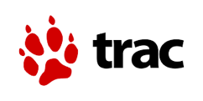


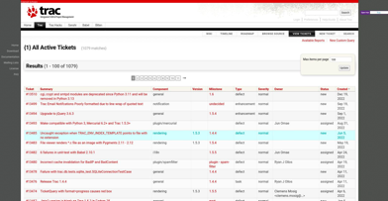
trac
Jonas Borgström
(Stockholm)
Daniel Lundin
(Stockholm)
Trac is an open-source, web-based PM & bug tracking system
2004 - first release of trac
Edgewall Software is hosting edgewall.org website for development of open source Python software
~20 employees (in 2022)
https://trac.edgewall.org
https://en.wikipedia.org/wiki/Trac
https://trac.edgewall.org/browser
Trac integrates with Subversion and Git out of the box
Trac is available on Linux, MacOS, and MS Windows
Originally written by Jonas Borgström and Daniel Lundin
Written in Python, can use MySQL, PostgreSQL

Slide 8
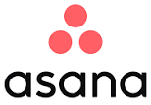

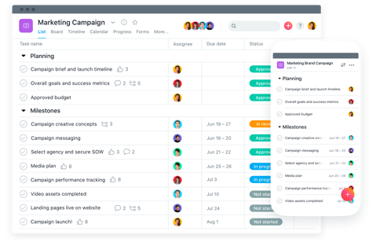
Asana
Dustin Moskovitz & Justin Rosenstein
Asana, Inc. was founded in 2008
by Dustin Moskovitz & Justin Rosenstein
based in San Francisco
1,700+ employees
cost - $11 per month per team member
https://en.wikipedia.org/wiki/Asana,_Inc.
https://asana.com

Slide 9
What is a bug-tracking system?
Bug-tracking systems are meant for software development. They allow teams of developers to effectively keep track of outstanding bugs (or defects), problems, issues, enhancement, new features and other change requests.
Bugzilla and Trac are free and open source and are specifically meant for bug and issue tracking for technical teams working on software development projects.
Bug/Issue Tracking vs Project Management
Jira
both bug/issue tracking system and project management software
initially it was purely issue tracking software, targeted at software developers, but it was later adopted by non-IT organizations as a project management tool
primary focus is on Agile software development, with features like Kanban and Scrum boards, burndown charts, and custom workflows
an advanced tool with extensive customization options and has a steeper learning curve
Asana
a more general-purpose project management tool that can be used for a wide range of projects and industries
user-friendly interface and intuitive design makes it easy for teams to get started and stay organized

Slide 10




Side by Side Comparison
Free and Open Source (since 1998)
Bug tracking and issue management
Written in Perl
Used by many important famous projects (Linux Kernel, Apache, Mozilla, ...)
Feature-rich and customizable
UI a bit dated and unintuitive
Free and Open Source (since 2004)
Bug tracking and issue management
Wiki functionality
Written in Python
Bare-bones but there are many plugins
Requires technical expertise to set it up
Commercial, but Free up to 10 people (2002)
$7.75/mo per user
Project Management, Bug Tracking
Agile methodology (Scrum and Kanban)
Very customizable and feature-rich
Very common for IT projects
Steeper learning curve
Commercial but Free up to 15 people (since 2012)
$10.99/mo per user
Project Management, Task Tracking, Team Collaboration
Simple and intuitive UI for managing tasks and projects
More general-purpose project management tool
but used in software

Slide 11


- Jira (/ˈdʒiːrə/ JEE-rə) is a proprietary issue tracking product developed by Atlassian that allows bug tracking and agile project management. When launched in 2002, Jira was purely issue tracking software, targeted at software developers. The app was later adopted by non-IT organizations as a project management tool.
- Type: Bug tracking system, project management software.
- The product name comes from the second and third syllables of the Japanese word pronounced as Gojira, which is Japanese for Godzilla. The name originated from a nickname Atlassian developers used to refer to Bugzilla, which was previously used internally for bug-tracking.
- In March 2019, Atlassian's value was US
$26.6 billion.
- Atlassian Headquarters: Sydney, Australia
- Asana, Inc. (/əˈsɑːnə/ or /ˈɑːsənə/), is an American software company based in San Francisco whose flagship Asana service is a web and mobile "work management" platform designed to help teams organize, track, and manage their work.
- Type: Project management and Process management software.
- Asana, Inc. was founded in 2008 by Dustin Moskovitz and Justin Rosenstein. The co-founders met at Facebook, where Moskovitz, Facebook's co-founder and vice president of engineering, and his colleague Rosenstein created a productivity tool called Tasks. In 2008, the co-founders left Facebook to start Asana. Asana launched commercially in April 2012.
- In September 2020, the company was valued at $5.5 billion following its direct listing.
- Asana Headquarters: San Francisco, California

Slide 12
Bugzilla
Free and open source
Bug tracking, feature requests, patches and code reviews
A robust, featureful and mature bug-tracking system
Packed with features that many expensive solutions lack
.. https://www.bugzilla.org/about/features
Some features include Custom Fields, Advanced Search, Custom Email Notifications, Workflow Management, bug visibility control (security), etc.
Speed and efficiency, lightweight implementation, customizable, can be integrated
Under active development and supported by a dedicated team and has a lot of community support
Originally developed by the Mozilla project, used by Linux, Apache,
Adopted by many open-source projects as their bug tracking system of choice
Used by hundreds or thousands of organizations across the globe
“Bugzilla is both free as in freedom and free as in price. Most commercial defect-tracking software vendors charge enormous licensing fees. Despite being free, Bugzilla has many features which are lacking in both its expensive and its free counterparts.”

Slide 13
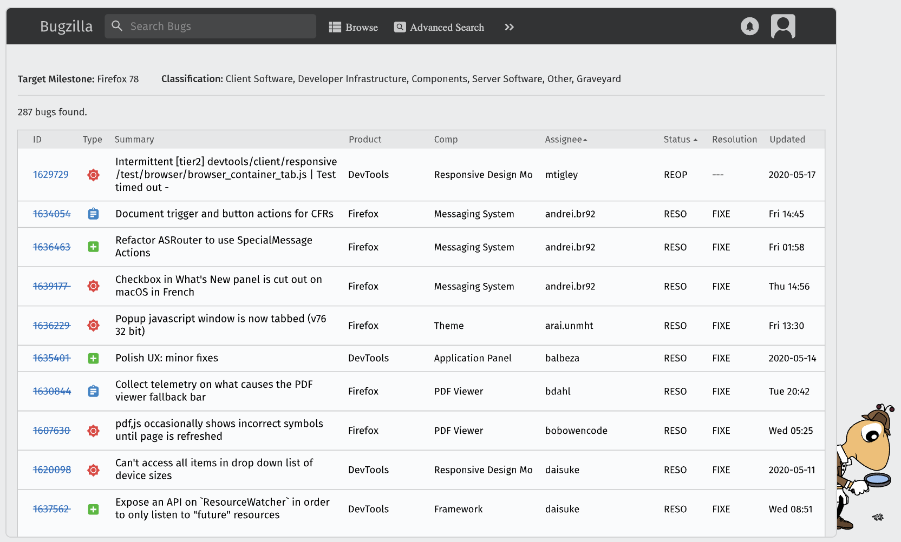
Bugzilla - Typical Screen

Slide 14
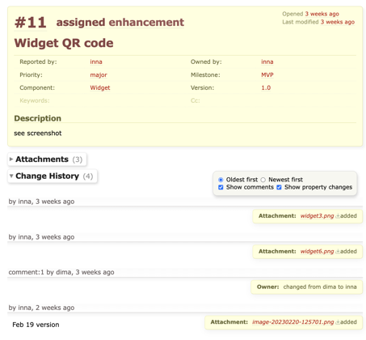
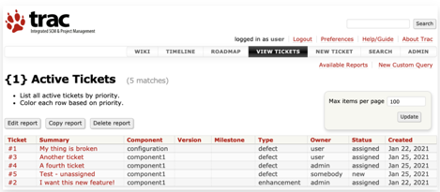
trac - Typical Screens

Slide 15
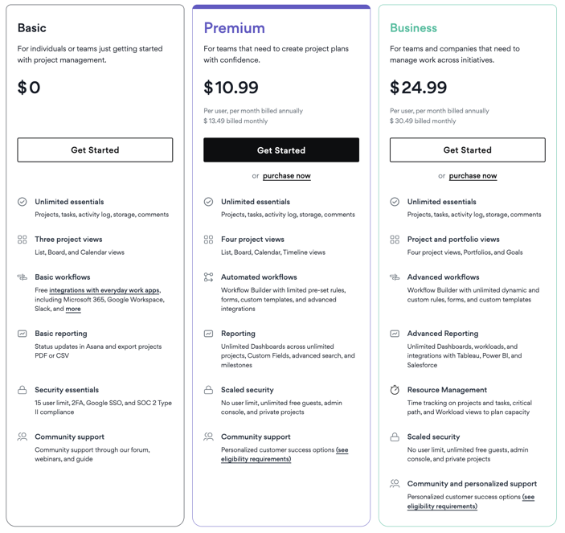
Asana Pricing

Slide 16
Overview of Asana Free vs Premium
Asana Free - $0 (Free)
Up to 15 users
Unlimited projects and tasks
Unlimited essentials - Projects, tasks, activity log, storage, comments
Unlimited storage space, with a 100MB file size limit
Views available: List, Board, and Calendar (not included: Timeline, Workflow, and Dashboard views)
Basic workflows
Free integrations with everyday work apps, including Microsoft 365, Google Workspace, Slack, and more
Basic reporting - Status updates in Asana and export projects PDF or CSV
Security essentials - 15 user limit, 2FA, Google SSO, and SOC 2 Type II compliance
Community support - Community support through our forum, webinars, and guide
Asana Premium
$10.99/user per month annually or $13.49/user a month if billed monthly
For more than 15 team members; up to 100 members
Additional features such as timeline view, custom fields, advanced reporting, forms, rules, task dependencies, and advanced search

Slide 17

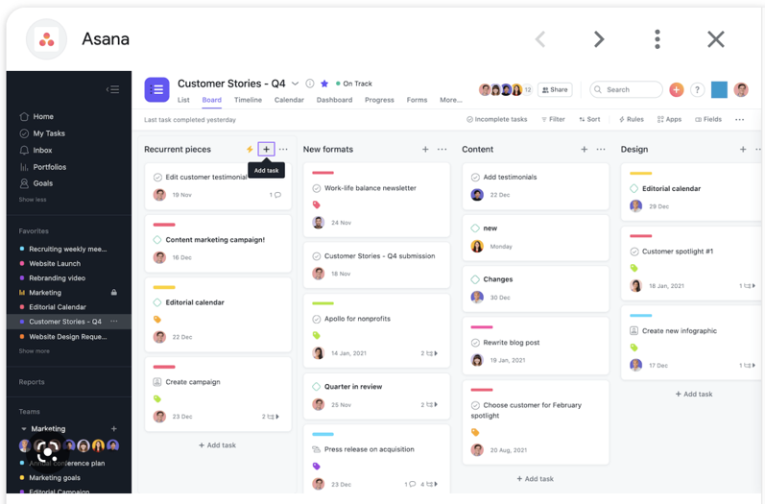
Board View

Slide 18
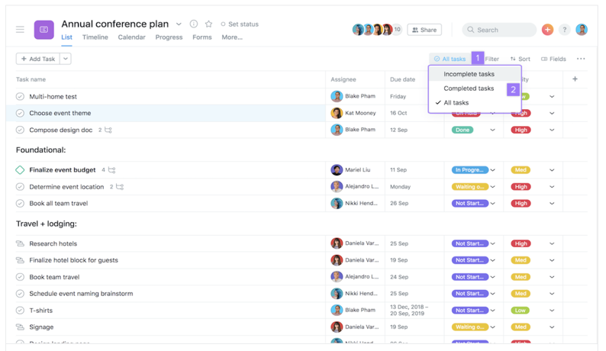
List View

Slide 19
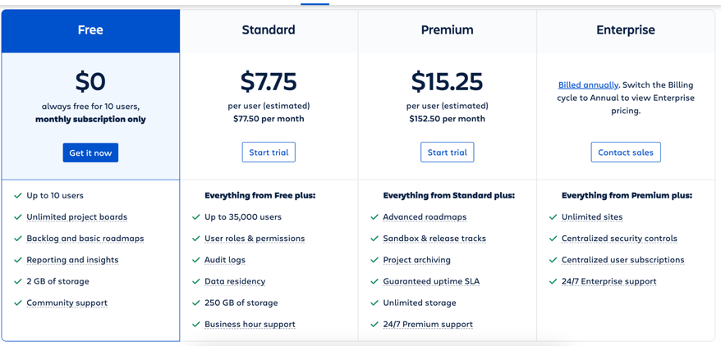
Jira Pricing

Slide 20
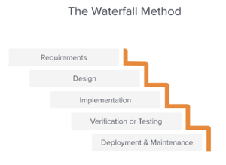
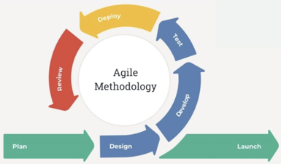
Two Project management methodologies - Agile vs Waterfall
Waterfall:
linear approach
completing each phase of a project before moving on to the next one
origin: 1976 (manufacturing & construction)
for projects where the requirements are well defined,
and the end product is expected to remain the same throughout the project
“Measure 7 times - then cut once”
Agile:
iterative approach
a continuous cycle of planning, analysis, implementation, and evaluation
origin: 2001 (software development, Agile manifesto)
adaptability and flexibility, delivering software in small increments
4 principles/core values
2 specific Agile methodologies: Scrum and Kanban
“Fire - then aim”

Slide 21
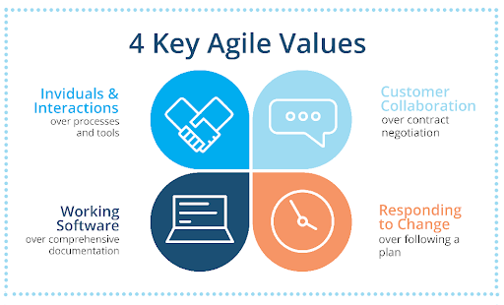
communication, collaboration, and teamwork between developers, stakeholders, and customers
the focus is on delivering the highest value features and responding to changing requirements as they arise, rather than sticking to a rigid plan

Slide 22
Two specific Agile methodologies - Scrum vs Kanban
Scrum:
Structured and iterative approach, frequent inspection
Iterations - Regular, fixed length SPRINTS (typically 2 weeks)
Specifically designed to track progress within a sprint and complete the sprint goals
Structured and has specific principles, roles, ceremonies, and artifacts
Four pillars of Scrum: sprints, sprint planning, daily stand ups, and sprint retrospectives/review
Daily scrums or stand ups (stand up meetings) - to track progress and unblock if needed
Backlog, Roadmap, Custom Workflows, Boards / Swimlane, Projects
Issue types: Bug, User Story, Epic, Coffee Runs, Custom Types (e.g., components) and Fields
Roles - Product owner, scrum master, development team
Scrum values: courage, focus, commitment, respect and openness
Kanban:
Continuous flow, a less structured and more flexible approach
Continuous delivery and workflow optimization, flexible processes, team collaboration
Visualizing the workflow (a visual board to track work in progress)
Flexible processes, no required roles or ceremonies, the whole team owns the board
Limiting WIP (work in progress ) - complete tasks before starting new ones to maximize efficiency
Focus on continuous delivery and work in progress, changes can be made at any time

Slide 23
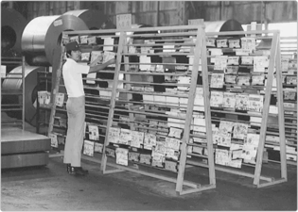
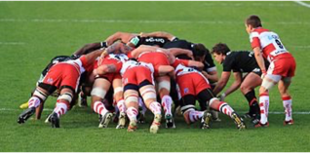
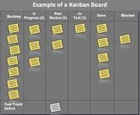
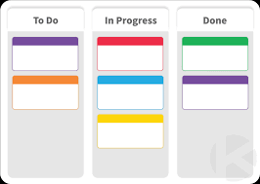
Kanban: originated in Japan (Toyota) :
visual board to see status,
moving cards from left to right
Scrum = restart the game
restart --> sprint
restart --> sprint
restart --> sprint

Slide 24
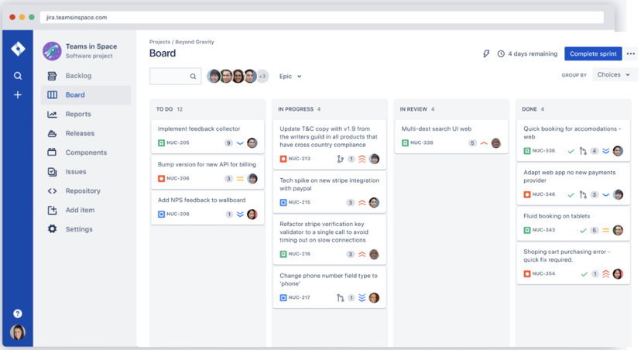
A Jira Scrum board https://www.atlassian.com/software/jira/features/scrum-boards

Slide 25
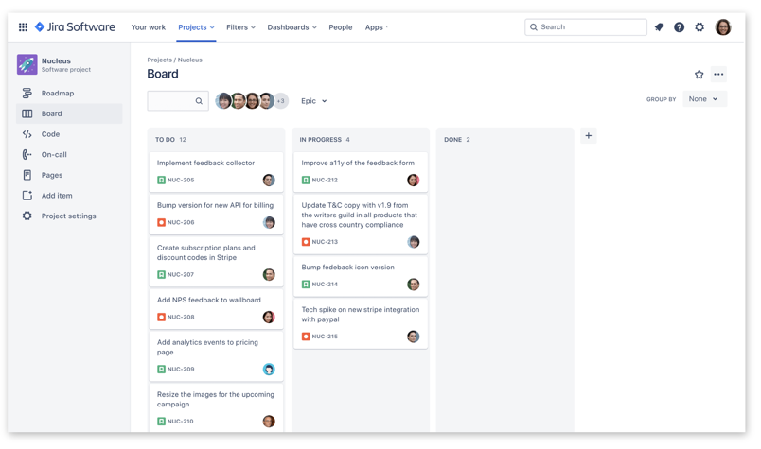
A Jira Kanban board
https://www.atlassian.com/software/jira/templates/kanban

Slide 26
CONCLUSION
Bugzilla and Trac are free and open source bug and issue tracking tools for software development. Bugzilla is more popular and feature-rich than Trac
Jira and Asana are very popular Project Management tools that are both commercial software (with free version for small teams). Jira is less expensive (at $7.50/mo/user vs $10.99 for Asana)
Asana is a more general-purpose project management tool and is used for a wide range of projects and industries and is praised for its user-friendly interface and intuitive design
Jira is most widely used by software engineering and product teams because it is designed specifically for their needs. Jira is focused on Agile development and offers features that are directly related to a software development lifecycle
Scrum and Kanban are two specific Agile methodologies. Both are popular, effective and widely used in software development. Kanban is more flexible and focused on continuous delivery and is well suited for teams that value flexibility and continuous improvement. On the other hand, Scrum is highly structured and specifically designed to track progress within a sprint and ensure that the team is working towards completing the sprint goal. It is better suited for teams that need structure and discipline to deliver working software in small increments.
Some teams use a combination of both methodologies, sometimes referred to as Scrumban, to get the best of both worlds.

Slide 27


Jokes
What do you call an Asana user who never completes their tasks? A downward-facing procrastinator.
What's the difference between Waterfall and Agile? In Waterfall, you drown.
In Agile, you sprint.
GOJIRA, 1954

Slide 28
Links
Jira .. https://www.atlassian.com/software/jira
Asana .. https://asana.com .. https://en.wikipedia.org/wiki/Asana,_Inc.
Bugzilla .. https://www.bugzilla.org .. https://www.bugzilla.org/about/features
Trac .. https://en.wikipedia.org/wiki/Trac .. https://trac.edgewall.org .. https://trac.edgewall.org/browser

