Slide 1
Categorical Features in Random Forest and Boosting Models
idx | Toyota | Ford | Mercedes
1 | 1 | 0 | 0
2 | 0 | 1 | 0
3 | 0 | 1 | 0
4 | 0 | 0 | 1
5 | 0 | 1 | 0
6 | 0 | 0 | 1
7 | 1 | 0 | 0
8 | 0 | 1 | 0
By Dequan Er, Ph.D.

Slide 2

About Speaker
Dequan Er, Ph.D.
Lead Data Scientist @ NDR
erdeq.upenn@gmail.com
LinkedIn: https://www.linkedin.com/in/dequan-er-69518643/

Slide 3
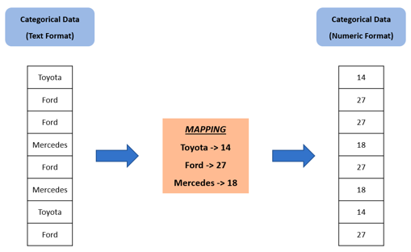
What is Categorical Data
Some of your features may be discrete values that aren't in an ordered relationship.
Examples include breeds of dogs, words, or postal codes.
These features are known as categorical and each value is called a category.
idx | Toyota | Ford | Mercedes
1 | 1 | 0 | 0
2 | 0 | 1 | 0
3 | 0 | 1 | 0
4 | 0 | 0 | 1
5 | 0 | 1 | 0
6 | 0 | 0 | 1
7 | 1 | 0 | 0
8 | 0 | 1 | 0
Ordinal Encoding
One-Hot Encoding

Slide 4
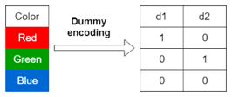
Encoding Categorical Data
idx | Toyota | Ford | Mercedes
1 | 1 | 0 | 0
2 | 0 | 1 | 0
3 | 0 | 1 | 0
4 | 0 | 0 | 1
5 | 0 | 1 | 0
6 | 0 | 0 | 1
7 | 1 | 0 | 0
8 | 0 | 1 | 0
https://machinelearningmastery.com/one-hot-encoding-for-categorical-data/
If your data contains categorical (nominal or ordinal) data, you must convert (encode) it to numbers before using it with ML.
Note: if the data has built-in ordering, it is called "Ordinal".
One-Hot Encoding
There are three common encoding methods:
Ordinal Encoding = substitute by integer (red:1, green:2, ...). Careful - this encoding imposes an ordinal relationship where it may not exist
One-Hot Encoding (for N values use N columns)
Dummy Variable Encoding (for N values use N-1 columns)
# ordinal
from sklearn.preprocessing import OrdinalEncoder
encoder = OrdinalEncoder()
result = encoder.fit_transform(data)
# one-hot: separate column for each value
from sklearn.preprocessing import OneHotEncoder
encoder = OneHotEncoder(sparse=False)
onehot = encoder.fit_transform(data)
# dummy: like one-hot, but without one value
from sklearn.preprocessing import OneHotEncoder
encoder = OneHotEncoder(drop='first', sparse=False)
onehot = encoder.fit_transform(data)
# when sparse=True, the output datatype is a sparse matrix
# of type scipy.sparse.csr_matrix
# when sparse=False, the resulting datatype is a dense
# numpy array of type numpy.ndarray

Slide 5
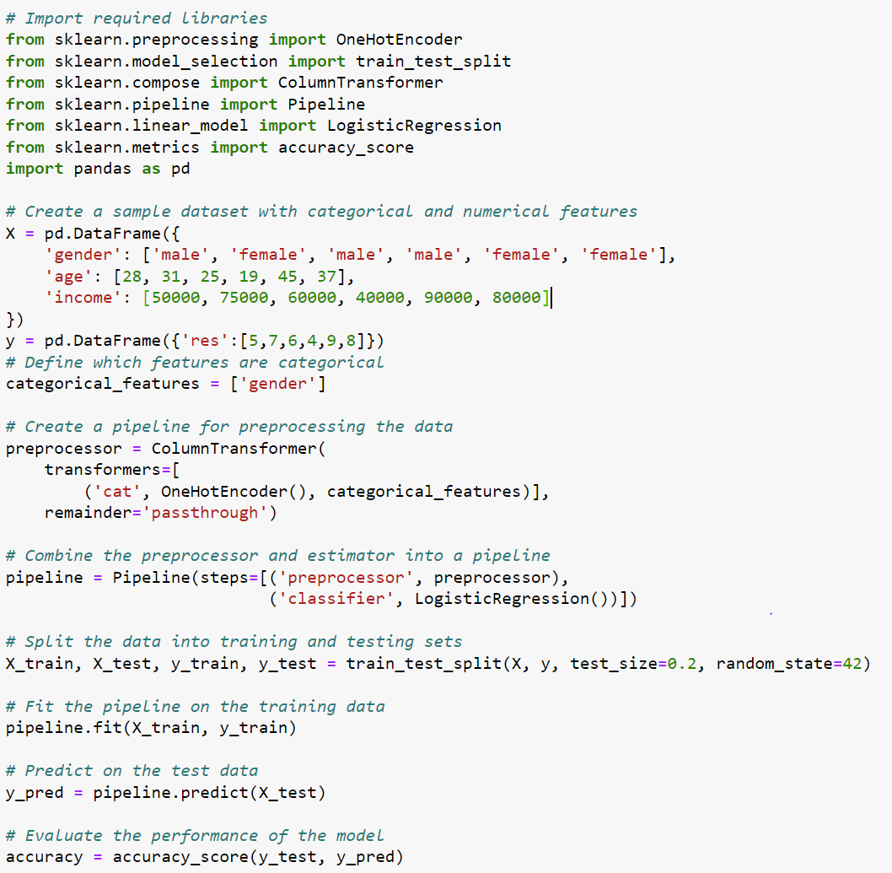
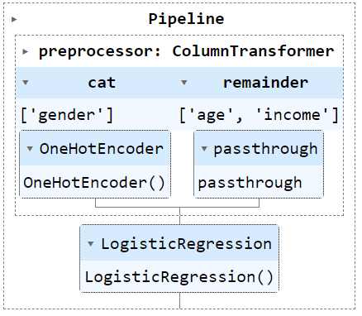
Example - Classification or Regression with Binary Features
# Sklearn
Using OneHotEncoder()
https://inria.github.io/scikit-learn-mooc/python_scripts/ensemble_random_forest.html

Slide 6
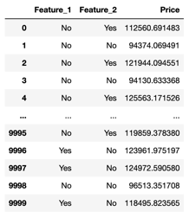
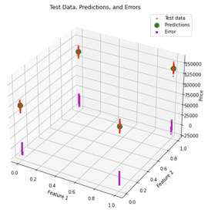
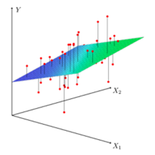
Example - Regression with just two binary features
http://localhost:8888/notebooks/nb_ChatGPT_XGBoost_Regressor.ipynb
In this example, we used synthetic data with two
binary categorical features and one numeric target.
We use dxgboost.XGBRegressor() model
Compare with regression over numeric features
Y = b₀ + b₁x₁ + b₂x₂

Slide 7

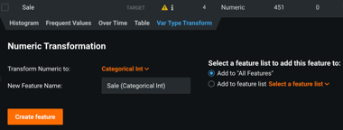
An example from real life
DataRobot: https://www.datarobot.com
DataRobot assigns data types automatically.
But you can control or overwrite the types.
For example, you can convert numeric zip code to categorical by adding non-numeric prefix: "zip_12741"
In DataRobot you can create a new feature as type "Categorical Int" which will treat this feature as categorical via the "Var Type Transform" tab.
You can also change the data type using the method "batch_features_type_transform".
Weather to use categorical type or not?
You may need to try both ways to see which gives you a better model.

Slide 8
Some Libraries Can't Handle Categorical Features
"(sklearn) one-hot encoding does not handle the categorical data the right way for random forest, ... You can easily see that by using R randomForest package which gives a totally different result, and it is not only by the random variance, you can repeat as much as you want the accuracy reached by scikit-learn using one-hot encoding is not even close to R's randomForest package"
https://stackoverflow.com/questions/24715230/can-sklearn-random-forest-directly-handle-categorical-features
Some libraries (like CatBoost, for example) are designed to handle categorical features automatically (no preprocessing is needed).

Slide 9
Python vs R
Different results even on a simple example
Python
R
# Python
import pandas as pd
from sklearn.ensemble import RandomForestClassifier
data = {
'Feature_A': ['red', 'red', 'green', 'blue', 'blue'],
'Feature_B': ['small', 'big', 'small', 'big', 'small'],
'Feature_C': ['low', 'high', 'high', 'low', 'high'],
'Label': [0, 1, 1, 0, 1]
}
df = pd.DataFrame(data)
df_dummies = pd.get_dummies(df, drop_first=True)
X = df_dummies.drop(columns=['Label'])
y = df_dummies['Label']
rf = RandomForestClassifier(random_state=42)
rf.fit(X, y)
print(rf.feature_importances_)
# A_green A_red B_small C_low
# 0.08 0.16 0.16 0.60]
# R
install.packages("randomForest")
library(randomForest)
data <- data.frame(
Feature_A = factor(c("red", "red", "green", "blue", "blue")),
Feature_B = factor(c("small", "big", "small", "big", "small")),
Feature_C = factor(c("low", "high", "high", "low", "high")),
Label = factor(c(0, 1, 1, 0, 1)) # Convert 'Label' to factor
)
data_dummies <- model.matrix(~ . - 1, data)
data_dummies <- data.frame(data_dummies[, -c(1, 7)],
Label=data$Label)
rf <- randomForest(Label ~ ., data=data_dummies,
importance=TRUE, set.seed=42)
print(importance(rf))
0 1
# Feature_Agreen 0.000000 0.0000000
# Feature_Ared -2.851330 -0.7750618
# Feature_Bsmall -3.506434 -2.3477028
# Feature_Clow 6.039924 6.1268974
# Label1 5.236999 5.3605627

Slide 10
R - factor() vs Python sklearn
In R we use factor() for categorical variables.
Feature_A = factor(c("red", "red", "green", "blue", "blue"))
In Python (pandas, sklearn) things are handled differently.
Pandas auto-detects the types.
You can also explicitly convert types, for example:
df['mycol'] = df['mycol'].astype('category')
Scikit-learn doesn't work directly with categorical variables.
You need to preprocess data using one-hot encoding or dummy variable encoding:
encoder = OneHotEncoder()
encoded_data = encoder.fit_transform(df[[mycol]])
df_dummies = pd.get_dummies(df, drop_first=True)

Slide 11

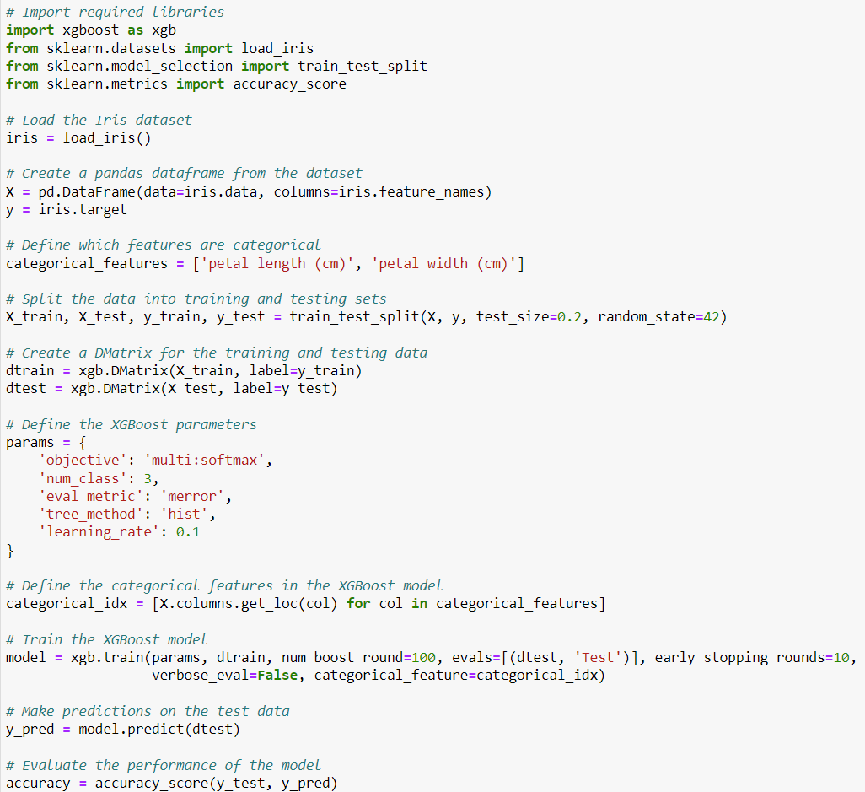
XGBoost
XGBoost handles categorical features nowadays (from ver. 1.5.x onwards).
The functionality is currently experimental but as it stands XGBoost handles categorical features the same way that LightGBM does
https://stats.stackexchange.com/questions/593242/xgboost-with-catigorical-nominal-features

Slide 12

CatBoost
How CatBoost Algorithm Works: https://dataaspirant.com/catboost-algorithm/
CatBoost is handling Categorical features automatically. We don't need to do any explicit pre-processing to convert categories into numbers.
CatBoost converts categorical values into numbers using various statistics on combinations of categorical features and combinations of categorical and numerical features.
CatBoost can handle data with many thousands of features!
By default CatBoost builds 1000 trees
In most cases, the optimal depth ranges from 4 to 10. Values in the range from 6 to 10 are recommended.
CatBoost for big data: an interdisciplinary review (2020): https://journalofbigdata.springeropen.com/articles/10.1186/s40537-020-00369-8
StatQuest videos:
One-Hot, Label, Target and K-Fold Target Encoding - https://www.youtube.com/watch?v=589nCGeWG1w
CatBoost Part 1: Ordered Target Encoding - https://www.youtube.com/watch?v=KXOTSkPL2X4
CatBoost Part 2: Building and Using Trees - https://www.youtube.com/watch?v=3Bg2XRFOTzg

Slide 13
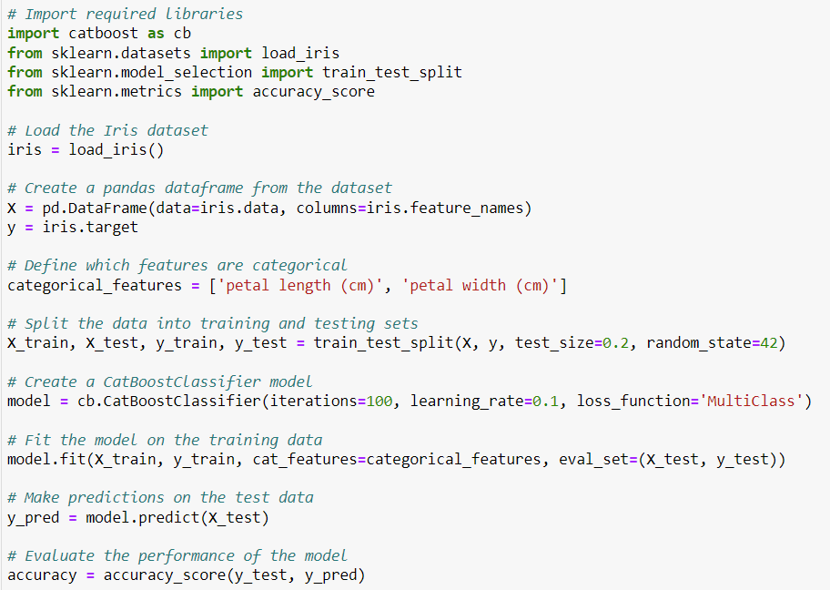
CatBoost

Slide 14

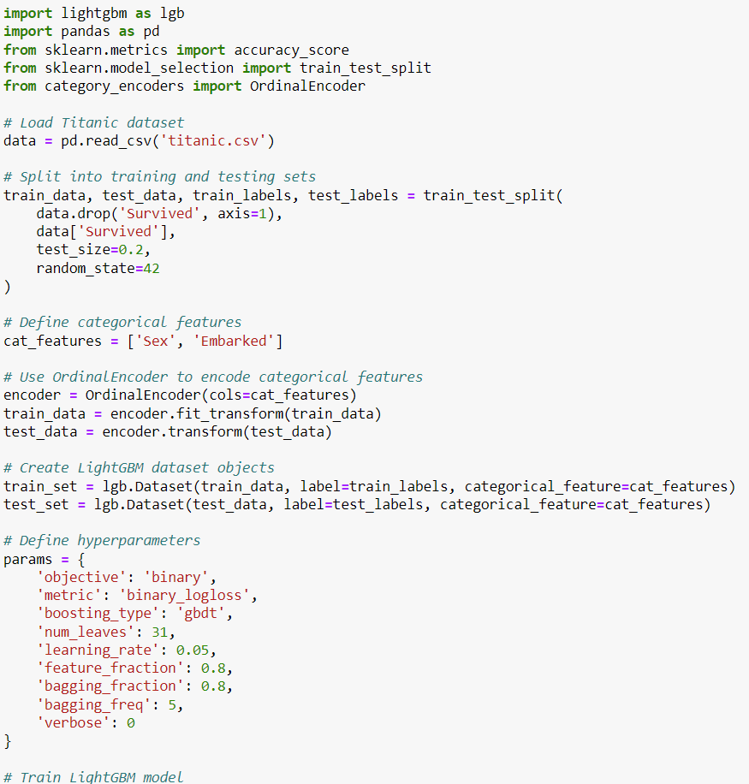
LightGBM
LightGBM has support for categoricals

Slide 15


Scikit-Learn
Sklearn doesn't support categoricals.
We need to use an encoder.
Here we use OneHotEncoder()

Slide 16

ML Libraries in "R"
https://www.geeksforgeeks.org/7-best-r-packages-for-machine-learning/
data.table - extension of data.frame package, cleaner syntax, memory efficiency
Optimized for large datasets, sorting, filtering, aggregating
Supports binary format for file operations (much faster)
Secondary indices make filtering faster
Framework for joining, reshaping, and summarizing data
dplyr - data manipulation and transformationd (Data Ply in R, data layers in R)
filtering, selecting, sorting, summarizing, and mutating data
works with the pipe operator (%>%) from the magrittr package
Lazy evaluation for better performance
A part of tidyverse, integrates with ggplot2 (graphs), tidyr (reshaping), ...
ggplot2 - data visualizations ("Grammar of Graphics Plotting, version 2.")
Layered approach: adding different elements (geoms) step by step
Many customization options (colors, themes, scales, ... )
Map variables in your data to different visual attributes (aesthetics) like size, color, shape, and position
Faceting - creating multiple related plots in a grid
A part of tidyverse, integrates with dplyr, tidyr, ...
caret (Classification And Regression Training)
Many ML algorithms
Tools for creating and tuning predictive models
Preprocessing, resampling, feature selection, visualization
e1071 - a collection of ML algorithms
named after the statistics course at Vienna University of Technology).
Includes SVMs, naive Bayes classifiers, fuzzy clustering, and several others
xgboost
randomForest

Slide 17
When choosing a ML library or a platform, you may need to consider many factors like:
Handling missing data
Handling categorical values
Tools for Feature Engineering
Handling thousands of features
Handling large amounts of data
Handling correlated features
Handling Classification or Regression
Tools for pre-processing
Tools for model tuning
Tools for visualization
Tools for automation

