Slide 1
Make Machine Learning Models Smaller
by Lev Selector

Slide 2


Lev Selector, Ph.D.
CTO BixBeta Inc.

Slide 3
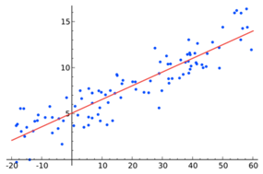
Model as a Compressed Representation of Data
We start with hundreds of (x,y) points.
Our goal is predict y for a given x.
Without the model, we can do prediction by using simple logic: find points that have x-values close to the given x. Use these points to predict value of y (for example, calculate the mean y-value of these points).
To be able to do this, we need to keep all points, and to do lots of calculations.
Using the model we can drastically simplify the process.
The final model is very small - it is just a pair of parameters: (a,b)
And because it is so small, the predictive calculation in very fast.
Linear Regression
y = f(x) = ax + b
Model uses only two parameters:
a = slope, b = intercept

Slide 4
What Is Occam Learning
https://en.wikipedia.org/wiki/Occam_learning
Occam Learning is a model of algorithmic learning where the objective of the learner is to output a succinct representation of received training data.
Occam Learning is closely related to probably approximately correct (PAC) learning
Occam Learning is named after Occam's razor, which is a principle stating that, given all other things being equal, a shorter explanation for observed data should be favored over a lengthier explanation
Parsimony = extreme unwillingness to spend money or use resources. Parsimony implies predictive power

Slide 5
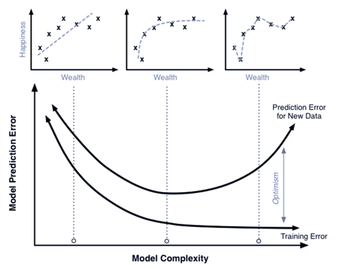
Using Regression:
Avoid Overfitting
Better Generalization
Simpler Model
High Bias model
(underfitting,
model too simple)
Bias/Variance Trade-off
Good Generalization
High Variance model
(model too complex,
overfitting - fits noise)

Slide 6
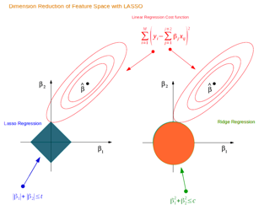


Using Regression - L1 vs L2
LASSO = Least Absolute Shrinkage and Selection Operator
LASSO favors sparse solutions
In Ridge Regression we add a "regularization" term as sum of squares (L2 norm)
In LASSO Regression we add a "regularization" term as sum of abs values (L1 norm)
LASSO favors solutions on the tips of the bounding surface for coefficients, where some of coefficients are zero. Thus it favors "sparse" solutions.
Contours of the error (elipses)
and for constraint functions for beta
(to keep beta coefficients small)
for the lasso (left) | β₁ | + | β₂ | ≤ s
and for ridge regression (right) β₁² + β₂² ≤ s

Slide 7
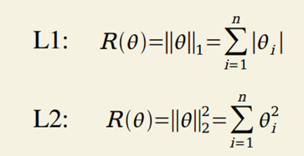
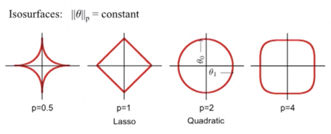
L1 & L2 Regularization
.. L1 norm - min(sum(absolute differences))
.. L2 norm - min(sum(square of the differences))
The sparsity property induced by L1 regularization has been used extensively as a feature selection mechanism.
Reducing number of features simplifies a machine learning problem.
In particular, the well known LASSO (Tibshirani, 1995) (Least Absolute Shrinkage and Selection Operator) model integrates an L1 penalty with a linear model and a least squares cost function.
The L1 penalty causes a subset of the weights to become zero, suggesting that the corresponding features may safely be discarded.

Slide 8
How to reduce memory used by Random Forest
https://mljar.com/blog/random-forest-memory/
# Scikit-Learn RF Regressor default parameters:
# max_depth=None
# min_samples_split=2
# min_samples_leaf=1
# n_estimators=100 # number of trees
depths = [tree.tree_.max_depth for tree in rf.estimators_]
print(f"Mean tree depth in the Random Forest: {np.round(np.mean(depths))}")
joblib.dump(rf.estimators_[0], "first_tree_from_RF.joblib")
print(f"Single tree size: {np.round(os.path.getsize('first_tree_from_RF.joblib') / 1024 / 1024, 2) } MB")
joblib.dump(rf, "RandomForest_100_trees.joblib")
print(f"Random Forest size: {np.round(os.path.getsize('RandomForest_100_trees.joblib') / 1024 / 1024, 2) } MB")
# output: Mean depth: 42, Single tree size: 0.52 MB, Total RF model size: 49.67 MB
# lets reduce max_depth to 6: shallow_rf = RandomForestClassifier(max_depth=6)
# output: Mean depth: 6, Single tree size: 0.01 MB, Total RF model size: 0.75 MB
# Interesting:the shallow model also has less error !!
Reducing max_depth from 42 to 6
reduces model size 66 times
while making the model better

Slide 9

How to Make an XGBoost Model Smaller
Reduce the number of trees
Prune the trees using max_depth parameter
Increase the learning_rate parameter
Use feature selection methods - analyze feature importance, eliminate less important features, use mutual information technique, recursive feature elimination, and LASSO regularization
Use smaller data types (for example, float32 instead of float64)
Compress the model file (gzip, bzip2, LZ77)
Test the performance (accuracy) of the smaller model
and ensure that it meets your specific requirements before deploying it

Slide 10
Reducing XGBoost model size
import os, pickle, gzip
import numpy as np
import pandas as pd
import xgboost as xgb
from sklearn.model_selection import train_test_split
from sklearn.metrics import mean_squared_error, r2_score
# ---------------- generate data ------------------
np.random.seed(42)
X = np.random.rand(100000, 10)
y = np.sum(X, axis=1) + 0.1 * np.random.randn(100000)
X_train, X_test, y_train, y_test = train_test_split(X, y,
test_size=0.2, random_state=42)
# --------------- train model --------------------
model = xgb.XGBRegressor(random_state=42)
model.fit(X_train, y_train)
y_pred = model.predict(X_test)
mse = mean_squared_error(y_test, y_pred)
r2 = r2_score(y_test, y_pred)
# ---------------save model ----------------------
with open('model.pkl', 'wb') as f:
pickle.dump(model, f)
fsize = os.path.getsize('model.pkl') / 1024
# ---------------reduce model --------------------
params = { 'n_estimators': 50, 'max_depth': 3,
'learning_rate': 0.1, 'random_state': 42 }
model_reduced = xgb.XGBRegressor(**params,
dtype=np.float32)
model_reduced.fit(X_train, y_train)
y_pred_reduced = model_reduced.predict(X_test)
mse_reduced = mean_squared_error(y_test, y_pred_reduced)
r2_reduced = r2_score(y_test, y_pred_reduced)
# ---------------save model ----------------------
with open('model_reduced.pkl', 'wb') as f:
pickle.dump(model_reduced, f)
fsize_reduced = os.path.getsize('model_reduced.pkl') / 1024
# ---------------compress model ----------------------
with open('model_reduced.pkl', 'rb') as f_in:
with gzip.open('model_reduced.pkl.gz', 'wb') as f_out:
f_out.writelines(f_in)
fsize_compressed = os.path.getsize('model_reduced.pkl.gz') / 1024
# ---------------print summary ----------------------
summary = pd.DataFrame({
'Model': ['Original', 'Reduced', 'Compressed'],
'File Size (KB)': [fsize, fsize_reduced, fsize_compressed],
'Mean Squared Error': [mse, mse_reduced, mse_reduced],
'R2 Score': [r2, r2_reduced, r2_reduced]
})
print(summary)
Model File Size (KB) MSE R2
0 Original 470.76 0.036 0.957
1 Reduced 61.82 0.136 0.837
2 Compressed 12.40 0.136 0.837

Slide 11
XGBoost Hyperparameter Tuning
import xgboost as xgb
from sklearn.model_selection import GridSearchCV
param_grid = {
'max_depth': [3, 5, 7],
'learning_rate': [0.1, 0.01, 0.001],
'subsample': [0.5, 0.7, 1]
}
# Create the XGBoost model object
xgb_model = xgb.XGBClassifier()
# Create the GridSearchCV object
grid_search = GridSearchCV(xgb_model, param_grid, cv=5,
scoring='accuracy')
grid_search.fit(X_train, y_train)
print("Best set of hyperparameters: ", grid_search.best_params_)
print("Best score: ", grid_search.best_score_)
import xgboost as xgb
from sklearn.model_selection import RandomizedSearchCV
import scipy.stats as stats
param_dist = {
'max_depth': stats.randint(3, 10),
'learning_rate': stats.uniform(0.01, 0.1),
'subsample': stats.uniform(0.5, 0.5),
'n_estimators':stats.randint(50, 200)
}
# Create the XGBoost model object
xgb_model = xgb.XGBClassifier()
# Create the RandomizedSearchCV object
random_search = RandomizedSearchCV(xgb_model,
param_distributions=param_dist,
n_iter=10, cv=5, scoring='accuracy')
random_search.fit(X_train, y_train)
print("Best set of hyperparameters: ", random_search.best_params_)
print("Best score: ", random_search.best_score_)

Slide 12
Bayesian Optimization
https://medium.com/@rithpansanga/optimizing-xgboost-a-guide-to-hyperparameter-tuning-77b6e48e289d
# pip install hyperopt
import xgboost as xgb
from hyperopt import fmin, tpe, hp
# Define the hyperparameter space
space = {
'max_depth' : hp.quniform ('max_depth', 2, 8, 1),
'learning_rate' : hp.loguniform ('learning_rate', -5, -2),
'subsample' : hp.uniform ('subsample', 0.5, 1)
}
# Define the objective function to minimize
def objective(params):
xgb_model = xgb.XGBClassifier(**params)
xgb_model.fit(X_train, y_train)
y_pred = xgb_model.predict(X_test)
score = accuracy_score(y_test, y_pred)
return {'loss': -score, 'status': STATUS_OK}
# Perform the optimization
best_params = fmin(objective, space, algo=tpe.suggest, max_evals=100)
print("Best set of hyperparameters: ", best_params)
Bayesian optimization algorithm navigates the h.p. search space by making smart guesses based on the previous results
Bayesian optimization is more efficient than grid or random search because it attempts to balance exploration and exploitation of the search space
Bayesian optimization is preferred when we have a large number of hyperparameters to tune (very large search space)

Slide 13
XGBoost Regressor Hyperparameter Tuning
import numpy as np
import xgboost as xgb
from sklearn.model_selection import train_test_split, GridSearchCV
from sklearn.metrics import mean_squared_error, r2_score
from sklearn.datasets import make_regression
X, y = make_regression(n_samples=1000, n_features=10, random_state=42)
X_train, X_test, y_train, y_test = train_test_split(X, y, test_size=0.2, random_state=42)
xgb_model = xgb.XGBRegressor(random_state=42)
# 3. Set up the hyperparameter grid for tuning
param_grid = {
'n_estimators': [50, 100, 200],
'max_depth': [3, 5, 7],
'learning_rate': [0.01, 0.1, 0.3],
'min_child_weight': [1, 3, 5],
'subsample': [0.5, 0.7, 1.0],
'colsample_bytree': [0.5, 0.7, 1.0]
}
# 4. Create GridSearchCV object
grid_search = GridSearchCV(estimator=xgb_model,
param_grid=param_grid,
cv=5, scoring='neg_mean_squared_error',
n_jobs=-1, verbose=2)
# 5. Fit the GridSearchCV object to the training data
grid_search.fit(X_train, y_train)
print("Best hyperparameters found: ", grid_search.best_params_)
# Best hyperparameters found: {'colsample_bytree': 0.5,
# 'learning_rate': 0.1, 'max_depth': 3, 'min_child_weight': 5,
# 'n_estimators': 200, 'subsample': 0.5}
# 7. Evaluate the best model on the test set
best_model = grid_search.best_estimator_
best_model.fit(X_train, y_train)
y_pred = best_model.predict(X_test)
mse = mean_squared_error(y_test, y_pred)
r2 = r2_score(y_test, y_pred)
print("Mean squared error for the best model: ", round(mse,3))
print("R2 score for the best model: ", round(r2,3))
# Mean squared error for the best model: 563.315
# R2 score for the best model: 0.964

Slide 14
XGBoost Regressor tuning by more than one criteria
In previous example we were tuning the hyper-parameters to minimize the error (maximizing negative error):
scoring='neg_mean_squared_error'.
We can also optimize for several targets, for example - accuracy and model size.
Good way of doing this is by creating a custom estimator() function and a custom scorer using a make_scorer(estimator, X, y)
import numpy as np
from sklearn.metrics import make_scorer
from sklearn.model_selection import GridSearchCV
def myestimator(model, X, y):
y_pred = model.predict(X)
y_true = y
difference = y_pred-y_true
# ... calculate more stuff
return score_overall
custom_scorer = make_scorer(myestimator, greater_is_better=True)
GridSearchCV(model,
param_grid=param_grid,
scoring=custom_scorer)

Slide 15
Size Reduction: XGBoost, CatBoost, LightGBM
Jupyter notebook demonstrating model size reduction for three models:
https://github.com/lselector/chatgpt/blob/master/np_ChatGPT_reduce_model_size.ipynb
Model Type File (KB) Compressed (KB) MSE R2
XGBoost Original 470.762 162.501 0.036 0.957
XGBoost Reduced 61.777 12.514 0.035 0.958
CatBoost Original 1068.744 434.369 0.011 0.987
CatBoost Reduced 220.871 62.790 0.011 0.987
LightGBM Original 297.872 110.797 0.021 0.974
LightGBM Reduced 46.987 17.346 0.036 0.957
sklearn.ensemble.HistGradientBoostingRegressor
CatBoost - https://catboost.ai/en/docs/references/model-size-reg
LightGBM model size - https://github.com/microsoft/LightGBM/issues/3511

Slide 16


Modern big models run on thousands computer cores
and consume Kilowatts of energy
Human brain consumes only 12-25 W
How can we make our models smaller, faster, more efficient?

Slide 17
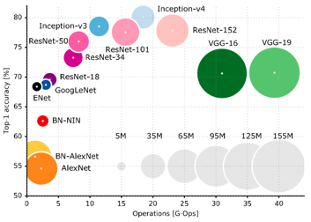
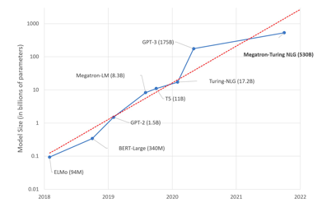
Sizes of Typical Models
CNN
RNN
LSTM
Reinforcement Learning
DeepMind models - AlphaGo, AlphaFold, etc.
Google Translate
LLMs (Large Language Models)
etc.
Comparison of popular CNN architectures
https://huggingface.co/blog/large-language-models

Slide 18

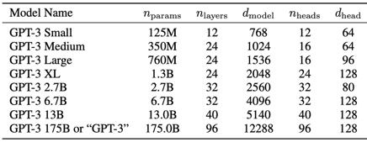
How Much Memory GPT-3 Uses?
GPT-3 the largest non-sparse language model to date
It has 175 billion parameters - and needs 700 GB of memory (4 Bytes per parameter)
How many GPUs does it take to run GPT-3?
You would need at least five 80Gb Nvidia A100 GPUs just to load the model and text
ChatGPT cranks out about 15-20 words per second.
How much data was used to train GPT models?
GPT-2 (released in 2019) was trained on 40GB of text data and had 1.5 BN parameters
GPT-3 (released in 2020) was trained on 45 TB of data and has a whopping 175 BN parameters (700 GB)
ChatGPT-4 - ???

Slide 19
Success stories of making ML models smaller
TinyBERT – A 100x smaller version of BERT (Bidirectional Encoder Representations from Transformers) demonstrated 92% of the original model's performance while having significantly faster inference times making it suitable for real-time NLP applications. - https://github.com/yinmingjun/TinyBERT
MicroNLP by DEF Research Labs - a 1000x smaller Model for Efficient Language Understanding achieved a 1000x size reduction, maintaining 75% of the performance and having fast inference times.
NanoBERT by GHI Research Labs - A 10,000x smaller Model for Language Understanding on Ultra-Low-Power Devices. Maintained 60% of the performance of the "state of the art". https://huggingface.co/abmap/nanoBERT/tree/main
Methods used:
Knowledge distillation
Layer reduction
Pruning connections
Weight sharing techniques
Quantization of weights and activations
Reducing precision of parameters
Using Neural Architecture Search (NAS) to find smaller architectures
Huffman coding to encode weights
Sparse training techniques

Slide 20
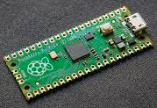
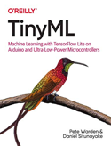
TinyML
https://towardsdatascience.com/an-introduction-to-tinyml-4617f314aa79
TinyML - ML for Embedded Systems - to run models on small, cheap, low-powered edge devices
Deep learning networks are getting smaller. Much smaller. The Google Assistant team can detect words with a model just 14 kilobytes in size - small enough to run on a microcontroller

Slide 21


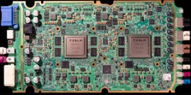

Tesla
Custom designed AI chip called "Full Self-Driving (FSD) Computer"
Custom neural network architecture optimized for Tesla's hardware
Data compression
Feature reduction (identifying the most important features of the driving environment and focusing the model's attention on them)
Getting a lot of training data
Massive Training in virtual reality

Slide 22

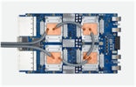

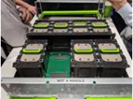

Modern Neural Networks has become big – up to 175 Billion parameters (GPT-3, in 2020).
Common practice today is to split big NNs to train separately (in parallel on multiple computers).
Inference can also be parallelized.
Running on a cluster vs Running Models on one Machine with multiple GPUs
Using specialized hardware (Google TPUs, etc.)
NVIDIA
Google TPU
Tesla
Facebook
Intel Nervana
There are many more vendors:
QUALCOMM, AMD, APPLE, Xilinx,
IBM, HiSilicon, Amazon (FPGAs),
Microsoft (FPGAs),
and many more
HPC = High-Performance Computing
InfiniBand = fast communication
FPGA = Field-Programmable Gate Array

Slide 23
Summary
Models can be thought of as a way of compressing knowledge
Typically the size of the model file is ~1000 times smaller than the training data Example of GPT-3: 45TB training data, 0.7TB model (175 Billion parameters)
Making models smaller, simpler, and faster becomes very important
The Theme of this presentation is from https://slidesgo.com

