Slide 1




Pandas => Polars

Slide 2



The Polars framework was developed by the Rust community
It was initially released in September 2020
Original developer was Ritchie Vink - https://mlconference.ai/speaker/ritchie-vink/ | https://www.youtube.com/watch?v=iwGIuGk5nCE | https://www.ritchievink.com/blog/2021/02/28/i-wrote-one-of-the-fastest-dataframe-libraries/ | https://github.com/ritchie46
Also important are Matt Brubeck - https://github.com/mbrubeck , Ralf Jung - https://github.com/RalfJung , https://www.ralfj.de
Ritchie Vink
Matt Brubeck
Ralf Jung
https://www.pola.rs/
https://pypi.org/project/polars/
https://github.com/pola-rs/polars - 200+ contributors, 16.4K stars
https://pola-rs.github.io/polars-book
https://towardsdatascience.com/pandas-vs-polars-a-syntax-and-speed-comparison-5aa54e27497e

Slide 3
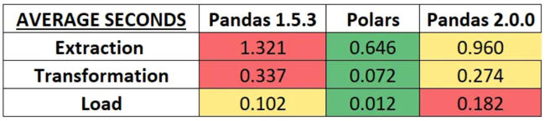
Polars is Faster than Pandas
https://levelup.gitconnected.com/pandas-vs-polars-vs-pandas-2-0-round-2-e1b9acc0f52f
New Pandas 2.0 uses Apache Arrow:
faster file operations
uses less memory
Copy-on-Write Optimization
Index can now hold NumPy numeric types (for speed)
But Polars is still the winner.
Average seconds (smaller = faster)

Slide 4
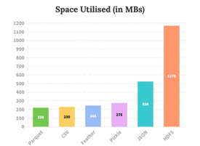
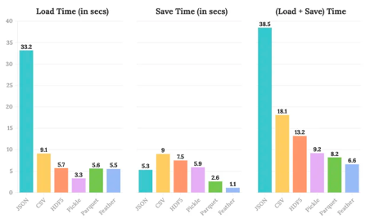
Stop Using CSV Files
https://towardsdatascience.com/why-i-stopped-dumping-dataframes-to-a-csv-and-why-you-should-too-c0954c410f8f
CSV
Pickle
Parquet
Feather
JSON (slow)
HDF5 (big)
df = pd.read_csv("myname.csv")
df.to_csv("myname.csv")
df = pd.read_pickle("myname.pkl")
df.to_pickle("myname.pkl")
df = pd.read_parquet("myname.parquet")
df.to_parquet("myname.parquet")

Slide 5
Key Points Switching from Pandas to Polars
https://pola-rs.github.io/polars-book/user-guide/coming_from_pandas.html
Polars rows are indexed by integer row numbers. There is no "label" or "multi-index".
Polars uses Apache Arrow arrays to represent data in memory while Pandas uses Numpy arrays
Polars can convert data to Numpy format with the to_numpy() method
Polars is written in Rust, runs many operations in parallel (multi-threading)
Polars supports both eager and lazy evaluation and can optimize queries
Polars has it own syntax that run faster than "pandas-like" syntax
select a column: df.select(['a']) select rows: df.filter( (pl.col('a') < 10) & (pl.col("price") < 300000) )
df = pl.scan_csv(csv_file) # scan is a lazy function - will only read 'id1' and 'v1' columns grouped_df = df.groupby('id1').agg(pl.col('v1').sum()).collect() # collect is used for eager evaluation
Adding two new columns: df.with_columns([ (pl.col("value") * 10).alias("tenXValue"), (pl.col("value") * 100).alias("hundredXValue"),
])
assigning value using a mask: df.with_columns(
pl.when(pl.col("c") == 2) # fow rows with value "2" in column "c"
.then(pl.col("b")) # we take value from column "b"
.otherwise(pl.col("a")) # for other rows - from column "a"
.alias("a") ) # and put this value in column "a"
Polars has "window" functions: df.select([ pl.all(),
pl.col("c").count().over("c").alias("size"),
pl.col("c").sum().over("type").alias("sum"),
pl.col("c").reverse().over("c").flatten().alias("reverse_type")
])
In Polars null is a Python None value and can be in all columns including integer type
np.NaN is NOT a null. There are functions is_nan(), is_null(), fill_nan(), fill_null()

Slide 6
Missing Data - null, None, np.NaN
# Missing Data
# https://pola-rs.github.io/polars-book/user-guide/howcani/missing_data.html
# Pandas: NaN , .fillna() df['col2'].fillna(-999)
# Polars: None = null , .fill_null()
# NaN .fill_nan()
# NaN values are NOT considered to be missing data
# and NOT counted with the null_count method
# NaN values are filled with fill_nan(), but not fill_null()
# Polars has is_nan() and fill_nan() methods
# which work similar to is_null() and fill_null() methods.

Slide 7
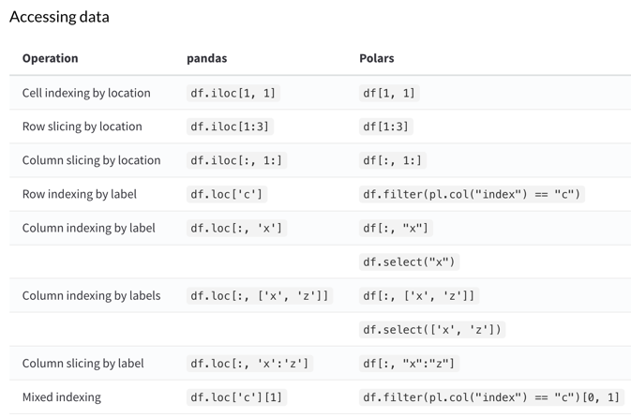
Pandas vs Polars
https://www.rhosignal.com/posts/polars-pandas-cheatsheet/

Slide 8
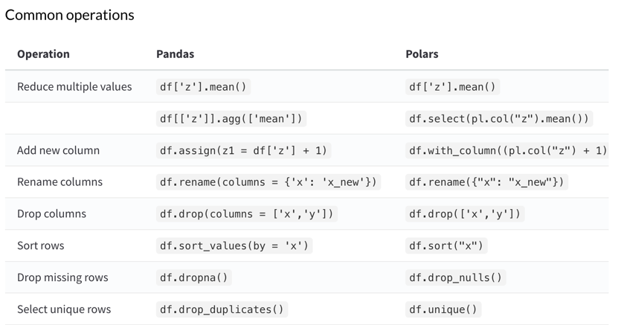
Pandas vs Polars - continued
https://www.rhosignal.com/posts/polars-pandas-cheatsheet/

Slide 9


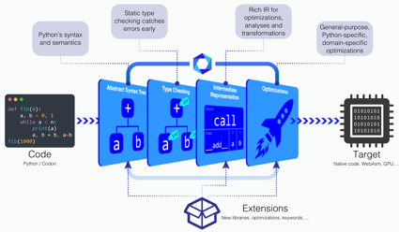
Codon: A Python Compiler
https://github.com/exaloop/codon
https://exaloop.io
https://medium.com/intuition/codon-a-python-compiler-3d5322e1c0a5
https://dl.acm.org/doi/abs/10.1145/3578360.3580275
https://news.mit.edu/2023/codon-python-based-compiler-achieve-orders-magnitude-speedups-0314
https://docs.exaloop.io/codon/interoperability/decorator
Codon by Exaloop is a new python compiler that can compile directly to machine code
Factorial test is 10,000 times faster than plain python
Can use GPU to run in parallel on thousands coresProject started as PhD work at MIT, initially with a focus on genomics and bioinformatics, published in 2023
Codon uses the LLVM framework to compile to LLVM bytecode and then to specific machine code
Works with plain vanilla Python, doesn't support Numpy, Pandas, sklearn, etc. yet
You can use JIT decorator "codon-jit" to speed up only selected functions of your code

Slide 10
Demo in Jupyter
GitHub repository:
https://github.com/lselector/python_tutorials
Jupyter notebook:
https://github.com/lselector/python_tutorials/blob/master/p01_Polars.ipynb

