Slide 1
Faster Pandas
Pandas Alternatives
iterrows vs apply vs vectorizing vs masking
decrease memory usage in pandas
Pandas Alternatives
Python
Polars
Dask
Ray
Modin
Vaex
R
data.table
dplyr

Slide 2


Polars
Polars is very fast and memory efficient
written in Rust, uses Apache Arrow
Can handle more data than fits in memory ! (Hybrid Streaming)
Lazy | eager execution, Multi-threaded
SIMD (Single Instruction / Multiple Data)
Query optimization, Powerful expression API (Rust | Python | NodeJS | ...)
https://www.pola.rs/
https://github.com/pola-rs/polars
https://pola-rs.github.io/polars-book/user-guide/
https://towardsdatascience.com/pandas-vs-polars-a-syntax-and-speed-comparison-5aa54e27497e
https://github.com/lselector/python_tutorials/blob/master/p01_Polars.ipynb
Pandas Polars
# pip install polars
import polars as pl
q = ( pl.scan_csv("iris.csv")
.filter(pl.col("sepal_length") > 5)
.groupby("species")
.agg(pl.all().sum())
)
df = q.collect()

Slide 3


Dask
Ray Datasets
Ray Datasets - load and exchange data in Ray libraries. Provide basic distributed data transformations. https://www.ray.io/ray-datasets
Dask - large parallel DataFrame composed of many smaller pandas DataFrames. https://www.dask.org
# pip install ray[complete]
import ray
df=ray.data.read_csvmy("myfile.csv")
print(df)
# pip install "dask[complete]"
import dask.dataframe as dd
df = dd.read_csv('myfile.csv')
print(df)
from dask.distributed import Client
client = Client() # multiprocessing
# or
client = Client(processes=False) # multithreading
def add(a):
return a+10
a = client.submit(add, 10)
print(a)

Slide 4





Maarten Breddels, PhD
Jovan Veljanoski, PhD
Yonatan Alexander
Scale your pandas workflows by changing one line of code (import modin.pandas as pd).
Modin uses Ray, Dask, or Unidist. Its syntax is very similar to pandas, but Modin is much faster
https://modin.readthedocs.io/en/stable/
https://github.com/modin-project/modin
https://vaex.io
Netherlands
Vaex – like pandas for big data, faster, can calculate stats (mean, sum, count, standard deviation etc. ) on an N-dimensional grid for more than a billion (10^9) samples/rows per second. Has good visualization tools.
# pip install modin
import modin.pandas as pd
df=pd.read_csv("myfile.csv")
print(df)
# pip install vaex
import vaex
df=vaex.read_csv("myfile.csv")
print(df)

Slide 5

data.table – R-library
dplyr – R library
dplyr
data.table is an R package that provides an enhanced version of data.frames, which are the standard data structure for storing data in base R
https://cran.r-project.org/web/packages/data.table/vignettes/datatable-intro.html
https://dplyr.tidyverse.org
https://en.wikipedia.org/wiki/Dplyr
One of the core packages of the tidyverse in the R programming language, dplyr is primarily a set of functions designed to enable DataFrame manipulation

Slide 6
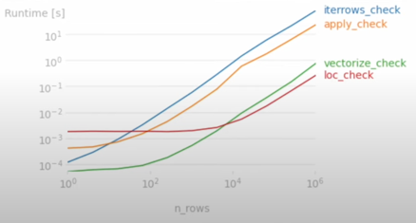
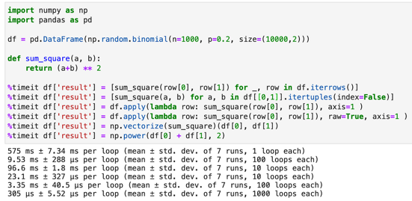
How to Speed-Up
Pandas Operations
How to make your Pandas operation 100x faster
.. https://towardsdatascience.com/how-to-make-your-pandas-operation-100x-faster-81ebcd09265c
How to Speed up Pandas by 100x
.. https://medium.com/geekculture/simple-tricks-to-speed-up-pandas-by-100x-3b7e705783a8
Good video in Russian
.. https://www.youtube.com/watch?v=DMjCQwUIoTk
Don’t use Apply in Python, follow these Best Practices!
.. https://towardsdatascience.com/dont-use-apply-in-python-there-are-better-alternatives-dc6364968f44
To time, use "%timeit"
For graphs use module "perfplot"
iterrows() is VERY slow,
apply() is also slow
numpy is better
column operations are fastest (.loc, mask)
pd.cut() is fastest for making histogram bins

Slide 7
Decrease Memory Usage in Pandas
https://pythonspeed.com/articles/pandas-load-less-data/
https://itnext.io/the-fastest-way-to-read-a-csv-file-in-pandas-2-0-532c1f978201
# Use only columns you need:
df = pd.read_csv( "myfile.csv",
usecols=["col1", "col2"])
df.info(verbose=False, memory_usage="deep")
# use smaller numeric types:
# object – use type "category"
int8 – 1 byte
int16 – 2 bytes
int64 – 8 bytes
df.info(verbose=False)
df.memory_usage()
df[col1].memory_usage()
df.memory_usage().sum()
df = pd.read_csv("myfile.csv",
dtype={"col1":"int8","col2":"category"})
# sometimes it is best not to specify column dtypes in read_csv(), # but instead use DataFrame.astype() afterwards
df[mycol] = df[mycol].astype('int16')
cat_cols = df.select_dtypes("object").columns
df[cat_cols] = df[cat_cols].astype("category")
# Change from float to int (losing accuracy):
(df[mycol]*100).astype("int8")
# get random subset of data (sampling)
from random import random
def sample(row_number):
if row_number == 0:
return False
return random() > 0.001
df_sample = pd.read_csv("myfile.csv", skiprows=sample)
# Split big dataset into several files
# and process them separately
# read big file in chinks:
result = None
for chunk in pd.read_csv("myfile.csv", chunksize=1000):
# process dataframe chunk and get chunk_result
if result is None:
result = chunk_result
else:
result = result.add(chunk_result, fill_value=0)

