Slide 1
Evolution of ML Search
& Image Recognition

Slide 2

About the Speaker
Boris Tolkachev
New Jersey, USA
Public domain media - 26 million of images
PICRYL - https://picryl.com - provides access to millions of public domain objects and tools for efficient research
https://www.linkedin.com/in/btolkachev
https://getarchive.net/our-team
https://picryl.com/about
https://www.facebook.com/to.bo.90857

Slide 3
GetArchive’s ML Stack
Multilingual Semantic Search - Google AI - 2020
Multilingual Universal Sentence Encoder for Semantic Retrieval - Google AI, Google Cambridge The sentence embedding model achieves monolingual and cross-lingual semantic retrieval (SR)
https://aclanthology.org/2020.acl-demos.12.pdf
CLIP - OpenAI - 2021 (CLIP = Contrastive Language-Image Pretraining) CLIP is trained on 400M (image, text) pairs produces snippets "without directly optimizing for the task, similarly to the zero-shot capabilities of GPT-2 and 3." "Zero-shot learning" is when a model attempts to predict a class it saw zero times in the training data.
Contrastive Language-Image Pre-Training) - the first multimodal (vision and text) model.
BLIP- Salesforce - 2022 (BLIP = Bootstrapping Language-Image Pre-training) Vision-Language Pre-training (VLP) improvement has been largely achieved by scaling up the dataset with noisy image-text pairs collected from the web. BLIP utilizes the noisy web data by bootstrapping the captions, where a captioner generates synthetic captions and a filter removes the noisy ones. BLIP demonstrates strong generalization ability for both Understanding-based tasks and Generation-based tasks.

Slide 4





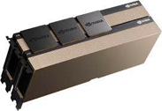


Picryl Technology stack
Pre-trained CLIP model from Hugging Face
https://huggingface.co/docs/transformers/model_doc/clip
Pre-trained Multilingual Semantic Search model from Google
https://aclanthology.org/2020.acl-demos.12.pdf
Linux servers with NVIDIA GPUs
Pre-trained BLIP model from Hugging Face
https://huggingface.co/docs/transformers/model_doc/blip

Slide 5
Main Idea
Train / Model
Improve Search
Images => text / labels
text / labels => Images

Slide 6
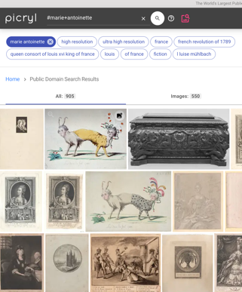
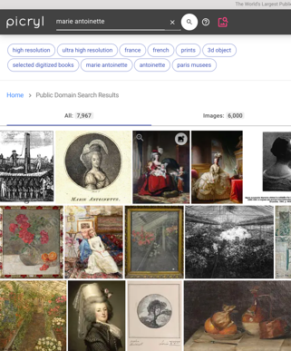
Evolution of Search: Semantic
Old School, tags #marie+antoinette ~1K results, precise
Fuzzy ElasticSearch + Google AI 2020 marie antoinette ~ 10K results, high % false-positive
2020
Semantic Search
Retrieving in multilingual metadata
Retrieving based on “context”
…
sort-of

Slide 7
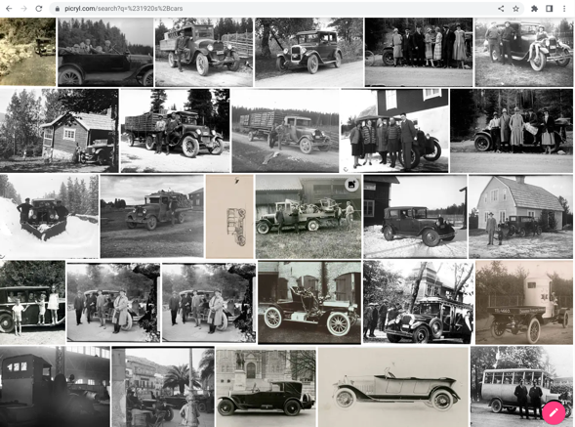
Evolution of Search: Image
2021
1st attempt in
Image Recognition
Supervised
GetArchive created more than 800 Supervised Datasets
#1920+cars
#steam+locomotive
#erotic+photography
Once we train the model, we run all images against the label trained
1K -> QC -> 10K+

Slide 8
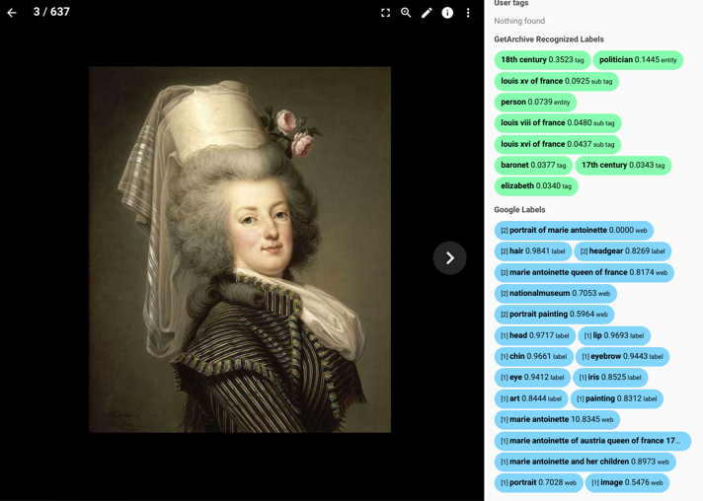
2022
Generating Metadata for Images
UnSupervised OpenAI CLIP +
Custom 10,000 labels
vs.
Supervised
Google vision
&
“Web” vision

Slide 9
GetArchive’s SaaS Search Engine Picryl.com
Image Understanding & Image Search Approach - 2022
Use Google Semantic Search as an aid to Search ✅
Fed CLIP with custom classes relevant to our audience = industry-specific label sets ✅
Used CLIP to find visually similar image pairs (vector similarity) ✅
Combined Human Metadata, CLIP and [BLIP] outputs to improve Search ✅
Next: Image Caption Generation
Combine Human Metadata, CLIP and BLIP outputs to generate niche-specific captions & descriptions through using open source Dolly 2.0 (Databricks) or similar model. Possibly, training GetArchive’s own model.

Slide 10
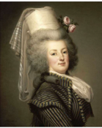
Better Caption Generation
OpenAI CLIP Interrogator 2.1 - 2023
a painting of a woman with a hat on her head, a portrait, by Adélaïde Labille-Guiard, pinterest, rococo, wearing a light grey crown, big hair, dressed in shako, maria panfilova, powdered wig, bouquet, photo portrait, portrait c 12.0, portrait knight female, inspiring, ebony rococo
https://huggingface.co/spaces/fffiloni/CLIP-Interrogator-2
GetArchive’s model should produce non-generic captions like:
Marie-Antoinette d'Autriche, reine de France (1788), artbase joconde, marie antoinette in riding habit wertmuller, yvelines, france, marie antoinette, queen of france
https://picryl.com/media/adolf-ulrik-wertmuller-marie-antoinette-dautriche-reine-de-france-1788-001-535916

Slide 11
Picryl Live Demo

