Slide 1




JavaScript
Inna Botchkina
May 5, 2023

Slide 2

About the Speaker
Software Engineer
UX Developer
Project Manager
Former Research Scientist (UCSF)
New York / San Francisco

Slide 3
Technology of front-end development
HTML - HyperText Markup Language [The bone of web application]
the standard markup language used to structure content on the web, enabling the creation of formatted text, images, and interactive elements within web pages
CSS - Cascading Style Sheets [The skin of the application]
a styling language used to control the appearance and layout of HTML elements on a web page by applying design rules and formatting
JavaScript [The mind and muscle of application]
a versatile, high-level programming language predominantly used for adding interactivity, dynamic content, and complex functionality to web pages. JavaScript allows developers to create dynamic and interactive web pages by adding client-side scripting to HTML pages.

Slide 4
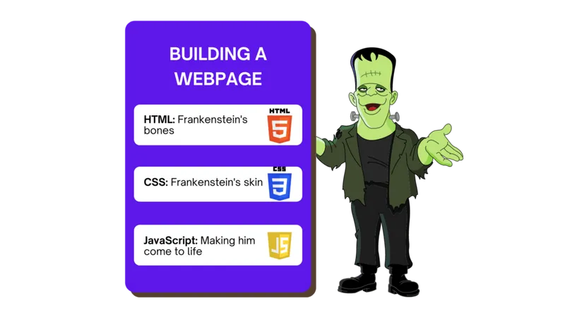

Technology of front-end development

Slide 5
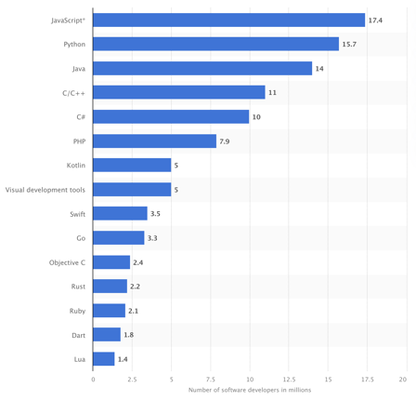
The Top 15 Programming Languages (as of November 2022, in Mln of active developers)
JavaScript - 17.4
Python - 15.7
Java - 14
C/C++ - 11
C# - 10
PHP - 7.9
Kotlin - 5
Visual Dev Tools - 5
Swift - 3.5
Go - 3.3
Objective C - 2.4
Rust - 2.2
Ruby - 2.1
Dart - 1.8
Lua - 1.4

Slide 6

JavaScript is the most widely used programming language in the world
Used to make dynamic and interactive websites and web apps
Primarily known as a Client-side scripting language, running in web browsers to provide interactivity, animations, and dynamic content updates
Also became a popular Server-side language via Node.js, a runtime environment that enables JavaScript to be executed on the server side, allowing developers to build scalable and high-performance web applications and APIs using JavaScript
Key characteristics of JavaScript
1. Interpreted: JavaScript is an interpreted language, meaning that it is executed directly by the browser without the need for compilation. (Versus compiled languages like C and Java)
2. Object-oriented: JavaScript supports object-oriented programming with prototypal inheritance, enabling code reuse and modularity.
3. Dynamically-typed: Variables in JavaScript can hold values of any type without needing explicit type declarations, and types can be changed during runtime. (However, TypeScript is statically-typed.)

Slide 7
Key characteristics of JavaScript (continued)
4. Event-driven: JavaScript is designed to respond to user actions or events (such as clicks or keypresses), making it well-suited for creating interactive web applications.
5. First-class functions: Functions in JavaScript are first-class objects, meaning they can be assigned to variables, passed as arguments, or returned from other functions.
6. Asynchronous: JavaScript supports asynchronous programming with features like callbacks, Promises, and async/await, which allows for non-blocking execution of code.
7. Client-side and server-side: Though originally designed for client-side web development, JavaScript can also be used for server-side programming with platforms like Node.js.
8. Cross-platform: JavaScript can be run on any platform with a web browser, making it a highly portable and platform-independent language.
9. Garbage-collected: JavaScript uses automatic memory management, which frees the programmer from having to manage memory allocation and deallocation.
10. ECMAScript standard: JavaScript is an implementation of the ECMAScript standard, which defines its core syntax and features. The standard is updated periodically to introduce new features and improvements.

Slide 8

JavaScript in mobile phones (mobile app development):
Mobile web applications: responsive and interactive web applications that run in a mobile browser
Hybrid mobile apps: a web-based app is wrapped inside a native container, which can be installed on a mobile device like a native app. Via hybrid mobile app development frameworks, such as React Native, Ionic or Apache Cordova (previously known as PhoneGap). Such apps can be run on iOS or Android
Progressive Web Apps (PWAs): installed on mobile devices and function similarly to native apps. JavaScript plays a crucial role in the development of PWAs, enabling features like offline capabilities, push notifications, and background syncing.
NativeScript: Another framework that allows developers to build native mobile apps for iOS and Android using JavaScript (or TypeScript), along with XML and CSS for UI components.
The most common languages for native mobile app development
Android | Java Kotlin
iOS | Swift Objective-C (legacy)
Both | React Native (JavaScript) Xamarin (C#)

Slide 9

JavaScript History
https://en.wikipedia.org/wiki/JavaScript
https://en.wikipedia.org/wiki/JavaScript_syntax
https://www.javatpoint.com/es5-vs-es6#
JavaScript:
Created as a scripting language for websites
Can now be used for server-side development (through Node.js, Deno, and many more)
Here is a brief history of JavaScript:
1995: JavaScript (originally called Mocha, then LiveScript) was created by Brendan Eich at Netscape.
It is introduced in Netscape Navigator 2.0 as a scripting language for web browsers.
1997: standardized by ECMA (European Computer Manufacturers Association)
The first edition of ECMAScript (ES1) was released, which became the standardized version of JavaScript
2005: AJAX (Asynchronous JavaScript and XML) - web apps can communicate with the server and update parts of the page
2006: John Resig releases jQuery, a popular JavaScript library that simplifies DOM manipulation and event handling
2008: Google released Chrome, which included the V8 JavaScript engine, greatly improving JavaScript performance
2009: Ryan Dahl introduced Node.js, a framework to run JavaScript on the server-side
2012: Microsoft introduced TypeScript, a statically typed superset of JavaScript, compiles into standard Javascript
2010-2016: The rise of modern JS frameworks and libraries, such as Angular (2010), Backbone (2010), Ember (2011), React (2013), Vue (2014), Redux (2015), Svelte (2016)
2015: ES6 (the sixth edition of ECMAScript) was released (arrow functions, classes, modules, promises, ...)
2017: ES8 (the eighth edition of ECMAScript) was released (async/await, ...)
2018-2022: the rise of serverless architecture, WebAssembly, Progressive Web Apps (PWAs), and new frameworks like Next.js, Deno etc
Brendan Eich

Slide 10
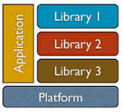
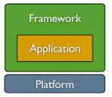
Frameworks vs Libraries
Library: YOUR CODE CONTROLS A LIBRARY.
A collection of pre-written code that focuses on specific tasks or functionality (for example, manipulating the DOM, handling events, or performing calculations)
The developer maintains control over the application's flow and explicitly decides when and where to use the library.
React is primarily considered a library because it focuses on providing a way
to build reusable UI components and efficiently update the DOM, without imposing a specific structure or organization on the entire application.
Framework: A FRAMEWORK CONTROLS YOUR CODE / APPLICATION. ("Inversion of control")
A set of conventions, rules, and tools that dictate how the application should be organized and how different parts should interact
Developers follow these conventions and build their applications within the framework's structure
Enforces a specific way/structure of building applications
Opinionated and more comprehensive than libraries
Angular is a component-based framework that encourages modular development and comes with a wide range of features, such as data binding, dependency injection, routing, and form handling. Developers build their applications within the Angular framework's structure, following the provided conventions.

Slide 11
JavaScript Frameworks and Libraries
Framework
Library
Calls
Calls
Code
Client-side JavaScript libraries:
jQuery: A popular library for DOM manipulation, event handling, and AJAX requests that simplifies cross-browser compatibility.
React.js: A library developed by Facebook for building user interfaces, focusing on the efficient rendering and updating of components.
Redux: A predictable state container for JavaScript applications, often used with React to manage application state more effectively and consistently.
Lodash: A utility library that provides a wide range of functions for working with arrays, objects, strings, and other data structures, simplifying and optimizing JavaScript code.
Axios: A promise-based HTTP client for making requests to RESTful APIs, offering a simple and consistent API for both client-side and server-side applications.
Chart.js: A library for creating responsive and interactive charts and graphs using HTML5 canvas, with support for various chart types such as line, bar, pie, and more.
D3.js: A library for creating data-driven documents, enabling complex visualizations using SVG, HTML, and CSS.

Slide 12
Client-side JavaScript frameworks:
Angular.js: A comprehensive framework developed by Google for building complex, single-page web applications using a component-based architecture.
Vue.js: A progressive JavaScript framework for building user interfaces, enabling developers to create reactive and reusable components, manage application state, and efficiently update the DOM.
Ember.js: A full-featured framework for building ambitious web applications with a focus on conventions and productivity.
Backbone.js: A lightweight framework for building web applications with a RESTful JSON interface, using a modular approach with models, views, and collections.
Svelte: A modern framework for building user interfaces, designed with a unique approach where components are compiled away during the build process, resulting in highly optimized, efficient, and small-sized output code that directly manipulates the DOM without the need for a virtual DOM.

Slide 13
Server-side JavaScript frameworks:
Node.js: A platform that allows JavaScript to be used for server-side development, built on the V8 JavaScript engine and providing an event-driven, non-blocking I/O model.
Next.js: A framework for building server-rendered React applications with support for static site generation, server-side rendering, and API routes. It simplifies the development of universal (isomorphic) JavaScript applications and provides performance optimizations like automatic code-splitting and prefetching.
Express.js: A minimal, unopinionated web framework for Node.js, widely used for building APIs and web applications.
Koa.js: A modern, lightweight framework for Node.js, developed by the team behind Express.js, offering a more expressive and robust foundation for web applications and APIs.
Sails.js: A framework for building Node.js applications, inspired by Ruby on Rails, focusing on convention over configuration and providing a full-featured MVC architecture.
Nest.js: A progressive framework for building scalable server-side applications with Node.js, offering a modular architecture and built-in support for TypeScript. Uses some features from Angular.

Slide 14

jquery
https://en.wikipedia.org/wiki/JQuery
https://github.com/jquery/jquery
https://jquery.com
John Resig
Chief Software Architect
at Khan Academy
jQuery is a popular, fast, and lightweight JavaScript library
created by John Resig in August 2006
provides easy-to-use API to handle events, create animations, perform AJAX requests, and manipulate the DOM (Document Object Model)
<script src="https://code.jquery.com/jquery-3.6.0.min.js"></script>
<h1 id="myElement">Hello, World!</h1>
<button id="myButton">Click me</button>
<script>
$(document).ready(function() {
$('#myButton').on('click', function() {
$('#myElement').text('You clicked the button!');
});
});
</script>

Slide 15

Typescript
https://en.wikipedia.org/wiki/TypeScript
https://www.typescriptlang.org
TypeScript was released in 2012
It’s developed by Microsoft, who made it FOSS (Free and Open Source Software)
It is a strict syntactical superset of JavaScript, it adds (optional) static typing,
which means that all JS is also valid TS
TypeScript can be used for both client-side and server-side execution (Node.js)
To convert TypeScript to JavaScript, one can use TypeScript Compiler, or the Babel compiler
function add(left: number, right: number): number {
return left + right;
}

Slide 16

Node.JS
https://en.wikipedia.org/wiki/Node.js
https://github.com/nodejs/node
https://nodejs.org/en
Node.js is an open-source, server-side, cross-platform, JavaScript runtime environment that executes JavaScript code outside of a web browser
It allows developers to create scalable and high-performance network applications using JavaScript on the server-side
Node.js has a large and active community of developers
Node.js offers a vast array of modules and packages through its built-in package manager, npm, making it easy to find and integrate external libraries and frameworks into your Node.js projects.
Some commands:
node myscript.js # run script
npm install mypackage # install
npm init # create a new Node.js project
node server.js # start Node.js server
node debug app.js # debug
npm test # test application
node # enter interactive session (REPL = Read-Evaluate-Print Loop)
npm update # update all the packages listed in the package.json
Some other npm commands: run, publish, search, view, audit, outdated, dedupe, ls

Slide 17


Deno
Deno is Node.js improved
https://deno.com
https://en.wikipedia.org/wiki/Deno_(software)
https://github.com/denoland/deno
https://deno.com/company
Deno and Node.js are both Javascript / Typescript runtime environments built on the V8 JavaScript engine.
Both created by Ryan Dahl.
Node released in 2009.
Deno released in 2020.
Deno is newer and focuses on security, simplicity, and web standards, while Node.js is a mature and widely-adopted platform.
Ryan Dahl
Advantages of Deno:
Security: strict security policies by default (for example, for network requests)
TypeScript support: built-in, without a separate compilation step like in Node
Standard library: core modules for common tasks, reducing the need for external dependencies
Module system: ES Modules and URL-based imports, no need for a package manager like npm
Built-in tools: for testing, formatting, and linting
Browser-compatible API: more aligned with web standards,

Slide 18
ReactJS vs Angular vs Vue
ReactJS
from Facebook, very popular, complicated
https://github.com/facebook/react
https://en.wikipedia.org/wiki/React_(software)
https://www.newline.co/fullstack-react-with-typescript#packages - tutorials
Angular
from Google, TypeScript-based
https://github.com/angular
https://en.wikipedia.org/wiki/Angular_(web_framework)
Vue
growing the fastest, loved by open-source community, light and flexible, easy to use and learn
https://en.wikipedia.org/wiki/Vue.js
https://github.com/vuejs

Slide 19


Svelte (2016) & SvelteKit (2022)
https://en.wikipedia.org/wiki/Svelte
https://github.com/sveltejs/svelte
https://svelte.dev
https://svelte.dev/tutorial
Svelte in 100 seconds! https://www.youtube.com/watch?v=rv3Yq-B8qp4
15 min intro (3 years ago) https://www.youtube.com/watch?v=043h4ugAj4c
35 short videos going through tutorial (in 2020): https://www.youtube.com/watch?v=zojEMeQGGHs&list=PL4cUxeGkcC9hlbrVO_2QFVqVPhlZmz7tO&index=1
Rethinking Reactivity (2019) https://www.youtube.com/watch?v=AdNJ3fydeao
Svelte was recently voted as
the most loved web framework
with the most satisfied developers
drawing the most interest in learning it
Svelte produces code which is small and very fast
Svelte: slender and elegant
pronounced as [svelt]
Rich Harris
Reactive programming:
"when something changes, the code knows what to update at declaration time".
Analogy:
Lotus 123 spreadsheet was much faster than Apple VisiCalc, because it was updating only what needed to be recalculated.
Similarly, Svelte is much faster than ReactJS, etc.
svelte is written in Typescript
.svelte files contain components containing script, css, html, and custom syntax. You need to compile it into standard HTML, CSS, JavaScript files by running command: npm run build

Slide 20
CSS Frameworks
CSS Framework is a package containing pre-written and standardized CSS code; often contain resources like responsive grid systems, pre-defined UI components and elements like buttons, forms, text, and more
responsive design! (the website looks good when rendered on different screen sizes)
top CSS Frameworks: .. Bootstrap (#1), .. Tailwind (#2), .. Foundation, Bulma, Materialize, Semantic UI, UIKit
component-based CSS frameworks (like Bootstrap and most others) vs utility-first CSS frameworks (Tailwind CSS)
Bootstrap: A widely-used and comprehensive front-end framework for creating responsive, mobile-first websites and applications. It includes a variety of pre-designed components, utilities, and a grid system.
Tailwind CSS: A utility-first CSS framework for rapidly building custom user interfaces. Instead of pre-designed components, Tailwind provides low-level utility classes that can be combined to create unique designs. It comes with common utility patterns and has responsive utility variants to easily build responsive literally anything! Tiny build size (~10kb) because all unused CSS is removed.

Slide 21

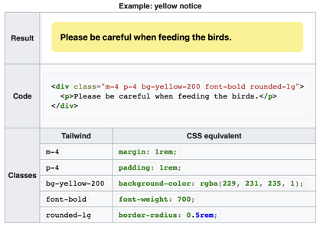
Tailwind CSS
https://tailwindcss.com
https://en.wikipedia.org/wiki/Tailwind_CSS
https://github.com/tailwindlabs/tailwindcss (~70K stars !!)
Tailwind CSS is an open source CSS framework
It creates a list of "utility" CSS classes
Multiple utility classes can be used together
Tailwind CSS is written in JavaScript, runs via Node.js, and installs with npm or yarn
Tailwind automatically removes all unused CSS when building for production, which means your final CSS bundle is the smallest it could possibly be
You can create your own custom css or classes https://csstailwind.com/how-to-add-custom-css-or-classes-in-tailwindcss/
Tailwind CSS:
<div class="w-full md:w-3/4 lg:w-1/2"></div>
vs. regular CSS media queries:
div {width: 50%;}
@media screen and (max-width: 1024px) and (min-width: 768px) { div {width: 75%; }}
@media screen and (max-width: 767px){ div { width: 100% }}

Slide 22


Bootstrap
https://getbootstrap.com
https://github.com/twbs/bootstrap
https://en.wikipedia.org/wiki/Bootstrap_(front-end_framework)
Mark Otto Jacob Thornton
Bootstrap is a popular open-source front-end framework
It was created by Twitter developers Mark Otto and Jacob Thornton in 2011
It provides pre-built components, CSS styles, and JavaScript functionality
It helps building responsive and mobile-first websites
Bootstrap is known for its responsive grid system, which automatically adjusts the layout of elements based on the screen size (desktops, tablets, and smartphones)
It includes a variety of buttons, forms, navigation bars, modals, and other styled components
It provides a set of utility classes for quickly applying CSS styles, as well as a range of JavaScript plugins
Bootstrap allows to speed up the development process, improve consistency across projects, and create visually appealing, responsive websites with minimal effort

Slide 23
New Features in ES6 (the sixth edition of ECMAScript)
Let and Const: New variable declarations - provide block scoping and prevent accidental global variable creation.
Arrow Functions: using the => syntax. They have lexical this scoping
Iterators and for...of loops: iterate over collections, arrays or sets
Classes: prototype-based inheritance (class, constructor, and extends keywords)
Promises: handle asynchronous operations, standardized approach to callbacks
Template Literals: create strings with embedded expressions, using backticks (` `) and ${expression} syntax.
Default Parameters: can set default values for function parameters
Rest and Spread Operators: The rest operator (...) allows a function to accept an indefinite number of arguments as an array, while the spread operator can be used to expand arrays or objects in a concise way
Destructuring Assignment: unpacking values from arrays (or properties from objects) into distinct variables
Enhanced Object Literals: Improved syntax for object literals, including shorthand property names, computed property keys, and concise method definitions
Modules: split code into modules, use import and export keywords (for functions, objects, and values)
Generators: Functions that can be paused and resumed, allowing for more flexible and powerful control flow
New Built-in Objects and Methods: Map, Set, WeakMap, WeakSet, along with new methods on existing objects, such as Array.prototype.includes() , String.prototype.startsWith()
… and some more stuff

Slide 24
Promise (introduced in 2015 in ES6)
In JavaScript, a Promise is an object that represents the eventual completion (or failure) of an asynchronous operation and its resulting value.
A Promise is in one of three states:
Pending (initial state)
Fulfilled (completed successfully, and the Promise has a resulting value)
Rejected (operation failed, and the Promise has a reason for the failure)
A Promise is said to be "settled" if it is either fulfilled or rejected.
You can use the .then() method to attach callbacks that will be called when the Promise is fulfilled, or the .catch() method to attach callbacks that will be called when the Promise is rejected. The .finally() method can be used to attach callbacks that will be called when the Promise is settled, regardless of whether it was fulfilled or rejected
Before the introduction of Promises in JavaScript, asynchronous operations were commonly handled using callback functions.
A callback function is a function that is passed as an argument to another function, and is executed when the operation completes.
Callbacks can lead to complex and hard-to-read code when multiple asynchronous operations need to be chained together.
Promises provide a cleaner and more readable way to handle asynchronous operations and avoid the so-called "callback hell".

Slide 25
Promise
# using promise (new way)
function httpRequest(url) {
return new Promise(function(resolve, reject) {
var xhr = new XMLHttpRequest();
xhr.open('GET', url, true);
xhr.onload = function() {
if (xhr.status === 200) {
resolve(xhr.responseText);
} else {
reject(xhr.statusText);
}
};
xhr.onerror = function() {
reject('Network error');
};
xhr.send();
});
}
httpRequest('https://example.com') // returns promise
.then(function(response) {
console.log(response);
})
.catch(function(error) {
console.error(error);
});
# using callback (old way)
function httpRequest(url, callback) {
var xhr = new XMLHttpRequest();
xhr.open('GET', url, true);
xhr.onload = function() {
if (xhr.status === 200) {
callback(null, xhr.responseText);
} else {
callback(xhr.statusText);
}
};
xhr.onerror = function() {
callback('Network error');
};
xhr.send();
}
httpRequest('https://example.com',
function(error, response) { // callback
if (error) {
console.error(error);
} else {
console.log(response);
}
}
);

Slide 26
async await (introduced in ES8 in 2017)
https://developer.mozilla.org/en-US/docs/Web/API/Fetch_API/Using_Fetch
Async/Await serve as syntactic sugar for promises.
Instead of attaching a .then, you can use the await keyword to tell JS to stop code execution until the promise is settled.
Stopping your entire website while you wait for a request is obviously not that practical, so JS only allows you to use await within async functions and modules. That way, only the function/module stops, not your whole website.
JS runs async functions in their own ?, meaning the rest of your code can keep working while you wait
async function logJSONData() {
const response = await fetch("https://example.com/movies.json");
const jsonData = await response.json();
console.log(jsonData);
}
In this example we’re fetching a JSON file - and logging it to the console
fetch() returns a promise that resolves with a Response object
json() returns a promise that resolves with the JSON

Slide 27
JavaScript Tutorials
I like tutorials by Derek Banas
He made a 1.5 hr tutorial in 2015 based on JavaScript version ES5 (2009)
https://www.youtube.com/watch?v=fju9ii8YsGs
https://www.newthinktank.com/2015/09/learn-javascript-one-video/ - cheatsheet
Note that Derek has also a more recent (2019)
set of 13 tutorials as a Playlist (using ES6 standard of 2015):
JavaScript Tutorial Real Projects https://www.youtube.com/watch?v=IyDVvGmzTlo&list=PLGLfVvz_LVvTP2Op3wZlaGTUcgCfDuwn8
Differences between ES5 & ES6:
https://www.javatpoint.com/es5-vs-es6#
https://en.wikipedia.org/wiki/JavaScript
https://en.wikipedia.org/wiki/JavaScript_syntax
// Major features in ES6:
// let and const
const name = “world”
let exampleWebsiteHTML = 5
// Arrow-function syntax
const c = (name) => {console.log(`Hello ${name}!`)}
// Promises
fetch(‘https://example.com’).then(
(resp) => {exampleWebsiteHTML = resp.text()}
)
https://www.newline.co/fullstack-react-with-typescript#packages

Slide 28
Additional Slides

Slide 29

JavaScript for the Haters
.. https://www.youtube.com/watch?v=aXOChLn5ZdQ
The Weird History of JavaScript
.. https://www.youtube.com/watch?v=Sh6lK57Cuk4
JavaScript: How It's Made (Fireship channel):
.. https://www.youtube.com/watch?v=FSs_JYwnAdI
Why I Hate JavaScript (Fireship channel):
.. https://www.youtube.com/watch?v=qvFG8J7SUDE
The JavaScript Survival Guide (Fireship channel):
.. https://www.youtube.com/watch?v=9emXNzqCKyg
JavaScript:
"high-level single-threaded, garbage-collected, interpreted (or just-in-time compiled), prototype-based, multi-paradigm, dynamic language with a non-blocking event loop"
Watch Fireship YouTube Channel
https://www.youtube.com/@Fireship
Recommended Development Tools
IntelliJ IDEA - includes webstorm - https://www.jetbrains.com/webstorm/download/
VS Code (+ extensions ...)
Cypress.io ( https://www.cypress.io ) for debugging

Slide 30
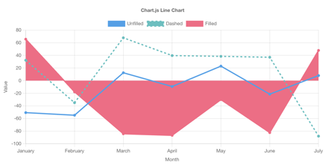
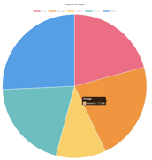
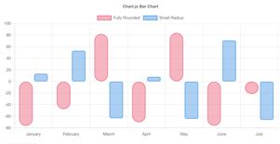
Graphs and Charts
Chart.js (https://www.chartjs.org) - simple and flexible
D3.js (https://d3js.org) - poreful, steeper learning curve
Chartist.js (https://gionkunz.github.io/chartist-js/) - lightweight and responsive, SVG-based charts
ECharts (https://echarts.apache.org) - open-source from Baidu
C3.js (http://c3js.org) - D3-based, wrapper around D3, easier to use
Plotly.js (https://plotly.com/javascript/) - open-source built on top of D3.js and stack.gl

Slide 31
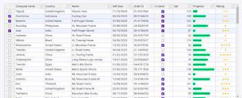
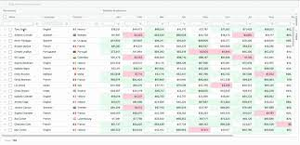
Grid Libraries
Many (51) grids libraries are shown here:
https://jsgrids.statico.io
AG Grid:
https://ag-grid.com
https://github.com/ag-grid/ag-grid
https://www.youtube.com/watch?v=KS-wg5zfCXc
https://youtu.be/8OeJn75or2w - enterprise features
https://www.ag-grid.com/javascript-data-grid/grid-features/
https://www.ag-grid.com/javascript-data-grid/
Some other libraries:
https://gridjs.io/docs/examples/resizable
https://datatables.net
https://www.jtable.org

