Slide 1






Slide 2

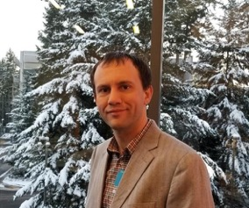




Slide 3
GPT-3
Large, pretrained Language Models that use deep learning to generate content
Use cases:
Generating natural language for chatbots and virtual assistants with awareness of the
previous history of chat
Power chatbots that can handle customer inquiries, provide assistance, and converse but
doesn’t have memory of conversations
Automatically summarize lengthy texts
Assist writers by suggesting synonyms, correcting grammar and spelling errors, and even generating entire sentences or paragraphs
Help researchers by quickly processing large amounts of data and generating insights, summaries, and visualizations to aid in analysis
Generate good quality code based on natural language
ChatGPT (preview)
Customize generation by adding your data as context to the AI model
GPT-4 (preview) Built-in responsible AI to detect and mitigate
harmful use
Use cases:
Generating natural language for chatbots and virtual assistants that has memory of the previous history of chat
Improving the accuracy and efficiency of automated customer service interactions
Enhancing language translation software for more accurate and natural translations
Generating more human-like content for social media and marketing campaigns
Improving the effectiveness of natural language processing for tasks such as sentiment analysis
and text classification
Use cases:
Generating and understanding natural language for customer service interactions, chatbots, and virtual assistants – doesn’t have memory of conversations
Generating high-quality code for programming languages based on natural language input.
Providing accurate translations between languages
Improving text summarization and content generation
Provides for multi-modal interaction (text and images)
Substantial reduction in Hallucinations
Consistency between different runs is high

Slide 4
Azure OpenAI | Comparing the GPT 3 models
GPT-3
Codex
Davinci
4096 Tokens
Summarizing for specific audience
Generating creative content
Davinci-codex
Curie
Cushman-codex
2048 Tokens
Answering questions
Complex, nuanced classification
Babbage
Inferencing time
2048 Tokens
Semantic search ranking
Moderately complex classification
Ada
2048 Tokens
Simple classification
Parsing and formatting text
Capability
Capability

Slide 5
Azure OpenAI | Comparing the GPT 3-5 models
Model Description
text-davinci-002
A GPT-3.5 model that was custom-tuned on natural language instructions and can perform a variety of tasks including summarization, question answering, classification, and more.
text-davinci-003
An improvement over the text-davinci-002 model. The model is similar to its predecessor but generally more capable across all tasks.
ChatGPT model
(gpt-3.5-turbo)
A model custom-tuned for working with dialogue.
ChatGPT is a great model to use for conversational tasks.
Visit the Azure OpenAI Service pricing page for pricing details

Slide 6

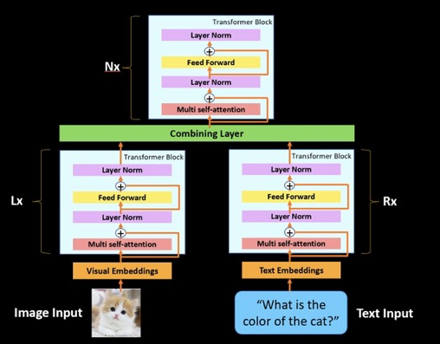
Azure OpenAI GPT-4 Overview
GPT-4 is a large multimodal model (accepting text inputs, emitting text outputs) that, while less capable than humans in many real-world scenarios, exhibits human-level performance on various professional and academic benchmarks.
GPT-4 is more reliable, creative, and able to handle much more nuanced instructions than GPT-3.5.
Can do everything that GPT 3.5 can do
+ Visual Question and Answering (VQA)
+ Steerability
+ context length of 8,192 tokens
Apply here for GPT-4 access: applying for access to GPT-4 today

Slide 7
Previous GPT-3 models
Previous models were text-in and text-out
(i.e., they accepted a prompt string and returned a completion to
append to the prompt).
The ChatGPT model
The ChatGPT model is conversation-in and message-out.
(i.e., it expects a prompt string that is formatted in a specific chat- like transcript format and returns a completion that represents a model-written message in the chat)
Answer questions from the context below.
Context:
A neutron star is the collapsed core of a massive supergiant star, which had a total mass of between 10 and 25 solar masses, possibly more if the star was especially metal-rich.
Q: What is a neutron star? A:
[System Message]
Assistant is an AI Chatbot designed to answer questions from the context
provided below.
Context:
A neutron star is the collapsed core of a massive supergiant star, which had a total mass of between 10 and 25 solar masses, possibly more if the star was especially metal-rich.
[User]
What is a neutron star?
[Assistant]

Slide 8
There are two different APIs available for working with the ChatGPT model.
Chat Completion API
(Recommended)
A new API designed for working with Chat models (gpt-35-turbo and gpt-4). We recommend using this API moving forward.
In this API, you pass in a series of messages rather than the prompt as a raw string making it easier to manage the conversation.
Completion API
The ChatGPT model also works with the existing completions API. In this API, you’ll format your prompt as a string and need to use the special tokens from Chat Markup Language.
We generally recommend using the Chat API instead because the special tokens may get updated in future version of gpt-35-turbo meaning you would need to update your prompts before updating to newer versions of the model.
<|im_start|>system
Assistant is a large language model trained by OpenAI.
<|im_end|>
<|im_start|>user
What is a garbanzo bean?
<|im_end|>
<|im_start|>assistant
messages = [
{
“role”: “system”,
“content”: “Assistant is a large language model trained by OpenAI.”
},
{
“role”: “user”,
“content”: “What is a garbanzo bean?”
}
]

Slide 9
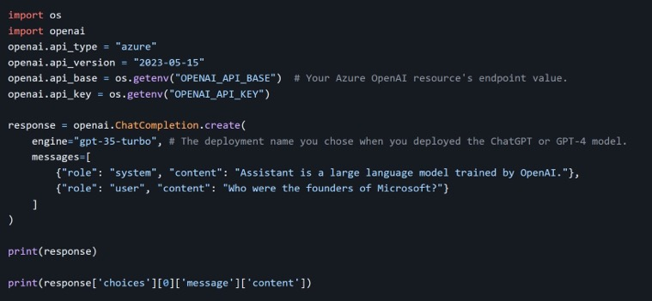
azure-docs/chat-completion.md at main · MicrosoftDocs/azure-docs · GitHub
{
"choices": [
{
"finish_reason": "stop", "index": 0,
"message": {
"content": "The founders of Microsoft are Bill Gates and Paul Allen. They co-founded the company in 1975.",
"role": "assistant"
}
}
],
"created": 1679014551,
"id": "chatcmpl-6usfn2yyjkbmESe3G4jaQR6bsScO1", "model": "gpt-3.5-turbo-0301",
"object": "chat.completion", "usage": { "completion_tokens": 86,
"prompt_tokens": 37,
"total_tokens": 123
}
}

Slide 10







Slide 11
– Topic Classifier
Classify customer's question. Classify between category 1 to 3.
Detailed guidelines for how to choose:
choose 1 if the question is about auto insurance.
choose 2 if the question is about home flood insurance.
choose 3 if the question is not relevant to insurance.
Instructions
High level and detailed
Customer question: Hi there, do you know how to choose flood insurance? Classified topic: 2
Customer question: Hi there, I have a question on my auto insurance. Classified topic: 1
Customer question: Hi there, do you know how to apply for financial aid?
Classified topic: 3
Examples
Order of examples matter
Customer question: {insert new question here} Classified topic:
Task and Prompting
answer

Slide 12


Fine-tuning is a way of utilizing transfer learning. Specifically, fine-tuning is a process that takes a model that has already been trained and tune it using a labeled dataset for a specific task.
Fine-tuning results in a new model being generated with
updated weights and biases. This contrasts with few-shot learning in which model weights and biases are not updated.
To fine-tune a model, you'll need a set of training examples that each consist of a single input ("prompt") and its associated output ("completion").

Slide 13


For some use cases, fine-tuned less capable models (Ada, Babbage, Curie) performs well but more cost effective and faster than Davinci.
Latency is important for use case. Because no need to include examples in the inputs to fine-tuned models, tokens
on few-shot examples are removed, this enables lower-latency requests and saves inferencing costs.
Customer has a lot of high-quality data and ground truth labels (at least a couple hundred for each use case), and customer committed to maintain high-quality data set overtime.
Use case is very domain specific, so model needs to learn from a lot of examples to know how to provide correct answers, and the number of examples needed don't fit in prompt due to token limit (less likely with 32K token limit).

Slide 14
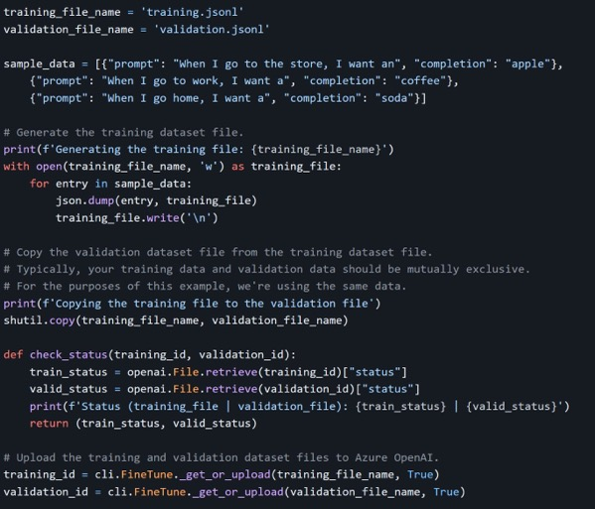
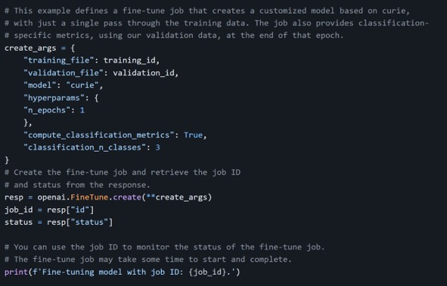

Slide 15

An embedding is a special format of data representation that can be
easily utilized by machine learning models and algorithms.
The embedding is an information dense representation of the semantic
meaning of a piece of text.
Each embedding is a vector of floating-point numbers, such that the distance between two embeddings in the vector space is correlated with semantic similarity between two inputs in the original format.
For example, if two texts are similar, then their vector representations should also be similar.

Slide 16

Embedding models
Different Azure OpenAI Service embedding models are specifically created to be good at a particular task.
Similarity embeddings are good at capturing semantic similarity between two or more pieces of text.
Text search embeddings help measure long documents relevant to a short query.
Code search embeddings are useful for embedding code snippets and embedding
natural language search queries.
Embeddings make it easier to do machine learning on large inputs representing words by
capturing the semantic similarities in a vector space.
Therefore, we can use embeddings to determine if two text chunks are semantically
related or similar, and provide a score to assess similarity.

Slide 17
We strongly recommend using text–embedding–ada–002 (Version 2). This model/version provides parity with OpenAI’s text–embedding–ada– 002.
To learn more about the improvements offered by this model, please
refer to this blog post : https://learn.microsoft.com/en-us/azure/cognitive-services/openai/concepts/models#embeddings-models
Even if you are currently using Version 1, you should migrate to Version 2 to take advantage of the latest weights/updated token limit. Version 1 and Version 2 are not interchangeable, so document embedding and document search must be done using the same version of the model.

Slide 18
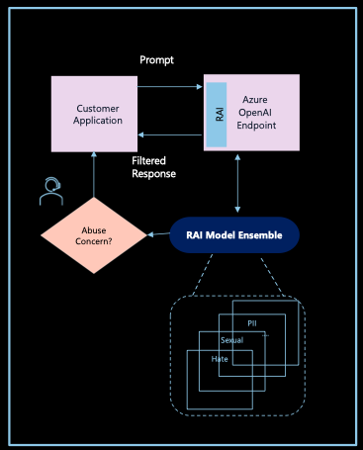


Azure OpenAI Service Responsible AI

Slide 19
Azure OpenAI Key Sites
Azure OpenAI Studio
https://oai.azure.com
GitHub Azure-Samples - demo
https://github.com/Azure-Samples/azure-search-openai-demo
GitHub Microsoft Docs - OpenAI
https://github.com/MicrosoftDocs/azure-docs/blob/main/articles/cognitive-services/openai/overview.md
Embeddings
https://platform.openai.com/docs/guides/embeddings/what-are-embeddings
GitHub OpenAI Cookbook
https://github.com/openai/openai-cookbook/

