Slide 1
Evolution of ML
Image Recognition
for Search
Presentation # 2
Boris Tolkachev
June 23, 2023

Slide 2
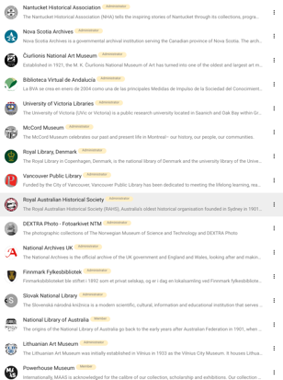
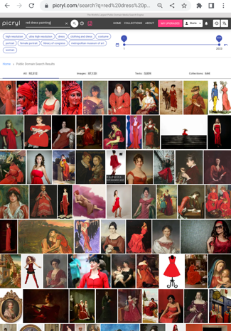
2016 - GetArchive.com
Product: 2B2 platform for publishing of archives
2017 - Picryl.com
Product: Public Domain Media Search Engine - originally was a demo of GetArchive, later become an independent image search & SAAS

Slide 3

2016 - GetArchive.com
2017 - Picryl.com
About the Speaker
Boris Tolkachev
New Jersey, USA
Public domain media - 28.5 million of images
PICRYL - https://picryl.com - provides access to millions of public domain objects and tools for efficient research
https://www.linkedin.com/in/btolkachev
https://getarchive.net/our-team
https://picryl.com/about
https://www.facebook.com/to.bo.90857

Slide 4
GetArchive’s SaaS Search Engine Picryl.com
Idea: Combine several Image Recognition methods, including pre-trained, to augment image metadata for Search improvement. Completed.
Image Understanding & Image Search Approach - 2022
Google Semantic Search (Language agnostic ML, old, GPT~2.0) as an aid to ElasticSearch ✅
CLIP with custom classes relevant to our audience = industry-specific label sets ✅
CLIP to build visually similar image pairs (vector similarity) ✅
Combine Human Metadata, CLIP and [BLIP+] outputs to improve Search ✅

Slide 5
GetArchive’s ML Stack
Multilingual Semantic Search - Google AI - 2020
Multilingual Universal Sentence Encoder for Semantic Retrieval - Google AI, Google Cambridge The sentence embedding model achieves monolingual and cross-lingual semantic retrieval (SR)
https://aclanthology.org/2020.acl-demos.12.pdf
CLIP - OpenAI - 2021 (CLIP = Contrastive Language-Image Pretraining) CLIP is trained on 400M (image, text) pairs produces snippets "without directly optimizing for the task, similarly to the zero-shot capabilities of GPT-2 and 3." "Zero-shot learning" is when a model attempts to predict a class it saw zero times in the training data.
Contrastive Language-Image Pre-Training) - the first multimodal (vision and text) model.
BLIP- Salesforce - 2022 (BLIP = Bootstrapping Language-Image Pre-training) Vision-Language Pre-training (VLP) improvement has been largely achieved by scaling up the dataset with noisy image-text pairs collected from the web. BLIP utilizes the noisy web data by bootstrapping the captions, where a captioner generates synthetic captions and a filter removes the noisy ones. BLIP demonstrates strong generalization ability for both Understanding-based tasks and Generation-based tasks… and three more similar models in the process

Slide 6
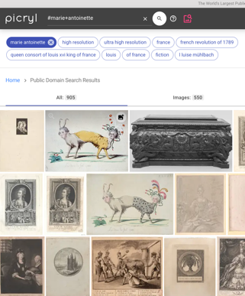
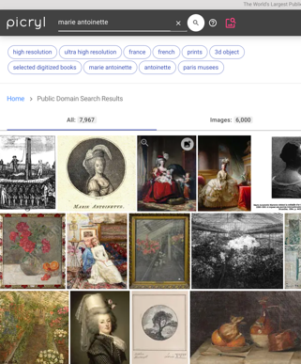
Evolution of Search: Semantic - x10
Old School, tags #marie+antoinette ~1K results, precise
Fuzzy ElasticSearch + Google AI 2020 marie antoinette ~ 10K results, high % false-positive
2020
Semantic Search
Retrieving in multilingual metadata
Retrieving based on “context”
…
sort-of

Slide 7
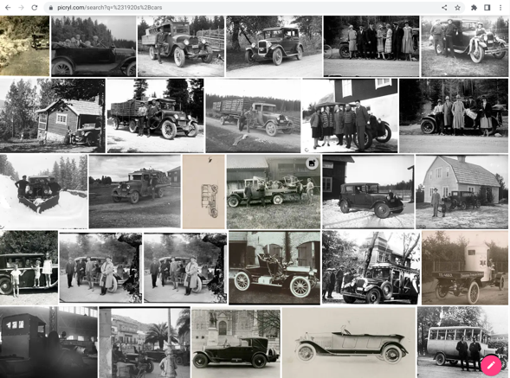
Evolution of Search: Image - x10
2021
1st attempt in
Image Recognition
Supervised
GetArchive created more than 800 Supervised Datasets
#1920+cars
#steam+locomotive
#erotic+photography
Once we train the model, we run all images against the label trained
1K -> QC -> 10K+

Slide 8




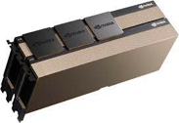



Technology stack
Data: Images + metadata
Image recognition … Pre-trained transformers
Populating MongoDB
Picryl.com Search: MongoDB <-> Elasticsearch
Fallback call to Google Semantic search
Pre-trained CLIP model from Hugging Face
https://huggingface.co/docs/transformers/model_doc/clip
Pre-trained BLIP model from Hugging Face
https://huggingface.co/docs/transformers/model_doc/blip
Linux servers with NVIDIA GPUs
Pre-trained Multilingual Semantic Search model from Google
https://aclanthology.org/2020.acl-demos.12.pdf

Slide 9
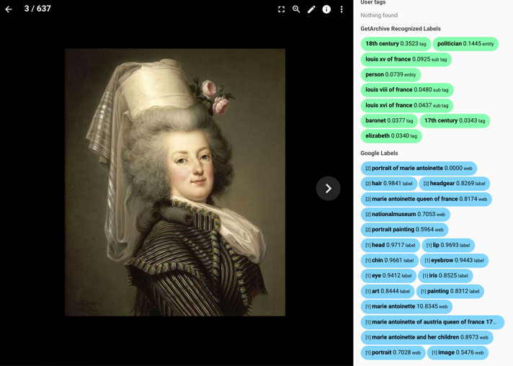


2022
Generating Pieces of Metadata for Images
UnSupervised OpenAI CLIP +
Our own, ~5,000 labels
vs.
Supervised
Google vision
&
“Web” vision
Google API ~50,000 labels
Elasticsearch

Slide 10
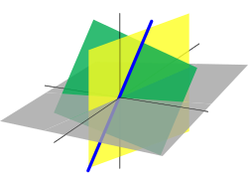
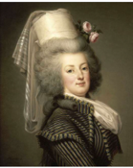
GPT4 + Vector DB
2022: OpenAI CLIP Interrogator 2.1 2023: BLIP Bootstrapping Language-Image Pre-training
a painting of a woman with a hat on her head, a portrait, by Adélaïde Labille-Guiard, pinterest, rococo, wearing a light grey crown, big hair, dressed in shako, maria panfilova, powdered wig, bouquet, photo portrait, portrait c 12.0, portrait knight female, inspiring, ebony rococo
https://huggingface.co/spaces/fffiloni/CLIP-Interrogator-2
Dynamic, User-Fit captions and labels Marie-Antoinette d'Autriche, reine de France (1788), marie antoinette in riding habit wertmuller, yvelines, france, marie antoinette, queen of france
Marie-Antoinette, Queen of France (1788), marie antoinette five years before her execution, france, marie antoinette, queen of france, french revolution

Slide 11


Repurpose Vector Databases developed for ML for Search - 2024
Different people (and models) see different things/entities in the same image
Different people (and models) give different textual description to the same image
Knowing you, the system ideally can:
Present you with personally fit search results
Generate custom labels, summaries and descriptions, and by doing so deliver search results fit to how you, the user, see the world!
How: Vector Representation of Image-Object, Article-Object, User-Object
Personalized Search Experience = Align User- and Media- Vectors dynamically
User-Specific Descriptions = Generate User-fit Captions, Summaries dynamically

Slide 12
Picryl Live Demo

