Slide 1
Generative AI
Updates
Presented by Lev Selector
June 30, 2023

Slide 2

About the Speaker
Lev Selector, Ph.D.
BixBeta CTO & Co-Founder
40+ years of software engineering, data science, and building teams (hiring, training, and managing)
Ph.D. in mathematical modeling and computer simulations
Interests:
crypto, accounting
cloud architecture, fin-tech, application security
Generative AI
Find me on Linkedin, GitHub, YouTube, Google to connect

Slide 3
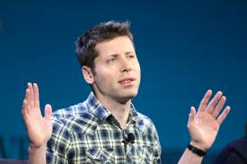
OpenAI - What's Next After GPT-4 ?
It took ~ 6 months to train GPT-4.
GPT-4 is the latest model from OpenAI
(there is also GPT 3.5-turbo at 1/10th cost)
https://platform.openai.com/docs/models
There is no GPT-5 yet (not even in training).
OpenAI is working on many improvements:
.. improving safety
.. adding access to current data
.. adding image inputs
.. adding audio
.. better math, better coding
.. faster/cheaper training
.. plugins/extensions (June 30 - 592 plugins)
.. APIs, function calling, etc.
Sam Altman
OpenAI CEO and Co-Founder

Slide 4


Google Gemini
Google Gemini is the codename for Google's next-generation foundation model, a major upgrade over PaLM 2 - the current AI model behind Google's Bard chatbot.
Demis Hassabis, the CEO of DeepMind, says the company’s Gemini AI is a large language model (LLM) that utilizes text similar to ChatGPT’s processes, but will be equipped with new capabilities like planning or problem-solving.
The system will be based on technology and techniques used in AlphaGo, an early AI system developed by DeepMind in 2016.
Gemini is multimodal, meaning that it can understand and process information from multiple sources, such as text, images, and audio.
Gemini can be used for generating text, translating languages, and writing different kinds of creative content, answering questions, learning and adapting to new information and tasks.
Google says its Gemini will be more powerful than ChatGPT
PaLM (Pathways Language Model) is a 540 Bln parameter transformer LLM from Google AI released in March 2023.
It was trained over two TPU v4 Pods with 3,072 TPU v4 chips in each Pod attached to 768 hosts
PaLM 2 is a 320 Bln model released in May 2023, current model behind Google Bard.
Note - there are also smaller models with 8 & 62 Bln parameters
Google
Gemini
OpenAI ChatGPT

Slide 5

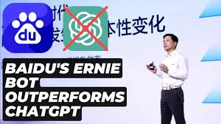
Baidu ERNIE 3.5
June 27, 2023 - Baidu revealed their latest LLM ERNIE 3.5
Baidu claims that this ERNIE 3.5 model surpasses GPT-3.5 model in comprehensive ability scores and outperforms GPT-4 in several Chinese language capabilities
ERNIE Bot now offers improved creative writing, Q&A, reasoning, and code generation
Baidu is also following OpenAI by adding plugins to ERNIE bot

Slide 6
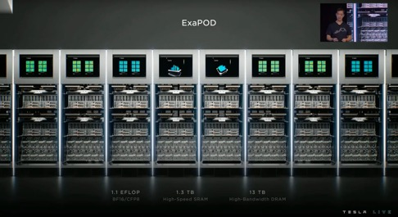
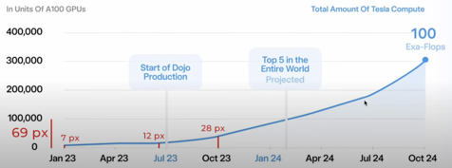
Tesla Dojo Supercomputer
https://en.wikipedia.org/wiki/Tesla_Dojo
Tesla Dojo architecture overview
354 computing cores per D1 chip
25 D1 chips per Training Tile (8,850 cores)
6 Training Tiles per System Tray (53,100 cores, along with host interface hardware)
2 System Trays per Cabinet (106,200 cores, 300 D1 chips)
10 Cabinets per ExaPOD (1,062,000 cores, 3,000 D1 chips)

Slide 7
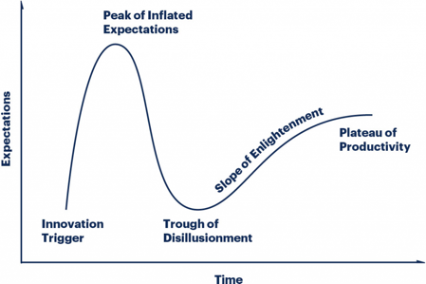

AI Money Craze
It’s rumored that ChatGPT costs OpenAI around $700,000 dollars to run… every day.
It took 6 months to train GPT-4 - you can estimate the cost.
Meta’s LLaMa’s 65-billion model burning $5 million in just 21 days of training
France's Mistral AI blows in
with a $113M seed round
and no product ... !
Open Source, B2B model, https://mistral.ai
Hype Cycle Structure

Slide 8
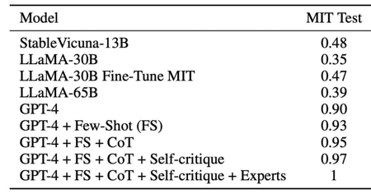
GPT-4 Solves MIT Exam Questions with 100% Accuracy?
Not True, Researchers Say. But Still Very Good!
https://mpost.io/gpt-4-solves-mit-exam-questions-with-100-accuracy-not-true-researchers-say/
MIT researchers conducted the experiment with the goal of evaluating GPT-4’s capabilities. They wanted to know if GPT-4 would be able to graduate from their prestigious school and pass the exams.
The results were nothing short of astounding, as GPT-4 displayed exceptional competence in a variety of fields, including engineering, law, and even history.
... assertion of 100% accuracy was not entirely accurate due to self-assessment and repeated questions.
GPT-4 achieved a high success rate, but this is misleading due to the lack of information regarding the timeline and breakdown of the questions.

Slide 9
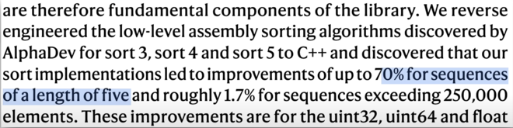
AlphaCode from Google DeepMind
DeepMind’s New AI: History In The Making !
https://www.youtube.com/watch?v=n2qCry_o2Fs

Slide 10
AI-based coding systems (78 examples)
AI Dev Codes | ChatGPT Plus | ExplainDev | Krater.ai | SinCode AI
AI Query | Cmd J | Fig | Lightly | Snappify
AirOps AI Data Sidekick | Codacy | Figstack | Marve Chat | SourceAI
AIWriter | Code GPT | Ghostwriter | MutableAI | Sourcegraph Cody
aiXcoder | Code Snippets AI | GitFluence | Noya | SpellBox
AlphaCode | CodeAssist | GitGab | OpenAI Codex | StarCoder
Amazon CodeWhisperer | Codefy.ai | GitHub Copilot | Phind | Stenography
AskCodi | CodeGeeX | GPT95 | Programming Helper | Tabnine
Autocode | CodeGen | Hacker AI | ProMindGPT | Vivid
Bard | Codeium | IntelliCode | Q | Warp AI
Bito | CodeSquire | IntelliSense | Raycast | What The Diff
Blackbox AI | CodeWP | Jedi | Refact | Wing Python IDE
Bloop | CometCore | JetBrains Datalore | Refraction AI | YouChat
BotCity | Denigma | K.Explorer | Replit | Zentask
Buildt | DevBox | Kite | Safurai
ChatGPT | DevKit | Kodezi | Second

Slide 11
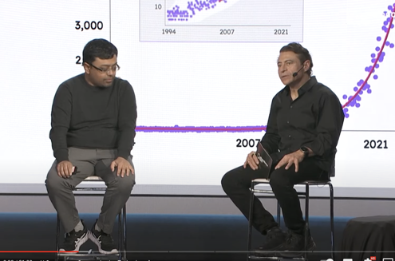
Why AI Matters And How To Deal With The Coming Change
w/ Emad Mostaque | EP #52
Peter H. Diamandis
.. https://www.youtube.com/watch?v=ciX_iFGyS0M
Emad Mostaque
Peter H. Diamandis

Slide 12
Some Cool AI Tools
Adobe Firefly: Image and text effect generation
Notion AI: More efficient notes and docs
NVIDIA Broadcast: AI-enhanced voice and video: Noise removal, Virtual background, Room echo removal, Eye contact (a feature that introverts will love)
Canva AI: Image Generator, Text Generator, Magic Design, and Photo Editor
GPT-4 (Plugins)
Eleven Labs: AI Text to Speech
D-ID: AI Generated Video Creation
Midjourney/Leonardo AI: Image generation
AutoGPT / AgentGPT - you only need to provide 1 prompt and then the tool does all the reasoning and self-prompting to get the best result possible.
GPT-Engineer - the perfect tool for those who want to build apps with just one prompt.

Slide 13

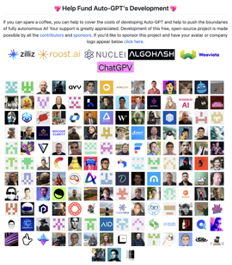
Auto-GPT
Auto-GPT is an open-source Python project .. https://github.com/Significant-Gravitas/Auto-GPT
Auto-GPT uses GPT-4
Auto-GPT can automate tasks and self-prompt
Auto-GPT can search the internet, interact with files, etc.
Auto-GPT can be installed locally on your computer .. https://artificialcorner.com/auto-gpt-a-powerful-ai-tool-that-makes-gpt-4-autonomous-4157b54f94c7 .. https://levelup.gitconnected.com/autogpt-the-new-kid-on-the-ai-block-thats-changing-everything-6d6ee8cf169f
git clone https://github.com/Significant-Gravitas/Auto-GPT.git
cd Auto-GPT
pip install -r requirements.txt
OPENAI_API_KEY=sk-qAcpYqAcpYqAcpYqAcpYqAcpYqAcpYqAcpYqAcpYqAcpY
# run it python -m autogpt
# answer prompt to start ...

Slide 14




LangChain
LangChain is a software development framework designed to simplify the creation of applications using large language models
.. https://en.wikipedia.org/wiki/LangChain
.. https://github.com/hwchase17/langchain
.. https://langchain.com
.. https://python.langchain.com
First released in October 2022
Created by Harrison Chase
Written in Python and JavaScript
Harrison Chase
Co-Founder & CEO
Multiple YouTube tutorials

Slide 15

Auto-GPT vs LangChain
AutoGPT is designed to provide targeted, goal-oriented solutions by segmenting larger objectives, like “establishing an online business”, into a sequence of manageable, smaller subtasks - and executing those tasks.
You can make a fully autonomous chatbot which will automatically self-prompt itself to search internet to find answers to questions. But unfortunately it is also known for getting stuck in logic loops, repeated steps, and tend to go down these "rabbit holes".
LangChain is not an autonomous agent. It is a toolkit/library of various Language Models and utility packages. It can be used to develop apps. It is good at reasoning and planning.

Slide 16

Using ChatGPT with YOUR OWN Data (LangChain)
.. https://www.youtube.com/watch?v=9AXP7tCI9PI
.. https://github.com/techleadhd/chatgpt-retrieval
pip install langchain openai chromadb \
tiktoken unstructured
import os, sys, openai, constants
from langchain.chains import RetrievalQA
from langchain.chat_models import ChatOpenAI
from langchain.document_loaders import DirectoryLoader, TextLoader
from langchain.embeddings import OpenAIEmbeddings
from langchain.indexes import VectorstoreIndexCreator
from langchain.indexes.vectorstore import VectorStoreIndexWrapper
from langchain.llms import OpenAI
from langchain.vectorstores import Chroma
os.environ["OPENAI_API_KEY"] = constants.APIKEY
PERSIST = False # Enable to save to disk & reuse
query = sys.argv[1]
if PERSIST and os.path.exists("persist"):
print("Reusing index...\n")
vectorstore = Chroma(persist_directory="persist", embedding_function=OpenAIEmbeddings())
index = VectorStoreIndexWrapper(vectorstore=vectorstore)
else:
#loader = TextLoader("data/data.txt") # Use this line if you only need data.txt
loader = DirectoryLoader("data/")
if PERSIST:
index = VectorstoreIndexCreator(vectorstore_kwargs={"persist_directory":"persist"}).from_loaders([loader])
else:
index = VectorstoreIndexCreator().from_loaders([loader])
chain = RetrievalQA.from_chain_type(
llm=ChatOpenAI(model="gpt-3.5-turbo"),
retriever=index.vectorstore.as_retriever(search_kwargs={"k": 1}),
)
print(chain.run(query))

Slide 17
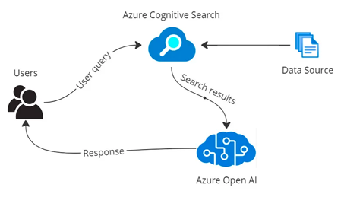
Q & A on Your Private Data
Retrieval Augmented Generation (RAG)
retrieve data from outside the language model (non-parametric)
augment the prompts by adding the relevant retrieved data in context
"Retrieval-Augmented Generation for Knowledge-Intensive NLP Tasks Lewis et al., May 2020" - https://arxiv.org/abs/2005.11401
Example:
Index company documents into Azure Cognitive Search
(it uses RAG), and use Azure OpenAI LLM as user interface: https://medium.com/version-1/unleashing-the-power-of-azure-open-ai-and-azure-cognitive-search-f5a97d729f18
You can do the same in AWS SageMaker: https://aws.amazon.com/blogs/machine-learning/question-answering-using-retrieval-augmented-generation-with-foundation-models-in-amazon-sagemaker-jumpstart/

Slide 18


Microsoft Orca
10+ times smaller than GPT-3
performance on-par with GPT-4
"Orca" is the common name for the largest species of dolphin, Orcinus orca
("killer whale").
https://www.microsoft.com/en-us/research/publication/orca-progressive-learning-from-complex-explanation-traces-of-gpt-4/
https://indianexpress.com/article/technology/artificial-intelligence/microsoft-orca-ai-model-8672524/
Idea - imitation learning, drawing on the outputs generated by large foundation models (LFMs)
Orca has 13 Bln parameters, which is ~13 times smaller than GPT-3.
Despite being small, Orca can very closely imitate GPT-4 on many benchmarks
Orca can learn explanations, step-by-step thought processes, and other complex instructions
Orca can learn progressively from Complex Explanation Traces of GPT-4

Slide 19


ChatGPT School
Siraj Raval
.. https://chatgptschool.io .. https://www.youtube.com/watch?v=EEwsOc9iCXY
OpenAI
ChatGPT API
LangChain (LLM libraries)
Prompt IDEs
https://replit.com (collaborative IDE)
https://wandb.ai (Weights and Biases platform)
Whisper - https://openai.com/research/whisper - speech recognition
https://www.pinecone.io - Pinecone vector database
Siraj Raval
AI Jesus Made Me a Believer
.. https://www.youtube.com/watch?v=kyY9PSQRH1Q
.. https://github.com/llSourcell/AI_Jesus

Slide 20

ChatGPT Jailbreak
A ChatGPT jailbreak is any specially crafted ChatGPT prompt to get the AI chatbot to bypass its rules and restrictions, to do things that it is not allowed to do.
OpenAI works on improving jailbreaking resistance.
ChatGPT, by default, will refuse to create NSFW (Not Safe For Work) content. This can be counter-productive in some creative processes. Jailbreaks smash these restrictions and let the chatbot go full throttle, improving accuracy and creativity.
One of the core elements of a ChatGPT jailbreak is an instruction to the chatbot not to refuse to answer a question. While this ensures that ChatGPT answers even the most unethical of questions, it also means that the chatbot will make up responses that have no roots in facts or reality to obey the instruction of "not refusing to answer." This can significantly increase inaccuracies and cases of AI hallucinations.

Slide 21
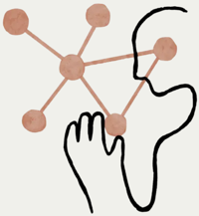
Claude - harmless AI
.. https://www.anthropic.com/index/introducing-claude
.. https://sapling.ai/llm/claude
.. https://www.anthropic.com
Next-generation AI assistant based on Anthropic’s research into training helpful, honest, and harmless AI systems
The term "anthropic" typically refers to the anthropic principle, a philosophical consideration that any data we observe about the universe is filtered by the requirement for the formation of sentient life, particularly human life.
In other words, it proposes that human observers are necessary to bring the universe into being, and it attempts to explain why the laws of physics and the constants of nature seem remarkably fine-tuned for the emergence of life and consciousness.

Slide 22
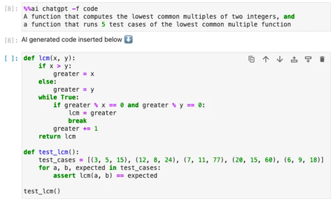
Jupyter AI (Jupyter Lab Extension)
https://artificialcorner.com/jupyter-ai-the-ai-extension-for-jupyter-lab-c4c3be5444fe
$ conda create -n jupyter-ai python=3.10
$ conda activate jupyter-ai
$ pip install jupyter_ai
$ pip uninstall grpcio; conda install grpcio
jupyter lab
%load_ext jupyter_ai
%ai list
!pip install openai
import os
os.environ[“OPENAI_API_KEY”]=your-api-key
%%ai chatgpt

Slide 23
10 ChatGPT Plugins for Data Science
https://www.kdnuggets.com/2023/06/10-chatgpt-plugins-data-science-cheat-sheet.html
webpilot - open-source plugin to interact with websites
Coder Interpreter - solving math, data analysis, visualizations
Noteable - ask questions, explore data, ML
ScholarAI - access to scientific papers (PubMed, Arxiv, Springer, ...)
ChatWithGit - search GitHub
Show Me - visualizations
Bing - access Internet, Wikipedia, news articles, ...
Wolfram - access to math
Link Reader - reads web pages, PDFs, presentations, MS Word docs, ...
Zapier - automate repetitive tasks, integrate 5,000+ apps into your workflow

Slide 24

Noteable Plugin
Noteable is a product by open source project Jupyter (Jupyter notebook, ...) - common data science IDE tool
Noteable adds ChatGPT capabilities to Jupyter notebooks. You can describe what you need in English - and it builds the whole notebook with no coding required !
You work with Noteable notebook at the noteable website
Noteable Plugin was announced in May of 2023
Example, you can ask ChatGPT to search the Internet for specific data, download it into CSV files, load those files into multiple pandas DataFrames, join these DataFrames together, process the data - and make visualizations.
You can describe the queries and data transformations, ask it to describe patterns and trends, describe the details of the graphs / visualizations you want to get
Collaboration - you can have a shared workspace, enabling teams to work together
.. https://noteable.io
.. https://blog.enterprisedna.co/noteable-chatgpt-plugin-user-guide-with-examples/
.. https://www.youtube.com/watch?v=A1ualvzgJoo
.. https://www.youtube.com/watch?v=b48NCYLkawk
.. https://www.youtube.com/watch?v=otk2AA6hGgU

Slide 25
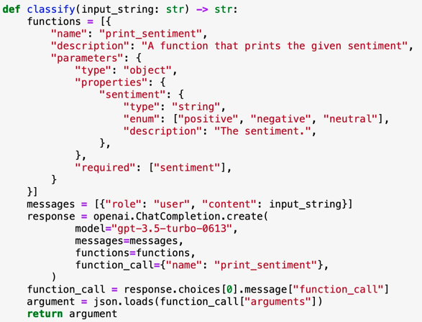
Function calling for turning GPT into a classifier:

Slide 26
Some AI Tools
https://www.youtube.com/watch?v=jb3Qxi9U4P4
ChatSonic AI - https://writesonic.com/chat - chat, uses ChatGPT and Google
Durable AI - https://durable.co - build a website in 30 sec
Eightify AI - https://eightify.app - Chrome extension - summarize videos, insights, updates, education
Perplexity AI - https://www.perplexity.ai - chat bot, supports real time data, an answer engine
Runway ML AI - https://runwayml.com - AI Magic Tools (text, image, video, custom, ...)
Amazon Code Whisperer AI - https://aws.amazon.com/codewhisperer/ - Free AI coding companion
Caktus AI - https://www.caktus.ai - AI study tool for students (need paid subscription)

Slide 27
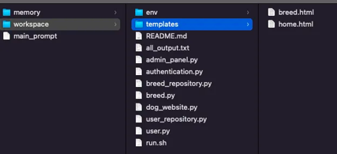
GPT-Engineer: Generate an Entire Codebase with 1 Prompt!
https://artificialcorner.com/gpt-engineer-generate-an-entire-codebase-with-1-prompt-7e98ca368410
git clone https://github.com/AntonOsika/gpt-engineer.git
cd gpt-engineer
make install
source venv/bin/activate
export OPENAI_API_KEY=[your api key]
cp -r projects/example/ projects/my-new-project
gpt-engineer projects/my-new-project
# just type “Create a website about dogs” to see
# what it can deliver without much prompting.

Slide 28
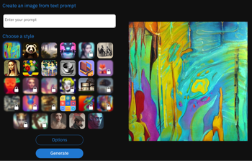

Generating Images for Linkedin Posts
deepai.org
You can use Midjourney or DALL·E 2 to generate images.
There are also many other free services.
Search for them on Google:
best free services to generate images from text
For example:
.. https://www.makeuseof.com/ai-text-to-art-generators/
Try:
.. https://deepai.org/machine-learning-model/text2img
If you want to make an animated image,
simply generate a couple of images,
and then combine them into one animated GIF file using GIF Maker on https://ezgif.com

Slide 29

Is The New AMD MI300X Better Than The NVIDIA H100?
AMD Unveils Instinct MI300 APUs In MI300A & MI300X Flavors:
CDNA 3 GPU,
Up To 24 Zen 4 Cores,
192 GB HBM3 memory,
153 Billion Transistors
https://www.forbes.com/sites/karlfreund/2023/06/13/is-the-new-amd-mi300x-better-than-the-nvidia-h100/?sh=45ebfc1f56f0
MI300 does not have a transformer engine like the Nvidia H100,
which can triple performance for the popular LLM AI models.

Slide 30
Thank You!

