Slide 1
Adding Long-Term Memory to LLMs via Document Embeddings (aka Retrieval Augmented Generation)
Presented by Malte
July 14 2023

Slide 2

About The Speaker
Malte Thesenvitz
Data Scientist and Cloud Engineer
Redapt. Inc
Seattle University, WA
https://www.linkedin.com/in/maltethesenvitz/

Slide 3
Table of Contents
Why do we need embeddings when using Open AI?
Model limitations
Fine-tuning vs. embedding
Vector Databases
Quick History on Word Embeddings
Word embedding ‘map’
Cosine similarity
Demo

Slide 4
Key Question
LLM Limits: changing knowledge base, expensive retraining, token limits,
How can we efficiently store documents in a database so the model can retrieve it quickly during the query?
Requirements:
Storage space should be relatively small
Retrieval of documents should be quick
Only most n relevant documents should be returned
Some random text
Some unique mathematical representation

Slide 5
Quick History on Word Embeddings
2003: Term ‘embeddings’ was coined by Bengio et al. when they trained them in a neural language model together with the model’s parameters
2008: Colbert and Weston demonstrate the power of pre-trained embeddings in a still modern NN architecture
2013: Mikolov et al. creates word2vec, a toolkit enabling the use and training of pre-trained embeddings models
2014: Pennington introduces GloVe, similar to w2v but smaller and faster at training
Notes:
Difference between Word2Vec and GloVe: https://speakai.co/word2vec-vs-glove/#:~:text=The%20vector%20representation%20of%20the,the%20co%2Doccurrence%20of%20words.

Slide 6
Word Embedding Models
Context Independent
Context Dependent
No ML
With ML
RNN based
Transformers
Bag-of-words
GloVe
ELMO
BERT
TF-IDF
Fast Text
CoVe
ALBERTA
Word2Vec
XLM
RoBERTa
Source

Slide 7
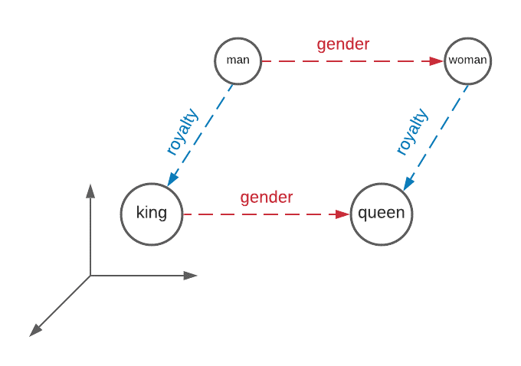
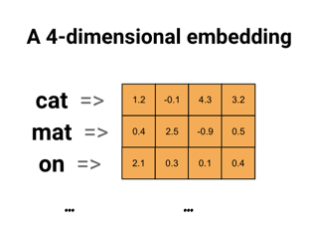

Word Embedding = How can we represent language in mathematical form?
‘Similar word will have similar meanings’ ZS Harris, 1956 - Distributional Structure

Slide 8
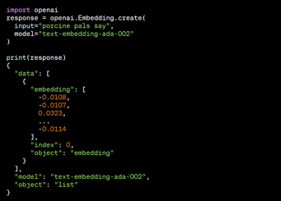
‘Bad’ Alternatives:
Goal of embeddings:
Count based encoding
Bag of words
N-gram approach
TF-IDF (how frequent a word is relevant to one document and how often the word is present in ‘all’ documents
One-Hot Encoding
Representing the word in a dense vector (not many zeros)
Similar words should have a similar vector (coffee and tea vs. pea and tea)
Notes:
No context, can’t deal with new words, embeddings are very large

Slide 9
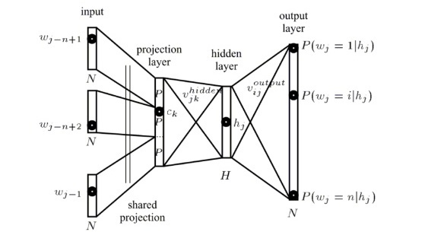
Architectural Overview
Notes:
Usually embeddings are trained as a by product of neural networks. Usually the approach is to train the NN to predict the next word in a phase. The
Naturally, every feed-forward neural network that takes words from a vocabulary as input and embeds them as vectors into a lower dimensional space, which it then fine-tunes through back-propagation, necessarily yields word embeddings as the weights of the first layer, which is usually referred to as Embedding Layer.
Embedding models are learned as part of a Neural Network. The embedding vectors for a specific word are the parameters of the projection layers, that have been fine tuned via backpropagation. This implies two questions to me:
How are the parameters returned when I want to receive the vector for a given body of text?
How can the embedding model generate a vector for a body of text?

Slide 10
How are Embedding Models Trained? - 3 Examples
Embeddings are actually a side effect of solving an NLP problem!
Option 1: Embedding Layer on the front of NN
One hot encoded vocabulary -> define # of vector dimensions -> initialize vectors with small numbers -> fit in a supervised way using backpropagation
Requires a lot of training data, compute power, and time
Option 2: Word2Vec
Improvement of above general embedding layer approach that introduced Continuous Bag-of-words and continuous skip-gram model
More efficient learning, larger embedding spaces possible, while using much larger corpora of text (billions of words)
Option 3: GloVe (Global Vectors for Word Representation)
Extension of Word2Vec developed by Pennington at Stanford
Marries matrix factorization techniques (latent semantic analysis) with W2V
Instead of using a neighboring words window as above, it uses an explicit word-context matrix with stats from entire corpus (learn how this is done..)
Notes:
CBOW: Use surrounding words to get meaning of word in question
Skip-gram: Use current word to predict surrounding words
Local usage context: parameterizable sliding window in which to look for neighboring words

Slide 11
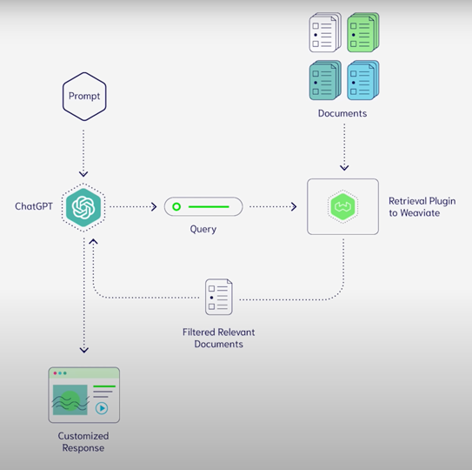
Long-Term Memory (through RAG)
Complement big scale LLMs through adding external knowledge base.
Aka: Retrieval Augmented Generation
Combining Open and Closed Book, Less-retraining
Source

Slide 12


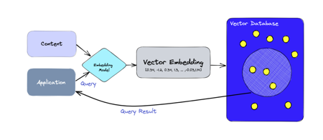

Vector DB = Hot Hot Hot
$16M Series A
Open Source - $18M …with 7.2k GitHub Stars
$700M Evaluation
Notes:
Vector databases are the name of the game currently in the DB world. This is closely related to embeddings and LLM models. All new AI applications rely on vector embeddings, a type of data representation that carries semantic meanings of words in numerical vector representation.

Slide 13
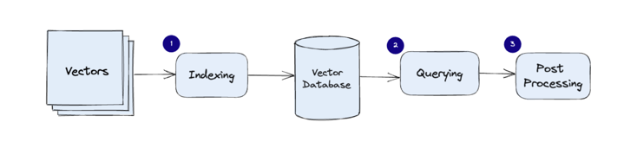
How does a Vector Database work?
Random Projection
Product Quantization
Local-sensitive hashing
See Presentation in a few weeks by Tyler Williams
Traditional DBs: query for rows where the value matches exactly (usually)
Vector DB: similar approach to find most similar vectors to query
Utilize combination of different algorithms that all participate in Approximate Nearest Neighbor (ANN) search
These algorithms utilize features like hashing, quantization, or graph-based search
Common pipeline for a vector database
Notes:
1 Indexing: The vector database indexes vectors using an algorithm such as PQ, LSH, or HNSW (more on these below). This step maps the vectors to a data structure that will enable faster searching.
2 Querying: The vector database compares the indexed query vector to the indexed vectors in the dataset to find the nearest neighbors (applying a similarity metric used by that index)
3 Post Processing: In some cases, the vector database retrieves the final nearest neighbors from the dataset and post-processes them to return the final results. This step can include re-ranking the nearest neighbors using a different similarity measure.

Slide 14
Indexing Vectors for Similarity Search
Large modern models (GPT, Diffusion) use huge latent vectors or tensors (dimensions: 12K .. 60K numbers).
If you put these huge vectors in a vector database, how do you query them?
Here are some common indexing techniques (to speed-up the similarity search):
Locality-sensitive hashing (LSH) - similar vectors get into same buckets
Product quantization (PQ) - lossy compression to reduce the size of vectors while preserving similarity
Hierarchical Navigable Small World (HNSW) - create a graph where each vector is connected to its nearest neighbor(s)
Hierarchical Grid Index (HGI) - divides a multidimensional space into a hierarchy of grids
Ball Tree Index (BTI) - a tree of nodes (balls) and leaves (actual points)
Random Forest Index (RFI) - trees represent regions in space, and the leaves represent the actual points.
Examples:
Pinecone uses a hybrid approach : an HGI with a LSH index. Fast search on large and small datasets
Weaviate uses a hybrid approach : an HGI with a BTI index. Fast performance for both range and point queries
Chroma uses a single-level grid index, which is a simple but effective approach for vector indexing
Redis Vector Database uses a Sorted Set data structure to store vectors, which allows for efficient range queries
Qdrant uses a hybrid approach : an HGI with a RFI index. Good performance for both range and point queries
Milvus Project uses an HGI
Vespa.ai uses a hybrid approach : an HGI with a LSH index. Fast search on large and small datasets

Slide 15
Demo
How we can use vector databases to power efficient semantic search with ChatGPT and add long-term memory.

Slide 16
Conclusion
RAG allows to add modifiable long-term to LLMs via embeddings.
Vector databases are going to achieve growing demand over the next few years.
Open Questions
How can embedding models output one vector for a body of text?
How can embedding models embed words they haven’t been trained on?
How do embedding models return a vector output for a given input word AFTER they have been trained?
Good Tools
LangChain
Chroma, Pinecone (both Vector DBs)
OpenAi LLMs
Keras
Tensorflow
Pandas

Slide 17
Appendix

Slide 18
What is the Cheapest Way to Generate Embeddings ?
And the Best ?
$0 Embeddings (OpenAI vs. free & open source)
.. https://youtu.be/QdDoFfkVkcw
.. https://github.com/rabbit-hole-syndrome/open-source-embeddings

Slide 19
Sources:
https://aylien.com/blog/overview-word-embeddings-history-word2vec-cbow-glove
https://towardsdatascience.com/explaining-vector-databases-in-3-levels-of-difficulty-fc392e48ab78
https://developers.google.com/machine-learning/crash-course/embeddings/obtaining-embeddings (Google Courses: GREAT!)
https://www.tensorflow.org/tutorials/text/word2vec (Tensorflow Word2Vec Tutorial)
Jason Brownlee (as always lol): https://machinelearningmastery.com/use-word-embedding-layers-deep-learning-keras/

