Slide 1
AI Updates
July 16, 2023
Presented by Lev Selector
July 16, 2023

Slide 2



An Opinion
In May, a memo from one of Google DeepMind engineers was leaked to the internet.
According to it, neither Google nor OpenAI has what it needs to succeed in the AI industry.
Instead, according to the researcher, "a third faction has been quietly eating our lunch".
He was referring to open-source AI models that are "faster, more customizable, more private, and pound-for-pound more capable.".

Slide 3
Open LLM Leaderboard (on HuggingFace.co website)
https://huggingface.co/spaces/HuggingFaceH4/open_llm_leaderboard
Compared 346 models -(as of July 16, 2023). Here are the top 10
Model | Average | ARC | HellaSwag | MMLU | TruthfulQA (MC)
tiiuae/falcon-40b-instruct | 63.4 | 61.6 | 84.3 | 55.4 | 52.5
CalderaAI/30B-Lazarus | 63.2 | 57.8 | 81.7 | 55.3 | 58
ausboss/llama-30b-supercot | 62.4 | 58.4 | 82.9 | 55.8 | 52.5
llama-65b | 62.1 | 57.6 | 84.3 | 63.4 | 43
huggyllama/llama-65b | 62.1 | 57.6 | 84.3 | 63.4 | 43
tiiuae/falcon-40b | 61.5 | 61.9 | 85.3 | 57 | 41.7
MetaIX/GPT4-X-Alpasta-30b | 61.4 | 56.7 | 81.3 | 56.9 | 50.6
openaccess-ai-collective/manticore-30b-chat-pyg-alpha | 61.2 | 58.2 | 81.8 | 54 | 50.8
mosaicml/mpt-30b-chat | 61.1 | 58.3 | 82.4 | 51.2 | 52.6
timdettmers/guanaco-33b-merged | 60.9 | 57.5 | 82.8 | 52.5 | 50.8

Slide 4
346 LLModels from HuggingFace Leaderboard
tiiuae/falcon-40b-instruct, CalderaAI/30B-Lazarus, ausboss/llama-30b-supercot, llama-65b, huggyllama/llama-65b, tiiuae/falcon-40b, MetaIX/GPT4-X-Alpasta-30b, openaccess-ai-collective/manticore-30b-chat-pyg-alpha, mosaicml/mpt-30b-chat, timdettmers/guanaco-33b-merged, Aeala/VicUnlocked-alpaca-30b, TheBloke/dromedary-65b-lora-HF, digitous/Alpacino30b, Aeala/GPT4-x-AlpacaDente2-30b, llama-30b, elinas/chronos-33b, TheBloke/Wizard-Vicuna-13B-Uncensored-HF, cyl/awsome-llama, TheBloke/wizardLM-13B-1.0-fp16, ehartford/Wizard-Vicuna-13B-Uncensored, NousResearch/Nous-Hermes-13b, TheBloke/gpt4-x-vicuna-13B-HF, openaccess-ai-collective/wizard-mega-13b, jondurbin/airoboros-13b, Monero/Manticore-13b-Chat-Pyg-Guanaco, psmathur/orca_mini_v2_13b, lmsys/vicuna-13b-v1.3, openaccess-ai-collective/manticore-13b, openaccess-ai-collective/manticore-13b-chat-pyg, TheBloke/gpt4-alpaca-lora-13B-HF, TheBloke/airoboros-13B-HF, mosaicml/mpt-30b-instruct, digitous/13B-HyperMantis, TehVenom/Metharme-13b-Merged, dvruette/oasst-llama-13b-2-epochs, TheBloke/guanaco-13B-HF, Aeala/GPT4-x-Alpasta-13b, kevinpro/Vicuna-13B-CoT, openaccess-ai-collective/minotaur-13b, eachadea/vicuna-13b-1.1, dvruette/llama-13b-pretrained-sft-do2, TheBloke/wizard-vicuna-13B-HF, junelee/wizard-vicuna-13b, Open-Orca/OpenOrca-Preview1-13B, project-baize/baize-v2-13b, mosaicml/mpt-30b, xzuyn/Alpacino-SuperCOT-13B, TheBloke/vicuna-13B-1.1-HF, TheBloke/tulu-13B-fp16, wahaha1987/llama_13b_sharegpt94k_fastchat, pillowtalks-ai/delta13b, ausboss/llama-13b-supercot, PocketDoc/Dans-PileOfSets-Mk1-llama-13b-merged, dvruette/llama-13b-pretrained-sft-epoch-1, digitous/Alpacino13b, dvruette/llama-13b-pretrained, dvruette/llama-13b-pretrained-dropout, camel-ai/CAMEL-13B-Combined-Data, eachadea/vicuna-13b, dvruette/oasst-llama-13b-1000-steps, camel-ai/CAMEL-13B-Role-Playing-Data, shibing624/chinese-alpaca-plus-13b-hf, Ejafa/vicuna_7B_vanilla_1.1, llama-13b, llama-anon/instruct-13b, TheBloke/koala-13B-HF, eachadea/vicuna-7b-1.1, lmsys/vicuna-7b-v1.3, wahaha1987/llama_7b_sharegpt94k_fastchat, ehartford/WizardLM-13B-Uncensored, TheBloke/tulu-7B-fp16, xzuyn/MedicWizard-7B, TehVenom/Pygmalion-13b-Merged, TehVenom/Pygmalion-Vicuna-1.1-7b, bigcode/starcoderplus, medalpaca/medalpaca-7b, LLMs/AlpacaGPT4-7B-elina, TheBloke/wizardLM-7B-HF, notstoic/PygmalionCoT-7b, Neko-Institute-of-Science/metharme-7b, ehartford/Wizard-Vicuna-7B-Uncensored, TheBloke/Wizard-Vicuna-7B-Uncensored-HF, psmathur/orca_mini_v2_7b, mosaicml/mpt-7b-chat, wannaphong/openthaigpt-0.1.0-beta-full-model_for_open_llm_leaderboard, togethercomputer/GPT-JT-6B-v0, TheBloke/airoboros-7b-gpt4-fp16, jphme/orca_mini_v2_ger_7b, jondurbin/airoboros-7b, project-baize/baize-v2-7b, tiiuae/falcon-7b, mosaicml/mpt-7b-instruct, TheBloke/guanaco-7B-HF, llama-7b, TehVenom/Pygmalion_AlpacaLora-7b, facebook/galactica-30b, THUDM/chatglm2-6b, togethercomputer/GPT-JT-6B-v1, baichuan-inc/Baichuan-7B, ehartford/WizardLM-7B-Uncensored, shibing624/chinese-llama-plus-13b-hf, shibing624/chinese-alpaca-plus-7b-hf, TheBloke/Planner-7B-fp16, illuin/test-custom-llama, Neko-Institute-of-Science/pygmalion-7b, togethercomputer/RedPajama-INCITE-Instruct-7B-v0.1, togethercomputer/RedPajama-INCITE-7B-Instruct, mosaicml/mpt-7b, openlm-research/open_llama_7b_v2, tiiuae/falcon-7b-instruct, openlm-research/open_llama_13b, dvruette/gpt-neox-20b-full-precision, Salesforce/codegen-16B-nl, TheBloke/koala-7B-HF, dvruette/oasst-gpt-neox-20b-1000-steps, facebook/opt-66b, togethercomputer/RedPajama-INCITE-7B-Base, togethercomputer/GPT-NeoXT-Chat-Base-20B, EleutherAI/gpt-neox-20b, h2oai/h2ogpt-oasst1-512-20b, mosaicml/mpt-7b-storywriter, OpenAssistant/oasst-sft-1-pythia-12b, h2oai/h2ogpt-gm-oasst1-multilang-1024-20b, h2oai/h2ogpt-gm-oasst1-en-1024-12b, digitous/Javelin-GPTJ, dvruette/oasst-gpt-neox-20b-3000-steps, databricks/dolly-v2-12b, Vmware/open-llama-7b-v2-open-instruct, OpenAssistant/oasst-sft-4-pythia-12b-epoch-3.5, digitous/GPT-R, dvruette/oasst-pythia-12b-pretrained-sft, togethercomputer/RedPajama-INCITE-Base-7B-v0.1, databricks/dolly-v2-7b, OpenAssistant/pythia-12b-sft-v8-7k-steps, Pirr/pythia-13b-deduped-green_devil, KoboldAI/GPT-NeoX-20B-Erebus, AlekseyKorshuk/chatml-pyg-v1, OpenAssistant/pythia-12b-sft-v8-2.5k-steps, togethercomputer/RedPajama-INCITE-Chat-7B-v0.1, EleutherAI/gpt-j-6b, digitous/Javalion-R, togethercomputer/RedPajama-INCITE-7B-Chat, PygmalionAI/pygmalion-6b, digitous/Javelin-R, KoboldAI/GPT-NeoX-20B-Skein, h2oai/h2ogpt-oasst1-512-12b, KoboldAI/GPT-J-6B-Skein, TehVenom/Dolly_Shygmalion-6b-Dev_V8P2, digitous/Adventien-GPTJ, psmathur/orca_mini_7b, digitous/Janin-R, OpenAssistant/pythia-12b-pre-v8-12.5k-steps, digitous/Skegma-GPTJ, TehVenom/PPO_Shygmalion-V8p4_Dev-6b, digitous/Javalion-GPTJ, Fredithefish/ScarletPajama-3B-HF, dvruette/oasst-pythia-6.9b-4000-steps, digitous/Janin-GPTJ, TehVenom/PPO_Pygway-V8p4_Dev-6b, Corianas/gpt-j-6B-Dolly, TehVenom/Dolly_Shygmalion-6b, TehVenom/GPT-J-Pyg_PPO-6B-Dev-V8p4, Fredithefish/RedPajama-INCITE-Chat-3B-Instruction-Tuning-with-GPT-4, KoboldAI/GPT-J-6B-Shinen, Salesforce/codegen-6B-nl, KoboldAI/GPT-J-6B-Janeway, TehVenom/Dolly_Malion-6b, TehVenom/ChanMalion, togethercomputer/RedPajama-INCITE-Chat-3B-v1, togethercomputer/Pythia-Chat-Base-7B, EleutherAI/pythia-12b-deduped, KoboldAI/OPT-13B-Erebus, KoboldAI/fairseq-dense-6.7B, KoboldAI/PPO_Pygway-6b-Mix, facebook/opt-13b, TehVenom/GPT-J-Pyg_PPO-6B, EleutherAI/pythia-6.9b-deduped, KoboldAI/OPT-13B-Nerybus-Mix, togethercomputer/RedPajama-INCITE-Instruct-3B-v1, TehVenom/PPO_Shygmalion-6b, KoboldAI/OPT-13B-Nerys-v2, hakurei/instruct-12b, openlm-research/open_llama_7b, VMware/open-llama-0.7T-7B-open-instruct-v1.1, facebook/opt-6.7b, KoboldAI/OPT-6.7B-Erebus, GeorgiaTechResearchInstitute/galactica-6.7b-evol-instruct-70k, Fredithefish/RedPajama-INCITE-Chat-3B-ShareGPT-11K, h2oai/h2ogpt-oig-oasst1-512-6_9b, KoboldAI/OPT-6.7B-Nerybus-Mix, EleutherAI/pythia-12b, h2oai/h2ogpt-oig-oasst1-256-6_9b, KoboldAI/OPT-6B-nerys-v2, psmathur/orca_mini_3b, togethercomputer/RedPajama-INCITE-Base-3B-v1, Fredithefish/CrimsonPajama, databricks/dolly-v2-3b, cerebras/Cerebras-GPT-13B, aisquared/chopt-2_7b, EleutherAI/pythia-6.7b, h2oai/h2ogpt-gm-oasst1-en-1024-open-llama-7b-preview-400bt, ewof/koishi-instruct-3b, CobraMamba/mamba-gpt-3b, KoboldAI/fairseq-dense-2.7B, NbAiLab/nb-gpt-j-6B-alpaca, openlm-research/open_llama_3b, openlm-research/open_llama_7b_700bt_preview, KoboldAI/OPT-2.7B-Erebus, Writer/camel-5b-hf, EleutherAI/pythia-2.8b-deduped, KoboldAI/OPT-2.7B-Nerybus-Mix, facebook/xglm-7.5B, EleutherAI/pythia-2.7b, KoboldAI/GPT-J-6B-Adventure, cerebras/Cerebras-GPT-6.7B, KoboldAI/OPT-2.7B-Nerys-v2, facebook/opt-2.7b, EleutherAI/gpt-neo-2.7B, pythainlp/wangchanglm-7.5B-sft-en-sharded, OpenAssistant/stablelm-7b-sft-v7-epoch-3, pythainlp/wangchanglm-7.5B-sft-enth, aisquared/chopt-1_3b, h2oai/h2ogpt-gm-oasst1-en-2048-open-llama-7b-preview-300bt-v2, PygmalionAI/metharme-1.3b, MBZUAI/LaMini-GPT-1.5B, MBZUAI/lamini-neo-1.3b, EleutherAI/pythia-1.4b-deduped, Writer/palmyra-base, stabilityai/stablelm-base-alpha-7b, facebook/xglm-4.5B, aisquared/dlite-v2-1_5b, stabilityai/stablelm-tuned-alpha-7b, hakurei/lotus-12B, bigcode/starcoder, facebook/opt-1.3b, EleutherAI/pythia-1.3b, PygmalionAI/pygmalion-2.7b, gpt2-xl, h2oai/h2ogpt-gm-oasst1-en-2048-open-llama-7b-preview-300bt, lxe/Cerebras-GPT-2.7B-Alpaca-SP, cerebras/Cerebras-GPT-2.7B, jzjiao/opt-1.3b-rlhf, EleutherAI/gpt-neo-1.3B, Corianas/Quokka_2.7b, aisquared/dlite-v1-1_5b, aisquared/dlite-v2-774m, EleutherAI/pythia-1b-deduped, shaohang/Sparse0.5_OPT-1.3, EleutherAI/polyglot-ko-12.8b, Salesforce/codegen-6B-multi, stabilityai/stablelm-tuned-alpha-3b, Rachneet/gpt2-xl-alpaca, PygmalionAI/pygmalion-1.3b, KoboldAI/fairseq-dense-355M, gpt2-large, stabilityai/stablelm-base-alpha-3b, aisquared/dlite-v2-355m, aisquared/dlite-v1-774m, gpt2-medium, EleutherAI/pythia-410m-deduped, facebook/xglm-1.7B, Corianas/Quokka_1.3b, cerebras/Cerebras-GPT-1.3B, xhyi/PT_GPTNEO350_ATG, aisquared/dlite-v1-355m, MBZUAI/lamini-cerebras-1.3b, TehVenom/DiffMerge-DollyGPT-Pygmalion, PygmalionAI/pygmalion-350m, BreadAi/PM_modelV2, beomi/KoAlpaca-Polyglot-5.8B, KoboldAI/OPT-350M-Erebus, MayaPH/FinOPT-Franklin, timdettmers/guanaco-65b-merged, microsoft/biogpt, IDEA-CCNL/Ziya-LLaMA-13B-v1, KoboldAI/OPT-350M-Nerys-v2, lmsys/vicuna-13b-delta-v1.1, lmsys/vicuna-7b-delta-v1.1, BreadAi/MusePy-1-2, MayaPH/FinOPT-Lincoln, microsoft/CodeGPT-small-py, KoboldAI/fairseq-dense-125M, SebastianSchramm/Cerebras-GPT-111M-instruction, IDEA-CCNL/Ziya-LLaMA-13B-Pretrain-v1, victor123/WizardLM-13B-1.0, vicgalle/alpaca-7b, huggingtweets/bladeecity-jerma985, WizardLM/WizardLM-13B-1.0, facebook/xglm-564M, EleutherAI/gpt-neo-125m, bigcode/tiny_starcoder_py, MBZUAI/lamini-neo-125m, Tincando/fiction_story_generator, microsoft/DialoGPT-small, EleutherAI/pythia-160m-deduped, concedo/OPT-19M-ChatSalad, cerebras/Cerebras-GPT-256M, alibidaran/medical_transcription_generator, BreadAi/gpt-YA-1-1_160M, ogimgio/gpt-neo-125m-neurallinguisticpioneers, microsoft/DialoGPT-medium, facebook/opt-125m, ai-forever/rugpt3large_based_on_gpt2, bigcode/gpt_bigcode-santacoder, EleutherAI/pythia-160m, roneneldan/TinyStories-1M, concedo/Pythia-70M-ChatSalad, Abe13/jgpt2-v1, anton-l/gpt-j-tiny-random, BreadAi/DiscordPy, Locutusque/gpt2-conversational-or-qa, euclaise/gpt-neox-122m-minipile-digits, EleutherAI/pythia-70m, microsoft/DialoGPT-large, MayaPH/FinOPT-Washington, BreadAi/StoryPy, psyche/kogpt, BreadAi/gpt-Youtube, huggingtweets/jerma985, roneneldan/TinyStories-33M, cyberagent/open-calm-7b, EleutherAI/pythia-70m-deduped, SaylorTwift/gpt2_test, roneneldan/TinyStories-28M, gpt2, roneneldan/TinyStories-3M, nthngdy/pythia-owt2-70m-50k, roneneldan/TinyStories-8M, aisquared/dlite-v2-124m, Corianas/256_5epoch, bert-base-uncased, MBZUAI/lamini-cerebras-256m, huggingtweets/gladosystem, nthngdy/pythia-owt2-70m-100k, abhiramtirumala/DialoGPT-sarcastic-medium, MBZUAI/lamini-cerebras-111m, cerebras/Cerebras-GPT-111M, distilgpt2, vicgalle/gpt2-alpaca-gpt4, Corianas/Quokka_256m, aisquared/dlite-v1-124m, MBZUAI/LaMini-GPT-124M, vicgalle/gpt2-alpaca, openai-gpt, Corianas/111m, Baseline

Slide 5

Falcon 40B - Best Open Source LLM ?
Is Falcon 40B "The BEST" Open Source LLM?
This model takes the very top position of the Open LLM Leaderboard
Released in May 2023 by a team of researchers at the Technology Innovation Institute (TII) in Abu Dhabi, United Arab Emirates. The team was led by Dr. Ebtesam Almazrouei, who is the Executive Director, Acting Chief AI Researcher, and Project Lead for LLM Projects at TII. https://www.tii.ae/news/uaes-technology-innovation-institute-launches-open-source-falcon-40b-large-language-model
As of July 13, the number of last month downloads was ~325,000
Free, Open Source, Apache License
You can run it locally (CUDA GPU with 48+ GB memory - $5K-$7K, +100 GB of CPU RAM) or on lambda: https://lambdalabs.com ($2/h for H100), or (more expensive) on any major cloud (AWS, Azure, Google)
Model available in 7B and 40B variants (compare with 175 GB of OpenAI GPT-3)
The model file size is close to 100 GB (compressed)
https://huggingface.co/tiiuae/falcon-40b-instruct
https://www.youtube.com/watch?v=-IV1NTGy6Mg - good video
https://github.com/Sentdex/Falcon-LLM - examples (scripts and notebooks)
https://www.youtube.com/watch?v=ukj_ITJKBwE - another video
https://www.tii.ae - Technology Innovation Institute (TII)
https://falconllm.tii.ae/proposal.php
Dr. Ebtesam Almazrouei
Acting Chief Researcher
AI Cross-Center Unit
Abu Dhabi, UAE
https://www.youtube.com/watch?v=ZYe0PMPlr-8

Slide 6
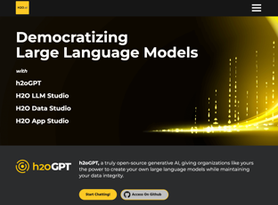
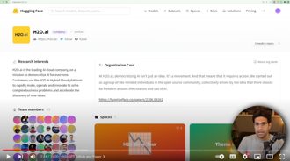
h2oGPT - Offline ChatGPT
100% Offline ChatGPT Alternative (step by step)
.. https://www.youtube.com/watch?v=Coj72EzmX20
based on Falcon LLM, open source (Apache 2.0 license)
can run locally without internet
can use your local data (files)
h2oGPT github repo: https://github.com/h2oai/h2ogpt
Hugging Face H2O page: https://huggingface.co/h2oai
h2o website: https://h2o.ai
h2oGPT UI: https://falcon.h2o.ai
h2oGPT GM-UI : https://gpt-gm.h2o.ai
h2o Discord: https://discord.gg/WKhYMWcVbq
number of parameters: 7 Bln or 40 Bln
request length ~2K (OpenAI ChatGPT-3 has 4K, GPT-4 has 8K)
integrates with LangChain - allowing to easily add your local data
reason to use - privacy, transparency, control, customizations

Slide 7
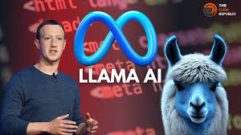
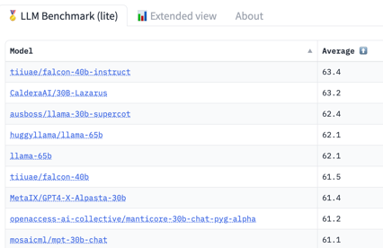
Meta's LLaMa - Open Source
LLaMA is a Large Language Model from Meta (FaceBook)
It was released on February 14, 2023
It is Open Source and Free
65 B parameters
It occupies positions 3,4,5 on the HuggingFace Open LLM LeaderBoard .. https://huggingface.co/spaces/HuggingFaceH4/open_llm_leaderboard
"LLaMA" is not an abbreviation. It is simply a chosen name, name of the "intelligent" animal. You can use your own names, like "Large Language Model Meta AI" or "Llama Language Model for Applications".
Meta LLaMA V2 is expected soon. It is expected to be improved in size, accuracy, fluency, reliability. Also ability to generate different creative text formats, like poems, code, scripts, musical pieces, email, letters, etc. Also it should be multi-modal (work with graphics and sound)

Slide 8

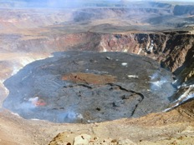
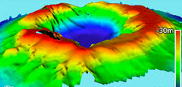
CalderaAI 30B-Lazarus Model - Open Source
Open Source, available on the Hugging Face Hub
It occupies position 2 on the HuggingFace Open LLM LeaderBoard
.. https://huggingface.co/spaces/HuggingFaceH4/open_llm_leaderboard
It was released on March 8, 2023
30 Billion parameters
based on the GPT-3
fine-tuned with LoRAs (Learning Objective Representations). LoRAs are a new technique for improving the performance of LLMs by providing them with additional information about the task they are trying to perform.
The model is very good at Question answering, Text summarization, Code generation, Creative writing, Translation
The model was developed by CalderaAI. The name "CalderaAI" is a registered trademark of Ilya Sutskever. There is no company or website
The word "caldera" means a large, bowl-shaped depression that forms when a volcano collapses. It comes from the Spanish word "caldera," which means "cauldron" (a large, metal pot that is used for cooking)
Ilya Sutskever
Co-Founder and Chief Scientist at OpenAI

Slide 9


Microsoft Orca - 13B Open Source LLM
Microsoft Orca LLM was released on June 5, 2023
13 B parameters (5 times smaller than LLaMA, 13+ times smaller than GPT-3)
26th position on the HuggingFace Open LLM LeaderBoard .. https://huggingface.co/spaces/HuggingFaceH4/open_llm_leaderboard
based on the LLaMA model developed by Meta AI
fine-tuned on a different big dataset, which includes explanation traces from GPT-4. This fine-tuning has allowed Orca LLM to learn to imitate the reasoning process of LFMs (Large Foundation Models), which gives it a significant advantage over other LLMs.
Idea - imitation learning, drawing on the outputs generated by large foundation models (LFMs)
Orca can learn explanations, step-by-step thought processes, and other complex instructions
Orca can learn progressively from Complex Explanation Traces of GPT-4
https://www.microsoft.com/en-us/research/publication/orca-progressive-learning-from-complex-explanation-traces-of-gpt-4/
https://indianexpress.com/article/technology/artificial-intelligence/microsoft-orca-ai-model-8672524/
"Orca" = "killer whale"
Note - there are multiple projects replicating/improving ORCA
One good project - Open-Orca
.. https://huggingface.co/Open-Orca
.. https://www.youtube.com/watch?v=DbavR0lvbv8
.. https://huggingface.co/spaces/Open-Orca/OpenOrca-Preview1-GGML

Slide 10
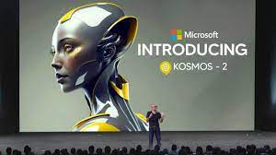
Microsoft Kosmos-2 Open Source Model
July 2, 2023 - Microsoft just released Kosmos-2
It is an Open Source Model (code on GitHub)
model can be downloaded from the Huggingface Transformers repository
It is a MLLM = Multimodal Large Language Model It can "understand" the image, and give answers as text or as image(s)
It has 1.5 .. 17 Bln parameters
It "shows the big convergence of language, multimodal perception, action, and world modeling, which is a key step to AGI!"
https://arxiv.org/abs/2306.14824
https://github.com/microsoft/unilm/tree/master/kosmos-2
https://www.youtube.com/watch?v=A7gBbBkLkns

Slide 11
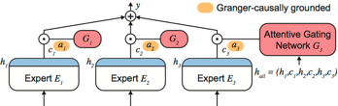
GPT-4 Architecture
July 10, 2023 - https://archive.is/2RQ8X
- https://www.youtube.com/watch?v=GwsRu9yLXnw
It looks like GPT-4 is more than 10 times larger than GPT-3 ( approx 1.8 Trillion params across 120 layers vs 0.175 Trillion and 96 layers in GPT-3.5)
OpenAI used a MoE (Mixture of Experts) model with 16 experts (each expert is about ~111B parameters). The main idea of MoE architecture is to decompose a complex predictive modeling task into simpler sub-tasks, each of which is handled by a separate expert model. A gating network is used to route tasks to experts
GPT-4 costs 3x that of the 175B parameter Davinchi.
Estimated cost of training the model was $63 Mln and ~ 100 days. It is now probably ~$20 Mln and ~50 days

Slide 12



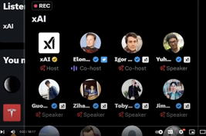
X.ai
July 12, 2023 - X.ai was announced - https://x.ai
The goal of x.AI is to "understand the true nature of the universe".
To make AI curious and truth seeking, train to reduce the error in knowledge
committed to open source
focus on building safe and ethical AI systems
build/hire "world-class AI research team"
will work with other companies (Tesla, ...)
will use public tweets as training data
July 14, 2023 - Twitter Spaces chat introducing the team (90 min) https://www.youtube.com/watch?v=3tV1KPkuiBI - 58 min
It was a 90-minute long discussion between Elon Musk and other members of the xAI team, including Brian Roemmele (ReadMultiplex.com), Ilya Sutskever (Chief Scientist of OpenAIO, and Timnit Gebru (Distributed AI Research Institute)
Elon Musk
Igor Babuschkin
Manuel Kroiss
Yuhuai (Tony) Wu
Christian Szegedy
Jimmy Ba
Toby Pohlen
Ross Nordeen
Kyle Kosic
Greg Yang
Guodong Zhang
Zihang Dai
Igor Babuschkin
Physics
DeepMind
OpenAI
X.ai

Slide 13
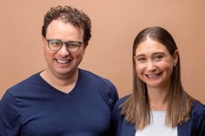
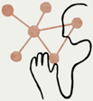
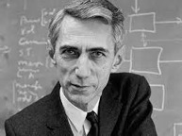

Claude 2 - better than GPT-4 ?
Claude - next-generation AI assistant
honest and harmless by design
Not free, but 4-5 times cheaper than GPT-4
https://www.anthropic.com/product
https://www.anthropic.com/index/claude-2
https://claude.ai
About latest version:
https://www.youtube.com/watch?v=azX3_k1sUD8
Claude-2 can process up to 100K tokens (~75K words) from one prompt. This allows to summarize long documents (chatGPT-4 has only 8K by default)
But GPT-4 is still better at coding
Anthropic's cofounders include siblings Dario Amodei (left, CEO),
and Daniela Amodei (right, President)
Why the name "Claude?
a nerdy tribute to the 20th-century mathematician Claude Shannon the "father of information theory"
a friendly, male-gendered name designed to counterbalance the female-gendered names (Alexa, Siri, Cortana) that other tech companies gave their A.I. assistants
Shannon's Entropy
Claude Shannon

Slide 14
Summarize a document
Best ways to summarize a PDF:
https://updf.com/knowledge/pdf-summarizer/
https://updf.com/updf/
https://www.intellippt.com
https://paraphrasingtool.ai
https://summarizing-tool.com
https://www.summarizingtool.net
https://www.summarizer.org
https://www.scholarcy.com
https://www.summarizebot.com
https://summarybox.com
https://myassignmenthelp.com
https://www.sumnotes.net
ChatGPT Plus ($20/mo) has Model > Web Browsing feature
You can give it a URL - and ask ChatGPT to summarize it.
Note: As of July 3, 2023, ChatGPT's browse with Bing feature has been temporarily disabled by OpenAI due to it displaying content in ways that aren't currently authorized. The company says they're fixing this and has confirmed it will be back up soon.
How to Summarize a PDF with ChatGPT
https://procoders.tech/blog/how-to-summarize-pdf-with-chatgpt/
Submit PDFs and MS Word files
https://www.youtube.com/watch?v=kk0GlkIx7U8
Create a powerful browser plugin that can read PDF and Word files using JavaScript!

Slide 15
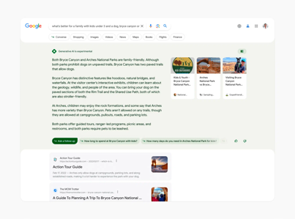
Google Bard Updates
July 2023 - Google Bard Updates:
Still Running Palm 2 model with 340 Bln parameters
Availability in 40 languages
Availability in more countries
pin and rename conversations (for re-visiting)
easily adjust Bard's responses (simple, long, short, professional, or casual)
export code to more places, including GitHub, GoogleDrive, other cloud storages
use images in prompts
Improved privacy and security
SGE
May 10, 2023 - Google announced its Search Generative Experience (SGE) at the Google I/O event
It is currently an experiment
The user experience (UX) is similar to that of Bing Chat

Slide 16
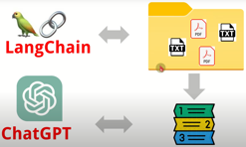
How To use ChatGPT on YOUR OWN data
using LangChain and OpenAI API
Tutorial on How To use ChatGPT on YOUR OWN data
in 2 Minutes using LangChain - OpenAI API
https://www.youtube.com/watch?v=541fRw_BnHU - part 1
https://www.youtube.com/watch?v=c6UExc6hdN8 - part 2
https://github.com/MarekOo/ChatGPTLangChain2 - script and data
The python script uses langchain library.
The data is a PDF of a book (7MB in size)

Slide 17
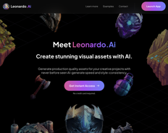
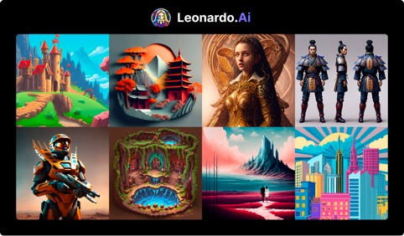
Leonardo.AI
https://leonardo.ai - text2image, useless DALL-E 2
Example, of a prompt: "cat with a jeans jacket, in a digital art style"
It can generate images in a variety of different styles, including digital art, watercolor, and pencil sketch. It can be used to create realistic images, as well as more abstract and stylized images.
price 10 images/month - Free, 1,000 images/month - $30/month 10,000 images/month - $100

Slide 18

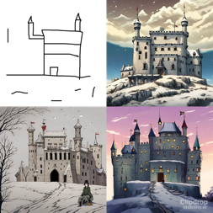
Stable Doodle
Stable Doodle by Stability.AI is a sketch-to-image tool
Converts a simple drawing into a dynamic image
Free, available online
uses a diffusion model called Stable Diffusion XL
To use Doodle, draw a sketch and then provide a few prompts, for example "cat with a jeans jacket, in a digital art style." Doodle will then generate a number of different images, and you can choose the one that you like the best.
Doodle can generate images in a variety of different styles, including digital art, watercolor, and pencil sketch. It can be used to create realistic images, as well as more abstract and stylized images. It is easy to use, even for people who are not familiar with AI tools.

Slide 19
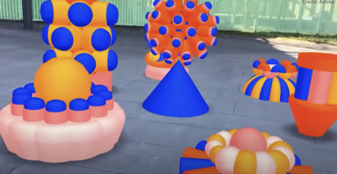
Adobe Gingerbread AI
AGAI is a new image AI tool that can layer AI-generated images to fit a roughly framed 3D scene
Users can create 3D scene presets to control the composition of the generated image. The AI is instructed to place the objects in the scene in a specific way.
Users can provide text prompts to the AI, which can help to influence the style and content of the generated image
Users can upload their own 3D objects to be used in the generated images
Possible applications of AGAI:
create realistic product renders for marketing and development
create custom graphics for websites, presentations, or other marketing materials
create new forms of art, such as generative paintings or sculptures.

Slide 20
ChatGPT Code Interpreter
Fireship - ChatGPT just leveled up big time...
https://www.youtube.com/watch?v=p6Yw0Bx5dbw
Currently only works with Python
Develop and execute / test your own code
Quite useful for data cleaning, for example

Slide 21
Use ChatGPT To Learn Quickly
How To Use ChatGPT To Learn ANY Skill Quickly (Tutorial)
https://www.youtube.com/watch?v=vYvOTGk7hOA
Ask ChatGPT:
to be your mentor in a specific topic. Then start asking questions
to create a study schedule (by weeks/days). Then follow your schedule
to summarize books and articles for you
to test you
for good resources, programs, books, videos, forums
to give you exercises to practice/learn
to give you common mistakes people make, ways you could go wrong

