Slide 1
GNNs
Graph Neural Networks
Presented by Shreya Patil
July 21, 2023

Slide 2
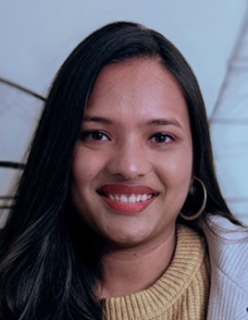

About the Speaker
Shreya Patil
Research Fellow at U.S. Food and Drug Administration
Contact : shreya.patil.u@gmail.com
LinkedIn : https://www.linkedin.com/in/shreya-patil-data-scientist/

Slide 3
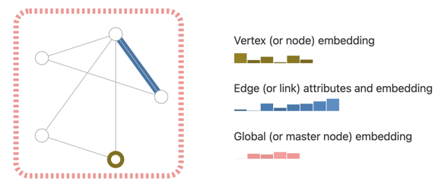
Introduction
Graph Neural Networks (GNN) learn the graph using neural networks and graph theory.
GNN builds an internal representations (embedding, vector) for each node
A graph is a data structure consisting of two components: nodes (vertices) and edges.
A graph G can be defined as G = f(V, E), where V is the set of nodes, and E are the edges between them.

Slide 4
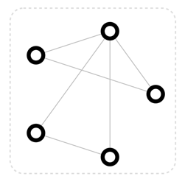
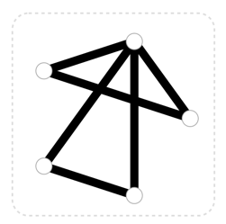
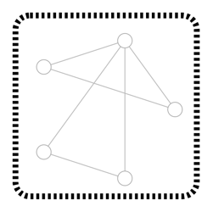
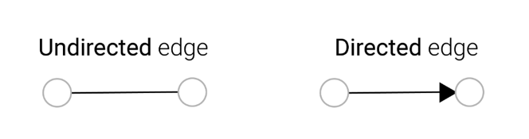
Types of Attribute in GNN

Slide 5
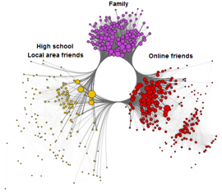
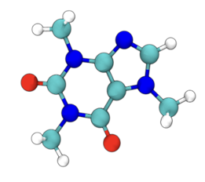
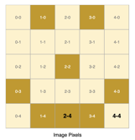
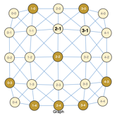
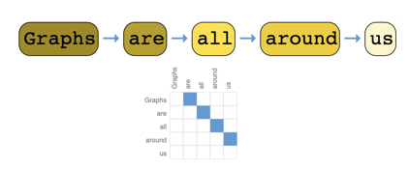
Graph Data
Social Media Network
Chem Informatics
Image Data
Text Data

Slide 6
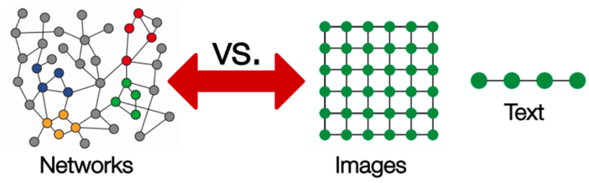
Why is it hard to analyze a graph?
Complexity of the data is a challenge for current ML algorithms.
Hard to give fixed size of input to algorithm.
Nodes are very dependant on each other, contrary to ML algorithms assumptions.

Slide 7
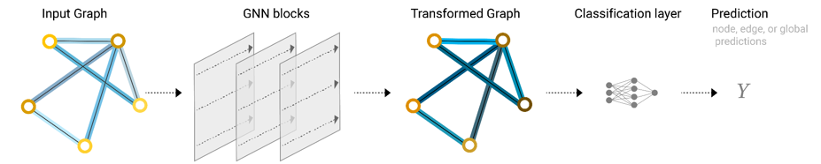
What are GNNs
Graph neural networks (GNNs) are a type of neural network that are designed to operate on graph-structured data.
GNN can be trained on just one graph. To train it, we need to provide graph structure and node features. Once trained, it can see patterns in nodes, can do predictions, find anomalies, etc.
GNNs can also be trained on multiple graphs. Also a pretrained GNN can be used for training on a different graph
2005 - "Neural Network Models for Graphs" by Gori et al.
2014 - "Convolutional Neural Networks on Graphs with Fast Localized Spectral Filtering" by Bruna et al. - proposed a graph convolutional neural network (GCN) architecture

Slide 8
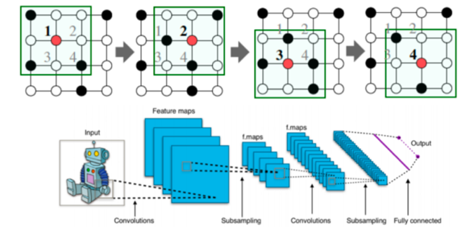
Why do Convolutional Neural Networks (CNNs) fail on graphs?
Arbitrary size of the graph.
Complex topology.
Unfixed node ordering of graphs.

Slide 9
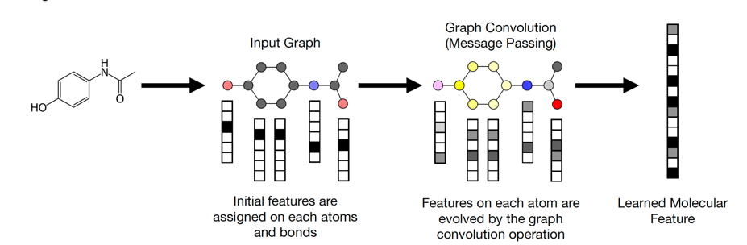
Graph convolution neural network (GCNN)

Slide 10
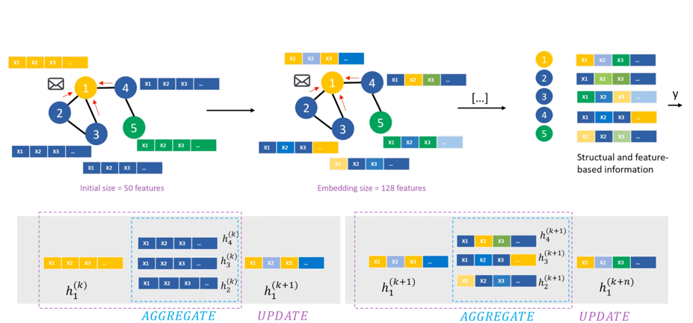
Graph convolution neural network (GCNN)

Slide 11
What are GNNs
2016 - Graph Convolutional Networks (GCN) - "Semi-Supervised Classification with Graph Convolutional Networks" by Kipf and Welling. Using convolution-like operations on nodes by aggregating and combining information from the node's neighbors. GCNs use graph Laplacian and adjacency matrices to define filters that capture the graph structure. By iteratively propagating and updating node representations, GCNs learn meaningful embeddings that encode both node features and graph topology.
2017 - GraphSAGE (Graph Sample and Aggregated) - "Inductive Representation Learning on Large Graphs" by Hamilton et al. Learn node embeddings by sampling and aggregating info from neighbors
2017 - Graph Attention Networks (GAT) - "Graph Attention Networks" by Velickovic et al. - using an attention mechanism to capture the importance of different nodes' neighbors during information propagation
2019 - Graph Transformer Networks (GTN) - "Graph Transformer Networks" by You et al. - remove the limitations of fixed graph neighborhood size by attending to all nodes in the graph. GTNs use multiple attention heads to capture different aspects of node relationships and incorporate positional encoding for handling node order - thus achieving state-of-the-art performance in various graph-related tasks such as node classification, link prediction, and graph-level predictions.
CNN
Attention
Transformer

Slide 12
Evolution of GNNs from Convolution to Transformer
is Typical for Other Networks as Well
CNN
Attention Mechanism
Transformer
RNN or LSTM
Attention Mechanism
Transformer
Context vector should have access to all parts of the input sequence instead of just the last one.
CNN = Convolutional Neural Network
RNN = Recurrent Neural Network
LSTM = Long Short Term Memory
Attention = important mechanism in Google Translate
Transformer = deep learning model architecture
paper "Attention Is All You Need" by Vaswani et al. in 2017

Slide 13
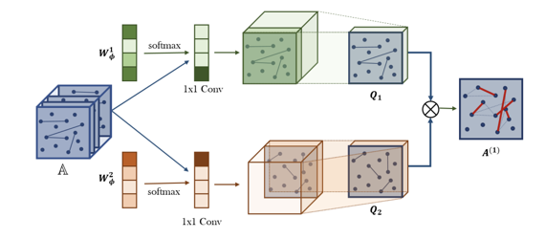
Graph Transformer Networks (GTNs)
Graph Transformer Networks (GTNs) work by first representing the graph as a sequence of nodes and edges. The nodes are then embedded into a vector space, and the edges are represented as a matrix of weights.
The Transformer architecture is then used to learn a representation of the graph by attending to the nodes and edges in the graph.
GTNs proved effective for node classification, link prediction, and graph classification
GTNs may prove to be useful for NLP and computer vision

Slide 14

Hugging Face
https://huggingface.co
Hugging Face is a company that provides/hosts open-source software (AI models)
Hugging Face have developed a number of GTNs - they are open-source and can be used for free.
Graphormer: A Graph Transformer Network that can be used for node classification, link prediction, and graph classification
GraphTransformer: A Graph Transformer Network that can be used for natural language processing tasks, such as text classification and question answering
GraphViT: A Graph Transformer Network that can be used for computer vision tasks, such as image classification and object detection

Slide 15
Typical Applications of GNNs
GNNs can process and model structured data (graphs):
Social Network Analysis (relationships between individuals, communities, and social interactions) - predict user behavior, identify influential nodes, detect communities, and recommend connections
Recommendation Systems - especially in scenarios where user-item interactions are complex (graphs) - better recommendations
Knowledge Graph Completion - infer missing facts/relationships in knowledge graphs.
Drug Discovery - model molecular structure as graphs and predict properties: drug efficacy, toxicity, and interactions with biological targets, molecular property prediction, drug similarity, and virtual screening
Computer Vision - create scene graph, object tracking, image segmentation, visual understanding
Fraud/Anomaly Detection - in financial transactions, social networks, and e-commerce - model complex relationships and patterns in the graph
Natural Language Processing (NLP) - document classification, sentiment analysis, named entity recognition, and semantic parsing
Traffic Prediction - model transportation networks and predict traffic patterns

Slide 16
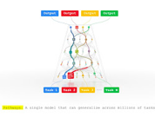
GNN + LLM
Examples:
Natural language understanding: GNNs can be used to represent the relationships between words in a sentence, while LLMs can be used to understand the meaning of the words themselves. This combination can be used to create systems that can understand complex natural language queries, such as "What is the relationship between the words 'dog' and 'cat'?"
Question answering: GNNs can be used to represent the relationships between entities in a knowledge graph, while LLMs can be used to understand the meaning of natural language questions. This combination can be used to create systems that can answer complex natural language questions, such as "What is the capital of France?"
Drug discovery: GNNs can be used to represent the relationships between molecules in a chemical compound, while LLMs can be used to understand the properties of the molecules themselves. This combination can be used to create systems that can predict the properties of new chemical compounds, which could be used to discover new drugs.
GNNs and LLMs can be used together to great effect.
GNNs - understand/process relationships between entities, LLMs - understand/processing natural language.
By combining the strengths of these two types of models, we can create systems that are capable of performing complex tasks that would be difficult or impossible to do with either model alone.
Google AI's Pathways project "Graph Reasoning" is using GNNs and LLMs to understand and reason about graphs.

Slide 17

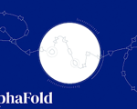
GNN + LLM - continued
Google AI's Pathways project "Graph Reasoning " is using GNNs and LLMs to understand and reason about graphs.
OpenAI's GPT-3 models are used in a variety of applications for Drug Discovery, which use GNNs and LLMs to predict the properties of new chemical compounds
DeepMind's AlphaFold (protein folding model) uses GNNs to predict the structure of proteins. This model has been used to make significant advances in the field of protein folding, and it has the potential to revolutionize the way we understand and treat diseases.
Generative AI

Slide 18
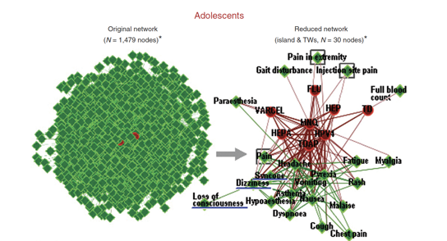
Using GNNs to analyze Adverse Drug Reaction data
According to the CDC more than 1 million individuals visit emergency departments for adverse drug events each year in the United States.
The U.S. Food and Drug Administration (FDA) has a database called FDA Adverse Event Reporting System (FAERS). FAERS is a database that contains adverse event reports, medication error reports and product quality complaints resulting in adverse events that were submitted to FDA.
Network analysis (NA) allows for simultaneous representation of complex connections among the key elements of a system that are represented as edges or links in the network.
The Vaccine Adverse Event Reporting System (VAERS ) can be represented as a network of 6,428 nodes (74 vaccines and 6,354 AEs) with more than 1.4 million interlinkages.
This NA method analyzes graphs and finds the hub node which has more links which are above threshold count.

Slide 19
Useful Links
https://en.wikipedia.org/wiki/Graph_neural_network
https://huggingface.co/
https://en.wikipedia.org/wiki/Hugging_Face
https://distill.pub/2021/gnn-intro/
https://neptune.ai/blog/graph-neural-network-and-some-of-gnn-applications
https://www.freecodecamp.org/news/graph-neural-networks-explained-with-examples/
Deep Generative Models for Graphs (Weights & Biases) https://wandb.ai/syllogismos/machine-learning-with-graphs/reports/10-Deep-Generative-Models-for-Graphs--VmlldzozNzcwMTI
GNNs on AWS https://www.xenonstack.com/blog/graph-neural-network-on-aws
Latest Research based on Graph Neural Networks part3(Machine Learning) https://medium.com/@monocosmo77/latest-research-based-on-graph-neural-networks-part3-machine-learning-a57089c04e67

