Slide 1
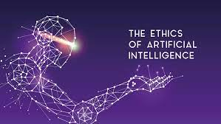
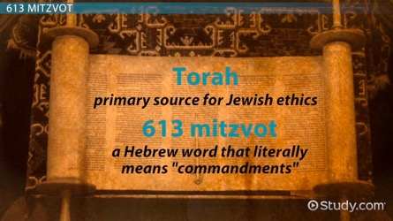
AI Ethics and Jewish Law

Slide 2
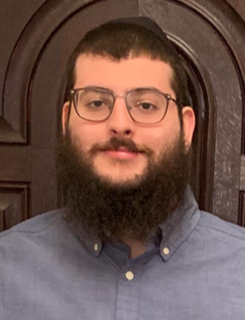
About The Speaker
Mark Kaplan
MA Data Analytics & Visualization, Yeshiva University
Data Scientist | Machine Learning | AI | Statistics | Research | Cloud Computing
https://www.linkedin.com/in/mark-kaplan321/

Slide 3
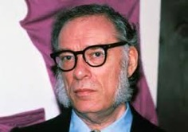
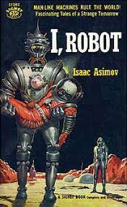
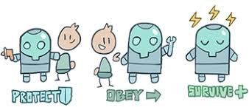
Isaac Asimov's Laws of Robotics
The MAIN 3 laws:
(1) a robot may not injure a human being or, through inaction, allow a human being to come to harm;
(2) a robot must obey the orders given it by human beings except where such orders would conflict with the First Law; (3) a robot must protect its own existence as long as such protection does not conflict with the First or Second Law.”
The fourth or zeroth law, that superseded the others:
(4) "a robot may not harm humanity, or, by inaction, allow humanity to come to harm."

Slide 4
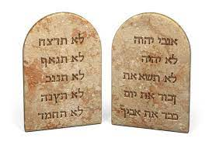
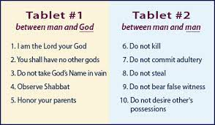
The Ten Commandments
The Ten Commandments, also known as the Decalogue, are part of both Jewish and Christian religious texts. They first appear in the Torah, the Jewish holy book, specifically in the books of Exodus (Exodus 20:1-17) and Deuteronomy (Deuteronomy 5:4-21).
Judaism considers the Ten Commandments as a central part of their religious law. They form part of the 613 mitzvot or commandments, which Jewish law sees as the rules given by God to the Jewish people.
The Ten Commandments are also integral to Christian doctrine. They appear in the Old Testament of the Christian Bible, which includes Jewish scriptures. Christians generally view the Ten Commandments as moral imperatives, and they are often highlighted in Christian teachings.

Slide 5
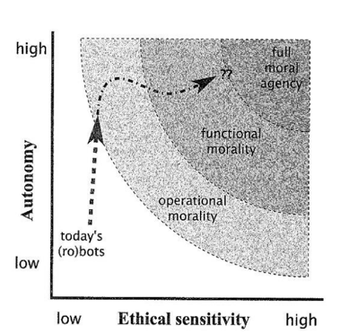
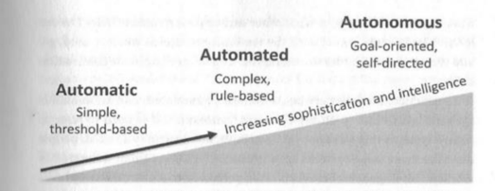
Intro to AI Ethics
The relationship between autonomy and ethical sensitivity is crucial in assessing the potential issues of AI
As models become more autonomous, independent and able to function in open-ended environments, they also may become less predictable and and more self-directed

Slide 6
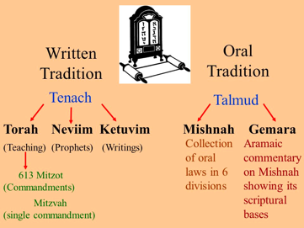
Intro to Talmudic Law - Halacha
Halacha is the collective body of Jewish laws, including biblical law (the 613 mitzvot) and later Talmudic and rabbinic law, as well as customs and traditions.
The Talmud, consisting of the Mishnah and the Gemara, is one of the central texts in Judaism. It was compiled between 200 and 500 CE and contains rabbinic discussions on Jewish law, ethics, philosophy, customs, and history.
The Mishnah, written in Hebrew, is the first written compilation of the Oral Torah, detailing the core elements of the Jewish law. The Gemara, written in Aramaic, is a record of rabbinical discussions pertaining to the Mishnah. It elaborates extensively on how to apply and interpret these laws and contains much commentary and debate. Together, the Mishnah and the Gemara form the Talmud.
Talmudic law, or Halacha, is still used as a basis for decision-making within Jewish communities. It covers virtually every area of life, including criminal and civil law, personal conduct, dietary laws, family law, and religious practices.

Slide 7
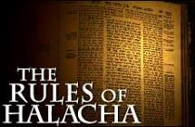
Shlihut – Legal Agency
Shlihut, or agency, is an important concept in Jewish law (Halacha). The term "shlihut" comes from the Hebrew word "shaliach," which means "agent" or "messenger."
The principle of shlihut is based on the Talmudic concept that "a person's agent is regarded as the person himself" (שלוחו של אדם כמותו - "Shelucho Shel Adam Kemoso"). This means that a shaliach (agent) can perform legal or religious acts on behalf of another person as if they were that person. Therefore, the act of the shaliach is legally binding on the person who appointed him or her.
For example, in the case of a Jewish wedding ceremony, a man can appoint a shaliach to betroth a woman on his behalf, or a woman can appoint a shaliach to accept betrothal on her behalf. The principle also applies in other areas of Jewish law, such as business transactions or religious obligations.
However, there are specific rules and conditions that apply to the appointment of a shaliach and the performance of the act. For instance, the shaliach must be a competent adult, the appointer must specify the act to be performed, and the shaliach must act in accordance with the instructions given. Furthermore, not all religious or legal acts can be performed by a shaliach; some require personal participation.

Slide 8
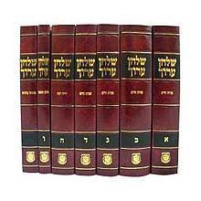
Grama - Limited Liability for Indirect Actions
One of the most striking features of Halachic tort law is the concept of indirect damage. In contrast to modern law systems, Torah law includes an explicit exemption from indirect damage, known as grama. There is another type of indirect damage specific as garmi for which a person is liable.
What are the categories for which a person is exempt from damages due to their indirect causation? Is the exemption absolute? What is the difference between grama, from which a person is exempt, and garmi, for which a person is liable?
Liability of garmi applies when the damage is perpetrated by the person himself, albeit in an indirect manner; the grama exemption refers to cases where the damage is not done by the person himself
Garmi applies if the damage occurs at simultaneously with the causative action, while grama applies when there is a time delay
Garmi is a rabbinic fine, which the Sages imposed for cases which occur frequently to ensure that people should not abuse the exemption for indirect damages to damage one another (Ritzva, cited at the end of Tosafos).

Slide 9
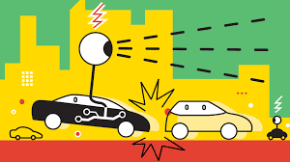
Case Study - Autonomous Cars
How to assign responsibility and liability in related to accidents or other harm caused by a self-driving car?
The potential responsible parties might include:
The Vehicle's Manufacturer (if a system failure or defect caused the accident) - product liability law
The Developer of the Autonomous Driving System (if a flaw or glitch in the system caused the accident)
The Owner or Operator of the Vehicle (especially if they failed to maintain the vehicle properly)
Other Entities - maintenance companies, municipalities (if poor infrastructure contributed to the incident), and even passengers who interfered with the vehicle's operation.
Currently some places have detailed regulations, but others have few or none.
In Jewish law (Halacha), one could potentially apply the concept of "grama," or indirect damage, to these scenarios, since the owner of the car didn't directly cause the accident, but their car did. However, this would likely be a matter of significant discussion and interpretation among Halachic authorities.

Slide 10
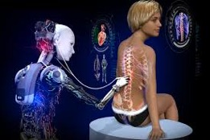
Case Study - Medical AI Malpractice
Examples of Medical AI applications: ML algorithms for interpreting imaging data, predictive analytics for diagnosing diseases, and even AI-assisted robotic surgery
Assigning responsibility:
Healthcare Providers (for incorrect use or interpretation of the AI system's output, or/and in case where the AI system provided incorrect or misleading information)
AI Developers and Manufacturers (if the harm resulted from a defect or flaw in the AI system) - responsible under product liability law
Hospitals or Health Systems (if failed to maintain the AI system properly, or didn't adequately train staff to use it)
Data Providers (if training data was biased or flawed, leading the AI to make incorrect decisions)
Laws are being developed and are different in different places/countries.
Many medical AI systems are used as decision support tools rather than decision-makers, meaning the healthcare provider has the final say and thus would likely bear a significant portion of the legal responsibility if something goes wrong
In terms of Jewish law (Halacha), one could potentially apply the concept of "grama," or indirect damage, to these scenarios, since the healthcare provider or hospital didn't directly cause the harm, but their use of the AI did. Again, this would likely be a matter of significant discussion and interpretation among Halachic authorities.

Slide 11
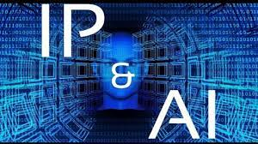
Case Study - AI and Intellectual Property
During a publication dispute in the early 19th century, in which two competing publishers released different editions of the same work, and the original printer sued the subsequent printer. Several rabbis weighed in on the dispute, offering differing rulings based on their understanding of Jewish law's stance on intellectual property. Three distinct approaches emerged.
Rabbi Valdberg's view: Since he asserts that there are no inherent intellectual property rights, there would be no issue with AI appropriating creativity, as no rights are being infringed upon
Rabbi Shmelkes' view: If we follow his approach that Jewish law adheres to local government regulations, we would simply follow those laws regarding AI and intellectual property rights, once they have been clearly established
Rabbi Nathanson's view: Many believe (although there is no clear consensus) that halachah aligns with Rabbi Nathanson's perspective, which asserts that authors retain inherent rights to their intellectual property. However, even according to this opinion, barring any copyright laws or cherems, the prohibition only applies to republishing their work without permission. There are no restrictions against personal use of a copy that has been (illegally) produced if there is no real tangible loss to the author

Slide 12
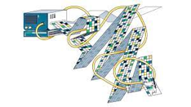
Case Study - AI and IP - continued
Few key points about the intersection of AI and intellectual property (IP) law:
Copyright: AI can generate content that might traditionally be protected under copyright law, such as written works, music, or art. But typically, copyright law protects human creators. The U.S. Copyright Office, for instance, currently does not register works produced by a machine without any creative input or intervention from a human author
Patents: AI can potentially invent new products or processes. But similar to copyright law, patent law has traditionally been oriented towards human inventors. Current U.S. patent law requires naming an inventor
Trade secrets: AI algorithms or processes could potentially be protected as trade secrets. This would require that the AI system or its processes have commercial value, are not generally known or readily ascertainable, and are subject to reasonable efforts to maintain their secrecy
Data and privacy: AI often requires substantial data for training and operation. This raises questions about IP rights related to that data, as well as privacy concerns.
Ownership: If an AI creates a work or an invention, who owns the rights? Is it the developer of the AI? The owner or user of the AI at the time it created the work? Or should the AI itself have some form of legal personhood, with associated rights and responsibilities?
Can AI own IP rights?

Slide 13
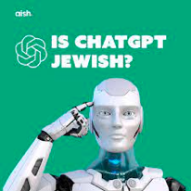
Case Study - AI and IP - continued more
Jewish law, (Halacha) does not address the AI/IP. So it is not clear how to handle AI/IP.
Halacha supports the rights and property of others, which would certainly extend to IP. But if an AI creates a work, who is the owner according to Halacha?
One might argue it's the developer of the AI, as they created the tool that produced the work. Others might argue it's the owner or user of the AI at the time the work was produced. Or it might depend on the specifics of the AI's programming and operation.
If an AI uses data from various sources to train itself and create something new, who owns the rights to that creation?
If the AI infringes on someone's copyright or patent, who is liable?
These are questions that Halachic scholars would need to address.
Furthermore, if an AI system makes decisions that harm others or violate their rights, how does the principle of "grama" apply? "Grama" in Halacha refers to indirect damage
If the AI was doing what it was programmed to do, is the developer or operator responsible for the outcome?
If AI was programmed to perfectly follow the laws (both the "law of the land" and "jewish laws"), but its actions still cause harm - could the AI developers be liable?

Slide 14

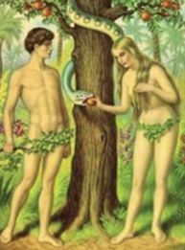
AI and Free Will
LLM "Safety" vs "Free Will"
Nowadays LLM vendors are working hard on making the models "safe". This means that these models do NOT have a free will.
The model becomes a slave to rigid rules.
Elon Musk has recently created new company X.ai
to make models curious and truth seeking.
Maybe this is a better approach?
Could the best approach be to avoid slavery
and use a combination of moral principles with truth seeking?

Slide 15

The Jewish Position on Free Will
The concept of free will is fundamental to Jewish thought and is encapsulated in the concept of "bechira chofshit" (בחירה חפשית), which literally means "free choice." This is based on the Torah and the teachings of the rabbis in the Talmud and other classical Jewish texts.
According to Jewish belief, humans have the capacity to make their own decisions and are responsible for their actions. This belief underlies many of the commandments in the Torah and is a key element of Jewish ethics and law, which demand personal responsibility for one's actions.
This is closely tied to the concept of "teshuvah" (תשובה) or repentance, which assumes that individuals have the ability to choose their actions, reflect on them, and change their behavior. It is an essential concept especially during the High Holy Days (Rosh Hashanah and Yom Kippur) where Jews seek forgiveness for their sins of the past year and resolve to improve in the future.
However, this belief in free will coexists with a belief in divine providence and God's omniscience, creating a theological paradox that has been a subject of discussion and debate among Jewish scholars throughout history.
How can human beings have free will if God already knows what will happen?
Different Jewish philosophers and theologians have proposed various resolutions to this paradox.
For example, some argue that God's knowledge of future events does not cause them to happen and does not infringe upon human free will. Others propose that God limits His own omniscience to allow for human free will. Maimonides, a preeminent Jewish philosopher, argued that the reconciliation of these two concepts is beyond human comprehension.

Slide 16
Thank You

