Slide 1
Vector Databases
Presented by Tyler Williams
August 4, 2023

Slide 2

About the Speaker
Tyler Williams
Data Slinger with Azure Expertise
Redapt, Inc.
Bothell, Washington, US
https://www.linkedin.com/in/tyler-williams-658881/

Slide 3
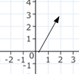
What is a vector?
Simply an array of numbers
Can be used to represent coordinates on a plane
[2, 3]
Or can represent more complex objects across many more dimensions
[8, 1, 9, 3, 4, 7, 9, 12, -3, 1, -44, 6, 9]

Slide 4



How do we use data to represent complex objects?
Discreet tags/attributes can be impractical for detailed representations!!

Slide 5
Use algorithms to represent object as a vector
More dimensions can allow for greater opportunities to reflect similarities and differences between different objects
[-8, 0.2, -4, 0.8, …, 6]
Typically, the number of dimensions is large. At least 512, often 768, 1024, 1536, and more
[5, 9, -4, 0.8, …, -3]

Slide 6
Vector Embedding
Algorithm to convert data to a vector
"Automatic" feature engineering
Rather than manually defining all of the dimensions/attributes of an object, a pre-trained machine learning model is used to generate this vector representation of the object
Raw data can be passed into an embedding model, which converts the data to a vector embedding, which indicates where the data should go in a vector space in relation to other data points
https://www.pinecone.io/learn/vector-embeddings-for-developers/
Massive Text Embedding Benchmark (MTEB) Leaderboard - https://huggingface.co/spaces/mteb/leaderboard

Slide 7
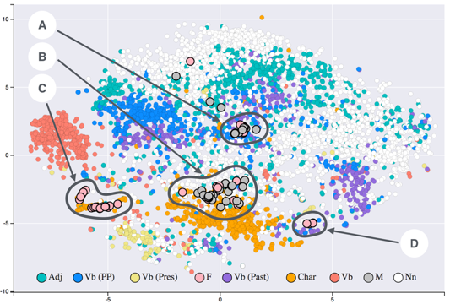
You have your vector embeddings, now what?
Each vector represents a point in a vector space, and similar data will be grouped together in the space

Slide 8
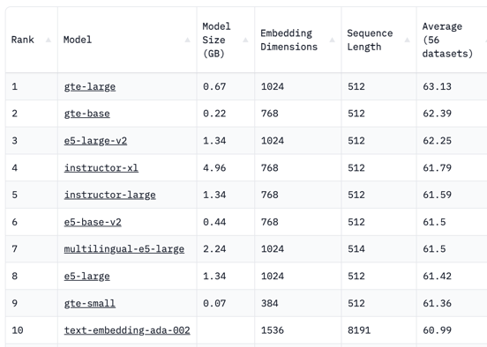
Embedding models - Hugging Face MTEB leaderboard
Massive Text Embedding Benchmark (MTEB) Leaderboard
https://huggingface.co/spaces/mteb/leaderboard
Deploy the No 1 embedding model on Huggingface with python
https://www.youtube.com/watch?v=ZB1nn3JWyec
OpenAI

Slide 9
Embedding Models
OpenAI’s Embedding Model With Vector Database https://betterprogramming.pub/openais-embedding-model-with-vector-database-b69014f04433
OpenAI updated in December 2022 the Embedding model to text-embedding-ada-002. The new model offers:
90%-99.8% lower price ($0.01 per 100,000 tokens = 150 pages)
1/8th embeddings dimensions size reduces vector database costs
Endpoint unification for ease of use
State-of-the-Art performance for text search, code search, and sentence similarity
Context window increased from 2048 to 8192
Choosing the Right Embedding Model - a Guide for LLM Applications
https://medium.com/@ryanntk/choosing-the-right-embedding-model-a-guide-for-llm-applications-7a60180d28e3
1 token = 4 chars (in English)
1 word = 5 chars = 1.25 tokens
100 tokens = 75 words
1 page (single-spaced) = 500 words = 2,500 chars = 625 tokens
100,000 tokens = 75,000 words = 150 pages
8192 tokens = 6,150 words = 12 pages

Slide 10
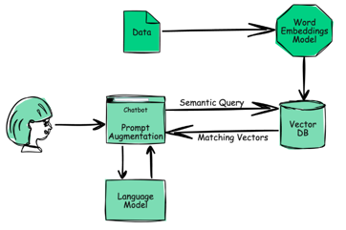
Why use a vector database with a language model?
Used to store and query vector embeddings
Vector DBs allow for more conversational queries against a large language model (LLM) by providing the context of previous queries
They also are used to organize and index vectors for much faster responses than using the LLM alone
Model is static; a vector DB can augment the model without needing to retrain the model
Here’s a good high-level video:
https://www.youtube.com/watch?v=dN0lsF2cvm4
And a more irreverent video:
https://www.youtube.com/watch?v=klTvEwg3oJ4

Slide 11
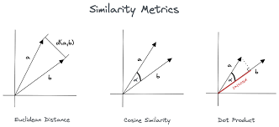
Vector DB Queries - Similarity Search
A vector database uses pipelines of different algorithms (vector indexing, hashing, quantization, graph-based search, ...) to do an Approximate Nearest Neighbor (ANN) search. This is area of active research!
Similarity measures
Cosine similarity (-1..1)
Euclidean distance (0..∞)
Dot product (-∞ .. ∞)
Since the vector database provides approximate results, the main trade-offs are between accuracy and speed
Here is a good article explaining different algorithms:
https://www.pinecone.io/learn/vector-database/
Embedding Vectors
Similarity Search
Data

Slide 12
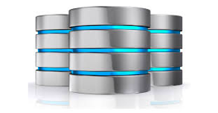
Other Familiar Database Features
Long-term storage and retrieval of data/embeddings
Data management (ie. Insert/Update/Delete)
Metadata storage and filtering
Real-time updates to data
Backups, disaster recovery
Integration with management and analysis tools (ETL, dashboards, plugins)
Data security and access control

Slide 13


Some Vector Database Use Cases
Long-term memory for LLMs
Semantic Searches
Searches that infer intent and context
Sam goes to the bank to withdraw some cash
Jill pulls her kayak up onto the bank
Similarity Searches
Recommendation Engine
Netflix: “You may also like…”
Sound Search

Slide 14
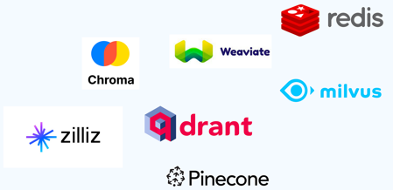

Popular Vector Databases
Here is a list of some vector databases (2023) https://sourceforge.net/software/vector-databases/
More:
Zilliz Cloud
Nomic Atlas
Vald
pgvector
Faiss
Metal
MyScale
Deep Lake
Supabase
Embeddinghub
Popular Vector Databases:
Pinecone
Weaviate - open source
Chroma - open source
Redis Vector Database
Qdrant - open source
Milvus Project - open source
Vespa.ai - open source

Slide 15
Vector Databases
https://thenewstack.io/top-5-vector-database-solutions-for-your-ai-project/
https://towardsdatascience.com/milvus-pinecone-vespa-weaviate-vald-gsi-what-unites-these-buzz-words-and-what-makes-each-9c65a3bd0696
https://www.reddit.com/r/SoftwareEngineering/comments/107vhoq/vector_databases_like_pinecone_or_weaviate_are/
Vector DB (VDB) | Type
Pinecone |  | https://www.pinecone.io
Redis Vector DB |  | https://redis.io/docs/interact/search-and-query/search/vectors/
Chroma | Open Source | https://www.trychroma.com https://python.langchain.com/docs/modules/data_connection/vectorstores/integrations/chroma (shows how to use db.persist() to save on disk) https://github.com/chroma-core/chroma https://docs.trychroma.com/getting-started https://docs.trychroma.com/deployment - hosted Chroma (still in "alpha" stage)
PGVector | Open Source PostgresSQL extension | https://github.com/pgvector/pgvector - vector similarity search, up to 16,000 dimensions https://www.youtube.com/watch?v=aBeVM5q0f5A https://www.youtube.com/watch?v=y10Wmr4fmlA
pg_embedding | Open Source, fast PostgresSQL extension | https://github.com/neondatabase/pg_embedding https://neon.tech/blog/pg-embedding-extension-for-vector-search - 20x times faster
Qdrant | Open Source - Rust | https://qdrant.tech https://qdrant.tech/documentation/guides/installation/ - docker
Milvus Project | Open Source - Go, C++, Python | https://milvus.io https://milvus.io/blog/how-to-get-started-with-milvus.md - docker
Weaviate (SeMI) | Open Source - Go | https://www.semi.technology/developers/weaviate/current/ https://weaviate.io/developers/weaviate/installation - docker
Vespa.ai (Yahoo!) | Open Source - Java, C++ | https://vespa.ai https://docs.vespa.ai/en/getting-started.html - docker
Faiss | Open Source Lib - C++, Python | FAISS = Facebook AI Similarity Search (library in C++ with Python wrapper) https://github.com/facebookresearch/faiss
Vald (Yahoo!) | Open Source - Go | https://vald.vdaas.org https://github.com/vdaas/vald - distributed, Kubernetes

Slide 16
Indexing Vectors for Similarity Search
Large modern models (GPT, Diffusion) use huge latent vectors or tensors
(GPT/Diffusion latent dimensions: 12K .. 60K numbers per vector/tensor).
If you put these huge vectors in a vector database, how do you query them?
Here are some common indexing techniques (to speed-up the similarity search):
Locality-sensitive hashing (LSH) - similar vectors mostly get into same buckets
Product quantization (PQ) - lossy compression to reduce the size of vectors while preserving similarity
Hierarchical Navigable Small World (HNSW) - create a graph where each vector is connected to its nearest neighbor(s)
Hierarchical Grid Index (HGI) - divides a multidimensional space into a hierarchy of grids
Ball Tree Index (BTI) - a tree of nodes (balls) and leaves (actual points)
Random Forest Index (RFI) - trees represent regions in space, and the leaves represent the actual points.
Examples:
Pinecone uses a hybrid approach : an HGI with a LSH index. Fast search on large and small datasets
Weaviate uses a hybrid approach : an HGI with a BTI index. Fast performance for both range and point queries
Chroma uses a single-level grid index, which is a simple but effective approach for vector indexing
Redis Vector Database uses a Sorted Set data structure to store vectors, which allows for efficient range queries
Qdrant uses a hybrid approach : an HGI with a RFI index. Good performance for both range and point queries
Milvus Project uses an HGI
Vespa.ai uses a hybrid approach : an HGI with a LSH index. Fast search on large and small datasets

Slide 17
Vector Database on Azure
Using SQL Server:
Vector Similarity Search with Azure SQL database and OpenAI
.. https://devblogs.microsoft.com/azure-sql/vector-similarity-search-with-azure-sql-database-and-openai/
Using Azure Cognitive Search (ACS):
ACS is similar to a vector database.
But until recently, you couldn't interact with the vectors directly.
Now Microsoft allows it :)
Example: index company documents into Azure Cognitive Search
(it uses RAG = Retrieval Augmented Generation), and use Azure OpenAI LLM as user interface: .. https://medium.com/version-1/unleashing-the-power-of-azure-open-ai-and-azure-cognitive-search-f5a97d729f18
The idea of RAG is to retrieve data from outside the language model (non-parametric),
usually from a vector database.
And then augment the prompts by adding the relevant retrieved data into context
Note: you can use PineconeDB (or other vector DB) instead of Azure Cognitive Search

Slide 18
Microsoft SQL Server Support for Vector/Similarity Data Queries
Microsoft SQL Server supports storing and querying vector/similarity data in a few different ways:
SQL Server includes the GEOMETRY and GEOGRAPHY data types that can store vectors and spatial data. These types support various spatial functions like STDistance() to calculate distances between vectors. So you can store vectors in a table and query for similar ones based on distance. https://learn.microsoft.com/en-us/sql/relational-databases/spatial/query-spatial-data-for-nearest-neighbor
semanticsimilaritytable() function help to Find similar or related documents https://learn.microsoft.com/en-us/sql/relational-databases/search/find-similar-and-related-documents-with-semantic-search
Starting in SQL Server 2019, it includes support for Python and R integration via Machine Learning Services. This allows you to write Python/R code that runs inside SQL Server to do similarity calculations on vector data stored in tables. https://learn.microsoft.com/en-us/sql/machine-learning/sql-server-machine-learning-services
For more advanced vector similarity capabilities, SQL Server 2019 added a new TEXT type that supports storing vectors and doing similarity search via approximate nearest neighbor indexes like Cosine Similarity. So you can find vectors that are close/similar to a search vector efficiently
There are also some third-party extensions that add things like approximate nearest neighbors functionality for fast similarity search across vectors

Slide 19
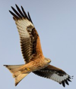

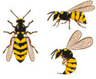


Narrowing Down Open Source VDBs
pgvector & pg_embedding
extensions for PostgreSQL
https://github.com/pgvector/pgvector - vector similarity search, up to 16,000 dimensions
https://www.youtube.com/watch?v=aBeVM5q0f5A
https://www.youtube.com/watch?v=y10Wmr4fmlA
https://github.com/neondatabase/pg_embedding
https://neon.tech/blog/pg-embedding-extension-for-vector-search
Milvus
https://milvus.io
https://milvus.io/blog/how-to-get-started-with-milvus.md
Vespa
https://vespa.ai
https://docs.vespa.ai/en/getting-started.html
1973 - Ingres db (INteractive Graphics REtrieval System), Berkeley
(also, Ingres is similar to ingress, which means "access")
1985 - Postgres (Post Ingres, Berkeley)
1994 - Open Sourced under MIT license
1996 - PostreSQL (signifying full support for SQL)

Slide 20




LangChain Framework: Create Apps Using LLMs
Universal API for LLMs (GPT-3, BLOOM, and Jurassic-1 Jumbo, ...)
Chains = sequences of commands for LLM
End-to-end chains for popular apps (chatbots, question-answering, and summarization)
Memory (keeping info about previous chat messages, ...)
Tools for debugging, testing, evaluating, and monitoring LLM apps
Prompt templates - strings containing variables in curly braces {myvar}. For example, templates for chatbots, ELI5 question-answering ("Explain Like I'm Five"), summarization, etc
Agents - use LLMs to decide what actions should be taken (generate a plan or execute tasks)
Harrison Chase
Co-Founder & CEO,
Released LangChain in October 2022
Software framework, released in October 2022 by Harrison Chase
Available as either a Python or TypeScript package
https://en.wikipedia.org/wiki/LangChain
https://github.com/langchain-ai/langchain
https://langchain.com | https://python.langchain.com | https://docs.langchain.com/docs/
https://python.langchain.com/docs/modules/model_io/prompts/prompt_templates/
quickstart tutorial - https://www.youtube.com/watch?v=aywZrzNaKjs
LangChain - https://www.youtube.com/watch?v=jFo_gDOOusk
Prompt Engineering - https://www.youtube.com/playlist?list=PLZnV2TKiv3wC0F5AQJwL3RGCfInRpu-LA
"DeepLearning.ai" - https://www.deeplearning.ai/short-courses/
Multiple YouTube tutorials

Slide 21
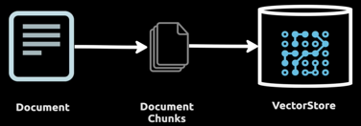
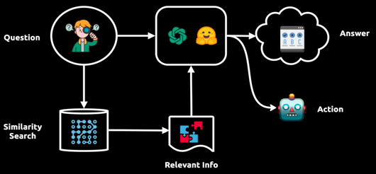
How a LangChain application integrates a Vector DB and LLM

Slide 22
LangChain - Some Scripts
Examples of LangChain Scripts connecting with different databases
https://github.com/langchain-ai/langchain/tree/master/libs/langchain/langchain/vectorstores
_pgvector_data_models.py
alibabacloud_opensearch.py
analyticdb.py
annoy.py
atlas.py
awadb.py
azuresearch.py
base.py
cassandra.py
chroma.py
clarifai.py
clickhouse.py
deeplake.py
elastic_vector_search.py
faiss.py
hologres.py
lancedb.py
marqo.py
matching_engine.py
milvus.py
mongodb_atlas.py
myscale.py
opensearch_vector_search.py
pgembedding.py
pgvector.py
pinecone.py
qdrant.py
redis.py
rocksetdb.py
singlestoredb.py
sklearn.py
starrocks.py
supabase.py
tair.py
tigris.py
typesense.py
utils.py
vectara.py
weaviate.py
zilliz.py

Slide 23
LangChain + Milvus
https://milvus.io/docs/integrate_with_langchain.md
https://milvus.io/blog/conversational-memory-in-langchain.md
https://github.com/hwchase17/langchain/blob/master/langchain/vectorstores/milvus.py
(800+ lines script)
# ! python -m pip install --upgrade pymilvus langchain openai tiktoken
from os import environ MILVUS_HOST = "localhost" MILVUS_PORT = "19530" OPENAI_API_KEY = "sk-******" environ["OPENAI_API_KEY"] = OPENAI_API_KEY ## Set env variable
from langchain.embeddings.openai import OpenAIEmbeddings
from langchain.vectorstores import Milvus
from langchain.document_loaders import WebBaseLoader
from langchain.text_splitter import CharacterTextSplitter
loader = WebBaseLoader(["https://milvus.io/docs/overview.md",])
docs = loader.load()
text_splitter = CharacterTextSplitter(chunk_size=1024, chunk_overlap=0)
docs = text_splitter.split_documents(docs)
embeddings = OpenAIEmbeddings(model="ada")
vector_store = Milvus.from_documents(docs, embedding=embeddings,
connection_args={"host": MILVUS_HOST, "port": MILVUS_PORT})
query = "What is milvus?"
docs = vector_store.similarity_search(query)
print(docs)
from langchain.chains.qa_with_sources import load_qa_with_sources_chain
from langchain.llms import OpenAI
chain = load_qa_with_sources_chain(OpenAI(temperature=0), chain_type="map_reduce", return_intermediate_steps=True)
query = "What is Milvus?"
chain({"input_documents": docs, "question": query}, return_only_outputs=True)

Slide 24
LangChain + PGVector + LLM
https://www.youtube.com/watch?v=Jl1S4ZcSY8k - Build AI-powered apps on Google Cloud with pgvector, LangChain & LLMs
https://colab.research.google.com/github/GoogleCloudPlatform/python-docs-samples/blob/main/cloud-sql/postgres/pgvector/notebooks/pgvector_gen_ai_demo.ipynb
https://www.youtube.com/watch?v=n2Fluyr3lbc - short video about PostgresSQL
CREATE TABLE product_embeddings(
product_id VARCHAR(1024) NOT NULL REFERENCES products(product_id),
content TEXT,
embedding vector(768)
)
conn.execute("CREATE EXTENSION IF NOT EXISTS vector")
register_vector(conn)
conn.execute(
"INSERT INTO product_embeddings (product_id, content, embedding) VALUES ($1, $2, $3)",
row["product_id"],
row["content"],
np.array(row["embedding"]),
)
-- Similarity Search Query:($1,$2,... - place holders)
"""WITH vector_matches AS (SELECT product_id, 1 - (embedding <=> $1) AS similarity FROM product_embeddings
WHERE 1 - (embedding <=> $1) > $2
ORDER BY similarity DESC LIMIT $3
)
SELECT product_name, list_price, description FROM products
WHERE product_id IN (SELECT product_id FROM vector_matches)
AND list_price >= $4 AND list_price <= $5"""

Slide 25

Comparisons of Vector Databases by Dmitry Kan
Dmitry Kan - https://www.linkedin.com/in/dmitrykan/
Vector Podcast YouTube Channel - https://www.youtube.com/@VectorPodcast/videos
Oct 2, 2021 - Dmitry Kan - "Not All Vector Databases Are Made Equal" A detailed comparison of Milvus, Pinecone, Vespa, Weaviate, Vald, GSI and Qdrant https://towardsdatascience.com/milvus-pinecone-vespa-weaviate-vald-gsi-what-unites-these-buzz-words-and-what-makes-each-9c65a3bd0696
Same review as a video in Summer 2022 - https://www.youtube.com/watch?v=Yo-AzVpWrRg
GitHub - https://github.com/DmitryKey
moves (Multilingual and multimodal vector search) - https://muves.io

Slide 26
Thank You!

