Slide 1
AI Updates
August 18, 2023
Presented by Lev Selector
August 18, 2023

Slide 2
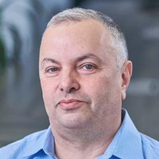
About the Speaker
Lev Selector, Ph.D.
BixBeta CTO & Co-Founder
40+ years of software engineering, data science, and building teams (hiring, training, and managing)
Ph.D. in mathematical modeling and computer simulations
Interests:
Generative AI, Using LLM with your data
crypto, accounting
cloud architecture, fin-tech, application security
Find me on Linkedin, GitHub, YouTube, Google to connect

Slide 3
You Need to be Constantly Learning
Things are changing fast. How do you survive?
You Need to be Constantly Learning - aggressively, proactively.
Also you need to practice what you learn.
Be clumsy and helpless - and get better and confident.
It takes time and effort - but you need to do that.
Join a group or create a group to learn and practice together.
Your college education is almost completely irrelevant.
You win by learning and practicing by yourself.
New Things:
Learn
Practice
Apply
"School never ends for the Pro"
"School is always in session"

Slide 4

Professions being Outsourced to AI
Graphic Designers
Translators & Interpreters
Manufacturing and Assembly-lines jobs
Data Entry and Data Processing
Accounting
Customer Service, Telemarketers, Call Centers
Proof-reading, copy-editing
Market Research Analysts
Marketing & Advertising
Legal Assistance
Financial Planners and Tax Preparers
Junior Software Developers
Warehouse work (example - Amazon shipping)
Driving (trucks, taxi, train, subway)
Retail (sales people, cashiers, MacDonalds order taking, Postal Service clerks, etc)
"Safe from AI" Jos:
AI doesn't have social or emotional intelligence. So it can't replace people in jobs that require empathy, and complex political and strategic roles
Surgeons
Nurses (patient care, emotional support)
Therapists, Physical Therapists
Social workers
Elementary School Teachers (despite AI education)
Research Scientists
Chefs
Hairdressers

Slide 5


Recycle GPT
- ORCAS = Open Resource for Click Analysis in Search ( paper 2020, https://arxiv.org/abs/2006.05324 )
- Orca: Progressive Learning from Complex Explanation Traces of GPT-4
( paper June 2023, https://arxiv.org/abs/2306.02707 )
- Open Orca Dataset Released! ( June 2023, ttps://huggingface.co/datasets/Open-Orca/OpenOrca )
Orca
Recycle GPT - idea of caching and re-using (recycling) intermediate results in LLM
https://www.youtube.com/watch?v=J7v2MIE_xls
Number of models in HuggingFace LLM Leaderboard: 885 models
https://huggingface.co/spaces/HuggingFaceH4/open_llm_leaderboard
Platypus (duck-billed) - semiaquatic, egg-laying mammal (Australia, Tasmania)
Small - but powerful model
# 95 - Open-Orca/OpenOrca-Platypus2-13B
https://www.youtube.com/watch?v=N-qaMCwqRHI
small - only 13b parameters
a merge between OpenOrca and Platypus2
the performance is comparable with 65b models
Curated dataset Open-Platypus
"Platypus: Quick, Cheap, and Powerful Refinement of LLMs"
https://platypus-llm.github.io

Slide 6
Google AdaTape, Google IDX
Google AdaTape - a Transformer-based model architecture that uses a dynamic set of tokens to create elastic input sequences.
.. https://ai.googleblog.com/2023/08/adatape-foundation-model-with-adaptive.html
AdaTape uses an adaptive tape reading mechanism to determine a varying number of tape tokens that are added to each input based on input’s complexity.
AdaTape is very simple to implement, provides an effective knob to increase the accuracy when needed, but is also much more efficient compared to other adaptive baselines because it directly injects adaptivity into the input sequence instead of the model depth.
Adatape offers better performance on standard tasks, like image classification, as well as algorithmic tasks, while maintaining a favorable quality and cost tradeoff.
Google Project IDX
Create Code in a Browser
New tool for building, managing and deploying web and multiplatform applications in the cloud
https://www.techrepublic.com/article/google-cloud-new-project-idx/

Slide 7

Tool-LLM - much more powerful than Gorilla
Tool-LLM:
follow human instructions to use external tools (APIs)
working with over 16,000 real-world APIs from https://rapidapi.com/hub
Meta + Microsoft + Stanford + UC Berkeley
can interact with various online services
can adapt to new APIs
available on GitHub
much more powerful than Gorilla
https://www.youtube.com/watch?v=N4R5BBb0o9g
https://www.youtube.com/watch?v=DrFb_ogjVk0
https://huggingface.co/papers/2307.16789
https://github.com/OpenBMB/ToolBench - https://arxiv.org/abs/2307.16789 - paper
https://gorilla.cs.berkeley.edu
ToolBench - an instruction-tuning dataset for tool use. It is created automatically using ChatGPT from 16,464 real-world RESTful APIs spanning 49 categories from RapidAPI Hub. We prompt ChatGPT to generate diverse human instructions involving these APIs, then use ChatGPT to search for a valid solution path (chain of API calls) for each instruction.
DFSDT (depth-first search-based decision tree) - evaluate multiple reasoning traces and expand the search space.
ToolLLaMA - LLaMA fine-tuned on ToolBench.
ToolEval - automatic evaluator of tools, shows that ToolLLaMA demonstrates a remarkable ability to execute complex instructions and generalize to unseen APIs, and exhibits comparable performance to ChatGPT.

Slide 8
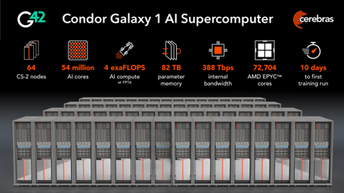
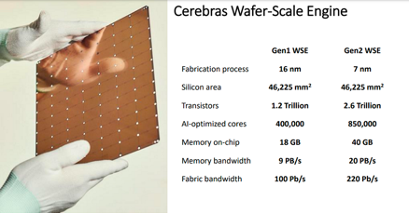
Cerebras
Company: Cerebras
Condor Galaxy 1 Supercomputer - 4 ExaFLOPs
https://www.cerebras.net/blog/introducing-condor-galaxy-1-a-4-exaflop-supercomputer-for-generative-ai/
https://www.youtube.com/watch?v=7KJibx077bE
Cerebras WSE-2 is ~100 times faster than NVIDIA H100 chip
Financed by Group G42 (Abu Dhabi, UAE)
Condor Galaxy | Phase 1 Done | Phase 2 Q4 2023 | Phase 3 H1 2024 | Phase 4 H2 2024
ExaFLOPS | 2 | 4 | 12 | 36
# CS-2 | 32 | 64 | 192 | 576
# Centers | 1 | 1 | 3 | 9
Milestone | Largest CS-2 setup | First 64-node Cerebras AI supercomputer | First distrib. super-computer network | Largest distrib. supercomputer network

Slide 9
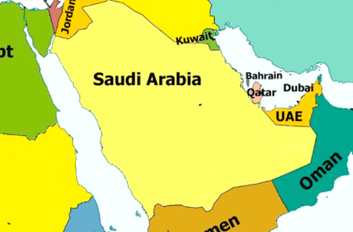


Miscellaneous
Saudi Arabia and the United Arab Emirates have joined the AI arms race, buying up thousands of Nvidia chips.
Cerebras is financed by Group G42
(Abu Dhabi, UAE). G42 is shelling out $100 million to Cerebras to have it build and manage a 32-node CS-2 cluster, known as Condor Galaxy-1
Saudi Arabia has also launched a program to educate 30,000 students in AI.
Fine-tuned small variations of LLaMa
Alpaca - 7b model from Stanford
https://crfm.stanford.edu/2023/03/13/alpaca.html
https://github.com/tatsu-lab/stanford_alpaca
Vicuna 13b chatbot (better than Alpaca): https://lmsys.org/blog/2023-03-30-vicuna/
WizardLM
https://github.com/nlpxucan/WizardLM
Alpaca
Vicuna

Slide 10
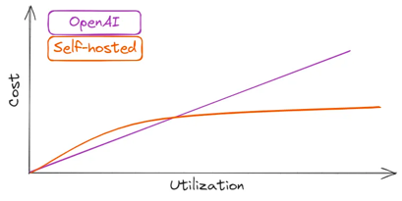
Hosted LLMs
https://betterprogramming.pub/you-dont-need-hosted-llms-do-you-1160b2520526
Self-hosted LLM:
more privacy,
full control,
no external dependencies
OpenAI:
quick development,
low cost,
minimal infra setup,
top quality
Example self-hosting for for LLaMA-2–70B
(on-par with GPT-3.5) on AWS or Google:
8x Nvidia A100
g5.48xlarge on AWS ($17K/mo)
a2-megagpu-16g on GCP ($6K/mo)
On-Prem solution may be the cheapest
OpenAI’s Terms of Use mentions that they “may use Content from Services other than our API ... to help develop and improve our Services”. This means that anything you send to ChatGPT, will be included in their training data.
OpenAI is cheaper for less than 10K requests/day
Azure OpenAI Service - provide private hosting.

Slide 11
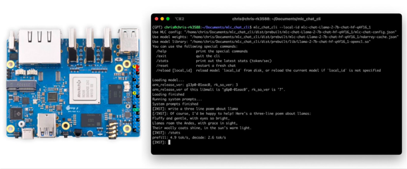
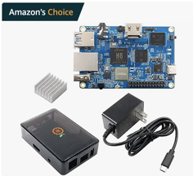
GPU-Accelerated LLM on a $100 Orange Pi
https://blog.mlc.ai/2023/08/09/GPU-Accelerated-LLM-on-Orange-Pi
A $100 Orange Pi 5 with Mali GPU, achieve 2.5 tok/sec for Llama2-7b
and 5 tok/sec for RedPajama-3b
through Machine Learning Compilation (MLC) techniques.
Additionally, Llama-2 13b model at 1.5 tok/sec on a 16GB version of the Orange Pi 5+ under $150.

Slide 12
Run Large LLMs on Small Computers
https://twitter.com/karpathy/status/1691571869051445433
Andrej Karpathy "How is LLaMa.cpp possible?"
great post by @finbarrtimbers
https://finbarr.ca/how-is-llama-cpp-possible/
"llama.cpp surprised many people (myself included) with how quickly you can run large LLMs on small computers,
e.g. 7B runs @ ~16 tok/s on a MacBook.
https://github.com/ggerganov/llama.cpp
Let's take a look:
A100: 1935 GB/s memory bandwidth, 1248 TOPS
MacBook M2: 100 GB/s, 7 TFLOPS
The compute is ~200x, but the memory bandwidth only ~20x.
So the little M2 chip that could will only be about ~20X slower
than a mighty A100.
This is ~10X faster than you might naively expect just looking at ops.

Slide 13
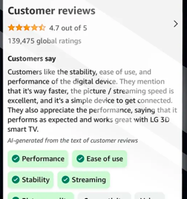
Amazon is planning to use Generative AI to provide summaries of customer reviews
... will use the new technology to provide a short paragraph of text right on the product detail page that will highlight the product features and customer sentiment mentioned across the customer reviews.
In addition to the summary text, Amazon will also highlight key product attributes as clickable buttons - allowing to see reviews talking about these attributes.
https://techcrunch.com/2023/08/14/amazon-taps-generative-ai-to-enhance-product-reviews/

Slide 14

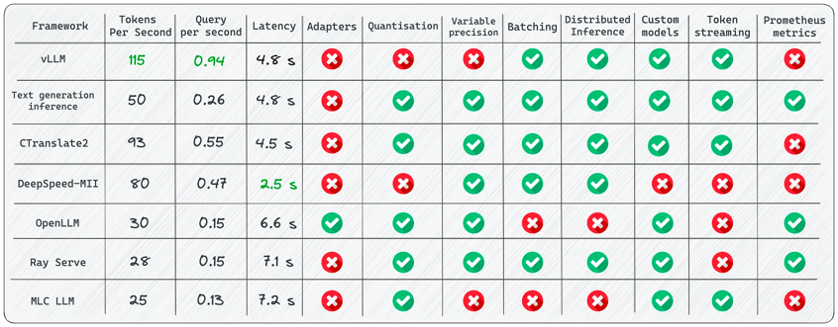
7 Frameworks for Serving LLMs
https://betterprogramming.pub/frameworks-for-serving-llms-60b7f7b23407
Compare several Open-Source Framework for LLM deploying and serving
vLLM
https://github.com/vllm-project/vllm

Slide 15
Thank You!

