Slide 1
LangChain
Presented by Lev Selector
August 18, 2023

Slide 2

About the Speaker
Lev Selector, Ph.D.
BixBeta CTO & Co-Founder
40+ years of software engineering, data science, and building teams (hiring, training, and managing)
Ph.D. in mathematical modeling and computer simulations
Interests:
crypto, accounting
cloud architecture, fin-tech, application security
Generative AI
Find me on Linkedin, GitHub, YouTube, Google to connect

Slide 3




LangChain Framework: Create Apps Using LLMs
Universal API for LLMs (GPT-3, BLOOM, and Jurassic-1 Jumbo, ...)
Chains = sequences of commands for LLM
End-to-end chains for popular apps (chatbots, question-answering, and summarization)
Memory (keeping info about previous chat messages, ...)
Tools for debugging, testing, evaluating, and monitoring LLM apps
Prompt templates - strings containing variables in curly braces {myvar}. For example, templates for chatbots, ELI5 question-answering ("Explain Like I'm Five"), summarization, etc
Agents - use LLMs to decide what actions should be taken (generate a plan or execute tasks)
Harrison Chase
Co-Founder & CEO,
Released LangChain in October 2022
Software framework created and open-sourced in 2022 by Harrison Chase
Available as either a Python or TypeScript package
https://en.wikipedia.org/wiki/LangChain
https://github.com/langchain-ai/langchain
https://langchain.com | https://python.langchain.com | https://docs.langchain.com/docs/
https://python.langchain.com/docs/modules/model_io/prompts/prompt_templates/
quickstart tutorial - https://www.youtube.com/watch?v=aywZrzNaKjs
LangChain - https://www.youtube.com/watch?v=jFo_gDOOusk
Prompt Engineering - https://www.youtube.com/playlist?list=PLZnV2TKiv3wC0F5AQJwL3RGCfInRpu-LA
"DeepLearning.ai" - https://www.deeplearning.ai/short-courses/ - good short courses
Multiple YouTube tutorials

Slide 4
LangChain Is The Most Popular and Flexible Framework
There are many Frameworks for orchestrating LLMs.
Here are the most popular (on top):
1. LangChain ( https://www.langchain.com ) - most popular, flexible, used everywhere (Google, Microsoft, Facebook, etc. ).
2. LlamaIndex ( https://www.llamaindex.ai ) - similar, make it easier to do Q/A, NLI, etc.
3. Hugging Face Transformers ( https://github.com/huggingface/transformers ) - variety of tasks, not for orchestration though.
4. Ada ( https://www.ada.cx ) - build conversational AI chatbots, supports a variety of LLMs, chaining, caching, logging.
5. DialoGPT ( https://github.com/microsoft/DialoGPT ) - build chatbots, similar to Ada - but specifically for LLMs from OpenAI.
6. Parrot ( https://parrotgpt.ai ) - build chatbots, similar to Ada and DialoGPT, but it is more open-source and flexible.
7. CogDL ( https://github.com/THUDM/CogDL ) - build graph neural networks (GNNs), orchestrate LLMs for Q/A and NLI.
8. Steamship ( https://www.steamship.com ) - build AI Agents, LLM apps, chaining, caching, logging.
9. FATE ( https://fate.fedai.org ) - build federated learning apps, orchestrate LLMs trained on distributed datasets.
10. PolyAI ( https://poly.ai ) - build voice assistants, conversational AI apps, uses its own proprietary framework.
11. Snips NLU ( https://www.sonos.com ) - build NLU apps - intent detection and entity extraction.
12. MindMeld ( https://www.mindmeld.com ) - build conversational AI apps - Q/A & NLI.
13. ReTune ( https://retune.so ) - managing & improving prompts for LLMs.
14. Dust ( https://dust.tt ) - build conversational AI apps, chaining, caching, and logging.
Q/A = Question Answering
NLI = Natural Language Inference
NLU = Natural Language Understanding

Slide 5
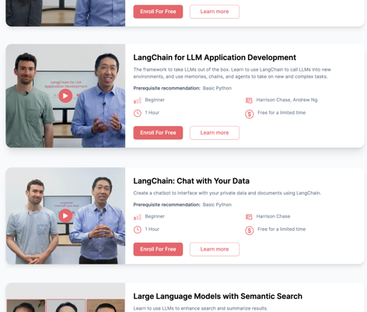
"DeepLearning.ai" - Short Courses
https://www.deeplearning.ai/short-courses/ - good short courses

Slide 6
Add Natural Language Interface (Create an Agent)
Example - add a NLI (Natural Language Interface) for an application with ten commands
Create a new LangChain project
Create a new template file for each of the ten commands. Each template should have two parts:
.. the prompt for triggering the command.
.. the chain that will be executed when triggered
Create a new agent file in which you define the logic that will be used to select the appropriate template file based on the user's input
Run the LangChain application
Example of a simple template for a command that adds two numbers:
prompt: "Add two numbers together."
chain:
- add:
numbers: ["1", "2"]
Here is an example of a simple agent file that selects the appropriate template file based on the user's input:
def select_template(input):
if "add" in input:
return "add_numbers"
else:
return None
Once you have created the template files and the agent file, you can run the LangChain application.

Slide 7
LangChain + PGVector + LLM
Build AI-powered apps on Google Cloud with pgvector, LangChain & LLMs
https://www.youtube.com/watch?v=Jl1S4ZcSY8k
https://colab.research.google.com/github/GoogleCloudPlatform/python-docs-samples/blob/main/cloud-sql/postgres/pgvector/notebooks/pgvector_gen_ai_demo.ipynb
CREATE TABLE product_embeddings(
product_id VARCHAR(1024) NOT NULL REFERENCES products(product_id),
content TEXT,
embedding vector(768)
)
conn.execute("CREATE EXTENSION IF NOT EXISTS vector")
register_vector(conn)
conn.execute(
"INSERT INTO product_embeddings (product_id, content, embedding) VALUES ($1, $2, $3)",
row["product_id"],
row["content"],
np.array(row["embedding"]),
)
-- Similarity Search Query:($1,$2,... - place holders)
"""WITH vector_matches AS (SELECT product_id, 1 - (embedding <=> $1) AS similarity FROM product_embeddings
WHERE 1 - (embedding <=> $1) > $2
ORDER BY similarity DESC LIMIT $3
)
SELECT product_name, list_price, description FROM products
WHERE product_id IN (SELECT product_id FROM vector_matches)
AND list_price >= $4 AND list_price <= $5"""

Slide 8
Embedding Models
OpenAI’s Embedding Model With Vector Database https://betterprogramming.pub/openais-embedding-model-with-vector-database-b69014f04433
OpenAI updated in December 2022 the Embedding model to text-embedding-ada-002. The new model offers:
low price ($0.01 per 100,000 tokens = 150 pages)
1/8th embeddings dimensions size reduces vector database costs
Endpoint unification for ease of use
State-of-the-Art performance for text search, code search, and sentence similarity
Context window increased from 2048 to 8192
Choosing the Right Embedding Model - a Guide for LLM Applications
https://medium.com/@ryanntk/choosing-the-right-embedding-model-a-guide-for-llm-applications-7a60180d28e3
1 token = 4 chars (in English)
1 word = 5 chars = 1.25 tokens
100 tokens = 75 words
1 page (single-spaced) = 500 words = 2,500 chars = 625 tokens
100,000 tokens = 75,000 words = 150 pages
8192 tokens = 6,150 words = 12 pages

Slide 9
What (Product) People Need To Know About LangChain
https://www.commandbar.com/blog/langchain-guide
Chain of Thought (CoT) - encourage the model to generate a series of intermediate reasoning steps.
Tree of Thoughts (ToT) - LLMs evaluate themselves at each stage of thought and stop inefficient approaches early, switching to alternative methods - https://medium.com/@astropomeai/implementing-the-tree-of-thoughts-in-langchains-chain-f2ebc5864fac
Action Plan Generation - ask LLM to make a plan sequence, then execute it, then re-do the plan, etc.
ReAct ("Reasoning and Action") - thought and action, understanding the 'why' behind the action. It's about the model taking a moment to contemplate, to reason, and then to act.
Self-ask - prompting encourages the model to be more proactive and inquisitive internally (ask itself questions).
Prompt Chaining - combine multiple LLM calls, with the output of one step being the input of the next
Memetic Proxy - simulate well-known figures or situations to shape its responses
Self Consistency - create multiple solutions and choose the most consistent one
Inception (First Person Instruction) - add the start of the model’s response into the prompt. For example, you might ask the model to “Tell me a joke. Make it start with “Knock, knock”.
MemPrompt - keep memory (history). This allows user to give feedback to LLM, correct it, improve the model's understanding of the task, prevent it from making the same mistake again .. https://js.langchain.com/docs/modules/memory/ .. https://github.com/madaan/memprompt

Slide 10
What (Product) People Need To Know About LangChain - p.2
https://www.commandbar.com/blog/langchain-guide
https://github.com/gkamradt/langchain-tutorials/tree/main
https://www.youtube.com/watch?v=vGP4pQdCocw (Cookbook part 2)
https://www.youtube.com/playlist?list=PLqZXAkvF1bPNQER9mLmDbntNfSpzdDIU5 - playlist of tutorials
Schema - The Blueprint of LangChain
Components - Models, Prompts, Indexes, Memory, Chains, and Agents
Models: Large Language Models (LLMs), Chat Models, Text Embedding Models
Prompts - Prompt Templates, Example Selectors (to include examples in your prompts), Output Parsers
Indexes - used for Document Loaders, Text Splitters, Vector Stores, Retrievers
Memory - Short-Term and Long-Term
Chains, for example:
LLMChain - may include a PromptTemplate , a model, Guardrails (optional quality checks)
Index-related Chains
Stuffing (stuff into prompt)
Map Reduce (run initial prompt on each chunk of data, then a different prompt to combine all the initial outputs
Refine (multi-step refining using output from previous step)
Map-Rerank - running initial prompt on each chunk of data, scoring the output, ranking, return response with highest score
Agents - Action Agents & Plan-and-Execute Agents

Slide 11
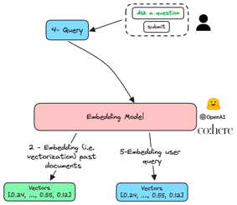
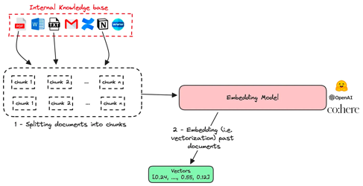
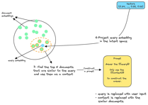
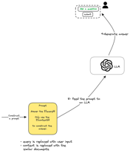
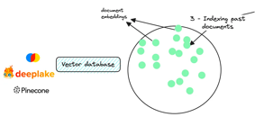
Build A Chatbot To Talk To Your Internal Knowledge Base
https://levelup.gitconnected.com/you-can-now-build-a-chatbot-to-talk-to-your-internal-knowledge-base-b6066cacf2d5

Slide 12
Thank You!

