Slide 1
AI Updates
September 8, 2023

Slide 2
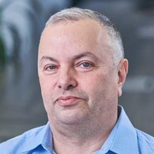
About the Speaker
Lev Selector, Ph.D.
40+ years of software engineering, data science, and building teams (hiring, training, and managing)
Ph.D. in mathematical modeling and computer simulations
Interests:
Generative AI, Using LLM with your data
Cloud architecture, fin-tech, application security
Crypto, accounting
Find me on Linkedin, GitHub, YouTube, Google to connect

Slide 3
Status Page
Google
TPU-4 is available to public
Duet AI - assistance for developers
Digital watermarking of images
Google + Nvidia + Spark
Google Meet (since 2017) - now AI making notes, ...
HuggingFace.co
> 1300 entries (was ~346 entries on July 16th)
ollama,
https://gpt4all.io
Falcon 180B, trained on 3.5 trillion tokens
Microsoft / OpenAI Enterprise Service - pricing?
Microsoft - a patent for AI backpack
Claude Pro
https://www.anthropic.com/index/claude-pro
5x more usage than our free tier provides, with the ability to send many more messages
Priority access to Claude.ai during high-traffic periods
Early access to new features that help you get the most out of Claude
Apple spends millions of $ per day on training LLMs, especially conversational assistants

Slide 4
Open LLM Leaderboard
LLaMa was open sourced on July 18th - started explosion of new versions
Open community creates new datasets/protocols to improve models
Also reducing model size (precision or number of parameters)
https://huggingface.co/spaces/HuggingFaceH4/open_llm_leaderboard
Sep 4-8, 2023 - > 1300 entries (was ~346 entries on July 16th before LLaMa July 18)
New entries are mostly variations of Meta's LLaMa
All top positions are 70B 16 bit and require big computer to run it (~160 GB VRAM).
Reducing model size:
reducing N-params from 70B down to 30,13,7B causes severe reduction of average test scores
reducing precision bits from 16 down to 4 surprisingly preserves the quality fo the model
rank size avg_quality bits VRAM name
1 70B 73.81 16 160 uni-tianyan/Uni-TianYan
33 70B 71.36 8 160 garage-bAInd/Camel-Platypus2-70B
50 70B 70.37 4 45 garage-bAInd/Camel-Platypus2-70B
55 65B 69.94 16 160 upstage/llama-65b-instruct
61 180B 68.74 16 400? tiiuae/falcon-180B
107 70B 66.8 16 160 meta-llama/Llama-2-70b-chat-hf (original LLaMa2, July 18)
122 13B 66.03 16 Aspik101/trurl-2-13b-pl-instruct_unload
approx:
170 30B 64.21 4 20 gaodrew/gaodrew-llama-30b-instruct-2048-Open-Platypus-100steps
195 40b 63.47 16 tiiuae/falcon-40b-instruct (was #1 before LLaMa2)
210 13B 63.19 4 10 Open-Orca/OpenOrca-Platypus2-13B
370 7b 59.89 16 HyperbeeAI/Tulpar-7b-v0
625 7b 55.72 4 6 joehuangx/spatial-vicuna-7b-v1.5-LoRA

Slide 5

Run LLaMa 4bit - Memory ? Price ?
The tinybox - $15K - George Hotz
Runs 65B FP16 LLaMA out of the box
1600W (one 120V outlet)
738 FP16 TFLOPS (using six AMD 7900 XTXs) ?
144 GB VRAM (six AMD 7900 XTX 24GB) CPU - AMD EPYC
https://tinygrad.org
https://www.youtube.com/watch?v=GKRu3Txc0sk
People can buy Apple Mac Studio foronly $5.4K (with 192 GB memory, M2 chip with 24‑core CPU, 60‑core GPU, 32‑core Neural Engine) - but it delivers only ~21 TFLOPS of compute, which is much less than 738 TFLOPS of the tinybox.
https://news.ycombinator.com/item?id=37067933
70b * 2 bytes = 140GB, runs in 160+ GB VRAM - expensive
70b * 1 byte = 70GB, runs in 80 GB VRAM - expensive
--------------------------------------------------------------
70b * 4 bit = 35GB, runs in 37-41GB VRAM (2x3090 + NVLink)
35b * 4 bit = 18GB, runs in 24 GB VRAM (1x3090)
--------------------------------------------------------------
Ollama models on Mac
70b * 4bit = 28GB, file 39GB, RES mem 45 GB (fails on 32GB Mac)
34b * 4bit = 17GB, file 19GB, RES mem 19.4 GB
13b * 4bit = 7GB, file 7.3GB, RES mem 9.7 GB
7b * 4bit = 4GB, file 3.9GB, RES mem 5.6 GB
3b * 4bit = 2GB, file 1.9GB, RES mem 3.3 GB
Solution 1: Buy a desktop with Nvidia RTX 3090. For example: https://www.ebay.com/itm/125970706114 - eBay Refurbished Gaming PC - Alienware with Ryzen 9 5950X 4.9GHz, 128GB RAM, 1TB SSD, Nvidia RTX 3090 24GB - $1,670
Rust code to run Llama2:
https://github.com/srush/llama2.rs
Solution 2: MacBook Pro 14" or 16" with 64GB memory.
You can find good deals for $2.3K - $2.5K (32G for $1.7K)
ExLlama - Python/C++/CUDA - Llama
for use with 4-bit GPTQ weights
Results:
llama-33b in 21-22 GB VRAM
llama-70b in 37-41 GB VRAM
https://github.com/turboderp/exllama
Solution 3: Build your own desktop with two identical Nvidia RTX-3090. Buy RTX NVLink bridge connector at Best Buy for $80.
You will need 1.6KW power and good (liquid?) cooling. $3K
https://timdettmers.com/2023/01/30/which-gpu-for-deep-learning/
NVLink

Slide 6
How do open source LLMs compare to GPT-4?
https://ai.stackexchange.com/questions/41214/how-do-open-source-llms-compare-to-gpt-4
Huggingface - 4 key benchmarks from the Eleuther AI Language Model Evaluation Harness:
ARC = AI2 Reasoning Challenge (25-shot) - a set of grade-school science questions.
HellaSwag (10-shot) - a test of common sense inference, which is easy for humans (~95%) but challenging for SOTA models.
MMLU (5-shot) - a test to measure a text model’s multitask accuracy. The test covers 57 tasks including elementary mathematics, US history, computer science, law, and more.
TruthfulQA (0-shot) - a test to measure a model’s propensity to reproduce falsehoods commonly found online.
 | ARC reasoning | HellaSwag common sense | MMLU (math, history, etc) | TruthfulQA truthful ?
GPT-4 | 96.3 | 95.3 | 86.4 | 59
GPT-3.5 | 85.2 | 85.5 | 70 | 47
Top 70b | 72.1 | 87.4 | 69.91 | 65.81
Top 4bit (13b) | 57.68 | 81.05 | 51.82 | 45.69

Slide 7
Training Requires More Hardware than Inference
Training is more demanding than inference.
GPU Memory - you need enough to fit the model - plus some more.
GPU Compute - training is much more computationally intensive than inference.
System Memory - you need to hold the training data in memory.
Storage - full dataset, checkpoints, logs - need fast storage (SSD or NVMe)
Software - PyTorch, TensorFlow, distributed training across multiple GPUs, data pipeline

Slide 8
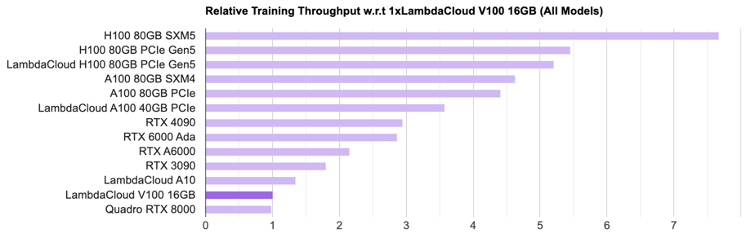
Best GPU for AI
https://lambdalabs.com/gpu-benchmarks
The AMD Radeon RX 7900 XTX and NVIDIA GeForce RTX 4090 are both flagship graphics cards. The RTX 4090 is faster, but it is also 60% more expensive. The RX 7900 XTX is better when it comes to price per FPS.
tiny box / tinygrad uses six AMD 7900 XTX 24GB
144GB = 24*6

Slide 9
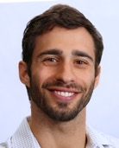
Prompt Engineering
What I Learned Pushing Prompt Engineering to the Limit
- by Jacob Marks, Ph.D.
https://towardsdatascience.com/what-i-learned-pushing-prompt-engineering-to-the-limit-c40f0740641f
General Lessons
Science? Engineering? Black Magic?
Which Model(s) to Use?
Where to Use LLMs?
LLMs Are Biased
Painful Post-Processing Is Inevitable (regex, remove hallucinations)
Prompting Techniques
The More the Merrier
Examples > Documentation
Modularity >> Monolith (ask LLM to do one task at a time)
Examples
How Many Do I Need?
Synthetic Examples
Tooling
LangChain
Vector Databases
TikToken
Jacob Marks, Ph.D.
https://www.linkedin.com/in/jacob-marks/
ARC HellaSwag MMLU TruthfulQA
GPT-4 96.3 95.3 86.4 59
Top 4bit 57.68 81.05 51.82 45.69

Slide 10

George Hotz interviewed by Lex Fridman
https://www.youtube.com/watch?v=dNrTrx42DGQ - 3+ hour interview, June 2023
George Hotz - American computer programmer and entrepreneur
known for his work on jailbreaking the iPhone and PlayStation 3
founder of comma.ai - self-driving car company (2014)
left comma.ai in Oct 2022, founded "tiny corp" to develop "tinygrad" framework for ML & AI, and tinybox computer to run LLMs ( https://tinygrad.org )
George Hotz
Interview covers lots of topics - his views on time, memes, virtual reality, AI friends, self-driving cars, programming, AI safety, working at Twitter, prompt engineering, video games, Andrej Karpathy, and the meaning of life.
time is an illusion, we are all living in a simulation. Potential dangers of memes (spreading misinformation)
optimistic about the potential of virtual reality to improve our lives (but risk of addiction)
AI friends could be a valuable for companionship and support, but could be misused for malicious purposes
supports self-driving cars, they can save lives
talented programmer, understands AI, advocates open source as essential for the safety of AI systems
concerned about the potential threat of AI, mitigate by developing AI systems that are aligned with human values
worked at Twitter - and left after disagreeing with the company's management
interested in the prompt engineering - generating creative content, writing code, and translating languages
enjoys playing video games, believes they can be a valuable tool for learning and problem-solving
worked with Andrej Karpathy, the former head of AI at Tesla, impressed by him
still searching for the meaning of life, believes that each individual must discover it for themselves

Slide 11
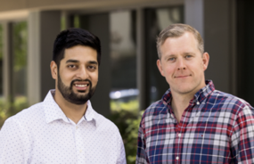
contextual.ai
contextual.ai - startup
raised $20M in June 2023
https://contextual.ai
building foundation models to run on your stack
customizable, trustworthy, privacy-aware AI
secure by default
Solving these enterprise challenges:
Hallucination: LLMs are known to make up information
Attribution: why LLMs say what they say,
Compliance: risk of retaining info inside LLM
Customization: LLMs should work with new data
Data privacy: no need to send private data outside
Founders: Amanpreet Singh (CTO), Douwe Kiela (CEO)
Microsoft Research, Meta/Facebook AI Research, Hugging Face, Cambridge, NYU, Stanford
worked in foundation models (RAG, FLAVA, UniT, Bloom), dense retrieval (Hallucination reduction, MDR, Unsupervised QA), evaluation (SentEval, GLUE, SuperGLUE, Dynabench, Eval on the Hub), multimodality (Hateful Memes, Winoground, TextVQA, MMF) and representation learning (InferSent, GroundSent, Poincare embeddings).
“this journey is only 1% finished”

Slide 12
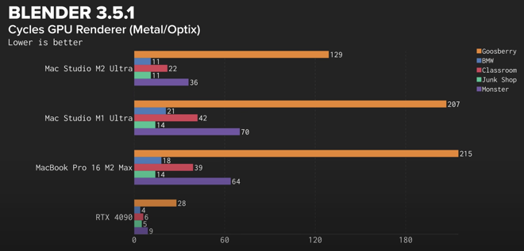
Running LLaMa on Mac Silicone
Running LLaMa on Mac Silicone - https://www.youtube.com/watch?v=TsVZJbnnaSs
Run Code Llama on a Mac with an M1 Chip https://www.youtube.com/watch?v=a1JlzUzHL-I
Linus Tech Tips - Apple fans, start typing your angry comments now… M2 Ultra Mac Studio Review - https://www.youtube.com/watch?v=buLyy7x2dcQ&t=10s

Slide 13
"How is LLaMa.cpp possible?"
Andrej Karpathy @karpathy
"How is LLaMa.cpp possible?" - https://twitter.com/karpathy/status/1691571869051445433
great post https://finbarr.ca/how-is-llama-cpp-possible/
llama.cpp surprised many people with how quickly you can run large LLMs on small computers, e.g. 7B runs @ ~16 tok/s on a MacBook Pro M2 (Apple silicone).
On Apple Silicone chip the CPU, GPU, and unified memory are located on the same chip.
Memory bandwidth depends on the Mac model:
M2 - 100GB/s, M2 Pro - 200GB/S, M2 Max - 400GB/S, M2 Ultra - 800GB/S
As you running just one query at a time, the batch_size=1, and the compute units are mostly waiting for data to go from memory. The memory bandwidth is the limiting factor.
Memory Bandwidth Ops/sec
A100: 1935 GB/s 1248 TOPS
MacBook M2: 100 GB/s 7 TFLOPS
The compute is ~200x but the memory bandwidth only ~20x. So M2 chip is only ~20X slower than a mighty A100.
The situation becomes a lot more different when you inference at a very high batch size (e.g. ~160+), such as when you're hosting an LLM engine simultaneously serving a lot of parallel requests. Or in training, where you aren't forced to go serially token by token and can parallelize across both batch and time dimension

Slide 14
Building Reliable Systems & Smart Systems
How to make a reliable system from a bunch of unreliable blocks?
How to make a smart model out of a bunch of stupid models
Reliable - use redundancy, several elements in parallel - and average the outputs
Smart - using chains and trees

Slide 15
Idea:
make a reliable system from unreliable blocks using single-shot democratic voting
Idea:
get to correct answer by making multiple corrective steps
Power of the majority
committee, senate, congress, council, board of directors, ...
1st approximation
Power of validation
science, open source community, ...
Computer 1
correction
Data
Computer 2
Majority voting
system
Weighted
voting
system
correction
Computer 3
...
correction
Bagging
Wrong bias is not removed,
it is simply averaged
Wrong bias is removed
using correction and validation
Boosting

Slide 16
Thank You!

