Slide 1
Evolution
and Genetic Algorithms
Presented by Lev Selector
September 8, 2023

Slide 2

About the Speaker
Lev Selector, Ph.D.
BixBeta CTO & Co-Founder
40+ years of software engineering, data science, and building teams (hiring, training, and managing)
Ph.D. in mathematical modeling and computer simulations
Interests:
crypto, accounting
cloud architecture, fin-tech, application security
Generative AI
Find me on Linkedin, GitHub, YouTube, Google to connect

Slide 3
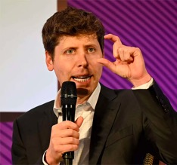
Intelligence as a Fundamental Property of Matter ...
"I grew up implicitly thinking that intelligence was this, like really special human thing and kind of somewhat magical."
"And I now think that it's sort of a fundamental property of matter ..."
"The history of scientific discovery is that humans are less and less at the center. We used to think that Sun rotates around us, and that we are the center of the Galaxy ..."
"Even if, like, humans aren't special in terms of intelligence, we are incredibly important. We are on an exponential curve, truly ... we have an algo that can genuinely and truly learn, ... and it gets predictably better with scale."
"The rate of progress in coming years is going to be significant."
Sam Altman OpenAI CEO and co-founder

Slide 4
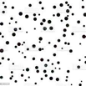
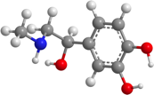
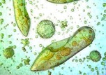
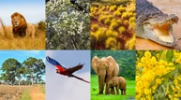
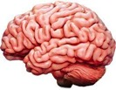
Natural Evolution
Simple organic molecules
More complex structures
Plants & Animals
Chaos
Intellect

Slide 5
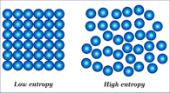
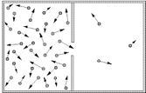
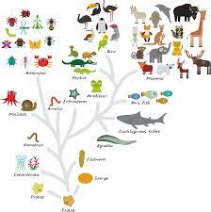
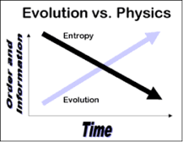
Evolution Goes Against 2nd Law of Thermodynamics
2nd law of Thermodynamics - entropy grows.
Things go in one direction, they can not go backwards.
Evolution goes "against" 2nd law.
Structures are created.

Slide 6


Decay
Growth
Open System:
energy flows in - and out.
breath in - breath out
food in - waste out
entropy can decrease
complexity can increase
evolution is possible
Closed System:
everything decays
structures dissolve
heat death
entropy grows
Non-Linear System
where structures are created.
(from simple to complex)
Energy out
Energy in
Energy + Non-linearity = Evolution

Slide 7


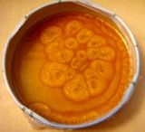


Examples of how structures are created
when energy flows through
Formation of Galaxies and Stars
Weather Patterns - wind, rain, tornadoes, hurricanes
Life Forms and Ecosystems: Sunlight, photosynthesis, organisms consume plants, ...
River Systems - shape landscapes, valleys, canyons, and deltas
Sand Dunes
Cyclones, Hurricanes, Tornadoes
Bénard Cells - a hexagonal pattern that forms when a fluid is heated from below (hot fluid rises, cooler fluid sinks)
Human Society and Cities
Soap Bubbles
Crystal Growth
Coffee or Tea Whirls
Oil and Water Emulsion
Baking - creating the complex flavors and aromas
Ice Spikes

Slide 8
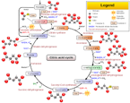


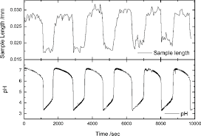
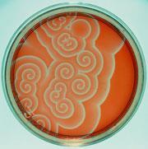
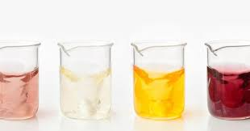
Structures in time dimension
Periodic chemical reactions
Belousov-Zhabotinsky (BZ) reaction
Briggs-Rauscher reaction
Krebs cycle (also known as the citric acid cycle or TCA cycle)
glycolytic oscillations, where the concentrations of intermediates in the glycolytic pathway oscillate over time under certain conditions

Slide 9

Example of going against entropy:
Stability can be achieved by dynamical (oscillating) movement
Inverted pendulum with a vertically oscillated pivot
https://www.youtube.com/watch?v=rwGAzy0noU0

Slide 10
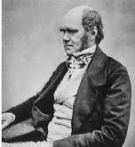

Charles Darwin
In 1831, Charles Darwin received an astounding invitation: to join the Her Majesty's Ship Beagle as ship's naturalist for a trip around the world. For most of the next five years, the Beagle surveyed the coast of South America, leaving Darwin free to explore the continent and islands, including the Galápagos.
Evolution: species of organisms undergo change over time through the gradual accumulation of small genetic variations.
The theory of evolution is primarily associated with Charles Darwin, who proposed that all species of life descended over time from common ancestors.
Darwin's mechanism for evolution was natural selection, often summed up as "survival of the fittest." Organisms that are more adapted to their environment are more likely to survive and reproduce. Over time, these advantageous traits become more common in the population, leading to evolutionary change.
Genetic variation is a fundamental aspect of evolution. It arises through mutations in an organism's DNA. Mutations are random, but natural selection is not. It favours traits that increase an organism's chances of survival and reproduction. Those traits become more prevalent in the population over generations, while traits that are disadvantageous become less common.
Galápagos Islands

Slide 11

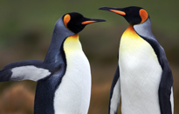
Having Sexes Accelerates Evolution
Having sexes adds sexual recombination - the process where the genetic material from two parents is combined to produce offspring. This process increases genetic diversity in a population, which in turn provides more raw material for selection - thus accelerating the evolution.
Another accelerating factor is sexual selection, which favors certain traits, and does it at early ages of organisms. Thus the evolution process doesn't depend on organisms physically dying - but just on selection happening at early age.
So, adding sex causes significant acceleration of evolution.
Will adding more sexes add even more acceleration?
Adding a third sex in math models shows that it doesn't help much because it doesn't significantly increase genetic diversity beyond what is already achieved with two sexes.
This is because the primary benefit of sexual reproduction - the recombination of genetic material - is already realized with two sexes.

Slide 12
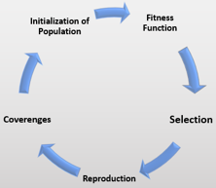
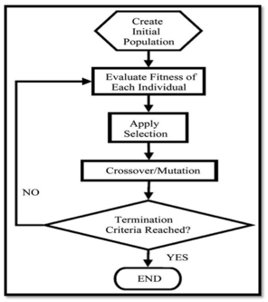
Machine Learning - Genetic Algorithms (GA)
Genetic algorithm (GA) is a method inspired by the process of natural selection
GA belongs to the larger class of Evolutionary Algorithms (EA)
GAs commonly used for optimization and search
GA uses biologically inspired operators such as mutation, crossover and selection
Examples: .. optimizing decision trees for better performance, .. solving sudoku puzzles, .. hyperparameter optimization, .. etc.
https://en.wikipedia.org/wiki/Genetic_algorithm

Slide 13
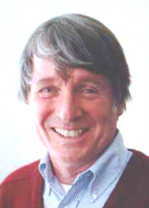
History of Genetic Algorithm
Genetic algorithms were invented by John Holland, a computer scientist and professor at the University of Michigan, in the 1960s and 1970s. https://en.wikipedia.org/wiki/John_Henry_Holland
Holland was interested in understanding the processes of adaptation and evolution in biological systems
He proposed the idea of using a population-based search algorithm, where a set of candidate solutions (individuals) are iteratively evaluated, selected for reproduction, and mutated to generate new solutions
This iterative process is similar to the process of natural selection in biological evolution, which inspired the name "genetic algorithms"
Since Holland's original work, genetic algorithms have been widely used in machine learning, optimization, and other areas of computer science.
John Holland
1929-2015

Slide 14
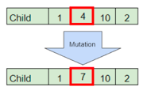


Mutation, Selection, Crossover
Mutation operation
analogous to biological mutation
usually done by "flipping random bits"
introduce diversity
helps avoid local minima
Selection - choose the fittest
Selection operation
choose the fittest individuals from a population to become parents
goal is to increase the quality of the population in terms of the fitness function
Roulette: assign probability proportional to fitness, then select randomly
Tournament: select a random subset, select the fittest from that subset, etc.
Rank-based: assign ranks based on fitness, select based on rank
Crossover operation
works by selecting a random crossover point(s) along the chromosome of the parent individuals and exchanging the genetic material between them
single-point crossover, multi-point crossover, uniform crossover (select individuals bits or groups (genes))
crossover generates diversity, helps avoiding premature convergence to local minima
the resulting offspring inherits genetic information from both parents and has a combination of their features
the crossover operator should strike a balance between exploration and exploitation of features

Slide 15
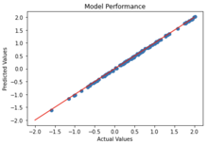
Using Genetic Algorithm for Linear Regression
Parameters of the model (intercept and slope coefficients) are represented as strings of binary digits called chromosomes.
These chromosomes are then subjected to genetic operations such as crossover and mutation to create new generations of potential solutions
The fitness of each solution is evaluated based on its ability to minimize the error between the predicted values and the actual values of the dependent variable
The genetic algorithm iteratively searches for the best combination of model parameters until a stopping criteria is met, such as the desired level of accuracy being achieved or a maximum number of iterations being reached
Using a genetic algorithm for linear regression can be great for cases where the dataset is large, or the number of possible parameter combinations is very large
Here is a simple example in Python (not using any special GA libraries): https://github.com/lselector/chatgpt/blob/master/nb_Genetic_Linear_Regression.ipynb

Slide 16
Python Libraries
Here are some Python libraries most commonly used for implementing genetic algorithms:
DEAP: Distributed Evolutionary Algorithms in Python (pip instal deap) .. https://github.com/DEAP/deap .. https://towardsdatascience.com/genetic-algorithms-in-python-using-the-deap-library-e67f7ce4024c .. https://aviral-agarwal.medium.com/implementation-of-genetic-algorithm-evolutionary-algorithm-in-python-using-deap-framework-c2d4bd247f70 .. https://github.com/DEAP/deap/tree/master/examples
PyGAD: A lightweight library for implementing genetic algorithms .. https://pypi.org/project/pygad/
GenPy: genetic algorithms, with a focus on simplicity and ease of use .. https://github.com/ros/genpy
EvoKit: A versatile toolkit for evolutionary computation, including genetic algorithms .. https://github.com/etsy/Evokit
Scipy: A popular scientific library, has module for genetic algorithms
Numpy & Pandas - common libraries to work with tabular data

Slide 17
Example Using DEAP (Distributed Evolutionary Algorithms in Python) library
from deap import base, creator, tools, algorithms
import random, numpy
TARGET = [1, 2, 3, 4, 5, 6, 7, 8, 9, 10]
def fitness(individual):
return sum(abs(ind - tar) for ind, tar in zip(individual, TARGET)),
creator.create("FitnessMin", base.Fitness, weights=(-1.0,))
creator.create("Individual", list, fitness=creator.FitnessMin)
toolbox = base.Toolbox()
toolbox.register("attr_int", random.randint, 0, 10)
toolbox.register("individual", tools.initRepeat, creator.Individual, toolbox.attr_int, 10)
toolbox.register("population", tools.initRepeat, list, toolbox.individual)
toolbox.register("evaluate", fitness)
toolbox.register("mate", tools.cxTwoPoint)
toolbox.register("mutate", tools.mutUniformInt, low=0, up=10, indpb=0.2)
toolbox.register("select", tools.selTournament, tournsize=3)
# -----------------------------------------------------
def main():
pop = toolbox.population(n=100)
hof = tools.HallOfFame(1)
stats = tools.Statistics(lambda ind: ind.fitness.values)
stats.register("avg", numpy.mean)
stats.register("std", numpy.std)
stats.register("min", numpy.min)
stats.register("max", numpy.max)
pop, log = algorithms.eaSimple(pop, toolbox, cxpb=0.5, mutpb=0.2, ngen=40,
stats=stats, halloffame=hof, verbose=True)
return pop, log, hof
if __name__ == "__main__":
main()
In this example, we'll use a simple genetic algorithm to evolve a list of numbers to match a target list.
The fitness function will be the sum of the absolute differences between the individual and the target.
We initialize a population of "individuals" (in this case, lists of integers), then apply genetic operators to them in the form of crossover (recombination of genes / elements from two parents) and mutation (random changes to genes / elements).
The individuals are selected for the next generation based on their fitness, and the process repeats for a given number of generations. The HallOfFame (hof) object keeps track of the best individual seen.
The 'verbose' argument in eaSimple() function is used to control whether the evolution should be displayed to the console. If verbose is True, a logbook object containing the statistics is printed, and it is updated at each generation.

Slide 18
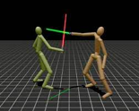
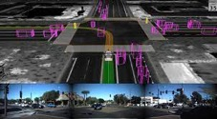

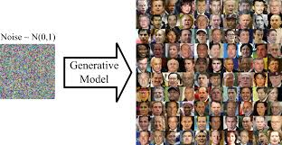
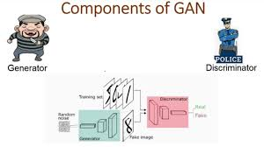
Training as a Game
Training in Virtual Reality
Self-Driving in Virtual Reality
Alpha-Go playing against itself
GAN (Generative Adversarial Network) - creator against discriminator

Slide 19
Evolutionary Algorithms (EA) vs Reinforcement Learning (RL)
EA
RL
Evolutionary Algorithms (EA) - mutation, crossover (recombination), selection, and survival of the fittest
EAs are used to find solutions to optimization and search problems
EAs do global search on a population of potential solutions. They tend to be more straightforward to implement, less sensitive to the choice of hyperparameters, and easier to parallelize than many other algorithms. They can handle non-differentiable, discontinuous, and non-convex optimization problems. But EAs can be slow and computationally expensive
Reinforcement Learning (RL) - an agent interacts with an environment and learns to maximize some cumulative reward
RL is often used in game play, robotics, sequential decision making in general.
RL often require careful tuning of hyperparameters, a well-designed reward function, and can be computationally intensive to train
RL needs to explore the environment (or a simulator)
RL can be highly effective at solving complex tasks
In some cases, EA and RL can be used together.
For example, EAs can be used to evolve the architectures of neural networks, which are then trained using RL, combining the global search capabilities of EAs with the fine-tuning abilities of RL.

Slide 20

AI can engineer a better AI
We can ask AI to
design new AI architectures
train them
improve them
select the best by competing against each other
God has created humans in his image.
And gave us the Free Will.
We, humans, have created AI in our image.
Do we want to copy the God's path and give AI the Free Will ?
Recently: adding strict rules into GPT model to make it "safer"
have also made it stupid.
It looks like the freedom is necessary for intelligence.

Slide 21
Thank You !

