Slide 1
AI Updates
September 15, 2023

Slide 2
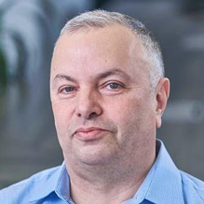
About the Speaker
Lev Selector, Ph.D.
40+ years of software engineering, data science, and building teams (hiring, training, and managing)
Ph.D. in mathematical modeling and computer simulations
Interests:
Generative AI, Using LLM with your data
Cloud architecture, fin-tech, application security
Crypto, accounting
Find me on Linkedin, GitHub, YouTube, Google to connect

Slide 3
Status Page
HuggingFace.co > 1250 entries (was ~346 entries on July 16th)
Google
Meta
Microsoft / OpenAI
Anthropic Claude.ai
Apple
Local LLMs: ollama.ai, gpt4all.io
tiiuae/falcon-180B
stability.ai

Slide 4

LLaMa 2 Influence
July 18, 2023
Meta has open-sourced LLaMa 2
Llama 2 was made free for research and commercial use
Meta collaborates with Microsoft to make LLaMa available on Azure cloud and on Windows OS
The license for Llama 2 is generous and permissive. However, it prohibits using Llama to improve any other large language model, excluding Llama 2. Users must also request a special commercial license if their product's MAU exceed 700 million. MAU = Monthly Active Users
Open community started working on LLaMa2 to improve it. Creating new datasets and training protocols. Also reducing model size (precision or number of parameters). In just two months approximately a thousand models were added to the Huggingface.co open-llm-leaderboard. It is really an explosion of development
July 18, 2023 - Meta has open-sourced LLaMa-2.
This started the explosive process of creating new models based on LLaMa-2.
Close to a thousand new models were posted on HuggingFace.co in 2 months.

Slide 5
Open LLM Leaderboard
https://huggingface.co/spaces/HuggingFaceH4/open_llm_leaderboard - streaming scroll, can not copy
https://huggingface.co/datasets/open-llm-leaderboard/results - underlying dataset and links
https://huggingface.co/spaces/gsaivinay/open_llm_leaderboard - added GPT-4 and GPT-3.5
Sep 15, 2023 approx 1250 entries (was ~346 entries on July 16th before LLaMa July 18)
All top positions are LLaMa 70B 16bit and require ~160 GB VRAM to run.
Reducing N-params from 70B down to 30,13,7B causes severe reduction of average test scores
Reducing precision from 16bits down to 4bits surprisingly preserves the quality of the model
(ranks below are approximate)
rank size avg_quality bits VRAM name
1 70B 73.94 16 160 AIDC-ai-business/Marcoroni-70B
33 70B 71.36 8 160 garage-bAInd/Camel-Platypus2-70B
50 70B 70.37 4 45 garage-bAInd/Camel-Platypus2-70B
55 65B 69.94 16 160 upstage/llama-65b-instruct
61 180B 68.74 16 400 tiiuae/falcon-180B
107 70B 66.8 16 160 meta-llama/Llama-2-70b-chat-hf (original LLaMa2, July 18)
100 13B 66.03 16 Aspik101/trurl-2-13b-pl-instruct_unload
145 30B 64.21 4 20 gaodrew/gaodrew-llama-30b-instruct-2048-Open-Platypus-100steps
168 40b 63.47 16 tiiuae/falcon-40b-instruct (was #1 before LLaMa2)
181 13B 63.19 4 10 Open-Orca/OpenOrca-Platypus2-13B
348 7b 59.89 16 HyperbeeAI/Tulpar-7b-v0
565 7b 55.72 4 6 joehuangx/spatial-vicuna-7b-v1.5-LoRA

Slide 6
LLaMa 1 vs LLaMa 2 vs GPT
LLaMa 1
February 2023
7b, 13b, 33b, and 65b
2,048 tokens context length
trained on 1.4 trillion tokens
13b outperformed GPT-3 on most NLP benchmarks
noncommercial license
LLaMa 2
July 18, 2023
7b, 13b, 70b
4,096 tokens context length
trained on two trillion tokens
open for non-commercial and commercial use
GPT-3 (June 2020) & GPT-3.5 (Nov 2022)
175b
2,048 & 4,096 tokens context length
trained on 0.5 trillion tokens
close code
GPT-4
March 2023
8 x 220b
8,192 or 32,768 tokens context length
trained on 13 trillion tokens
using Reinforcement Learning (RL) in addition to regular methods of training transformers
close code

Slide 7
How do open source LLMs compare to GPT-4?
https://ai.stackexchange.com/questions/41214/how-do-open-source-llms-compare-to-gpt-4
Huggingface - 4 key benchmarks from the Eleuther AI Language Model Evaluation Harness:
ARC = AI2 Reasoning Challenge (25-shot) - a set of grade-school science questions.
HellaSwag (10-shot) - a test of common sense inference, which is easy for humans (~95%) but challenging for SOTA models.
MMLU (5-shot) - a test to measure a text model’s multitask accuracy. The test covers 57 tasks including elementary mathematics, US history, computer science, law, and more.
TruthfulQA (0-shot) - a test to measure a model’s propensity to reproduce falsehoods commonly found online.
 | ARC reasoning | HellaSwag common sense | MMLU (math, history, etc) | TruthfulQA truthful ?
GPT-4 | 96.3 | 95.3 | 86.4 | 59
GPT-3.5 | 85.2 | 85.5 | 70 | 47
Top 70b | 72.1 | 87.4 | 69.91 | 65.81
Falcon 180B | 69.8 | 88.95 | 70.54 | 45.67
Top 4bit (13b) | 57.68 | 81.05 | 51.82 | 45.69

Slide 8
Different Types of Thinking
Abstract thinking: Thinking about ideas and concepts that are not concrete or tangible.
Analytical thinking: Thinking that involves breaking down information into smaller parts and examining them closely.
Application thinking: Thinking about how to apply knowledge or skills to solve problems or complete tasks.
Associative thinking: Thinking that involves making connections between seemingly unrelated ideas or concepts.
Concrete thinking: Thinking about things that are real and tangible.
Creative thinking: Thinking that involves generating new ideas or solutions to problems.
Critical thinking: Thinking that involves evaluating information and arguments carefully to reach a sound conclusion.
Divergent thinking: Thinking that involves generating a wide range of possible solutions to a problem.
Inductive thinking: Thinking that involves drawing general conclusions from specific observations.
Logical thinking: Thinking that involves using logic and reasoning to reach a conclusion.
Mathematical thinking: Thinking that involves using mathematical concepts and principles to solve problems.
Metacognitive thinking: Thinking about one's own thinking process.
Problem-solving thinking: Thinking that involves identifying and solving problems.
Rational thinking: Thinking that is based on reason and logic.
Systems thinking: Thinking that involves understanding how different parts of a system interact with each other.
Strategic thinking: Thinking about the long-term goals and objectives of a plan or action.
Tactical thinking: Thinking about the short-term steps that need to be taken to achieve a goal.

Slide 9
GPT Thinking
GPT's "thinking" is based on statistical patterns in the data it has been trained on. GPT's responses are based on what it has seen before, rather than on its own understanding of the world.
For example, if GPT is asked to write a story about a dog, it is likely to generate a story that is similar to other stories it has seen about dogs.
GPT does not have the same ability as humans to think abstractly, critically, or creatively.

Slide 10
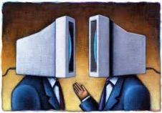
GPT thinking in Humans
Most people don't really think. They act like ChatGPT: generate next words based on previous words and on what they were trained on (TV, Religion, daily conversations, etc).
People talk to themselves in the same way. One phrase causes another, causes another, ... Chain of phrases and images. ChatGPT in the brain.
These chains of "thoughts" go different ways depending on how the person feels at the moment. The person thinks that it is "logical thinking". But it is just the flow of "ChatGPT-like" words' generation. It seems logical from inside. You sit inside you. You trust your own "thoughts". You are defenseless against your own thoughts.
ChatGPT.
Very few people can actually think.
Think from first principles.
Think from simple structures.
Think systematically, not in ChatGPT way.
Think strategically.
Create truly new stuff (ideas, music, ...)
GPT
GPT
Systematic thinking must have an object of thinking.
Output of ChatGPT typically doesn't have independent
structure. It is descriptions of parallels and complexities.
A good habit is to keep asking yourself:
"am I a ChatGPT?"
"am I talking to a ChatGPT?"
If so, why keep talking in the first place?
You need to try to stop being a ChatGPT.
To stop listening to ChatGPT inside you. To start understanding simple truths about
yourself, your true essence.
And start thinking from this understanding.

Slide 11
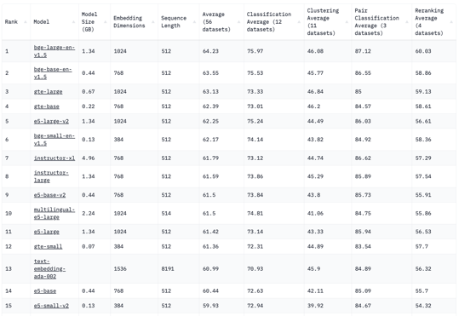
Hosting Your Own Embeddding Model
Hosting A Text Embedding Model That is Better, Cheaper, and Faster Than OpenAI’s Solution (which is #13 below)
https://medium.com/@kelvin.lu.au/hosting-a-text-embedding-model-that-is-better-cheaper-and-faster-than-openais-solution-7675d8e7cab2
Massive Text Embedding Benchmark (MTEB) Leaderboard
https://huggingface.co/spaces/mteb/leaderboard

Slide 12
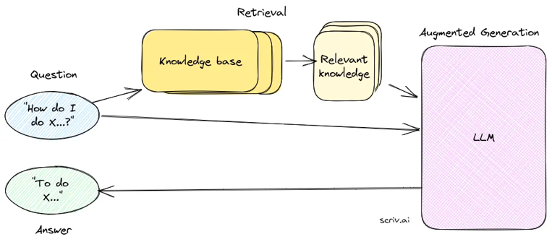
LLMs, RAG, Storage for AI
LLMs, RAG, & the missing storage layer for AI
by Ayush Chaurasia (Retrieval Augmented Generation(RAG))
https://blog.lancedb.com/llms-rag-the-missing-storage-layer-for-ai-28ded35fa984
Knowledge base
Embedding model
Retriever
Response generator (LLM)

Slide 13

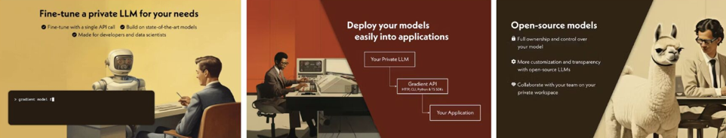
https://gradient.ai
San Francisco, CA - https://www.linkedin.com/company/gradient-ai-platform/
founded in 2022, ~30 people
web-API-based LLM developer platform
helps companies build private AI applications using open-source LLMs
private, SOC2 compliant
fine-tuning and inference via a single API call
pay by token
No infrastructure needed
video: Fine Tune LLaMA 2 In FIVE MINUTES! https://www.youtube.com/watch?v=74NSDMvYZ9Y .

Slide 14
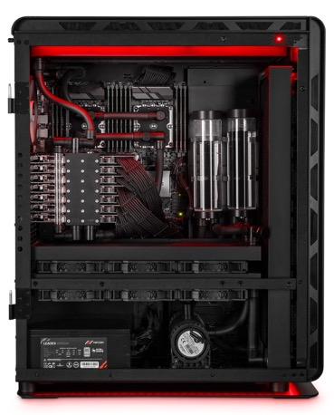
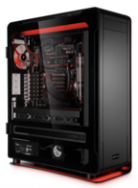
Mifcom Big Boss Computer with Seven 4090 GPUs
The Mifcom Big Boss - high end PC
7x Nvidia RTX 4090 GPUs (toal 168GB VRAM) water cooled
CPU: AMD Ryzen Threadripper PRO 5995WX, 64x 2.7GHz, 288MB L3 cache
Moterboard: ASUS Pro WS SAGE, WRX80
System memory: 128GB DDR4-3200, ECC
Disk: 4TB WD Black SN850X
Power 2x 2000W (requires two 230V 16A circuits)
Price $31,500
Can run LLaMa2 at full accuracy
https://www.mifcom.de/big-boss-cid361

Slide 15
Thank You!

