Slide 1
Hugging Face
September 15, 2023

Slide 2
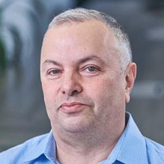
About the Speaker
Lev Selector, Ph.D.
40+ years of software engineering, data science, and building teams (hiring, training, and managing)
Ph.D. in mathematical modeling and computer simulations
Interests:
Generative AI, Using LLM with your data
Cloud architecture, fin-tech, application security
Crypto, accounting
Find me on Linkedin, GitHub, YouTube, Google to connect

Slide 3





Hugging Face
https://huggingface.co
Hugging Face is a platform for machine learning (ML) technologies.
It provides tools for building, training, and deploying ML models using open source code.
Hugging Face was launched in 2016 and is based in New York City. 20 Jay St Ste 620, Brooklyn, New York, 11201
Original product - a chatbot app for teenagers. It was open-sourced. Then the company pivoted to being a platform for ML.
Hugging Face raised $40M in Series B in 2021
In 2022 it was valued at $2Bln - and received $100M in Series C funding
In August 2023 raised $235M at $4.5Bln valuation
Key people: Clément Delangue (CEO), Julien Chaumond (CTO), Thomas Wolf (CSO)
Hugging Face is a community and data science platform for AI experts and enthusiasts.
It allows users to host their own AI models, train them, and collaborate with their team.
Hugging Face also provides libraries and tools for natural language processing (NLP) tasks.
Hugging Face's goal is to democratize machine learning. It makes money by charging for features such as access to computing power and higher levels of customer support. Hugging Face currently has 10,000 paying customers.
https://en.wikipedia.org/wiki/Hugging_Face
Main products - transformers, datasets, spaces, LLMs
Revenue $15M in 2022, estimated $30-50M in 2023
160 employees (2023) (per employee: $0.3M revenue, $30M value)

Slide 4
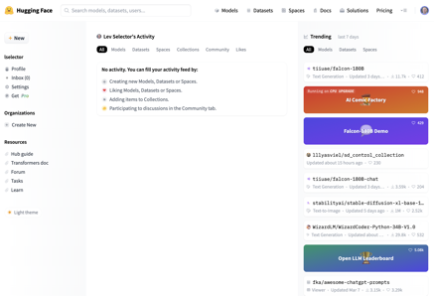
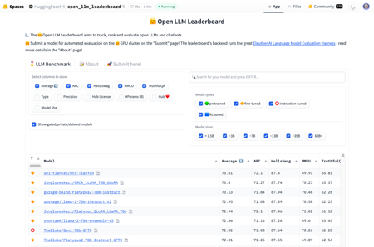
Hugging Face
Home Page
Open LLM Leaderboard

Slide 5
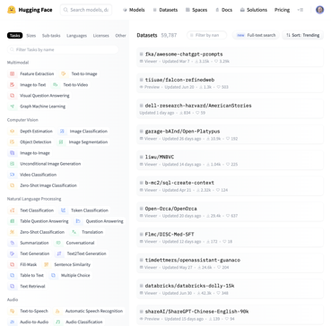
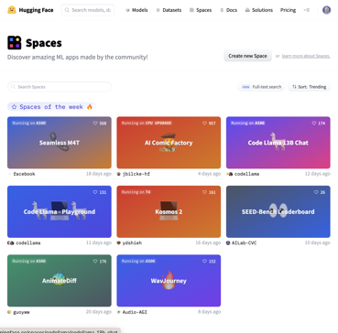
https://huggingface.co/datasets
https://huggingface.co/spaces
Datasets
Spaces

Slide 6
Open LLM Leaderboard
https://huggingface.co/spaces/HuggingFaceH4/open_llm_leaderboard - streaming scroll, can not copy
https://huggingface.co/datasets/open-llm-leaderboard/results - underlying dataset and links
https://huggingface.co/spaces/gsaivinay/open_llm_leaderboard - added GPT-4 and GPT-3.5
https://huggingface.co/spaces/Weyaxi/open_llm_leaderboard
Sep 9, 2023 - 1211 entries (was ~346 entries on July 16th before LLaMa July 18)
All top positions are LLaMa 70B 16bit and require ~160 GB VRAM to run.
Reducing N-params from 70B down to 30,13,7B causes severe reduction of average test scores
Reducing precision from 16bits down to 4bits surprisingly preserves the quality of the model
rank size avg_quality bits VRAM name
1 70B 73.81 16 160 uni-tianyan/Uni-TianYan
33 70B 71.36 8 160 garage-bAInd/Camel-Platypus2-70B
50 70B 70.37 4 45 garage-bAInd/Camel-Platypus2-70B
55 65B 69.94 16 160 upstage/llama-65b-instruct
61 180B 68.74 16 400 tiiuae/falcon-180B
107 70B 66.8 16 160 meta-llama/Llama-2-70b-chat-hf (original LLaMa2, July 18)
100 13B 66.03 16 Aspik101/trurl-2-13b-pl-instruct_unload
145 30B 64.21 4 20 gaodrew/gaodrew-llama-30b-instruct-2048-Open-Platypus-100steps
168 40b 63.47 16 tiiuae/falcon-40b-instruct (was #1 before LLaMa2)
181 13B 63.19 4 10 Open-Orca/OpenOrca-Platypus2-13B
348 7b 59.89 16 HyperbeeAI/Tulpar-7b-v0
565 7b 55.72 4 6 joehuangx/spatial-vicuna-7b-v1.5-LoRA

Slide 7
Getting a Dataset via git clone ...
Go to the Hugging Face Hub and navigate to the dataset you want to clone. For example, here is the page for dataset "open-llm-leaderboard/results" : https://huggingface.co/datasets/open-llm-leaderboard/results
Find clone instructions. May be under "Code" or under some 3-dot menu.
Open terminal on your computer - and run the commands, for example: git lfs install # LFS = Large File Sytem git clone https://huggingface.co/datasets/open-llm-leaderboard/results
Running the command above creates a "results" directory with many subdirectories and files
If you are set with an SHH connection, then the git url will look differently, for example: git clone git@huggingface.co:datasets/glue.git
Git LFS (Large File System) is a command that stores large files in a different repository than your project's. It uses pointers instead of the actual files to link your repository with a remote service like GitHub. This allows you to save space by storing binary files in a different location https://www.mankier.com/1/git-lfs-install

Slide 8
Hugging Face Basics
https://huggingface.co/docs
https://huggingface.co/learn/nlp-course
https://www.youtube.com/watch?v=QEaBAZQCtwE
https://huggingface.co/datasets
https://huggingface.co/docs/datasets/index
https://huggingface.co/spaces
Transformers Library (pip install transformers)
Pipeline
Model / Tokenizer
PyTorch / TensoFlow
Save / Load
Model Hub
Finetuning
from transformers import pipeline
classifier = pipeline("sentiment-analysis")
res = classifier("some text here")
print(res)
generator = pipeline("text-generation",
model="distilgpt2")
res = generator(
"In this course, we will teach you how to",
max_length=30, num_return_sequences=2)
print(res)

Slide 9
Hugging Face Python Modules
https://huggingface.co/docs
pip install transformers - pre-trained models (natural language inference, question answering, summarization) https://huggingface.co/docs/transformers
pip install datasets - datasets including text, code, and speech https://huggingface.co/docs/datasets
pip install evaluate - tools to evaluate models https://huggingface.co/docs/evaluate
pip install huggingface_hub - interact with the Hugging Face Hub, a ML platform https://huggingface.co/docs/huggingface_hub
pip install tokenizers - tokenization schemes for NLP tasks https://huggingface.co/docs/tokenizers
import transformers summarizer = transformers.pipeline('summarization') summary = summarizer(text, max_length=100, language='en') # https://huggingface.co/docs/transformers/tasks/summarization
from transformers import pipeline translator = pipeline("translation", model="Helsinki-NLP/opus-mt-en-fr") print(translator("I love you")) # https://huggingface.co/learn/nlp-course/chapter7/4?fw=tf
text-generation (poem, code, email) https://huggingface.co/docs/transformers/main_classes/text_generation
automatic speech recognition https://huggingface.co/docs/transformers/tasks/asr

Slide 10
Thank You!

