Slide 1

Microsoft Exposes 38TB in AI Data Leak (September 19, 2023)
https://www.therundown.ai/p/microsoft-ai-data-leak
Key points:
The token granted full access to an Azure storage account, not just the intended open AI datasets.
Wiz Research discovered computer backups in the data with passwords, keys, and 30,000+ internal Teams messages.
Microsoft published a blog reassuring that no customer data was exposed, with no action needed from customers.
Why it matters:
Reminder - tighten your AI guardrails
More data - more security needed (AI - lots of data)

Slide 2
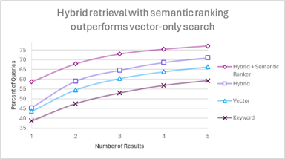
Local Private Data + Embedding + VectorDB + LLM
LLaMa 2 was open-sourced on July 18th, 2023
In 2 months ~1,000 variations of LLaMa were created at HuggingFace.co - improving the model, making it smaller.
You can now have performance at ChatGPT-3.5 level with local open-source model running on relatively inexpensive hardware
Average ARC HellaSwag MMLU TruthfulQA
reason common sense sciences truthful?
GPT-4 84.25 96.3 95.3 86.4 59
GPT-3.5 71.93 85.2 85.5 70 47
LLaMa+ 70b 74.05 71.76 88.2 71 65.3
LLaMa+ 4bit 59.06 57.7 81.1 51.8 45.7
(13b)
hybrid retrieval + semantic ranking perform better than simple Vector search
https://techcommunity.microsoft.com/t5/azure-ai-services-blog/azure-cognitive-search-outperforming-vector-search-with-hybrid/ba-p/3929167
Local Components:
File storage
VectorDB
Embedding Model
LLM
LangChain framework
Front-end application
RAG = Retrieval Augmented Generation
System generates response based in the prompt with user query augmented with text retrieved from local vectorDB.
The quality of RAG depends mostly on
quality of the embedding model (vectors)
quality of similarity search (in VectorDB)

