Slide 1
AI Updates
September 22, 2023

Slide 2
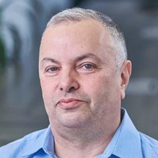

About the Speaker
Lev Selector, Ph.D.
40+ years of software engineering, data science, and building teams (hiring, training, and managing)
Ph.D. in mathematical modeling and computer simulations
Interests:
Generative AI, Using LLM with your data
Local AI for Local Private Data
Cloud architecture, fin-tech, application security
Find/connect: Linkedin, GitHub, YouTube, Google
https://eais.ai

Slide 3

Status Page
HuggingFace.co > 1379 entries (was ~346 entries on July 16th)
Google Genesis - drafting news articles (for journalists) Google Gemini - multimodal generative AI (answer to GPT-4) partially out legal safety (not using textbooks, ...) Bard updates - extensions for apps - Maps, YouTube, Flights, Hotels, Docs, Drive, Gmail, FactCheck using Google Search. You can ask to summarize emails to/from particular recipient, ...
Meta 3 to be released in 2024, using their own infrastructure
Microsoft Photos AI (editing, photo search by content) MSFT Paint with AI (blurring background, etc.)
OpenAI - ChatGPT fine-tuning, new data cutoff Sept 2022, gpt-3.5-turbo-instruct model (completion, instruction, chess) DALLE-E 3 is coming to ChatGPT , Cobi (new chat model), vision / image understanding
Anthropic Claude.ai
Apple
Local LLMs: ollama.ai, gpt4all.io
tiiuae/falcon-180B
stability.ai (image, audio, language) - text2image - install locally - https://www.youtube.com/watch?v=aiZWEbUjAGw - stable audio - https://stability.ai/stable-audio - stableLM (LLM) - https://github.com/stability-AI/stableLM/
MEDUSA - fast multihead LLM decoding (2-7 times faster) - 4 heads with tree attention:
https://arxiv.org/abs/2002.08046
https://together.ai/blog/medusa
https://github.com/FasterDecoding/Medusa
The Rundown AI - Daily Updates
https://www.therundown.ai
Complete Beginners Guide to Hugging Face LLM Tools
https://www.unite.ai/complete-beginners-guide-to-hugging-face-llm-tools/
ElevenLabs text2speech, create audiobooks, voice cloning - https://elevenlabs.io

Slide 4
Open LLM Leaderboard
https://huggingface.co/spaces/HuggingFaceH4/open_llm_leaderboard
https://huggingface.co/datasets/open-llm-leaderboard/results - underlying dataset and links
https://huggingface.co/spaces/gsaivinay/open_llm_leaderboard - added GPT-4 and GPT-3.5
Sep 22, 2023 1379 entries (was ~346 entries on July 16th before LLaMa July 18)
GPT-4 (best) and GPT-3.5 (31st place) provided for comparison
All top positions (except GPT) are LLaMa 70B 16bit and require ~160 GB VRAM to run.
Reducing N-params from 70B down to 30,13,7B causes severe reduction of average test scores
Reducing precision from 16bits down to 4bits surprisingly preserves the quality of the model
rank size avg_quality bits VRAM name
0 1,760B 84.3 16 4,000 GPT-4
1 70B 74.05 16 160 ICBU-NPU/FashionGPT-70B-V1.1
...
31 175B 71.9 16 400 GPT-3.5
35 70B 71.36 8 160 garage-bAInd/Camel-Platypus2-70B
? 70B 70.37 4 45 garage-bAInd/Camel-Platypus2-70B
73 65B 69.94 16 160 upstage/llama-65b-instruct
90 180B 68.74 16 400 tiiuae/falcon-180B
118 70B 66.8 16 160 meta-llama/Llama-2-70b-chat-hf (original LLaMa2, July 18)
13B 66.03 16 Aspik101/trurl-2-13b-pl-instruct_unload
30B 64.21 4 20 gaodrew/gaodrew-llama-30b-instruct-2048-Open-Platypus-100steps
40b 63.47 16 tiiuae/falcon-40b-instruct (was #1 before LLaMa2)
13B 63.19 4 10 Open-Orca/OpenOrca-Platypus2-13B
7b 59.89 16 HyperbeeAI/Tulpar-7b-v0
7b 55.72 4 6 joehuangx/spatial-vicuna-7b-v1.5-LoRA

Slide 5
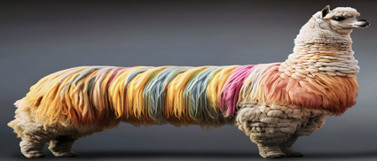
LLaMa 2 with 32K tokens context
Original LLaMa 2 has context length 4,096 tokens (~6 pages)
It is possible to configure the model for 32K tokens (~50 pages)
https://medium.com/@sushilkumar467/huge-llama-2-with-32k-context-length-9f7e11853d03
Code Llama can handle sequences of up to 100k tokens
https://www.linkedin.com/pulse/code-llama-its-implications-software-development-industry-shaun-tyler/
Run models with larger context length:
https://www.youtube.com/watch?v=yW90f1rfark
https://www.youtube.com/watch?v=ELax81LjFhU
https://github.com/TrelisResearch/code-llama-32k
https://github.com/togethercomputer/Llama-2-7B-32K-Instruct
https://together.ai/blog/llama-2-7b-32k-instruct
https://huggingface.co/TheBloke/Llama-2-7B-32K-Instruct-GGUF
token ~ 4 chars
word ~ 5 chars
page ~ 500 words (single spaced) = 2.5K chars
context pages Models
--------------------------------------------
4K 6.4 LLaMa 2, ChatGPT-3.5
8K 12.8 ChatGPT-4 (Plus)
16K 25.6
32K 50.1 ChatGpt-4 (Enterprise)
100K 150 Claude 2, Code LLaMa

Slide 6
ChatGPT Pricing
https://www.pcguide.com/apps/chat-gpt-price/
ChatGPT Free - uses ChatGPT-3.5
ChatGPT Plus - $20/month - better availability, ChatGPT-4 model, plugins Microsoft BingChat uses ChatGPT-4, free
ChatGPT Enterprise - price vary based on your number of employees. Sizes: 1-50, 51-150, 151-1,000, 1,001-10,000, 10,000+
Azure OpenAI Pricing
Azure has different models.
I spoke with their sales support.
Looks like OpenAI Enterprise is simply offering the chat based on GPT-4 32K, which is indeed twice faster and much better than 8K version. But it is also twice more expensive. They probably provide same tears as OpenAI based on the number of users. But they don't openly provide this pricing. Most probably it is the same as OpenAI.
https://azure.microsoft.com/en-us/pricing/details/cognitive-services/openai-service/
Models | Context | Prompt (Per 1,000 tokens) | Completion (Per 1,000 tokens)
GPT-3.5-Turbo | 4K | $0.00 | $0.00
GPT-3.5-Turbo | 16K | $0.00 | $0.00
GPT-4 | 8K | $0.03 | $0.06
GPT-4 | 32K | $0.06 | $0.12

Slide 7

Microsoft Exposes 38TB in AI Data Leak (September 19, 2023)
https://www.therundown.ai/p/microsoft-ai-data-leak
Key points:
The token granted full access to an Azure storage account, not just the intended open AI datasets.
Wiz Research discovered computer backups in the data with passwords, keys, and 30,000+ internal Teams messages.
Microsoft published a blog reassuring that no customer data was exposed, with no action needed from customers.
Why it matters:
Reminder - tighten your AI guardrails
More data - more security needed (AI - lots of data)

Slide 8
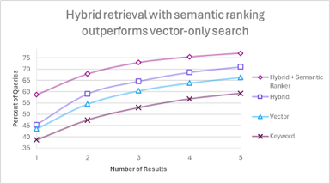
Local Private Data + Embedding + VectorDB + LLM
LLaMa 2 was open-sourced on July 18th, 2023
In 2 months ~1,000 variations of LLaMa were created at HuggingFace.co - improving the model, making it smaller.
You can now have performance at ChatGPT-3.5 level with local open-source model running on relatively inexpensive hardware
Average ARC HellaSwag MMLU TruthfulQA
reason common sense sciences truthful?
GPT-4 84.25 96.3 95.3 86.4 59
GPT-3.5 71.93 85.2 85.5 70 47
LLaMa+ 70b 74.05 71.76 88.2 71 65.3
LLaMa+ 4bit 59.06 57.7 81.1 51.8 45.7
(13b)
hybrid retrieval + semantic ranking perform better than simple Vector search
https://techcommunity.microsoft.com/t5/azure-ai-services-blog/azure-cognitive-search-outperforming-vector-search-with-hybrid/ba-p/3929167
Local Components:
File storage
VectorDB
Embedding Model
LLM
LangChain framework
Front-end application
RAG = Retrieval Augmented Generation
System generates response based in the prompt with user query augmented with text retrieved from local vectorDB.
The quality of RAG depends mostly on
quality of the embedding model (vectors)
quality of similarity search (in VectorDB)

Slide 9
RAG - Embedding Model and Vector Search
Augmented Query
Query
Response
Retriever
LLM
VectorDB
Example searching within a Bible text:
Prompt: "who divided the waters of red sea"
Good Embedding + Search:
"Moses, following God’s command, stretched out his hand over the sea with his staff, and God caused the sea to be divided"
Bad Embedding + Search:
"And king Solomon made a navy of ships in Eziongeber, which [is] beside Eloth, on the shore of the Red sea, in the land of Edom."
Embedding Model - How Text Converted to Vectors
Vector Search - SQL, tags, cosine similarity, etc.

Slide 10
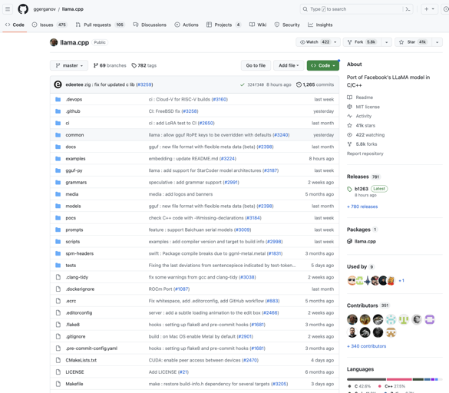
llama.cpp
https://github.com/ggerganov/llama.cpp
run LLaMA 4bit models on MacBook or Linux
Open-Source on GitHub since March 10, 2023
41K stars
351 contributors

Slide 11
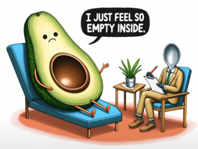
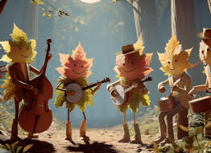
DALLE-E 3 coming to ChatGPT Plus
OpenAI DALLE-E 3 coming to ChatGPT https://www.nytimes.com/2023/09/20/technology/chatgpt-dalle3-images-openai.html
DALLE 3

Slide 12
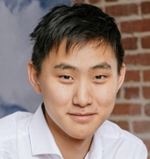


scale ai - data labeling
https://scale.com
7.3 Bln valuation
founded in 2016 by Alexandr Wang & Lucy Guo
600 employees, $603M raised
Alexandr Wang & Lucy Guo

Slide 13

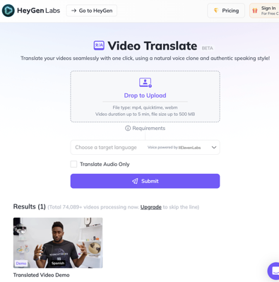
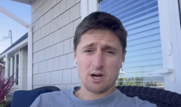
HeyGen Video Translator
HeyGen - translates videos (changing lips movements) https://labs.heygen.com/guest/video-translate
Released in September
https://www.youtube.com/watch?v=gzvxgMYO4vM - demo
https://www.youtube.com/watch?v=AACmqiiJJS4 - demo
wait list to use it

Slide 14
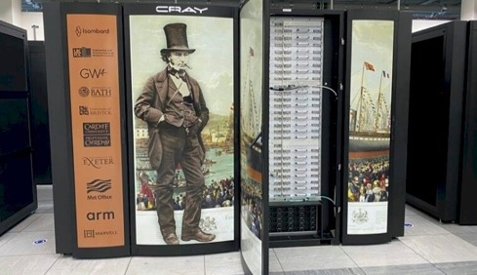
Isambard 3 Supercomputer in UK
UK, The University of Bristol will host Isambard-AI - the Isambard 3 supercomputer
It will be an "open supercomputer" to be used for medical and scientific research projects.
It is named after 19th century British engineer Isambard Kingdom Brunel
UK government provides $1.1 Bln to build it.
Isambard 3 will feature 384 Arm-based NVIDIA Grace CPU Superchips and same number of H100 GPUs https://www.nextplatform.com/2023/05/25/isambard-3-to-put-nvidias-grace-cpu-through-the-hpc-paces/

Slide 15



Install SDXL Locally on Windows
Easiest Install Ever!
AI Art Generator on Your PC!
MIDJOURNEY QUALITY
How to Install SDXL Locally on Windows
https://www.youtube.com/watch?v=aiZWEbUjAGw
https://github.com/lllyasviel/Fooocus
https://weirdwonderfulai.art/resources/installing-sdxl-1-0-on-local-computer/
https://stable-diffusion-art.com/sdxl-model/
SDXL = Stable Diffusion XL, text to image model
developed by Stability.AI
x3 times larger than previous versions of Stable Diffusion
create realistic faces, legible text, and better image composition
high-resolution AI image synthesis (1024 x 1024)
local machine execution

Slide 16
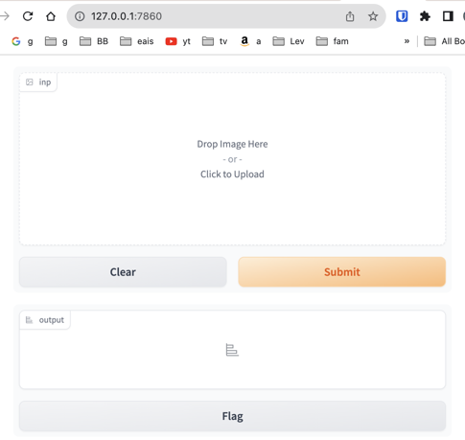
gradio-client
https://www.gradio.app
https://www.gradio.app/docs
Gradio is an open-source Python package
Quickly and easily build easy-to-use, customizable UI
For any ML, or API
Very concise (few lines of code)
Can use from Jupyter notebook
Share it as a link
import gradio as gr
def image_classifier(inp):
return {'cat': 0.3, 'dog': 0.7}
demo = gr.Interface(fn=image_classifier,
inputs="image",
outputs="label")
demo.launch()

Slide 17
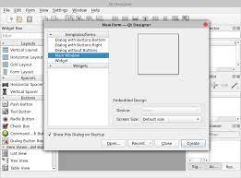
PyQt
https://en.wikipedia.org/wiki/PyQt
PyQt - uses cross-platform GUI toolkit Qt (since 1998)
PyQt implements ~440 classes and over 6,000 functions
# pip install PyQt5
import sys
from PyQt5.QtWidgets import ( QApplication, QMainWindow,
QAction, QTextEdit, QVBoxLayout, QWidget)
from PyQt5.QtGui import QIcon
...
Typical workflow:
Use Qt Designer GUI to design the UI
Save as mainwindow.ui
Convert UI to Python Code: pyuic5 -x mainwindow.ui -o view.py
Split code in modules (MVC):
model.py - business logic
controller.py - connects model and view, user I/O, updates
main.py - brings everything together
QtCore − Core non-GUI classes used by other modules
QtGui − Graphical user interface components
QtMultimedia − Classes for low-level multimedia programming
QtNetwork − Classes for network programming
QtOpenGL − OpenGL support classes
QtScript − Classes for evaluating Qt Scripts
QtSql − Classes for database integration using SQL
QtSvg − Classes for displaying the contents of SVG files
QtWebKit − Classes for rendering and editing HTML
QtXml − Classes for handling XML
QtWidgets − Classes for creating classic desktop-style UIs
QtDesigner − Classes for extending Qt Designer
Qt Designer GUI

Slide 18
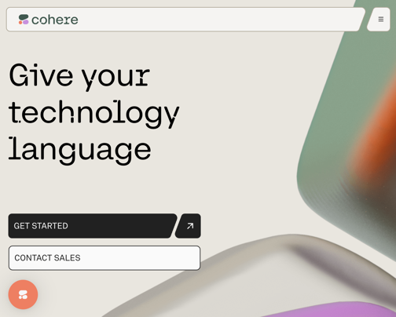
Cohere
https://cohere.com
https://docs.cohere.com/docs https://github.com/cohere-ai
.. Cohere is a Canadian startup (2019, Toronto)
.. founders: Aidan Gomez, Ivan Zhang, and Nick Frosst
.. provides NLP models for human-machine interactions
.. offices: Toronto, Palo Alto, London
.. interactive chat features
.. generate text for product descriptions
.. generate text for blog posts and articles
.. capture the meaning of text for search, content moderation, and intent recognition

Slide 19
Thank You!

