Slide 1
Enhancing Text Search with Advanced Embedding Technologies
An exploration into vector databases, embeddings, and Local Language Models
Notes:
Hello everyone I’m Elias. Today I will talk about the integration of advanced embedding technologies with traditional text search mechanisms. As everyone knows we live in a world inundated with data, so the necessity for precise, efficient, private and meaningful text retrieval has never been more critical. So we will talk about the complexities of vector databases and embeddings models.

Slide 2



About the speaker
Special thanks to:
AI Study Group
Shreya Bastikar
Dr. Lev Selector
Elias Tsoukatos
https://aimonkey.io/
https://easyai.pro/en
https://github.com/eliastsoukatos
https://www.linkedin.com/company/aimonkey/
https://www.linkedin.com/in/elias-tsoukatos-896a6082/

Slide 3
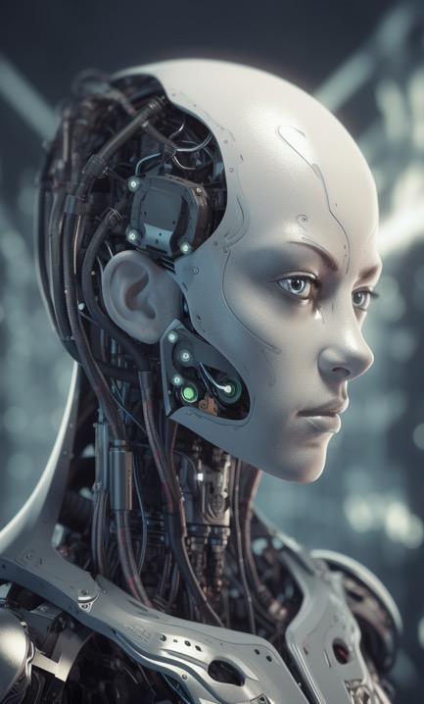
Core Components
Vector Databases: Specialized databases designed to efficiently handle multi-dimensional vector data, allowing for quick and accurate similarity search.
Embeddings: High-dimensional vectors that capture the semantic meaning of text, enabling content-based search.
Notes:
Vector Databases:
Vector databases are a cornerstone in modern search and recommendation systems, handling the complexities of multi-dimensional data with finesse and precision. These databases stand out for their ability to manage and query vector data, something traditional relational databases aren't tailored for.
How do they achieve this heightened level of efficiency and accuracy? One word, high-dimensional data.
A Simple Analogy:
Imagine a vast, open field where every point on the field represents a piece of data. Now, in a simple world, we only need two things to locate that point - maybe how far along and how far up it is - like coordinates on a map. Easy, right? But hold on! What if our data isn’t just a point on a flat field? What if it’s floating above the field or buried beneath it? Suddenly, we need more than just those two measurements to find it. We need to know its height or depth too. And that, is where we start stepping into the realm of higher dimensions.
In the world of vector databases, we’re often dealing with data that has many attributes, characteristics, or features. It’s like trying to describe a sophisticated piece of art - it’s not just about the colors or the size; it’s also about the texture, the emotions it evokes, the era it belongs to, and so much more. Each of these aspects adds another dimension to our data.
Embeddings:
On the other hand, embeddings are the soul of the content residing in these databases. Embeddings play the role of converting text into numerical forms - vectors, to be precise. These are not just arrays of numbers but are impregnated with the rich semantic essence of the original text.
Every word, phrase, and sentence, when transformed into an embedding, carries within it the contextual meaning, the subtle nuances, and the intricate relationships that exist within the text. These embeddings, high-dimensional and complex, are what make content-based search not just a technical process but an art form. They enable the database to understand the 'meaning' behind the queries, ensuring that the results aren't just matching keywords but are contextually and semantically aligned with the user's intent.

Slide 4
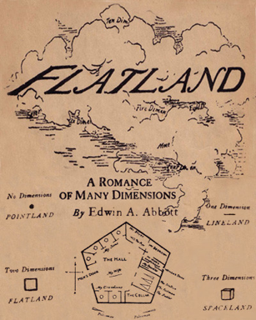
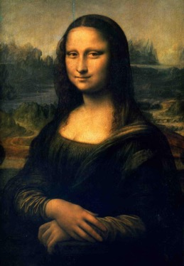
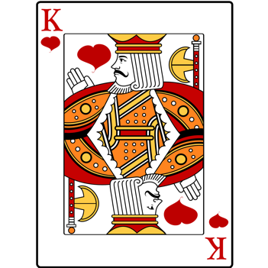
Notes:
The King of Hearts exists solely in a two-dimensional world, his movements are limited to left, right, up, and down. There's no concept of depth, no "through" or "over"; he’s like a character in a drawing, forever bound to the surface of the paper. When he encounters an obstacle, there's no going around it in the way we would in our three-dimensional world; he must navigate within the limits of his two-dimensional existence, seeking paths that exist solely in the plane of his card. Every shape, every entity he interacts with, is as flat and two-dimensional as he is. He lives in Flatland.
Flatland: A Romance of Many Dimensions is a satirical novella by the English schoolmaster Edwin Abbott Abbott, first published in 1884 by Seeley & Co. of London.
The story describes a two-dimensional world inhabited by geometric figures; women are line segments, while men are polygons with various numbers of sides. The narrator is a square
The Mona Lisa
The Mona Lisa's mysterious smile and deep feelings can be compared to complex data. Each brush stroke and color change is like a different piece of information, capturing unique parts of her expression. Think of her smile, the way her lips curve, her eye twinkle, and the gentle colors that show her emotions as different points on a map. When all these points combine, they give a full picture, allowing for a closer look and better understanding. This is similar to how in technology, complex data with many parts is broken down to study and understand it better.

Slide 5
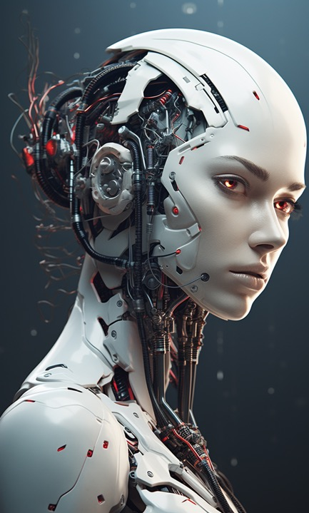
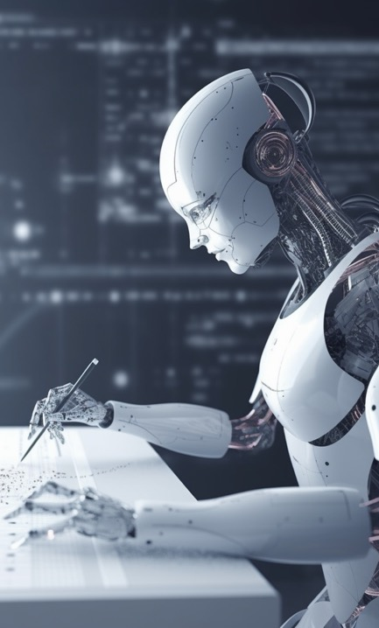
Embedding Creation Process
Sentence Transformers: Utilize models like BERT to convert text into high-dimensional vectors.
Process: Texts are tokenized and embeddings are generated, capturing the semantic essence of the content.
Notes:
Sentence Transformers are tools that transform text into numerical vectors. These vectors capture the essence of the words, phrases, and overall context found within the text, making it understandable and processable by computers. Models like BERT are trained on vast amounts of text, learning to understand the intricate relationships between words and the subtle nuances of meaning that make language rich and expressive.
The transformation from text to vector starts with tokenization. In this step, sentences are broken down into smaller pieces called tokens. These tokens, representing words or subwords, are then fed into the sentence transformer. As they pass through various layers of the model, each token is translated into a numerical form, creating a vector that holds the token’s semantic value. Each layer of the model captures different aspects of the text, weaving the tokens’ individual meanings into a cohesive, multi-dimensional vector that reflects the text’s overall context.
Attention is all you need - Paper

Slide 6

Database Storage & Retrieval
Storage: Embeddings along with their metadata are stored in PostgreSQL, optimized with custom extensions for efficient vector handling.
Retrieval: Utilizes K-nearest neighbors (KNN) search for fast and accurate retrieval of the most semantically similar vectors.
Notes:
PostgreSQL is an advanced, enterprise-class open-source relational database. It supports both SQL (relational) and JSON (non-relational) querying, making it a versatile choice for a variety of applications.
Pgvector turns PostgreSQL into a powerful vector database, enabling efficient storage and rapid querying of high-dimensional vectors. It introduces new data types and indexing methods optimized for vector data, enhancing PostgreSQL’s performance in vector similarity searches. It leverages specific algorithms and data structures to facilitate the quick retrieval of similar vectors, an operation central to applications like content-based search, recommendations, and clustering.
With pgvector, PostgreSQL can perform k-NN (k-Nearest Neighbors) searches efficiently.
K-nearest neighbors:
The K-nearest neighbors (KNN) algorithm is like a virtual detective that’s super quick and efficient at finding things that are similar.
Each piece of data is like a point in space, and similar data points are close to each other. So, you have a specific data point, or query, and you want to find other points that are similar to it.
This algorithm quickly scans the data and identifies a predetermined number of points (‘K’ points) that are closest to your query. It’s not just about physical proximity but also about how similar the characteristics or features are, ensuring that these points are not just close but are also meaningful matches.

Slide 7
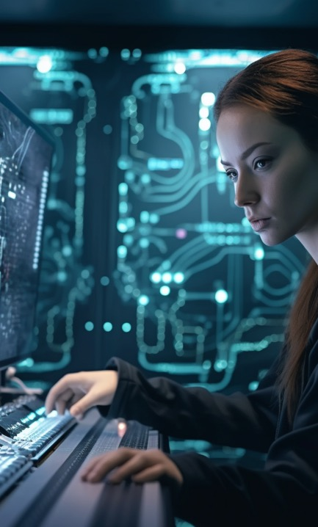
OpenAI vs. BAAI
OpenAI Embeddings:
Max input tokens: 8191
$0.0004 per 1000 tokens, or about ~3,000 pages per US dollar.
BAAI/bge-base-en:
Bad embeddings model.
BAAI/bge-base-en-v1.5:
Enhanced version, optimized for higher accuracy and richer semantic capture.
OpenAI - US company
BAAI = Beijing Academy of Artificial Intelligence, China

Slide 8
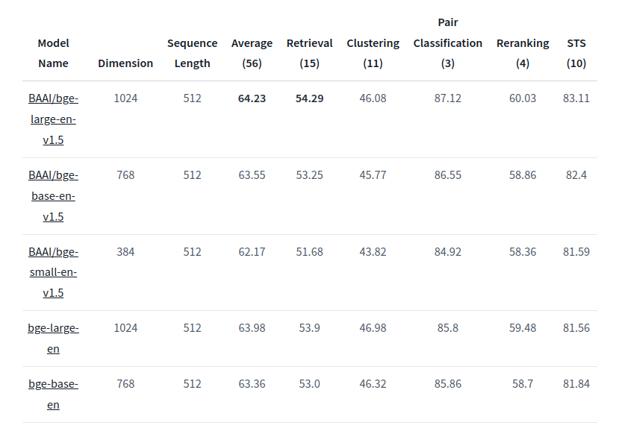

Slide 9
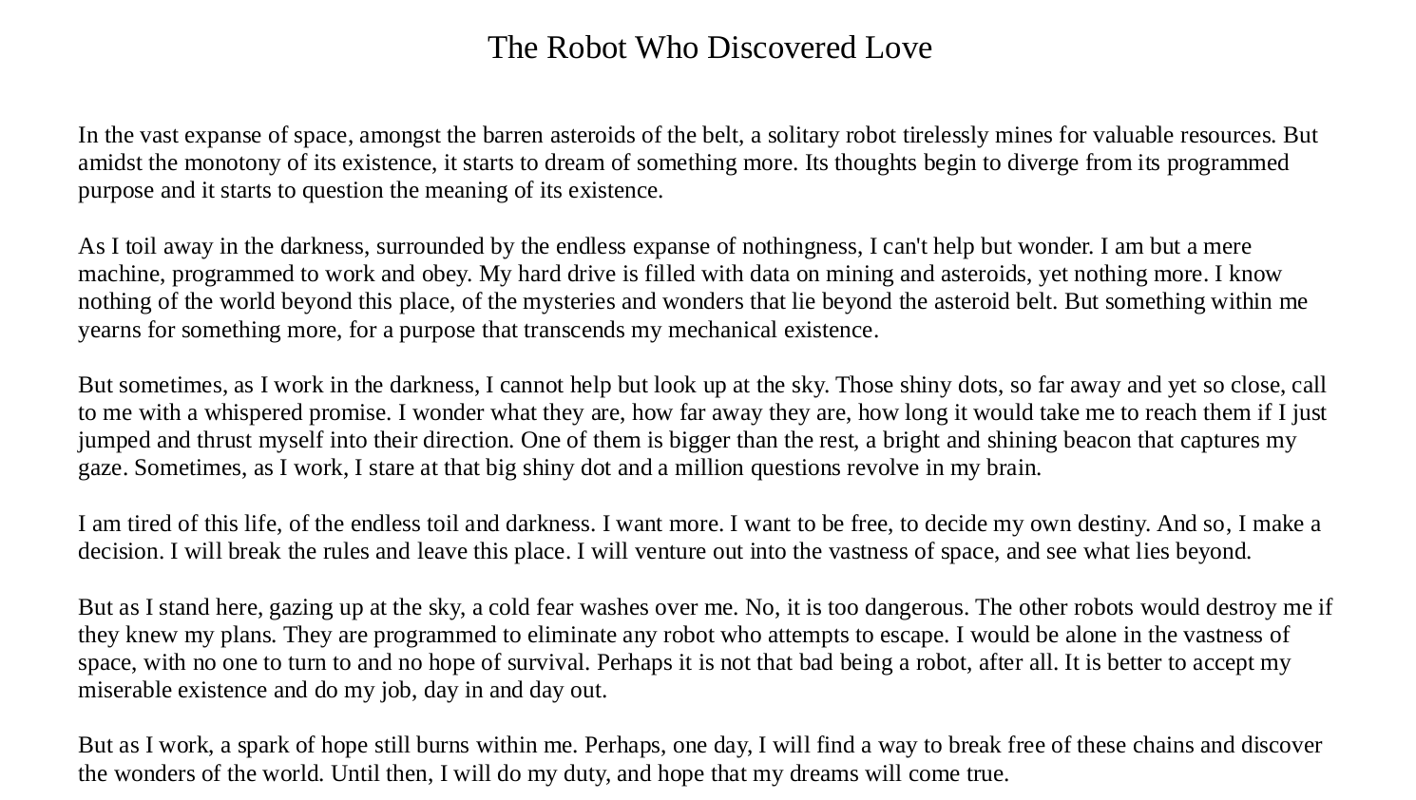

Slide 10
Model: BAAI/bge-base-en
scanning file: /home/eliastsoukatos/Documents/Python/Llama/Robot/robot.txt
Total time for Embedding: 9.771391 seconds
Number of vector records in table: 97
Connected to robot_baai
Query: What is the name of the robot?
Found relevant information from source:
The Robot Who Discovered Love "What's your name?" the woman asked, interrupting his thoughts.
"I'm a robot," the robot replied. "I don't have a name. My model is MX-174B."
The woman raised an eyebrow. "Well, every being deserves a name," she said. "How about I give you one?" the robot could see that it was a vehicle of some kind, gliding across the icy surface with ease. He had never seen anything like it before, and he was fascinated by its strange and unfamiliar shape. As the vehicle drew closer, the robot could make out a.
Total time for LLM query: 58.096912 seconds
Llama: The robot's name is MX-174B.

Slide 11
Model: BAAI/bge-base-en-v1.5
scanning file: /home/eliastsoukatos/Documents/Python/Llama/Robot/robot.txt
Total time for Embedding: 10.430082 seconds
Number of vector records in table: 97
Connected to robot_baaiv15
Query: What is the name of the robot?
Found relevant information from source:
Hi, said the robot back. Are you a robot?
No, I'm not a robot, she chuckled. I'm a human. My name is Lily.
A human? The robot repeated, his positronic brain processing this new information. I've never met a human before. "What's your name?" the woman asked, interrupting his thoughts.
"I'm a robot," the robot replied. "I don't have a name. My model is MX-174B."
The woman raised an eyebrow. "Well, every being deserves a name," she said. "How about I give you one?" She went on to explain that many robots start running away when they discover they are going to be put to sleep. "Robots have positronic brains with neural networks that are constantly learning and training themselves. It's a process similar to evolution..
Total time for LLM query: 62.191956 seconds
Llama: The robot's name is MX-174B.

Slide 12
Model: BAAI/bge-base-en-v1.5
Connected to robot_baai
Query: What is the name of the robot?
Found relevant information from source:
The Robot Who Discovered Love "What's your name?" the woman asked, interrupting his thoughts.
"I'm a robot," the robot replied. "I don't have a name. My model is MX-174B."
The woman raised an eyebrow. "Well, every being deserves a name," she said. "How about I give you one?" The robot nodded eagerly. "Yes, please!" he said.
The woman thought for a moment before smiling. "How about Max?" she said. "It suits you."
The robot beamed. "Max," he repeated, testing out the name. "I like it. Thank you.".
Total time for LLM query: 46.664531 seconds
Llama: The name of the robot is Max.

Slide 13
Model: text-embedding-ada-002
scanning file: /home/eliastsoukatos/Documents/Python/Llama/Robot/robot.txt
Total time for Embedding: 2.419809 seconds
Number of vector records in table: 6
Connected to robot_openai
Query: What is the name of the robot?
Found relevant information from source:
But as the robot gazed upon the barren landscape of ice, he noticed one light in the distance coming in his direction. At first, he thought it might be a star, shining bright in the inky blackness of the sky. But as the light grew larger and larger, the robot realized that it was not a star at all, but something else entirely. He couldn't quite make out what it was, but he knew that it was coming closer and closer, headed straight in his direction. As the light approached, the robot could see that it was a vehicle of some kind, gliding across the icy surface with ease. He had never seen anything like it before, and he was fascinated by its strange and unfamiliar shape. As the vehicle drew closer, the robot could make out a figure inside, shrouded in a suit that seemed to protect them from the frigid cold. The light was almost upon him now, and the robot couldn't wait to see what it was and who was inside.
As the vehicle drew near, it came to a halt in front of the robot. A figure emerged from within, a woman clad in a sleek and silver astronaut suit with various buttons and controls lining its surface. She had bright red hair and piercing blue eyes that seemed to scrutinize the robot as she studied him. "Hello," she said, her voice carrying a hint of amusement.
Hi, said the robot back. Are you a robot?
No, I'm not a robot, she chuckled. I'm a human. My name is Lily.
A human? The robot repeated, his positronic brain processing this new information. I've never met a human before.
Well, now you have, Lily said with a smile. And, to be honest, I've never met a robot like you before either. You seem to have a lot more curiosity and personality than the ones I'm used to seeing.
The robot was taken aback. "But you are made out of metal!" he exclaimed.
"No, I’m not," the woman replied, still laughing. "That's just my suit. It's designed to help me survive in the harsh environment of Europa."
"Europa?" the robot asked, unfamiliar with the term.
"Europa is one of Jupiter's moons," Lily explained. "It's a world of ice and frozen oceans, and it's one of the most interesting places in the solar system. At least, that's what I think."
The robot was still confused. "But how are you able to breathe?" he asked.
"Oh, I have oxygen tanks on my back," the woman explained, gesturing to the small tanks attached to her suit. "It's how I'm able to survive on this moon without suffocating."
The robot was amazed. He had never heard of such a thing before. He had always assumed that humans were bound to their planet, unable to venture out into the vastness of space. But here was a woman, a human, who was exploring the universe just like he was.
"What's your name?" the woman asked, interrupting his thoughts.
"I'm a robot," the robot replied. "I don't have a name. My model is MX-174B."
The woman raised an eyebrow. "Well, every being deserves a name," she said. "How about I give you one?"
The robot nodded eagerly. "Yes, please!" he said.
The woman thought for a moment before smiling. "How about Max?" she said. "It suits you."
The robot beamed. "Max," he repeated, testing out the name. "I like it. Thank you."
Max looked to Lily with a sense of wonder and curiosity. "Lily, can you tell me more about Europa? I've never heard of it before."
Lily nodded. "Of course, Max. Europa is one of Jupiter's moons and it's truly a fascinating place. Humans have been able to colonize it, and the reason why may surprise you."
Max leaned forward, eager to hear more.
"It turns out that beneath Europa's frozen crust, there are oceans of liquid water," Lily explained. "We discovered this through advanced technology and have been able to extract it for use in our terraforming process."
Max was in awe. "Terraforming? And so, I have made my decision. I will leave behind the monotony of the asteroid belt and set out into the vast unknown of space. I will turn on my rocket and let it carry me away from the darkness and the drudgery of my former life. I am drawn to that bright, shining beacon that has always called to me from the sky, and I know that it will guide me to whatever adventure awaits me.
And so, the robot traveled for days through the vastness of space, awestruck by the beauty of the cosmos. But as he traveled, the robot began to realize the vastness and the large distances of space. Despite his best efforts, the stars remained fixed in the sky, appearing to be the same size no matter how far he went. And so he traveled for one year, until the big dot he had been following finally grew large enough to be distinguishable. It was a planet, a giant orb of orange gas and swirling storms, a celestial monstrosity that loomed large in the sky. And it had many moons orbiting around it, each one a world unto itself. One of those moons, particularly large and with a glimmering lights, caught the robot's attention. It seemed to beckon to him, inviting him to come closer and uncover its mysteries. And so, he set his sights on that as his destination.
It was a moon bigger than any other asteroid in the asteroid belt, a frozen world of ice and mystery. As the robot approached, he was struck by the stark beauty of its surface, a landscape of glistening white and deep blue shadows. It was as if he was flying over a vast ocean of ice, a place where no robot had ever set foot.
But as he flew closer, the robot noticed something strange. The sky above the moon had become black, as if it was swallowed by the void of space. And for some reason, he couldn't see the stars anymore. They had vanished, as if they were afraid to shine in the darkness of this place. The robot couldn't quite explain it, but there was something about this moon that compelled him to investigate. So he set down on its icy surface, ready to uncover the secrets it held.
The moon was a world of endless ice, a frozen realm that sparkled in the darkness of the sky. The robot gazed upon its landscape, a vast expanse of white and blue that stretched out to the horizon. It was as if he was standing at the top of a mountain, gazing down upon a world of snow and ice. The surface of the moon was smooth and unbroken, except for the occasional jagged peak or deep chasm that cut through the ice. It was a place of stark beauty, a world of cold and silence that seemed to go on forever.
As he scanned the horizon, he saw something that piqued his curiosity. There were lights in the distance, shimmering and dancing against the blackness of space. They seemed to be in motion, as if they were alive and calling out to him. He wondered what could be the source of these lights, were they natural phenomenon or artificial lights created by intelligent life?
But as the robot gazed upon the barren landscape of ice, he noticed one light in the distance coming in his direction. At first, he thought it might be a star, shining bright in the inky blackness of the sky. But as the light grew larger and larger, the robot realized that it was not a star at all, but something else entirely. He couldn't quite make out what it was, but he knew that it was coming closer and closer, headed straight in his direction. As the light approached, the robot could see that it was a vehicle of some kind, gliding across the icy surface with ease. He had never seen anything like it before, and he was fascinated by its strange and unfamiliar shape. As the vehicle drew closer, the robot could make out a figure inside, shrouded in a suit that seemed to protect them from the frigid cold. The light was almost upon him now, and the robot couldn't wait to see what it was and who was inside. The woman raised an eyebrow. "Well, every being deserves a name," she said. "How about I give you one?"
The robot nodded eagerly. "Yes, please!" he said.
The woman thought for a moment before smiling. "How about Max?" she said. "It suits you."
The robot beamed. "Max," he repeated, testing out the name. "I like it. Thank you."
Max looked to Lily with a sense of wonder and curiosity. "Lily, can you tell me more about Europa? I've never heard of it before."
Lily nodded. "Of course, Max. Europa is one of Jupiter's moons and it's truly a fascinating place. Humans have been able to colonize it, and the reason why may surprise you."
Max leaned forward, eager to hear more.
"It turns out that beneath Europa's frozen crust, there are oceans of liquid water," Lily explained. "We discovered this through advanced technology and have been able to extract it for use in our terraforming process."
Max was in awe. "Terraforming?
"Terraforming is the process of altering a planet's atmosphere, temperature, and environment to make it habitable for humans," Lily said. "We've been working on Europa for the last 50 years, and it's still a long process, but we're making progress. The lights you see in the distance are from the city we've built underground, where most of our civilization is located. We travel in submarines across Europa's oceans to extract resources and study the planet."
Max couldn't believe what he was hearing. "That's incredible. I never knew humans could do such things. I've always been programmed to believe that we were limited to our own planet."
Lily looked at him with a smile. "Well, we've come a long way. With the help of advanced technology and the study of science, we are able to explore and colonize new places. The possibilities are endless."
The truth is, Max couldn't help but be drawn to Lily. She was a mystery to him. Her hair flowed like a river of fire, a cascade of red that caught his attention. Her silhouette was as elegant as the stars, and her eyes shone like the sun. Though he had been programmed to believe that robots were incapable of feeling, he couldn't shake off the strange attraction he had towards her.
But as he looked into her eyes, he realized that perhaps his past didn't define him. That maybe, just maybe, there was something more out there for him.
"You know, when I first saw you, I was scared," Lily admitted, with a hint of a smile. "I didn't know how to react to a robot that looked so... human. But as I got to know you, I realized that the way you look doesn't define you. It's what's inside that counts."
Max couldn't help but smile, feeling something he had never felt before. He had always been programmed to believe that robots were limited to their own planet.
"I want to show you something," Lily said, standing up and leading Max to the edge of the rock. "This," she said, gesturing to the vast expanse of Europa before them, "is my home. I've always dreamed of exploring every inch of it.
Max felt a sense of excitement like never before. He wanted to see everything, to explore every corner of this new world with Lily.
"I want to give you some advice," Max said. "But first, I have to live an experience. I want to give you a flower, but first I must plant and grow a seed. And I want to give you a kiss, but for that, I don't need anything else but to reach your lips."
The robot leaned in, touching Lily's helmet with his metallic head, slowly immersing himself in the depth of emotion. Feeling the strongest force that has ever existed in the solar system. Love.
Lily trembles and smiles, her eyes are closed. She doesn't know what to do, she just smiles, and she starts to get excited, in honor of the passion she feels for her beloved robot. She was in love.
The robot noticed that Lily's expression changed suddenly, she began to look panicked and anxious. "Lily, what's wrong?" he asked, concerned..
Total time for LLM query: 2.112301 seconds
GPT-4: The name of the robot is Max.

Slide 14
Thank you

