Slide 1
Make Large Language Models Smaller
ChatGPT runs on powerful servers which cost ~ $500K each.
There are ways to make model smaller to run on a laptop or cell phone
Quantization - reduce precision (16, 8, 4 bits) – almost without losing accuracy (~3%)
Mixed-precision quantization - go down to 2.5bits average.
Pruning - removing unnecessary (small) weights from the model
Train smaller model (70, 30, 13, 7 Bln parameters)
Knowledge distillation - training a smaller model on the outputs of a larger model (like an adult teaching a child).

Slide 2
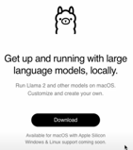
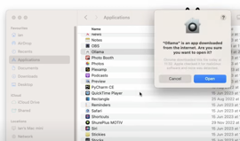

Ollama - Run 4bit models on Macbook or Linux
.. https://ollama.ai .. https://github.com/jmorganca/ollama
ollama run llama2 # 7b 5.6 GB
ollama run llama2-uncensored # 7b 5.6 GB
ollama run mistral:latest # 7b 6.0 GB
ollama run open-orca-platypus2 # 13b 9.7 GB
ollama run codellama:34b-... # 34b 19.4 GB
ollama run wizard-math:70b # 70b 45.0 GB
ollama list # downloaded models

